Slide 1
EVRC Python Course Training 1: What is Python? Background and Basic Module Structure
Aaron Rabinowitz, Vaishnavi Karanam

Slide 2
Section 0: Syllabus

Slide 3
Syllabus - Learning Objectives
Programming in Python:
Programming fundamentals
Python object structure and flow control
Data manipulation in Python
Leveraging Python site-packages
Run-time optimization
Programming Workflow:
Finding a development environment that works for you
Writing code others can use
Using the internet as a resource
Version control

Slide 4
Syllabus - Course Outline
Trainings:
What is Python? Background and Basic Module Structure (Aaron)
Data Types Deep Dive (Aaron)
CodeMari: Basic hacks to reduce coding chaos (Vaish)
Pandas and Beyond (Vaish)
Speeding up Code (Aaron, Vaish)
Version Control (Aaron)
Using Databases with Python (Vaish, maybe Kai)
Critical Internet-ing (TBD)
Advanced Topics at Request (TBD)

Slide 5
Practicum: Installing Anaconda

Slide 6
Links
https://www.anaconda.com/download
https://github.com/airabino/EVRC_Python_Training

Slide 7
Section 1: Background

Slide 8
Background - Abstractions
Abstraction - “the quality of dealing with ideas rather than events”
There are certainly more computers* in the world today than humans, and by a large margin - more than 90% of people on earth use a mobile phone, most of which are smart phones
There are probably more than 2 computers per person in this room
The widespread use of computers is enabled by a series of layered abstractions
One can be competent in computer use at any given layer without having to have any particular knowledge of those below
This comes at a price - what you don’t know can absolutely hurt you (or at least make you less efficient)
Physical Circuits
Computer Architecture
Stored Instructions
Operating System
Logical Code
Applications

Slide 9
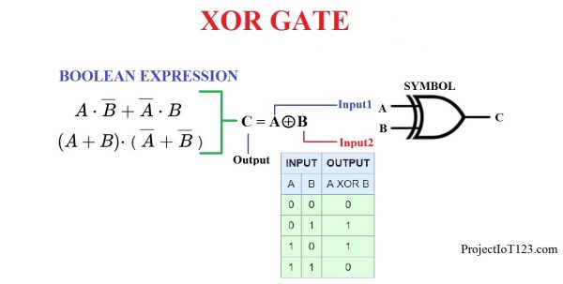
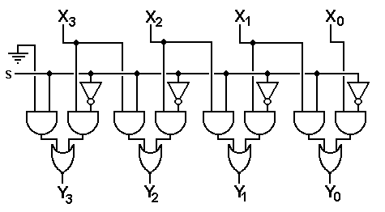
Background - Computers
Fundamentally a computer is an electrical device containing a bunch of circuits and some power electronics
The electromagnetic building blocks of computers are:
XOR
Register Shift
http://projectiot123.com/2019/05/26/introduction-to-xor-gate/
http://www.edwardbosworth.com/My5155Text_V07_HTM/MyText5155_Ch06_V07.htm

Slide 10
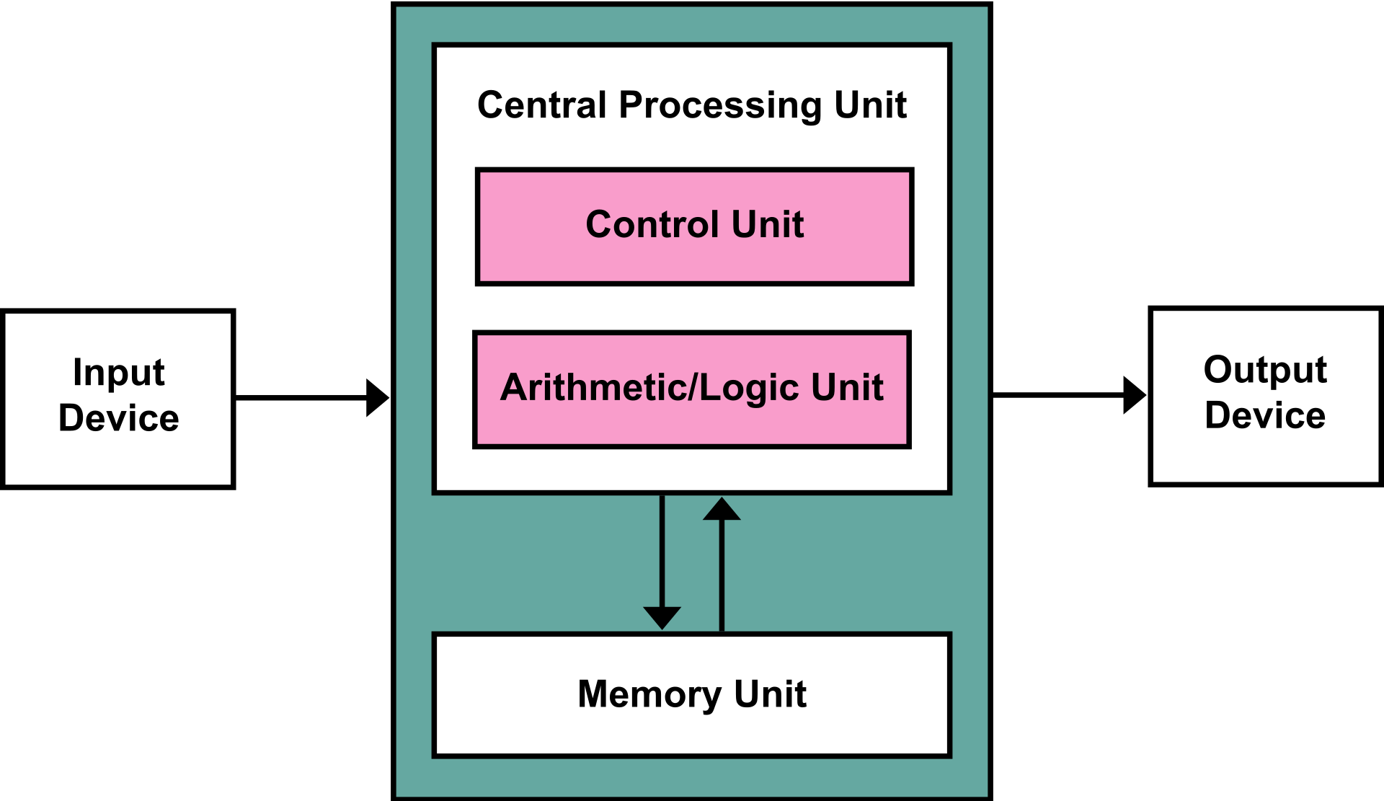
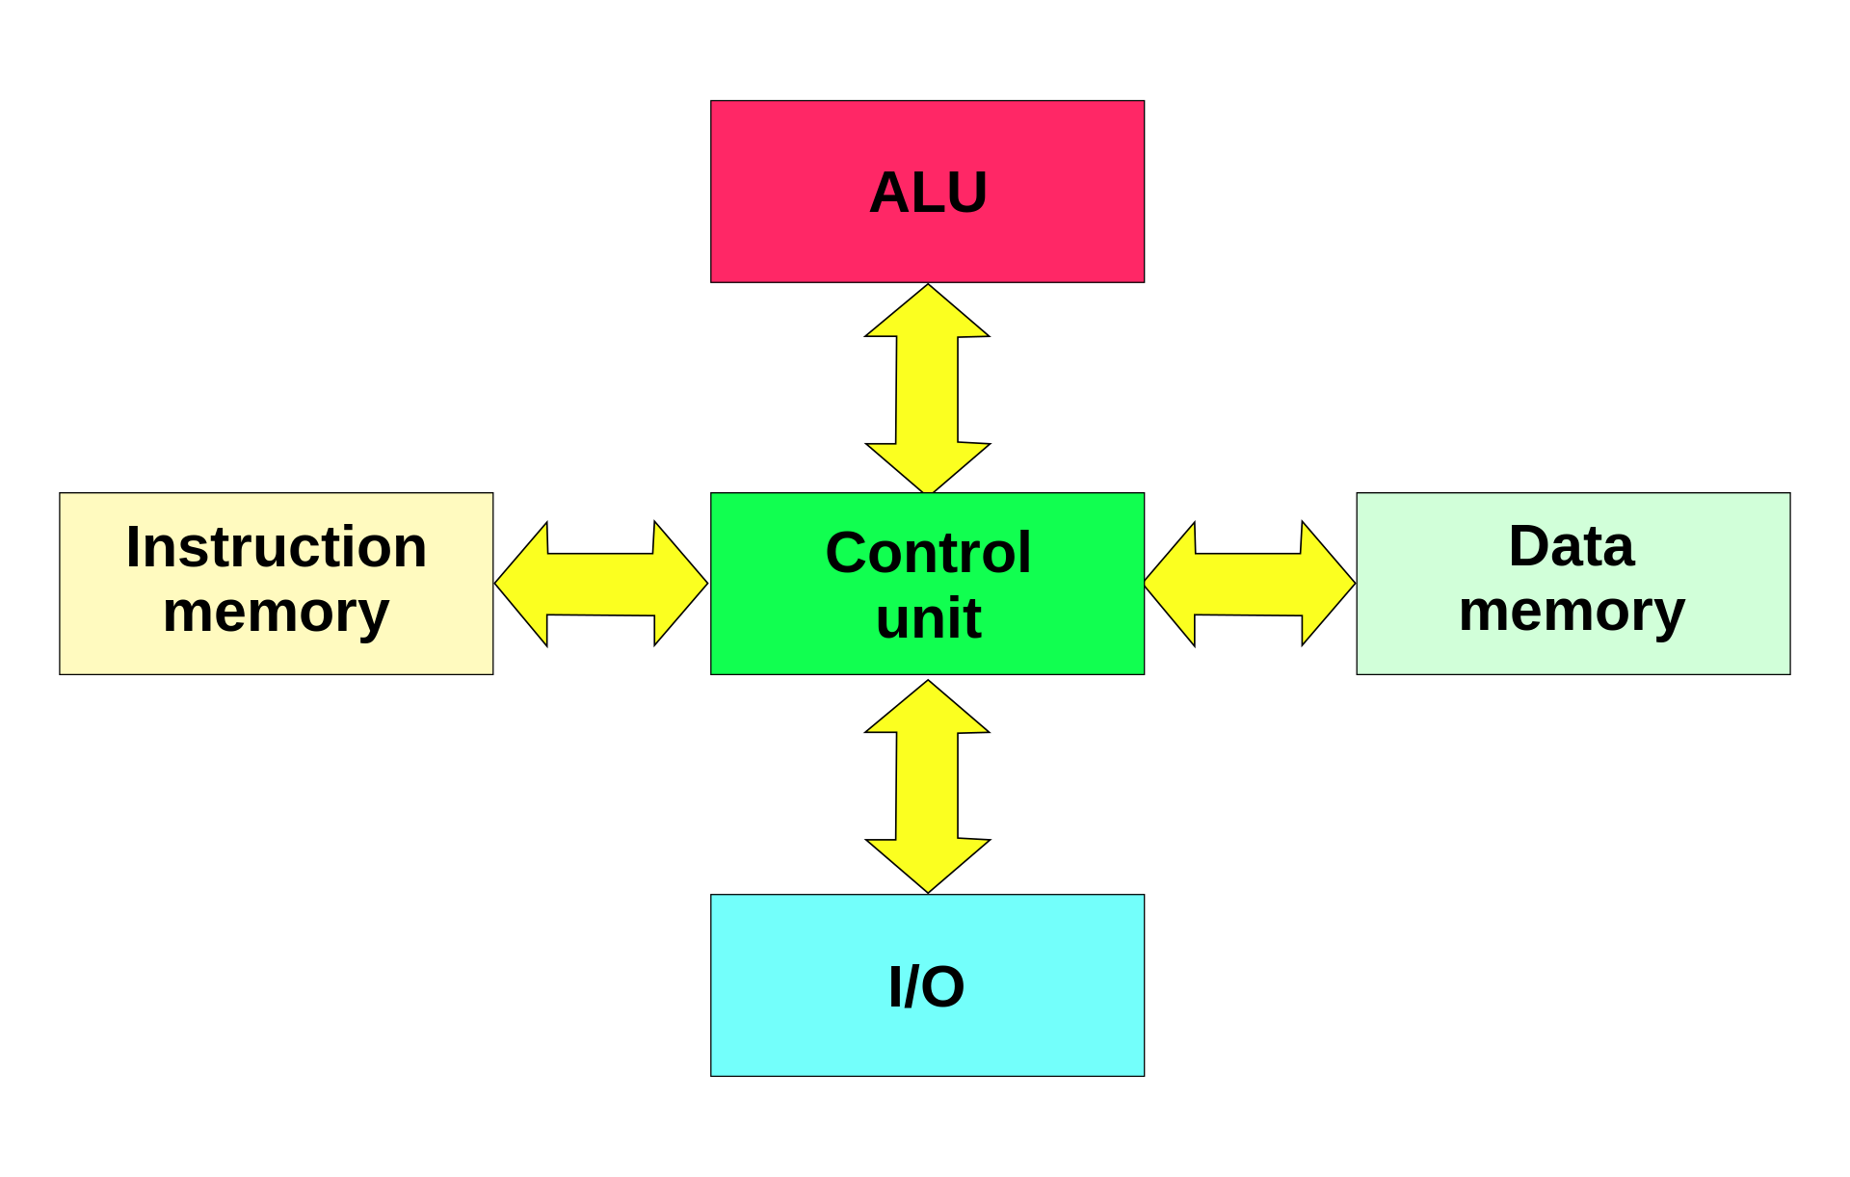
Background - Stored Program Computers
The earliest electronic computers (such as ENIAC) were purely electromagnetic devices - in order to change operations the physical layout of the computer had to be altered
In the late 1940s computing was fundamentally altered by the invention of stored-program computers capable of executing instructions retreived from memory
This is the first abstraction of computing - one can compute using instructions without any knowledge of physical circuit design. Computing is a separate field from circuitry.
https://en.wikipedia.org/wiki/Von_Neumann_architecture
https://en.wikipedia.org/wiki/Harvard_architecture

Slide 11
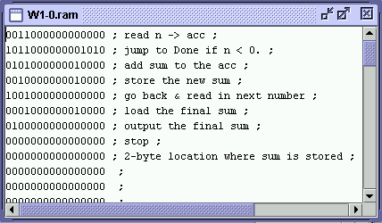
Background - Machine Code
Computers are systems containing massive numbers of logical gates - at the end of the day they can only deal with 1s and 0s
CPUs execute sequences of binary digits which represent instructions
Depending on computer architecture, instructions will be of a given length and will contain machine level commands such as:
moving values to registers
moving values to and from memory
register operations
https://www.researchgate.net/figure/A-simple-machine-language-program_fig6_220094525

Slide 12
Background - Low-Level Languages
Languages which more-or-less directly translate to machine code are “low-level” languages - Lets take a look at some assembly code:
MOV AL, 61h; Load AL with 97 decimal (61 hex)
Comes out as:
10110000 01100001
Low-level languages are fundamentally still machine code: “instructions-as-code”:
Implementations are hardware-specific and not portable
Allows for very precise manipulation of hardware and very fast execution
Can be assembled and run from BIOS - does not require an operating system
Low-level languages require extensive specific and general knowledge from the programmer and are sparingly used
less than 3% of the Linux kernel is in assembly

Slide 13
Background - High-Level Languages
Languages which describe logical processes using keywords, symbols, and syntax are “high-level” languages
C++
for (int i = 0; i < 5;i++){
cout << i << "\n";
}
FORTRAN-95
do i=0,4,1
print*, n, ”\n”
end do
High-level languages are an abstraction: “logic-as-code”
Possible to write high level code without any sense of how it manifests as instructions
Requires translation to machine code to execute
In most cases high-level programs will be “portable” meaning that they can be built and run on a variety of machines
High-level languages require programmers to know the language but not details about hardware
more than 97% of the Linux kernel is in C (high-level)

Slide 14
Background - Translators
In order to use a high-level language, the logic-as-code has to be translated into instructions
Translation is accomplished via
Compilation
Interpretation
Or

Slide 15
Background - Compilers
One way to go about the task of translation is to translate a whole program at once - this is called “compilation”
Compilers turn a program in high-level code into a file in machine code called an excutable
Compiled executables can be run directly and/or linked for use in other programs without needing re-compilation
Code Scanning, Cleaning, and Expansion:
Loads libraries
Removes commments
Expands macros and sub-routines
Converts logical flow control into goto statements
etc.
Translation of code into assembly
Assembly of machine code

Slide 16
Background - Interpreters
A second way to translate code is to do so in logical increments “line-by-line”
Each logical cell of code is translated into machine language and executed with its outputs remaining accessible to the interpreter
Code Scanning, Cleaning, and Expansion:
Loads libraries
Removes commments
Expands macros and sub-routines
Converts logical flow control into goto statements
etc.
Translation of code into assembly
Assembly of machine code

Slide 17
Background - Translator Comparison
Translators are executables in and of themselves - they take time to run and produce outputs
With compilers the translation is done once, with interpreters it is done every time and for every logical increment
Compiled code is faster while interpretation is more flexible
Compilation
Interpretation
Or

Slide 18
Background - Structure
High-level languages come in two main flavors: Procedural and Object-Oriented
The main difference is in how languages handle types (types will be the subject of Lecture 2)
Primitives (int, float, char, bool) define how variables are stored in and accessed from memory
Data structures (iterables) store addresses of primitives in an ordered manner
In a procedural language core functions act on types: a+b => add(a,b)
In an object-oriented language functions belong to types: a+b => a.add(b)
Object-oriented languages allow users to define custom types (called classes) which can inherit properties from other classes
Object-oriented languages are more flexible
Object-oriented languages require more translation time and more memory

Slide 19
Section 2: Introduction to Python

Slide 20
Python - What Type of Language is Python?
Python is a high-level, interpreted, object-oriented language
But we have to talk about Python’s interpreter briefly ...

Slide 21
Python - How Python Runs Code
Python interpretation is accomplished in two distinct steps:
Conversion to bytecode (bytecode is a low-level, non-human-readable language which consists of assembly-like instructions but is portable between architectures)
Line-by-line interpretation of bytecode
The Python application does step 1
The application that runs bytecode (step 2) is called CPython (as it is written in C). This is often described as the Python virtual Machine (PVM) because it takes machine-like instructions which are then translated into actual machine-instructions for the specific system in use.
Steps 1 and 2 need not be sequential
A module can be loaded or called at which point bytecode will be generated and stored in a .pyc file. If no changes are made to the module then the next call will just use the .pyc file.
There are interesting ways of speeding up this process which will be covered in Lecture 5

Slide 22
Python - Calling Python
There are essentially two ways to call Python
Calling the Python executable on a file containing Python code
Opeining an interpter session and inputting Python commands
(base) aaron@aaron-msi-laptop:~/Desktop/EVRC_Python_Training/Trainings/TR1$ python hello.py
Hello World
(base) aaron@aaron-msi-laptop:~/Desktop/EVRC_Python_Training/Trainings/TR1$ python
Python 3.11.3 (main, Apr 19 2023, 23:54:32) [GCC 11.2.0] on linux
Type "help", "copyright", "credits" or "license" for more information.
>>> print('Hello World')
Hello World
>>>

Slide 23
Practicum: Hello World!

Slide 24
Python - Script Code
Sometimes it is sufficient to execute logical cells in sequence - this is called script
Script is a unique feature of interpreted languages
All websites (and HTML or JavaScript GUIs in general) run script code
Right click on a website and select “Inspect Source” to see this
When Python is called on a code file it will interpret all commands from top to bottom - assuming that there are no bugs, all logical cells will execute in sequence
See ScriptExample.py

Slide 25
Python - Functions
One might want to repeatedly use a logical cell throughout a script without having to re-write it each time. In this case the logic can be stored in a function (in low-level languages this same concept is called a sub-routine)
Functions are stored in definitions
Python reads input files top-to-bottom so it is wise to put all definitions (functions and variables) at the top and then script below
Functions are abstractions! they store logic and make it easier for programmer to write complex code - the translator must write it out every time for the machine. This is a lot of the work that a translator does.
See FunctionExample.py

Slide 26
Python - Objects
In object-oriented languages, an object is data structure containing addreses to functions and variables (primitives and/or iterables)
The functions and variables are the attributes of the object
Attributes can be dynamic or static
Dynamic attributes can be edited after initialization
Static attributes cannot
A Class is a structured section of code that defines the attributes of an object. Classes commonly contain variable and function definitions well as definitions for specific functions that handle object creation and object calls.
Classes can inherit the attributes of other classes, a class that inherits form another class is considered as subclass
All classes, builtin or user defined are subclasses of one or several meta-classes depending on the language (Python only has one)
See ClassExample.py

Slide 27
Python - Python and Objects
Here’s the thing ... Almost everything in Python is an object
Python’s primitive types and basic math operations are the only exceptions
All variables are objects
All functions are objects
When Python is called on a code file it builds an object called a module
To put it properly: Python code files are class definitions for subclasses of the superclass module
The superclass module is created with functions such as len, sum, round, and eval which are often called “builtins”
These are not builtin functions!!!!! - these are attributes of the meta-class module
All Python objects are initialized using the attribute __init__
All python objects contain the attribute __dir__ which will list the object’s attributes, some also contain __dict__ which presents the attributes as a dict
So, let’s talk modules ...

Slide 28
Python - Modules
Python code is structured in modules - even a blank file will intialize a module
A module may contain code from several files if initialized correctly
A module may contain sub-modules
Just like any other class, a module is initialized by calling the __init__ attribute. If a module is spread among several files then a single file called __init__.py can be made to load the attributes from all of the files
After initializing a module, Python will attempt to execute the primary logic. The primary logical set is called __main__
By default, if Python is called on a file, that file will be designated as __main__
If Python is called on a folder it will run the file named __main__.py
The same Python module can function as main code and as a library through utilizing the __name__ attribute to determine if the current module is __main__ or not
See ModuleExample.py and LibraryExample

Slide 29
Practicum: Making Basic Modules

Slide 30
Section 3: Summary

Slide 31
Summary - What Makes Python Special?
There are many programming languages that are, at their core, very similar to Python - from a technical standpoint there are many languages that perform far better than Python does for a variety of applications
Python’s selling point is how generic and flexible it is
Since the first Python VM was created in 1994 the language has seen massive development both internally and from external package developers
An example of external development is the Anaconda implementation of Python
Python isn’t the best option for any single application but it is an option for virtually all applications - one can develop initially in python then later improve back-end by porting to other languages
Developing in Python really means developing in a multitude of environments with Python bindings - much of the remining material in this course will concern these bound environments

Slide 32
Thanks for attending!

