Slide 1
EVRC Python Course Training 2: What is Python? Background and Basic Module Structure
Aaron Rabinowitz, Vaishnavi Karanam

Slide 2
Section 0: Syllabus

Slide 3
Syllabus - Learning Objectives
Programming in Python:
Programming fundamentals
Python object structure and flow control
Data manipulation in Python
Leveraging Python site-packages
Run-time optimization
Programming Workflow:
Finding a development environment that works for you
Writing code others can use
Using the internet as a resource
Version control

Slide 4
Syllabus - Course Outline
Trainings:
What is Python? Background and Basic Module Structure (Aaron)
Data Types Deep Dive (Aaron)
CodeMari: Basic hacks to reduce coding chaos (Vaish)
Pandas and Beyond (Vaish)
Speeding up Code (Aaron, Vaish)
Version Control (Aaron)
Using Databases with Python (Vaish, maybe Kai)
Critical Internet-ing (TBD)
Advanced Topics at Request (TBD)

Slide 5
Section 1: Data Storage

Slide 6
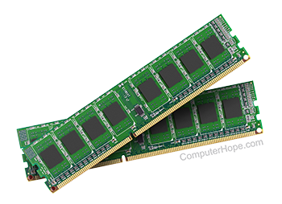
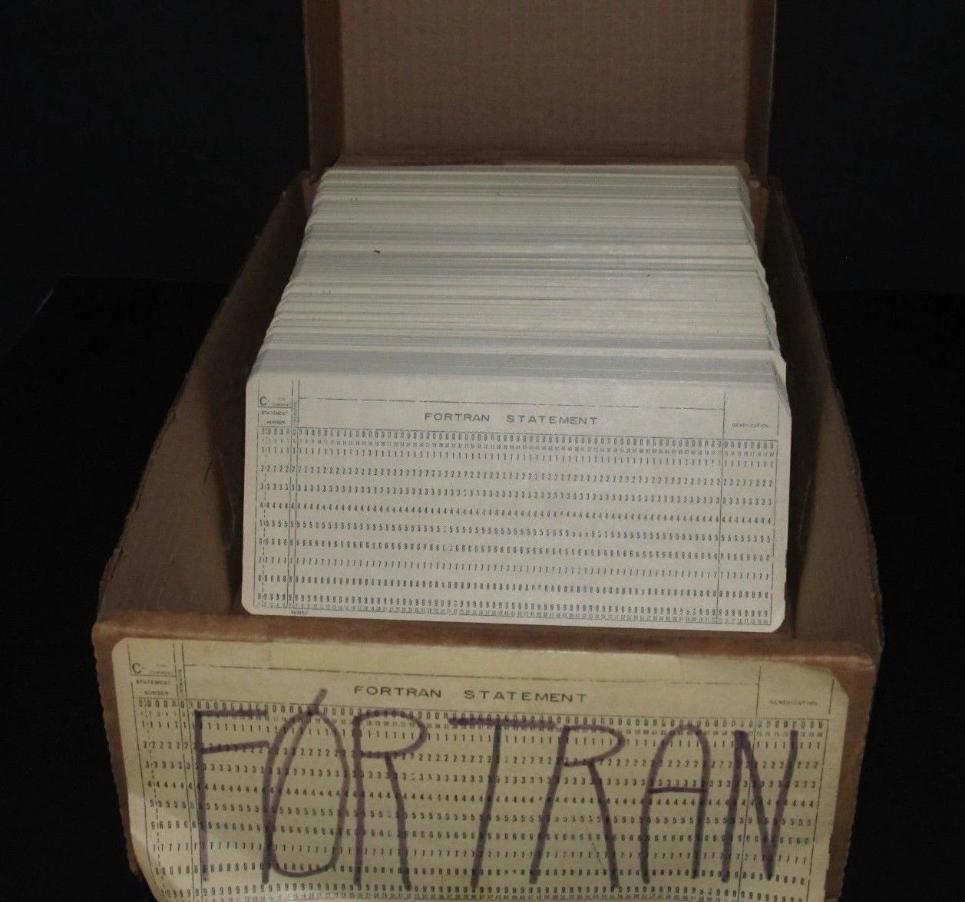
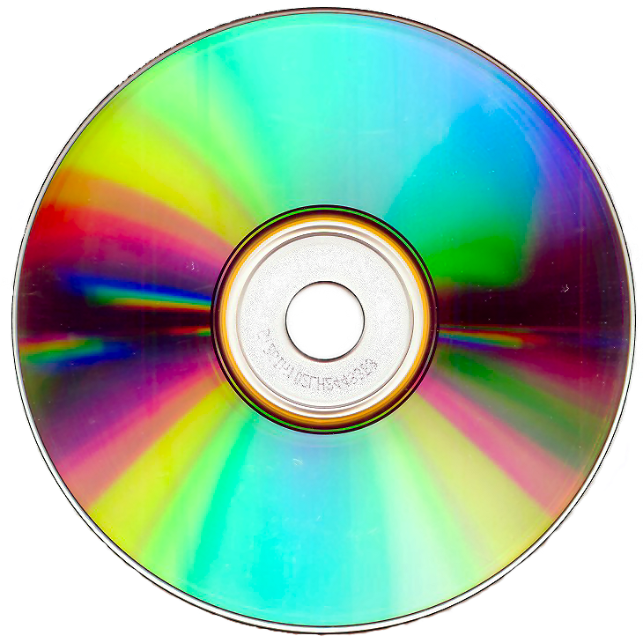
Data Storage - RAM vs. ROM
Computers store numbers in binary format using two types of memory:
Read-Only Memory (ROM)
Random Access Memory (RAM)
Physically the main difference is that ROM is stable* meaning that it will retain data if the power is turned off while RAM is unstable and data will be lost after the power is turend off for a sufficient duration
Generally speaking RAM has much higher throughput and most of the time processes will load data from ROM to RAM before processing
*Solid-state ROM is basically RAM with huge capacitance such that it can take years before data is lost - but it will eventually be lost. SSDs are used because they have high throughput compared to stable ROM

Slide 7
Data Storage - Addressing
Data in memory is only useful if it can be retreived
Each memory register has an unique address
Moden computers are generally “byte-accessible”
Data and instructions are sometimes stored together (flat-memory model) and sometimes stored separately (segmented-memory model)
Physical memory addressing is handled at the sub-operating-system level (BIOS and other firmware devices) and is inherently hardware-specific
Memory can be conceived as a table with addresses and values - this is what the BIOS maintains. All firmware devices (mouse, keyboard, flash memory, etc.) interact with the BIOS in order to access the memory table.
Physical Circuits
Computer Architecture
Stored Instructions
Operating System
Logical Code
Applications

Slide 8
Data Storage - Virtual Addressing
Fundmentally an Operating System (OS) is an abstraction: a “program which runs other programs”
In order to accomplish this, the OS cretes a virtual addressing scheme
Virtual addressing schema mean that programs which run in a given OS will run no matter what hardware is being used
Virtual addressing works by creating a virtual address table which maps to the physical address table used by the BIOS
The OS will also provide a file allocation scheme which assigns blocks of memory to files and folders and handles read, write, execute (rwx) permissions
When a high-level language writes data to an address the address is abstracted, at least once, by the OS virtual addressing scheme and possibly by the translator as well (in Python for example)
Any program which uses a virtual addressing scheme, such as CPython, can be described as a “Virtual Machine”
Physical Circuits
Computer Architecture
Stored Instructions
Operating System
Logical Code
Applications

Slide 9
Section 2: Taxonomy

Slide 10
Taxonomy - Values vs. Pointers
A value type maps directly to data at an address in memory
Changing a value type means that the physical configuration of the memory register that stores the type changes:
a=1 => a++ => a=2
A pointer type references the address of a value type - multiple pointers can reference the same address
Changing a pointer changes the memory state at the address where the referenced value is held:
a=1 => b=a => b++ => b=a=2
If the referenced value type is changed, then so is the value associated with the pointer
a=1 => b=a => a++ => b=a=2

Slide 11
Taxonomy - Types
When you create a variable in any high-level language, the translator has to decide how to store it in physical memory
Some languages require user specification, others allow for contextual specification.
Generally interpreted languages are more flexible in typing
This is necessary because different categories of information require defferent methods of storage
Most high-level languages have a small number (< 10) “native” types on which everything else is built
Native types correspond to physical memory objects at defined addresses in memory
Stored variables, regardless of type consist of an address and a data field. The translator maintains a table which relates human readable handles to addresses in memory

Slide 12
Types - Primitives (Value Types)
The most basic way to store information is to have a handle which corresponds to a single value - this is a value type
A primitive type is the most basic way of representing a value ina givne language.
Most languages have four varieties of native value types which are referred to as “primitives”:
int - represents an integer
float - represents a real number
bool - represents a truth value
char* - represents an ASCII character
*Python doesn’t have a char primitive

Slide 13
Types - Primitives (Value Types)
int - represents an integer
float - represents a real number
bool - represents a truth value
Numeric types in Python include ints and floats
Python typing is contextual:
a = 1 - a will be an int
a = 1. - a will be a float
a = True - a will be a bool

Slide 14
Types - Primitives (Value Types)
Arithmetic operations can be done between numeric types and bools
The result of an arithmetic operation between two variables of different types will be of the more general type:
bool < int < float in terms of generality
So ...
1 + 1 -> 2 (int)
1 + 1. -> 2. (float)
True + 1 -> 2 (int)
True + 1. -> 2. (float)
True + True -> 2 (int)

Slide 15
Practicum: Primitives (Primitives.ipynb)

Slide 16
Types - Reference Types
Value types are directly linked to values stored in memory, reference types are not
Reference types only store addresses to data in memory called pointers - a primitive is stored at the address
Multiple pointers can point to the same address in memory
This allows for lower memory usage and faster run-times
So ...
I can create an int then create a pointer which points to it
If either variable is changed then both will be changed!

Slide 17
Types - Array Types
An array type is a type which holds multiple values in the same variable
The reason to use pointers is to enable fast computation with array types
Array types are said to be iterable if they contain a method of getting then next value from the current value
Python has multiple array types:
tuple - iterable type which stores objects with integer indexing but cannot be changed
list - iterable type which stores objects with integer indexing and can be changed
dict - iterable type which stores objects with object indexing and can be changed
set - non-iterable type which stores objects and can be changed*
str - iterable type which stores ASCII characters and can be changed
*Don’t use sets (basically ever) - they aren’t iterable and they have a very specific role

Slide 18
Iterables - Indexing
Iterable array types are composed of elements - in order to use the elements within an array one has to call them by index
The indices can be specific or fleible
In Python:
lists, str, and tuples are integer indexed meaning that all indices are integers
dicts are flexibly indexed meaning that ints, floats, and strs can be used as indices

Slide 19
Iterables - Lists vs. Dicts
The two most important iterable types in Python are lists and dicts
Both lists and dicts are changable, iterable pointer arrays
Elements of lists and dicts can be of any type including lists and dicts and don’t have to be of a consistent type
a = [1, ‘abc’, [2, 4.]] is a valid list containing an int at index 0, a string at index 1, and a list at index 2.
a[1] = ‘abc’, a[1][0] = ‘a’
a = {‘first’:1, 1:‘abc’, 2.:{2:4.}} is a valid dict containing an int at key ‘first’ etc.
a[2.] = {2:4.} but a[2] does not exist
a[2.][2] = 4.
A vairable which is inherently sequential should be integer indexed, otherwise flexible indexing is more convenient

Slide 20
Iterables - Copying
A really big pain point for new users of Python is dealing with pointers
Lists and dicts only contain pointers, not actual values. When a new array-type object is created by referencing another array-type object then no new value is created, just a pointer to a pointer
For example
a = [1]
b = a
a[0] += 1
b = [2]
It is really important to manage this and make sure that you don’t have a bunch of references to the same value
Python has a copy functionality which duplicates an array-type object in memory
For example
a = [1]
b = a.copy()
a[0] += 1
b = [1]

Slide 21
Practicum: Iterables (Iterables.ipynb)

Slide 22
Section 3: Iterators

Slide 23
Iterators - Basics
If an array type is iterable then it will have an iterator as an attribute
In Python this will be called by the attribute __iter__
Check this by calling hasattr(<obj>, ‘__iter__’)
At minimum, an iterator will contain a function called __next__ as an attribute which serves the purpose of returning the next item in the array
Like everything else in Python, these attributes can be overwritten in user defined classes

Slide 24
Iterators - Accessing Elements
Iterating through integer-indexed type variables (list-likes) is straightforward and is mainly done in 3 ways:
for element in list:
for index in range(len(list)):
for index, element in enumerate(list):
Iterating through flexible-indexed type variables (dict-likes) is less straightforward because the indexing is not just increasing integers. Iteration is accomplished using the keys, values, and items attributes
keys() returns the indices as a dict
values() returns the values as a dict
items() returns both (keys then values)
for key,val in dict.items():

Slide 25
Iterators - Accessing Elements
If you want all elements of a list then use the * operator
This could be for function calls - fun(*list)
Or for concatenating lists - list_2 = [*list_0, *list_1]
All dict key-value pairs can be returned using the ** operator
This could be for function calls - fun(**dict)
Or for concatenating dicts - dict _2 = [*dict_0, *dict_1]
In Python function arguments are structured as fun(*args, **kwargs)
args in a list of values to be fed into the function in a pre-defined order
kwargs is a dict of arguments to be inputted after args and must be defined with a default value
fun(num_1, num_2, string = ‘the sum is:’):
print(f’{string} {num_1 + num_2}’)

Slide 26
Iterators - Generators
In Python for loop logic is handled by generators
(for index, value in enumerate(list)) is a generator
generators are an iterable type with two unique features:
They are not index-accesible
Elements are deleted after use
In addition to loop control generators can be used in a comprehension where they can procuderally generate an array type object
list = [fun(index) for index in range(n)]
dict = [index:fun(index) for index in range(n)]
Generators can be created, stored, and passed before being used to control a loop or in a comprehension but after they are used - they vanish
This is very useful in ways that will be covered later in the course

Slide 27
Practicum: Iterators (Iterators.ipynb)

Slide 28
Section 4: Summary

