Slide 1
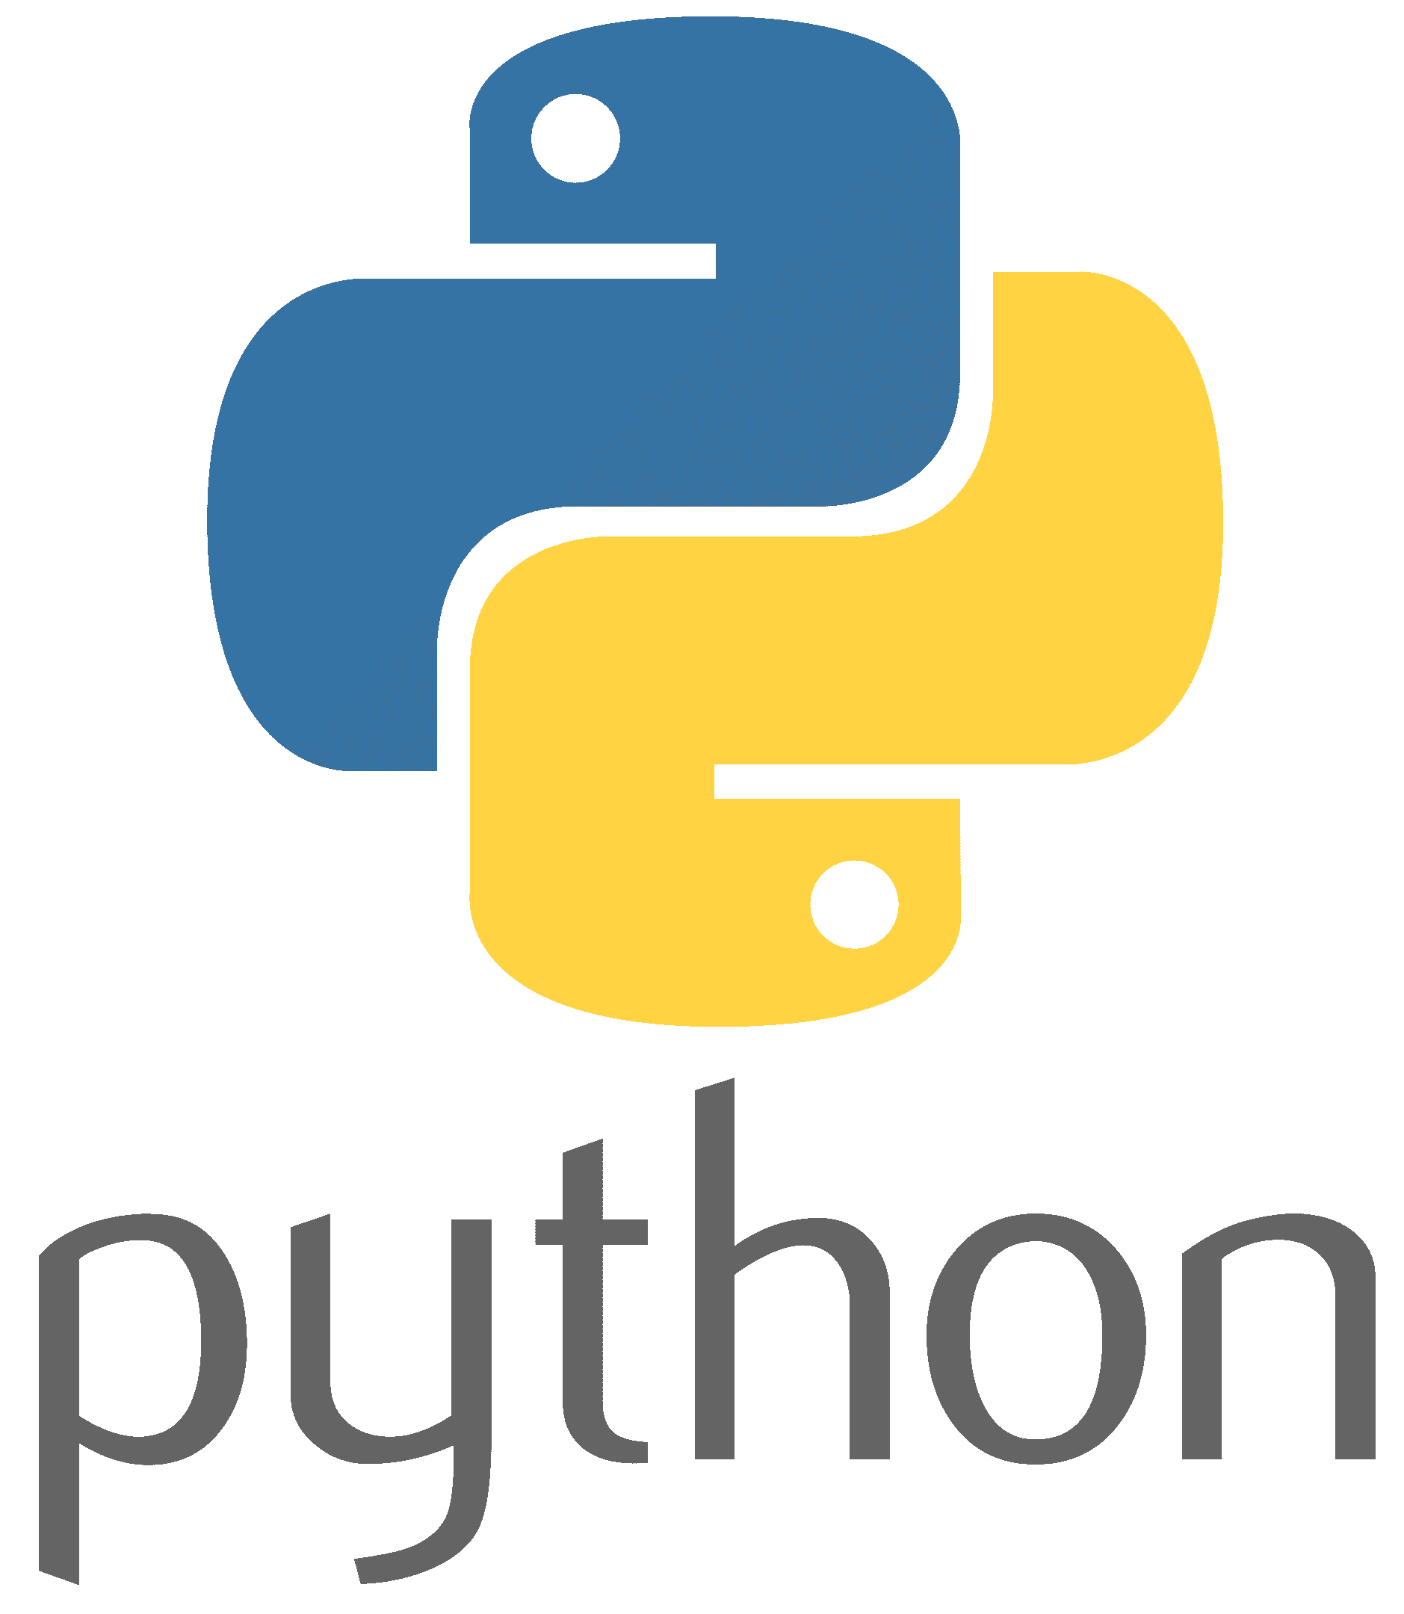
EVRC Python Training Module 1:
Background and Basic Module Structure

Slide 2
Course Outline

Slide 3
Agenda
Background

Slide 4
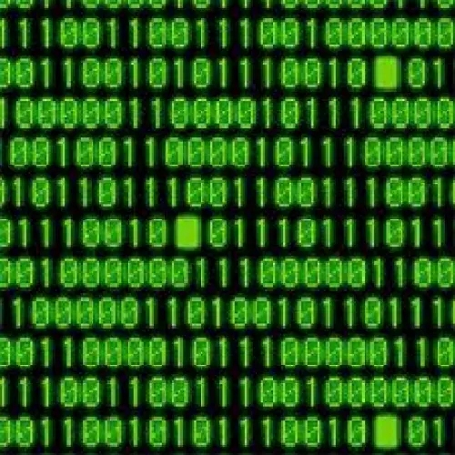
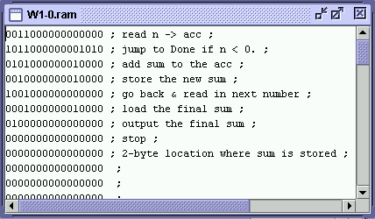
Background - Machine Code
Computers can only really deal with 1s and 0s
Your CPU runs off of sequences of binary digits which represent instructions
Depending on computer architecture, instructions will be of a given length and will contain machine level commands such as:
moving values to registers
moving values to and from memory
register operations

Slide 5
Background - Low Level Languages
The very earliest computation was “hand compiled” by manually imputting commands in binary onto punch cards
The first human readable code was introduced in 1952 by Grace Hopper however punch cards would remain the norm until the mass introduction semi-conductor based memory and peripherals such as monitors and keyboards.
Languages which more-or-less directly translate to machine code are “low-level” languages - Lets take a look at some assembly code
MOV AL, 61h ; Load AL with 97 decimal (61 hex)
Comes out as:
10110000 01100001

Slide 6
Background - Low Level Languages
The very earliest computation was “hand compiled” by manually imputting commands in binary onto punch cards
The first human readable code was introduced in 1952 by Grace Hopper however punch cards would remain the norm until the mass introduction semi-conductor based memory and peripherals such as monitors and keyboards.
Languages which more-or-less directly translate to machine code are “low-level” languages - Lets take a look at some assembly code
MOV AL, 61h ; Load AL with 97 decimal (61 hex)
Comes out as:
10110000 01100001
The MOV command

Slide 7
Background - Low Level Languages
The very earliest computation was “hand compiled” by manually imputting commands in binary onto punch cards
The first human readable code was introduced in 1952 by Grace Hopper however punch cards would remain the norm until the mass introduction semi-conductor based memory and peripherals such as monitors and keyboards.
Languages which more-or-less directly translate to machine code are “low-level” languages - Lets take a look at some assembly code
MOV AL, 61h ; Load AL with 97 decimal (61 hex)
Comes out as:
10110000 01100001
AL register address is 000

Slide 8
Background - Low Level Languages
The very earliest computation was “hand compiled” by manually imputting commands in binary onto punch cards
The first human readable code was introduced in 1952 by Grace Hopper however punch cards would remain the norm until the mass introduction semi-conductor based memory and peripherals such as monitors and keyboards.
Languages which more-or-less directly translate to machine code are “low-level” languages - Lets take a look at some assembly code
MOV AL, 61h ; Load AL with 97 decimal (61 hex)
Comes out as:
10110000 01100001
61h or 97 in decimal

Slide 9
Background - Low Level Languages
The first human readable code was introduced in 1952 by Grace Hopper
Languages which more-or-less directly translate to machine code are “low-level” languages - Lets take a look at some assembly code
MOV AL, 61h ; Load AL with 97 decimal (61 hex)
Comes out as:
10110000 01100001
61h or 97 in decimal

Slide 10
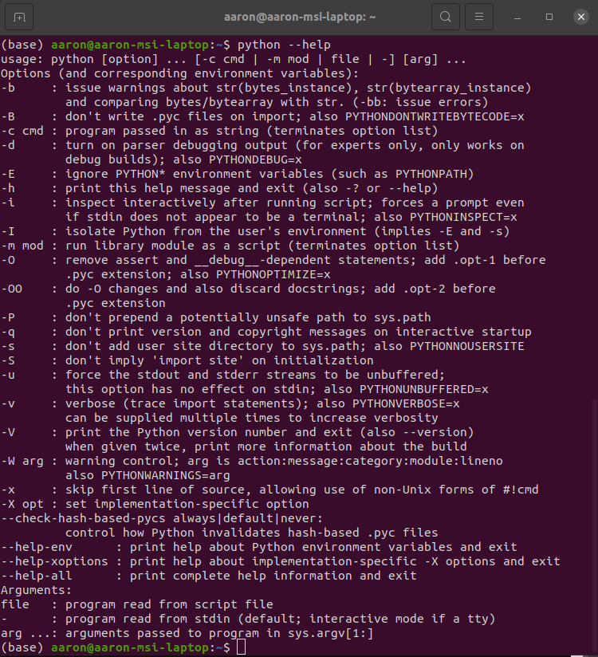
Calling Python
The Python executable can be called in several ways, mainly:
-c: executes a command passed as a string with no further argv. ex: python -c “print(‘Hello World’)”
-m: runs a library module as a script. ex: python -m hello_lib
file: executes code in the file with all remaining argv being treated as file inputs. ex: python hello.py
None: Opens an interpreter instance in the terminal. ex: Python (enter) >>>print(‘Hello World’)

Slide 11
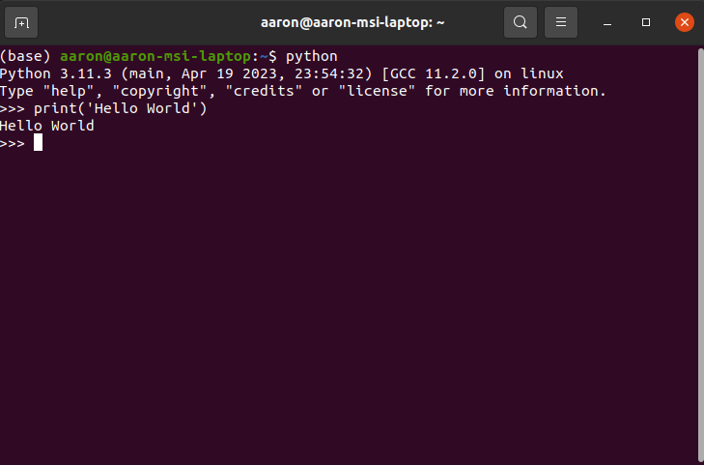
Python Modules
ASCII Text file which stores definitions

