Slide 1
EVRC Python Course Training 3: Fundamentals of Debugging
Vaishnavi Karanam, Aaron Rabinowitz
Notes:
Today, we’ll cover the basics of debugging in python

Slide 2
LEARNING OBJECTIVES
01
02
03
04
03
06
WEEK 3
Elements of Style
PEP8
Design Patterns
The theory behind coding standards and style
Python’s official style guide
Object-oriented Design Patterns
WEEK 5
Debugging
WEEK 4
IDEs
Virtual Environments
Print statements, breakpoints, etc.
How to effectively use IDEs to debug
Theory of Anaconda virtual environments
Notes:
Last week, we covered programming style
The main takeaway from that is that sticking to a consistent set of style rules will minimize bugs or errors in code
Today, we’ll go over common programming bugs that you may encounter
As well as ways to find and get rid of them
Next week we’ll cover design patterns and virtual environments

Slide 3
01
DEFINING BUGS
Notes:
We’re going to start off by defining different types of bugs that you could encounter in Python or any other programming language

Slide 4



TYPES OF PROGRAMMING BUGS
FUN FACT: The term "bug" in software possibly originated from a literal moth causing a hardware malfunction in the early days of computing, and it has since been used to describe any unexpected issue or error in software systems.
SYNTAX ERRORS
RUNTIME ERRORS
LOGICAL ERRORS
the interpreter is unable to parse the code due to the code violating Python language rules
the program is executing and encounters an unexpected condition that prevents it from continuing
the code runs without any syntax or runtime errors but produces incorrect results due to flawed logic in the code
Notes:
Bugs in software are errors, flaws, or faults in a program that causes it to produce an unintended or unexpected result.
A lot of people think that the term ”bug" possibly originated from a real-life insect.
The first recorded instance of a bug causing a technical malfunction was in 1947
when engineers working on the Mark II Aiken Relay Calculator, an early computer, found a moth lodged in the machine's hardware.
The moth was causing an electrical fault, disrupting the system's normal operations.
Grace Hopper was on the project and discovered the moth
But She taped it into the operator's logbook with the comment "First actual bug found" -implying that the term was already in use at that time.
So I don’t know if it’s the first use of the word “bug” in the context of computers but it’s a fun story
So there are three main types of programming bugs:
syntax errors occur due to violations of the programming language’s rules
Runtime errors occur while the program is running and are caused by events or conditions that are not properly handled by the code
Logical errors or semantic errors occur when the code compiles and runs without generating any error messages, but it does not produce the expected output

Slide 5
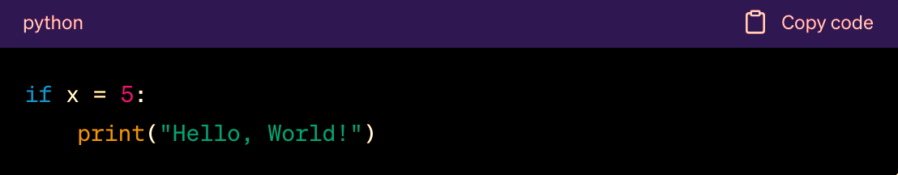
SYNTAX ERRORS
Syntax errors in Python result from code violations of language rules.
Common causes include
inappropriate indentation
erroneous keyword usage
incorrect operator use
These errors prevent the code from executing
The interpreter displays an error message pinpointing the issue's location within the code.
(This code contains a syntax error due to the use of the assignment operator '=' instead of the comparison operator '=='.)
Notes:
Syntax errors occur due to violations of the programming language's rules for writing code.
Missing semicolons, mismatched parentheses, misspelled keywords, or using a reserved word as a variable name are common syntax errors.
These errors are typically detected by the compiler or interpreter during the initial code compilation or interpretation phase. The code won't execute until syntax errors are fixed.
syntax errors prevent the program from even starting or compiling, making them the easiest type of error to detect and fix. They are often considered basic typographical mistakes.
The interpreter will usually display error messages pinpointing any syntax errors’ location within the code.
In this example, This code contains a syntax error due to the use of the assignment operator '=' instead of the comparison operator '=='

Slide 6
RUNTIME ERRORS
Runtime errors occur during program execution when an unexpected condition prevents the program from continuing (also called exceptions)
Most common runtime errors:
NameError:
Raised when Python can't find a variable or function in the current scope
Causes: misspelled names, using before defining, or referencing out-of-scope items.
TypeError
Raised when an inappropriate operation or function is applied to an object.
Causes: incompatible data types or incorrect argument types.
IndexError
Raised when accessing an out-of-range index of a sequence (e.g., string, list, tuple).
Causes: accessing non-existent elements or exceeding the sequence's length.
AttributeError
Raised when attempting to access an attribute or method that doesn't exist for an object.
Causes: misspelled names or accessing undefined attributes/methods.
Notes:
Runtime errors, also known as exceptions, occur while a program is running.
They are caused by events or conditions that are not handled by the code, such as division by zero, attempting to access an invalid array index, or opening a non-existent file.
Common examples of runtime errors include "division by zero," "null pointer exception," or "out of bounds array access.”
Runtime errors are typically detected when the code is executed, and they cause the program to terminate or crash unless they are caught and handled with exception handling mechanisms.
Runtime errors can be more challenging to diagnose and fix because they often involve complex program behavior and are dependent on specific input or circumstances. Proper error handling is crucial to prevent crashes and unexpected program termination.

Slide 7
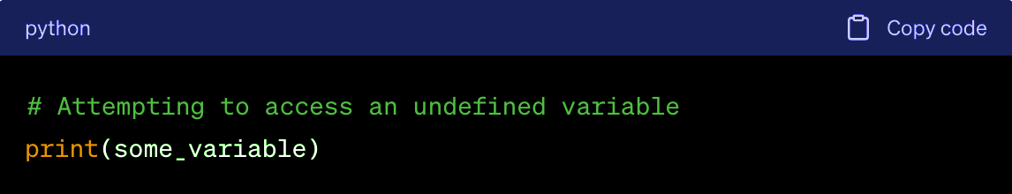
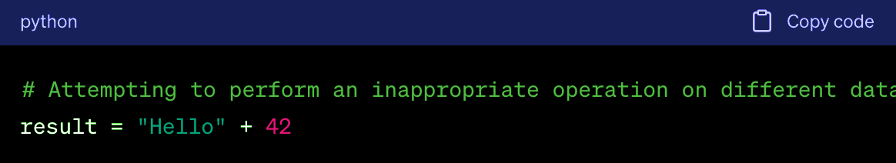
RUNTIME ERRORS
In this example, a NameError will occur because the variable some_variable has not been defined in the current scope, and the interpreter cannot find it.
In this example, a TypeError will occur because you are trying to concatenate a string ("Hello") with an integer (42), which is not a valid operation.
Notes:
In this example, a NameError will occur because the variable some_variable has not been defined in the current scope, and the interpreter cannot find it.
In this example, a TypeError will occur because you are trying to concatenate a string ("Hello") with an integer (42), which is not a valid operation.

Slide 8
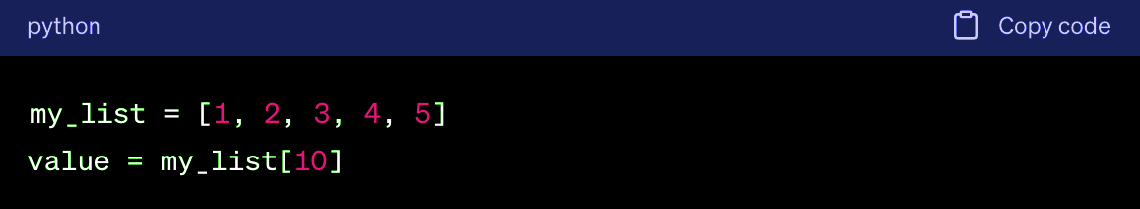
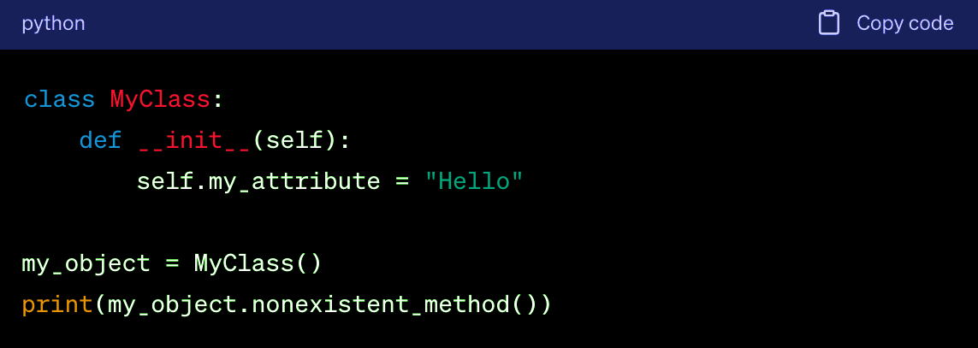
RUNTIME ERRORS
In this example, an IndexError will occur because you are trying to access an index (10) that is out of the range of the list my_list, which only has elements at indices 0 through 4.
In this example, an AttributeError will occur because you are trying to call the nonexistent_method() on the my_object, but this method does not exist in the MyClass class.
Notes:
In this example, an IndexError will occur because you are trying to access an index (10) that is out of the range of the list my_list, which only has elements at indices 0 through 4.
In this example, an AttributeError will occur because you are trying to call the nonexistent_method() on the my_object, but this method does not exist in the MyClass class.

Slide 9
RUNTIME ERRORS: HANDLING EXCEPTIONS
Exception handling helps maintain program stability in the face of unexpected events.
In Python, several built-in exceptions that can be raised when an error occurs (ZeroDivisionError, IndexError, etc.)
Try and except statements are used to manage exceptions in Python.
Code that may raise exceptions goes inside the try clause.
Code to handle exceptions is placed within the except clause.
try block attempts to execute code. try block attempts to execute code.
If an exception occurs, control moves to the except block for handling.
the 'else' clause in a try-except block, placed after the 'except' clauses, is executed only when no exception is raised in the 'try' clause
the 'finally' keyword is always executed after the 'try' and 'except' blocks, whether the 'try' block completes normally or due to an exception
Notes:
In normal circumstances, runtime errors will stop the code execution and display the error message.
But to create stable systems, we need to anticipate these errors and come up with alternative solutions or warning messages.
We can do this using try, except, else, finally blocks and learning about the many built-in exceptions defined in Python (like the ZeroDivisionError)
The most simple way of handling exceptions in Python is by using the `try` and `except` block.
For this, You place the code that may raise an exception within a try block. This is where you anticipate potential exceptions.
If an exception occurs within the try block, the normal flow of the program is interrupted, and the program looks for a corresponding except block to handle the exception.
An except block immediately follows the try block. It is responsible for "catching" and handling the exception.
The except block specifies the type of exception it can handle. If the exception matches the specified type, the code within the except block is executed.
The else block is used in conjunction with the try and except blocks.
Code within the else block is executed only if no exceptions were raised in the preceding try block.
It's often used to perform actions that should only happen when no exceptions occurred.
The finally block is used to define code that should be executed regardless of whether an exception occurred or not in the preceding try block.
It's typically used for cleanup operations, such as closing files or releasing resources, to ensure they are performed no matter what.

Slide 10
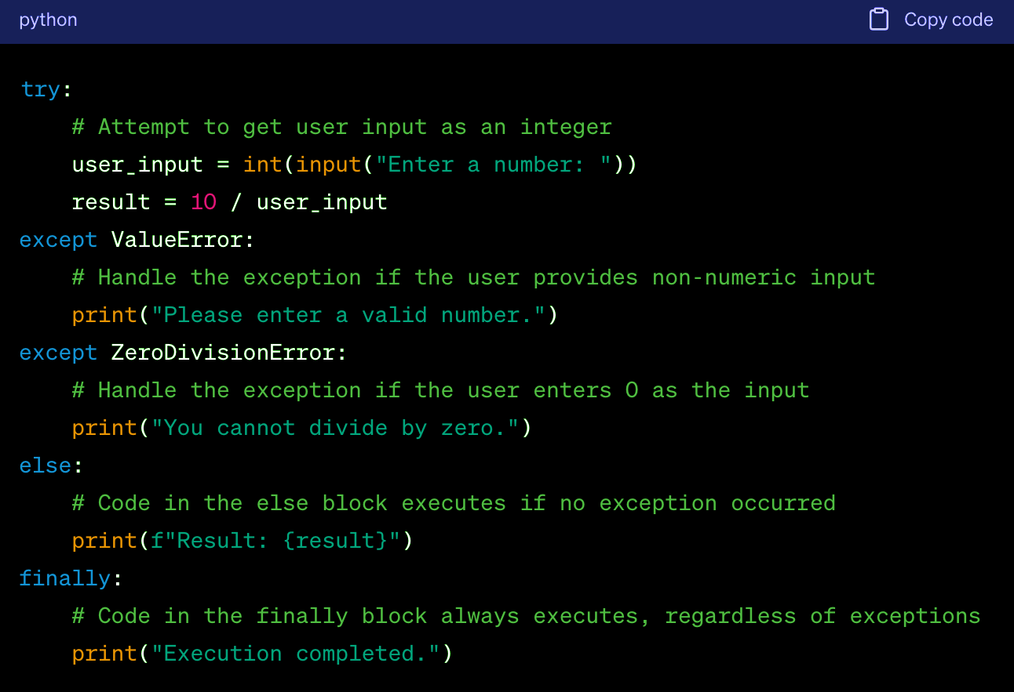
RUNTIME ERRORS: HANDLING EXCEPTIONS
Notes:
In this example, the code attempts to take user input as an integer, and it handles two potential exceptions:
ValueError for non-numeric input and ZeroDivisionError if the user enters 0.
If no exceptions occur, it calculates and prints the result.
The finally block always executes, and here it let’s us know that the program execution has been completed.

Slide 11
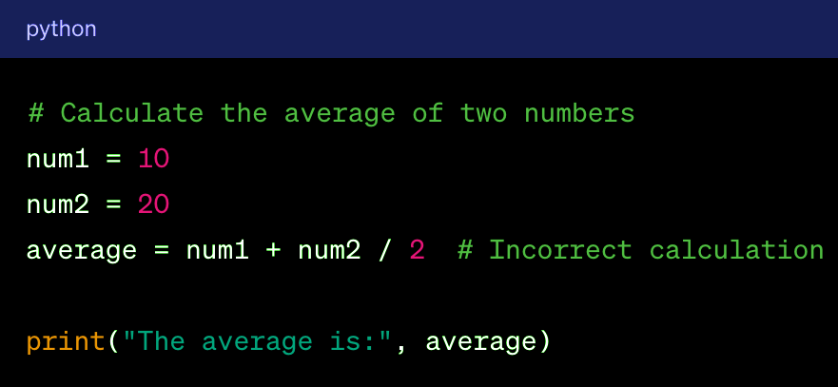
LOGICAL ERRORS
Logical errors occur when code runs without syntax or runtime errors but produces incorrect results due to flawed logic.
Common causes: incorrect assumptions, incomplete problem understanding, or incorrect algorithm/formula use.
Challenges of Detecting and Fixing
No error messages are produced.
Results may seem correct, but incorrect output can occur in specific situations.
The logic should be (num1 + num2) / 2 to correctly calculate the average, but the incorrect use of parentheses results in an incorrect average calculation.
Notes:
Logical errors, also known as semantic errors, occur when the code compiles and runs without generating any error messages,
but it does not produce the expected output or behaves incorrectly.
These errors stem from flawed logic or incorrect algorithms.
Logical errors could include incorrect calculations, misplaced conditions, or using the wrong algorithm to solve a problem.
Identifying logical errors can be more challenging as there are no explicit error messages or warnings.
Debugging techniques, such as code inspection, testing, and using print statements or debuggers, are essential for uncovering these issues.
In this example, The logic should be (num1 + num2) in parenthesis to correctly calculate the average, but the incorrect use of parentheses results in an incorrect average calculation.

Slide 12
02
FUNDAMENTALS OF DEBUGGING
Notes:
Now we’re going to look at techniques to find and fix the various bugs that we just talked about

Slide 13
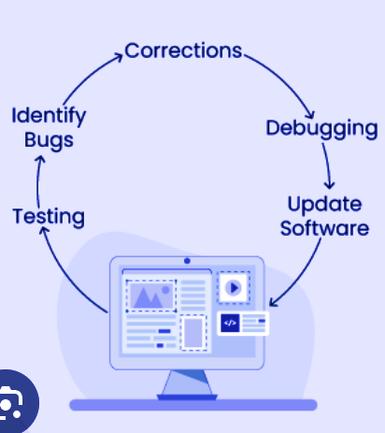
WHAT IS DEBUGGING
Debugging is the process of identifying, isolating, and fixing errors, or "bugs," in code
Writing clean, well-documented code that conforms to one coding style immensely simplifies the debugging process
It involves:
Finding the existence of the bug
Isolating the code segment that results in bug
Reproducing the bug consistently
Fixing the bug by correcting isolated code segment
Testing code to make sure bug is fixed
Notes:
Debugging is the process of identifying and fixing errors, or "bugs," in code to make it work as intended.
It involves finding, isolating, reproducing and resolving bugs
Debugging can be done using various techniques and tools,
such as adding print statements to inspect variable values,
using integrated development environments (IDEs) with debugging features,
and employing specialized debugging tools.

Slide 14
COMMON METHODS TO DEBUG PYTHON CODE
Read Code
Read Tracebacks
Print Statements
Logging
Rubber Duck Debugging
Step-through debugging
Command-line Debuggers: Python Debugger (pdb)
Visual Debuggers: PyCharm
Notes:
We’re going to go over a few of these techniques today

Slide 15
LEARN TO READ CODE
Have a clear mental model of how code is executed in Python
Execution Order:
Usually top to bottom
Function calls create stack frames
Import statements execute other files
Everything is an object
‘def’ defines a function object
‘class’ defines a class object
‘import’ defines a module object
Variables are references to objects
pythontutor can help with this
Notes:
The first technique is pretty simple but effective
Reading and understanding code is an essential skill in debugging.
It’s important to have a clear mental model of how code is executed in Python
Remember that execution usually happens from top to bottom
When a function is called, a new "stack frame" is created on the call stack to store information about that function's execution, including local variables and return addresses.
Import statements in Python execute other Python files (modules).
This means that when you import a module, its code is executed, and its variables and functions become accessible in your current module.
In Python, nearly everything is an object, including numbers, strings, functions, and classes.
Objects have attributes and methods, and understanding this object-oriented nature of Python is very important for debugging code.
pythontutor is an online tool and educational platform for learning Python.
It allows you to visualize and step through Python code execution, making it a great resource for helping you develop a mental model of your code

Slide 16
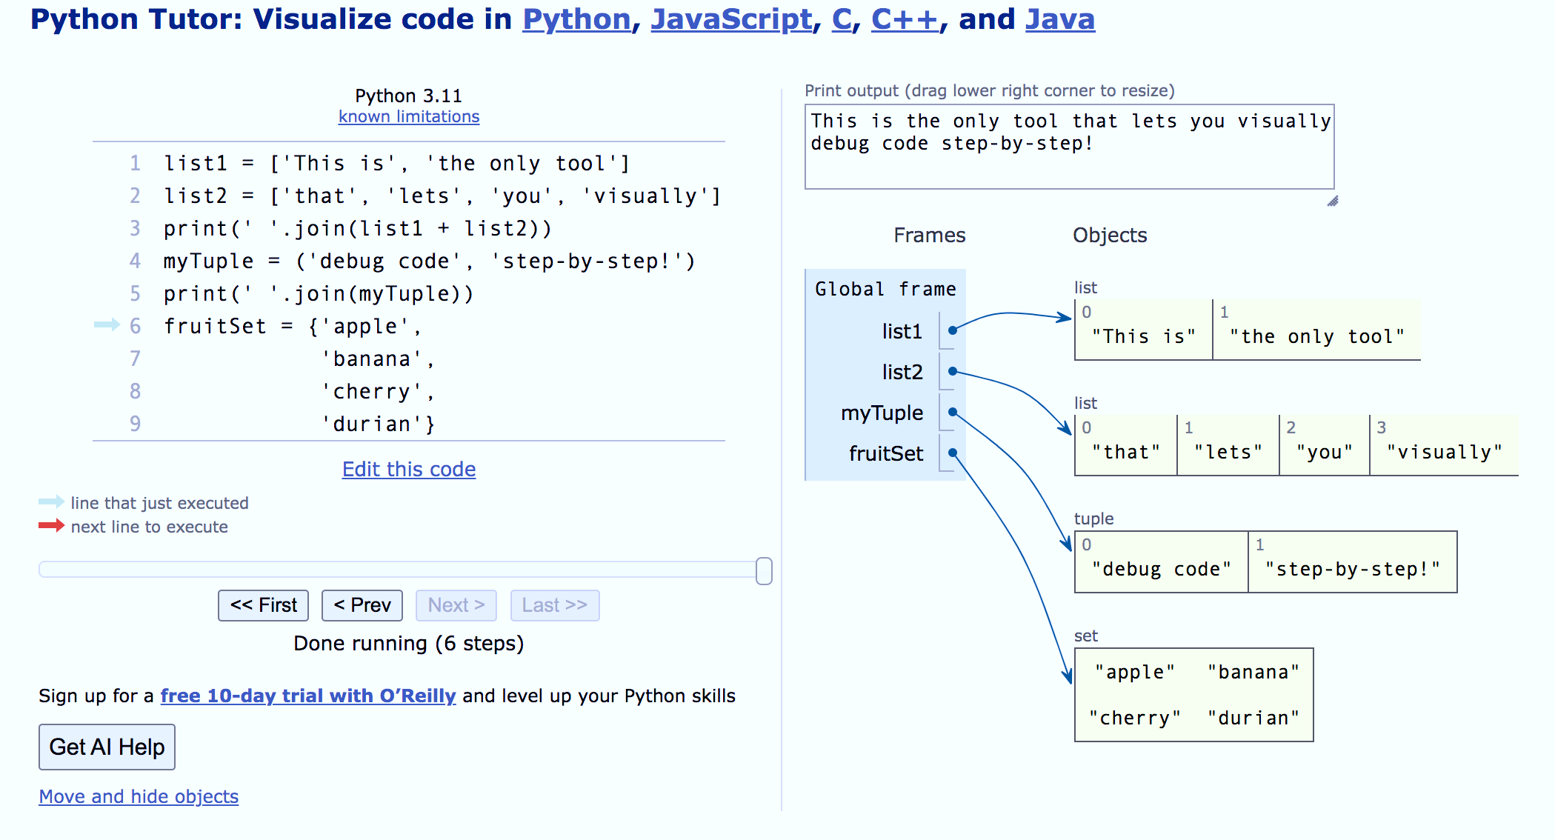
LEARN TO READ CODE: PYTHONTUTOR EXAMPLE
Notes:
This is an example of how pythontutor visualizes a program
Here we have two lists of strings
List1 contains two strings objects and its stored in memory as an iterable object
One of the string says “This is” and the other says “the only tool”
List2 contains 4 string objects
You can visually see how each element in the lists are stored in the right

Slide 17
LEARN TO READ CODE: PYTHON COURSES & TUTORIALS
Official Python Tutorial
Python Epiphanies (Youtube)
Python for Everybody Specialization by the University of Michigan (Coursera)
Whirlwind tour of Python – Jake VanderPlas (Book)
Python Data Science Handbook – Jake VanderPlas (Book)
Notes:
Really understanding the fundamentals of python is also very important when it comes to debugging
These are a list of resources that I think are good for understanding the basics of python

Slide 18
LEARN TO READ TRACEBACKS
Debugging often starts with an exception and traceback
Uncaught exceptions cause Python interpreter to print traceback and exit
Start at the Bottom: Tracebacks are displayed from the bottom up.
Identify the Error Type: The first part of the traceback line typically indicates the type of error that occurred
Look for Clues in the Error Message: Read the error message to understand the context of the error.
Check the File and Line Number: The traceback will include the name of the file in which the error occurred and the line number.
Examine the Code: Once you've identified the file and line number, go to that part of your code and carefully review it
Consult Documentation: Python's official documentation and library documentation
Google the Error Message: If the error message is not immediately clear, you can search for it online
Notes:
In python, a traceback is a report containing the function calls made in your code at a specific point i.e when you get an error
it is recommended that you should trace it backward(traceback) so start at the bottom
Begin by examining the last line, as it usually points to the specific line of code where the error occurred.
Read the error message to understand the context of the error. It often provides details about what went wrong.
For instance, it may mention that a variable is not defined or that there's a division by zero.
The traceback will include the name of the file in which the error occurred and the line number.
This information helps you locate the specific part of your code that caused the error.
Python's official documentation and library documentation are valuable resources for understanding error messages and finding information about specific functions and methods.
If that isn’t helpful, you can search for it online. Many programmers have encountered the same errors and shared solutions on sites like stakeoverflow.

Slide 19
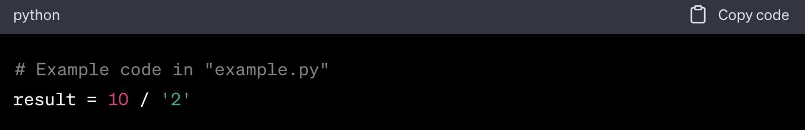
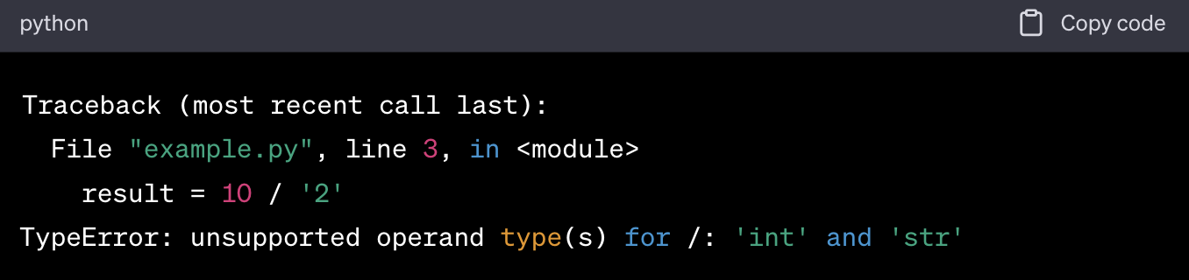
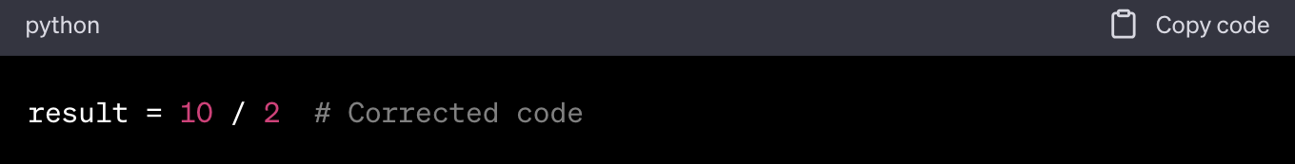
LEARN TO READ TRACEBACKS
Notes:
In this traceback:
The traceback begins with the header, showing the sequence of events, with the most recent call at the top.
The file name ("example.py") and line number (line 3) tell you where the error occurred.
In this case, the error occurred in the main module ("<module>"). If it were within a function or method, the function or method name would be displayed here.
The error type is "TypeError," indicating that there's an issue with the types of data being used.
The error message "unsupported operand type(s) for /: 'int' and 'str'" provides context.
It tells you that you're trying to perform a division operation with an integer and a string, which is not supported.
To resolve this error, you'd need to examine your code around line 3 in "example.py" and correct the operation to ensure you're performing a valid division between compatible data types
Here we convert the string to an integer).

Slide 20
PRINT STATEMENTS
Using print statements is a common and effective way to debug
Variable Values: Print the values of variables to check their current state at different stages of your program.
Execution Flow: Insert print statements to mark different stages in your code to help track the flow of execution.
Error Tracing: Add print statements before and after suspicious code sections to locate where issues occur.
Conditional Printing: Use if statements with print to selectively print information only when certain conditions are met.
Code Cleanup: After debugging, ensure that you remove or comment out unnecessary print statements to maintain clean code.
Notes:
Using print statements is a common and I think effective way to debug code by displaying variable values and execution flow.
You can use print statements to print the values of variables to check their current state at different stages of your program.
Or you can Insert print statements to mark different stages in your code to help track the flow of execution.
While using print statements is simple to implement and useful for small projects. It can clutter code
After debugging, ensure that you remove or comment out unnecessary print statements to maintain clean code
For larger projects, it may be better to use step-through debugging tools which we’ll cover soon

Slide 21
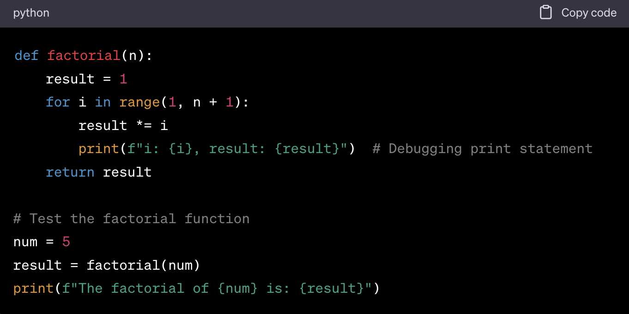
PRINT STATEMENTS
RESULT: 120
RESULT: 24
Notes:
here's an example of debugging using print statements in Python:
We have a simple function that calculates the factorial of a number but it is currently producing incorrect results.
According to it, the factorial of 5 is 24, but it should be 120
To debug it, you can insert print statements to inspect the variable values:
When you run the modified code, it will display the values of i and result at each iteration of the loop.
By examining the printed output, you can identify where the issue occurs and why the calculation is incorrect.
In this case, you'll likely notice that the loop doesn't include n in the range, and that's the source of the problem.
You can then correct the code range accordingly.

Slide 22
LOGGING
Logging involves tracking events during software execution
Python has a built-in module logging which allows writing status messages to any output streams
Logging Levels:
Debug: These are used to give Detailed information, typically of interest only when diagnosing problems.
Info: These are used to confirm that things are working as expected
Warning: These are used as an indication that something unexpected
Error: This tells that due to a more serious problem, the software has not been able to perform some function
Critical: This tells serious error, indicating that the program itself may be unable to continue running”
The logging module is packed with several features which you can explore at your own time
Notes:
logging is a technique used to capture and record information about the program's behavior, execution flow, and variable values during runtime.
Unlike print statements, which are often used for temporary debugging, logging is more structured and allows you to control the detail and destination of the logged information.
Python provides a built-in logging module that offers various log levels (e.g., debug, info, warning, error) to categorize messages.
Developers can configure where and how log messages are stored, so they can be in files, console, or other destinations.
There are different levels of logging
The debug level is used to give Detailed information, typically of interest only when diagnosing problems
The Info level is used to confirm that things are working as expected
The error level tells that due to a more serious problem, the software has not been able to perform some function
The critical level tells serious error, indicating that the program itself may be unable to continue running

Slide 23
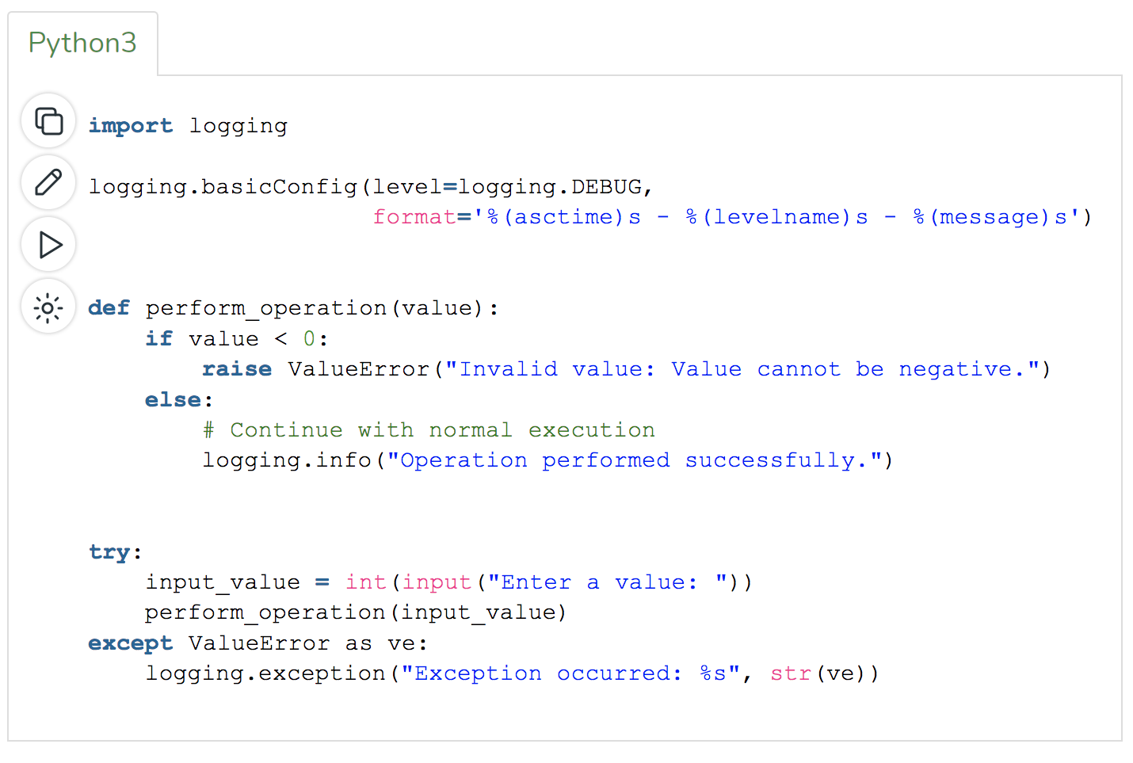
LOGGING
Notes:
In this code, we ask the user for a value
We pass that value to a function that raises an exception if that value is less than 0, this exception is then caught by the logging
Also, If the value is greater than 0, we log that the operation was performed successfully

Slide 24

RUBBER DUCK DEBUGGING
A simple yet effective debugging technique used by most programmers
Place a physical or imaginary rubber duck on your desk
When you encounter a problem, start explaining your code to the duck
Code's purpose,
Logic
Expected outcomes
Forces you to articulate the problem and your thought process.
Often leads to self-discovery of the issue.
Helps you understand the code more deeply
Notes:
Rubber duck debugging is a somewhat whimsical but highly effective method of debugging code.
The idea is to explain your code and the problem you're facing to an inanimate object, like a rubber duck, as if you were teaching it to someone else.
While it may sound strange, the process of verbalizing your code and the issues you're encountering can help you gain a clearer understanding of the problem.
The act of articulating your thought process and walking through the code step by step can reveal overlooked issues or logical errors

Slide 25
STEP-THROUGH DEBUGGING
Step-through debugging is a debugging technique where a program is executed one step at a time, allowing the developer to inspect and analyze its behavior at each step.
Terminology:
Breakpoint: a designated pause point in code for inspection.
Call stack: A record of function calls and their order
Continue: continue execution until the next breakpoint
Step over: Execute and move to the next line
Step into: Enter function or method calls for inspection
Step out: exit the current function or method and continue program execution
Step-through Debuggers
Python Debugger (pdb)
Pycharm’s Visual Debugger
Notes:
Step-through debugging is a systematic method of debugging code in which a developer examines a program's execution one step at a time.
Using a debugger tool, the developer can pause the program's execution at specific points, inspect variable values, and analyze the code's behavior incrementally.
This approach provides detailed insights into how the code is functioning and allows for the identification and resolution of issues in a controlled and systematic manner.
In step-through debugging:
A breakpoint is a designated point in the code where program execution pauses, allowing developers to inspect variables and the program's state
A call stack is a record of function calls and their order, which is very important for understanding code execution flow
The continue command in step-through debugging that allows the program's execution to proceed from the current point, bypassing breakpoints or stopping points. It's used to resume normal program flow after inspection and analysis.
The step over command allows us to execute the current line of code and move to the next line without entering function or method calls.
The step into command allows us to enter a function or method call, inspect its execution, and continue line-by-line execution.
The step out command allows us to exit the current function or method and continue program execution at a higher level. It's useful when you want to move out of the current function and focus on the calling context.
These are common aspects of step-through command-line and visual debugging tools

Slide 26
PYTHON DEBUGGER (PDB)
Python debugger (PDB) is a part of Python’s standard library
It allows developers to step through their code, inspect variables, and track program execution
Usage:
Insert breakpoints in your code using the import pdb; pdb.set_trace() statement.
Run your Python script, and it will pause execution at the breakpoint.
Key Commands:
n (next): Execute the current line and move to the next.
s (step): Enter a function and continue line-by-line execution.
c (continue): Resume normal execution until the next breakpoint.
q (quit): Terminate the debugging session.
Command line interface isn’t very friendly
Notes:
Python Debugger (PDB) is a command line step-through debugger built into Python
I personally do not use this because I don’t find the interface to be very friendly
But it has all the functionality of any step-through debugger
You can add breakpoints and step through the code

Slide 27
PYTHON DEBUGGER (PDB)
h — help
➤ q — quit
➤ p — print (use “pp” to pretty-print)
➤ ll — “long list” source code in current function or frame
➤ w — where (print stack trace)
➤ n — next (“step over”)
➤ s — step (“step into”)
➤ c — continue (run to breakpoint or exception or program end)
➤ b — breakpoint (add or list, use “cl” to remove)
➤ u — up (in stack frame)
➤ d — down (in stack frame)
Notes:
There are the various command-line options for the debugger

Slide 28
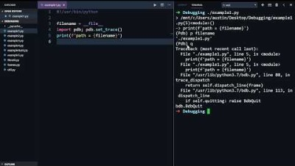
PYTHON DEBUGGER (PDB)
Notes:
Since I don’t use it very much, I figured someone else should demonstrate it
So let’s just watch this quick video

Slide 29
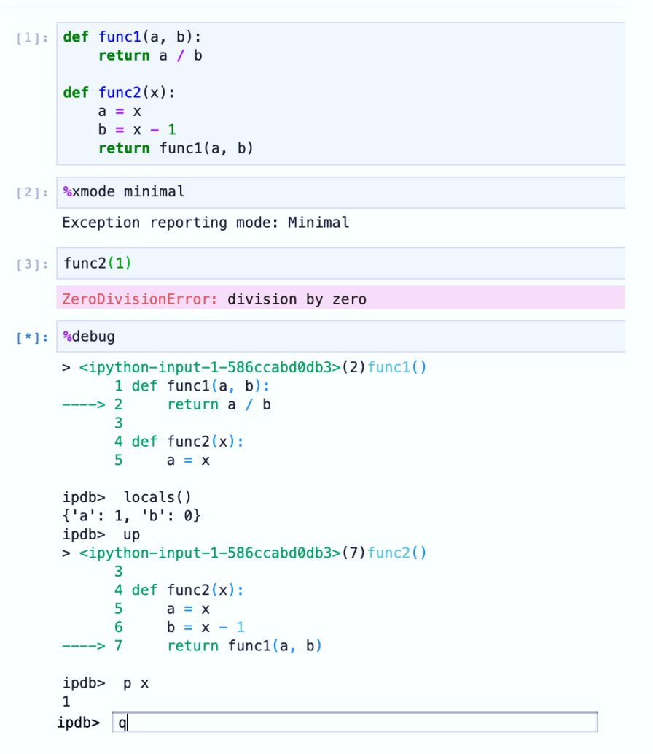
PYTHON DEBUGGER (PDB): JUPYTER
Jupyter Notebooks support the %debug magic command - using it will activate the Python Debugger (pdb) in an interactive session
Some Jupyter Notebook environments offer integrated visual debuggers
JupyterLab with extensions like "Variable Inspector" and "Interactive Debugger
Libraries like pdb++ provide a more interactive and feature-rich debugging environment within the Jupyter Notebook
Notes:
You can also use this command-line debugger in jupyter notebook by using the %debug magic command
It has all the same functionality
There are some visual debuggers that can be integrated with jupyter but it seems like they have limited features

Slide 30
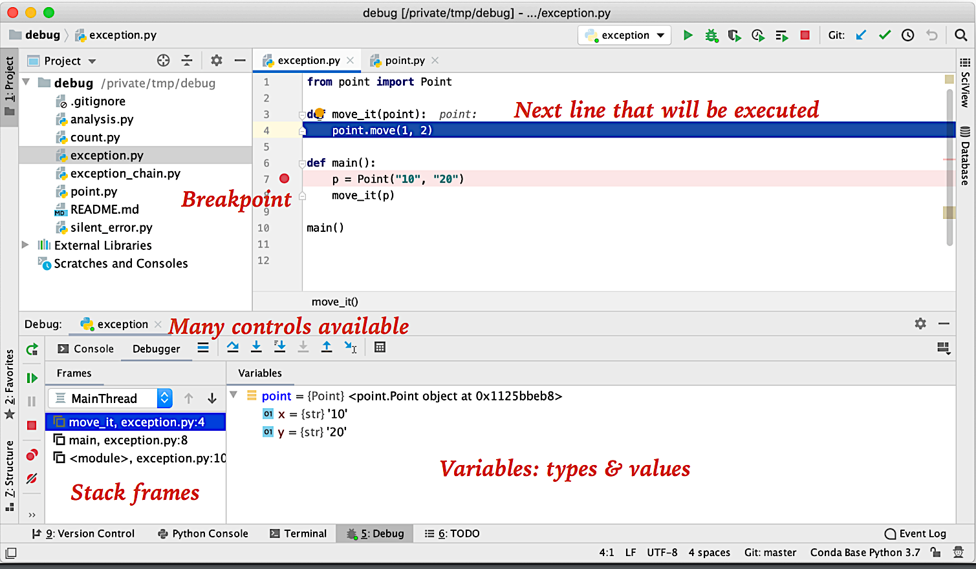
VISUAL DEBUGGERS
Many great Python editors & IDEs with visual debuggers
IDLE, PyCharm, VS Code, emacs, vim, Spyder, Mu, Xcode, Atom, Eclipse, Sublime, …
I recommend PyCharm or VS Code, but you can use whatever you like
Intuitive Interface: Visual debuggers offer a user-friendly, graphical interface for seamless debugging
Code Visualization: They provide graphical code representations, simplifying comprehension of complex code structures and program states.
Notes:
Visual debuggers are software tools that provide a graphical interface for debugging code.
So you can visually add breakpoints and step through code
The function state at each breakpoint is clearly visible in the debugger panel
You can see what value each variable holds and how those values change as you step through the code
You can use special commands to step into your own functions or functions in other modules
I think this is much nicer than command-line debugging

Slide 31
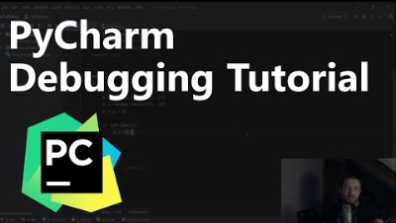
VISUAL DEBUGGERS: PYCHARM EXAMPLE

Slide 32
IN-CLASS ACTIVITY: DEBUG ROCK PAPER SCISSORS
Debug the buggy code I’ve given you using any of the debugging techniques we learned today!
Hint: It’ll be difficult to reproduce some bugs due to the random module
Good luck!
Notes:
The in-class activity today is to debug something, shocking
I provided you a buggy version of the rock, paper, scissors code from last week
Your goal is to debug it
You can use any of the techniques we talked about

Slide 33
THANKS

