Slide 1
EVRC Python Course Training 3: Coding Style & Design Hacks
Vaishnavi Karanam, Aaron Rabinowitz
Notes:
The objective for today's training was to go over python style and design hacks, but we're going to start off with a quick refresher of basic python concepts

Slide 2
00
PRACTICAL RECAP

Slide 3
VARIABLES, OBJECTS & CLASSES
A variable is a reference to a value stored in a computer’s memory.
Variables can be sorted into a variety of categories (or data types) such as numbers (int/float etc), Boolean values (true/false), and sequences (strings, lists etc).
An object is a collection of data from a computer’s memory that can be manipulated.
ALL VARIABLES ARE OBJECTS although some objects can be defined by data referred to by multiple variables.
Methods are the functions used to act on/alter an object’s data. They describe what your object can “do.”
Notes:
In Python, variables, objects, and classes are fundamental concepts that help us work with data and organize code.
Variables are like containers that store information.
For instance, you can have a variable called "number" that holds the value 42.
Objects, on the other hand, are much more versatile. Everything in Python is an object, from numbers and text (strings) to more complex things like lists and functions.
Objects have unique characteristics and actions associated with them, known as attributes and methods.

Slide 4
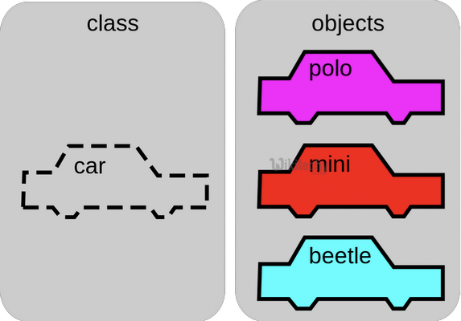
VARIABLES, OBJECTS & CLASSES
A class is a collection of objects who share the same set of variables/methods.
The definition of the class provides a blueprint for all the objects within it (instances).
Instances may share the same variables (color, size, shape, etc.), but they do NOT share the same values for each variable (blue/red/pink, small/large, square/circular etc.)
Instance #1
Color: Pink
Name: Polo
Instance #2
Color: Red
Name: Mini
Instance #3
Color: Blue
Name: Beetle
Notes:
Classes are like the blueprints for creating more complex objects. They define what an object can do and what data it can hold.
For example, you can create a ”Car" class to describe cars, with attributes like name and color, and methods like ”drive”
Object Instances of this class may share the same variables (color, name, etc.), but they do NOT share the same values for each variable
Like there is an instance of class car here named polo with the color purple and another instance of a class car named mini with the color red

Slide 5

BASIC SYNTAX RULES
The name of your variable (myInt etc.) is placed on the left of the “=“ operator.
The assignment operator (“=“) sets the variable name equal to the memory location where your value is found.
The value of your variable (“Hello, World”) is placed on the right of the “=“ operator.
The type of this value does NOT need to be stated but its format must abide by a given object type (as shown).
myString = “Hello, World”
myInt = 7 myFloat = 7.0 myList = [7, 8, 9]
myBoolean = true
Notes:
You can name variables with letters, numbers, and underscores, but they must start with a letter. For example, myString
The assignment operator (“=“) sets the variable name equal to the memory location where your value is found.
The name of your variable (myInt etc.) is placed on the left of the “=“ operator and
The value of your variable (“Hello, World”) is placed on the right of the “=“ operator

Slide 6
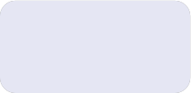
BASIC SYNTAX RULES
Function Syntax
def...: indicates that you are defining a new function.
function() refers to the name of your function. By convention, this name is typically lowercase and represents a verb/action.
a,b refers to parameters (values or variables) that can be used within the statements of your function’s definition (......). If your function has no parameters, an empty parenthetical () is used.
The return statement is an optional statement that will return a value for your function to your original call.
def add_numbers(a, b):
......
return a + b
Notes:
Python functions are usful tools that perform specific tasks in your code.
To create a function, you use the def keyword, followed by the function's name and parentheses.
Inside the parentheses, you can include any parameters the function needs.
You also use a colon (:) to mark the beginning of the function's code block.
The function's code should be indented.
Here we have a function called add_numbers which takes in two numbers and returns the sum of the two

Slide 7

BASIC SYNTAX RULES
Calling a function
Call the function by referring to its name (function()) and by placing any necessary arguments (1, 2) within the parenthesis separated by commas. myValue = function(1, 2)
If you wish, you can set your function call equal to a variable (myValue). The value returned by the function will be assigned to your variable name.
myValue = add_numbers(1, 2)
Notes:
When you want to use the function, you simply call it by typing its name followed by parentheses, with any required values inside.
So this function would assign the return value of the function which is 3 to the variable myValue

Slide 8
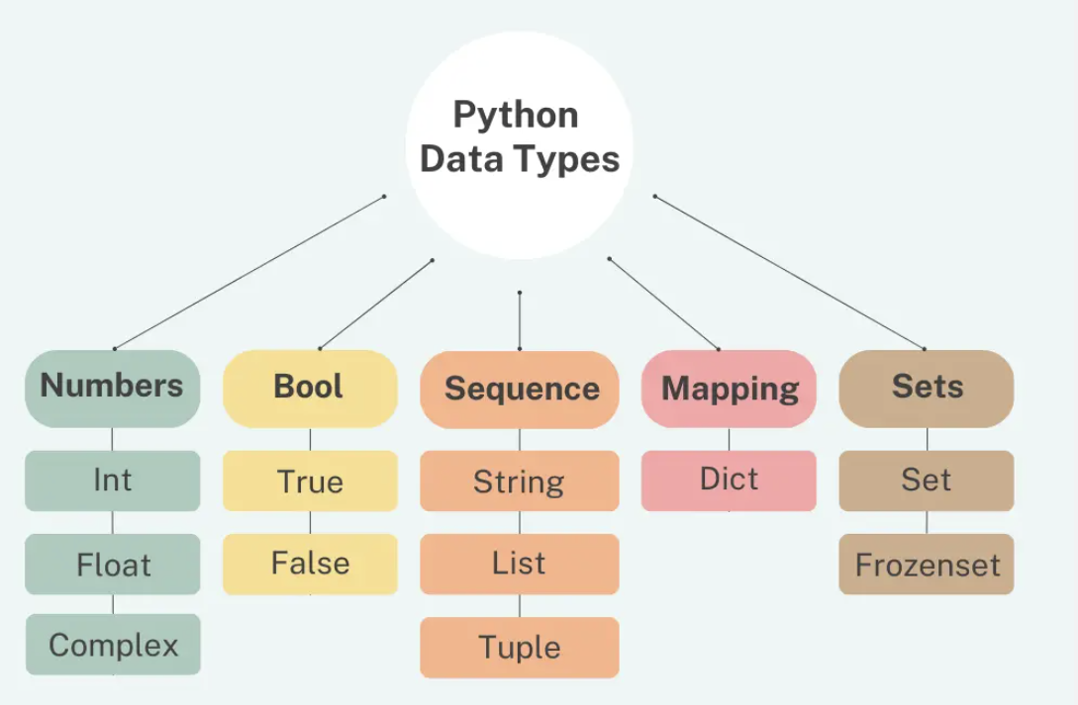
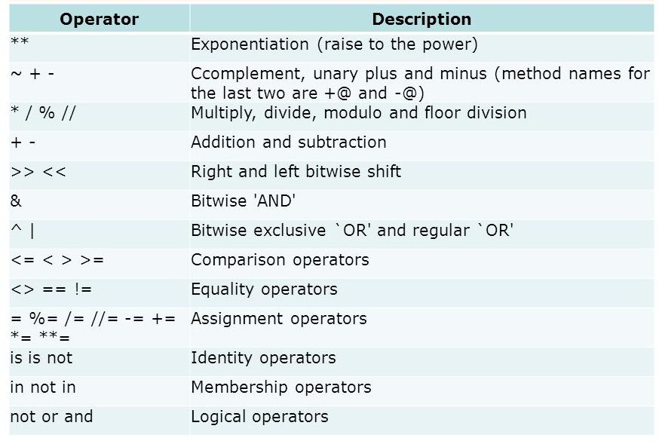
COMMON DATA TYPES & OPERATORS
A data type is a means of classifying a value and determining what operations can be performed on it. All objects have a data type.
Operators are symbols used carry out specific functions/computations.
Notes:
Python has several fundamental data types to represent different kinds of information.
Integers (int) are for whole numbers, like 5 or -10.
Floating-point numbers (float) handle decimals, such as 3.14.
Text is managed with strings (str), enclosed in single or double quotes, like "Hello, Python!"
Lists are collections of data, organized with square brackets, such as [1, 2, 3].
Dictionaries (dict) are used for key-value pairs, where each value has a unique identifier, like {"name": "Alice", "age": 30}.
Booleans (bool) handle true or false values
In Python, operators are like tools for performing various operations on data.
Arithmetic operators (+, -, *, /, %) are used for basic math, like addition, subtraction, multiplication, division, and finding remainders.
Comparison operators (>, <, ==, !=, <=, >=) are for comparing values, helping you make decisions in your code.
Logical operators (and, or, not) allow you to combine and manipulate Boolean values (True or False) to create complex conditions.
Assignment operators (=, +=, -=, *=, /=) are used to store values in variables or update them.
Bitwise operators (&, |, ^, ~, <<, >>) deal with binary representations of numbers and perform bitwise operations.

Slide 9
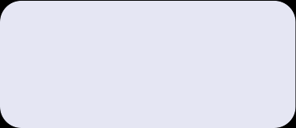
INPUT/OUTPUT
Input functions (input()) allow users of a program to place values into programming code.
The parameter for an input function is called a prompt. This is a string (this can be indicated by “” or ‘’) such as “Enter a number: “
The user’s response to the prompt will be returned to the input statement call as a string. To use this value as any other data type, it must be converted with another function (int()).
Print functions (print()) allow programs to output strings to users on a given interface.
The parameter of this function is of any type. All types will automatically be converted to strings.
xString = input(“Enter a number: “)
x = int(xString) y=x+2 print(y)
Notes:
Python input/output (I/O) statements are how a program communicates with the user.
The input() function lets you collect information from the user by displaying a prompt and waiting for them to type something, which is then stored in a variable.
For instance, here xString = input("Enter a number: ") stores the number the user enters.
the print() function allows you to display messages or the values of variables on the screen.
For example, here print(y) will show you the value of 2 + the user's input. If the user input 4, the program would print 6

Slide 10

IF/ELSE STATEMENTS
If-else statements allow programmers to adapt the function of their code based on a given condition.
If a given condition (i.e. x % 2 == 0) is true, then the statements following the if statement (if) will be executed. If the condition is false, the statements following the else statement (else) will be executed.
The condition is tested using the Boolean operators == (is equal to), != (is not equal to), and (used to test multiple conditions), and or (used to test if AT LEAST ONE condition is true).
Additionally, else-if statements (elif) can be used to provide unique coding statements for multiple conditions.
xString = input(“Enter a number: “)
x = int(xString)
if x % 2 == 0: print(“This is an even number”)
elif x == 0: print(“This number equals 0”)
else:
print(“This is an odd number”)
Notes:
if/else statements are like decision-makers in your code.
You can use them to set conditions, making your program take different actions based on whether a condition is true or false.
The "if" part checks if a condition is true, and if it is, the code inside the "if" block runs.
If the condition is false, the code inside the "else" block executes. It's like making choices in your code.
Here, the program takes in an input from the user and checks if it is odd, even or equal to zero using if/else statements

Slide 11

FOR LOOPS
For loops perform the same task (iterate) for the number of times specified by an iterable (something that can be evaluated repeatedly such as a list, string, or range).
for defines the for loop
x is the variable defining the number of times the statements within the loop (print(myInt)) are executed.
The range(start, stop, step) function is often used to define x.
The starting value is defined by start, the final value is defined by stop – 1, and the magnitude at which x changes between loops is defined by step.
in is a Boolean operator that returns true if the given value (x) is found within a given list, string, range etc.
myString = input(“Enter a number: “)
myInt = int(myString)
for x in range(0, 5, 1): print(myInt)
Notes:
In Python, a "for" loop is a useful tool for doing the same thing multiple times, especially when dealing with collections of data.
You specify the items you want to loop over, and for each item, the code inside the loop runs.
Here:
for defines the for loop
x is the variable defining the number of times the statements within the loop are executed.
The range(start, stop, step) function is used to define x.
The starting value is defined by start, the final value is defined by stop – 1, and the magnitude at which x changes between loops is defined by step.
in is a Boolean operator that returns true if the given value (x) is found within a given list, string, range etc.
So this program prints out the users input five times

Slide 12

WHILE LOOPS
While loops are statements that iterate so long as a given Boolean condition is met.
x (the variable determining whether or not the condition is met) is defined and manipulated OUTSIDE of the header of the while loop (while)
The condition (x < 5) is a statement containing a Boolean variable.
break is a statement used to exit the current for/while loop.
continue is a statement used to reject all statements in the current for/while loop iteration and return to the beginning of the loop.
myString = input(“Enter a number: “)
myInt = int(myString)
x = 0 while x < 5:
print(myInt)
x= x +1
Notes:
a "while" loop is a repetitive tool that keeps doing something as long as a certain condition remains true.
You define the condition at the beginning of the loop, and the code inside the loop runs repeatedly as long as that condition is true.
When the condition eventually becomes false, the loop stops.
In this program
x (the variable determining whether or not the condition is met) is defined and manipulated OUTSIDE of the header of the while loop (while)
The condition (x < 5) is a statement containing a Boolean variable.
this program like the one on the last slide prints out the users input five times but this time using a while loop

Slide 13
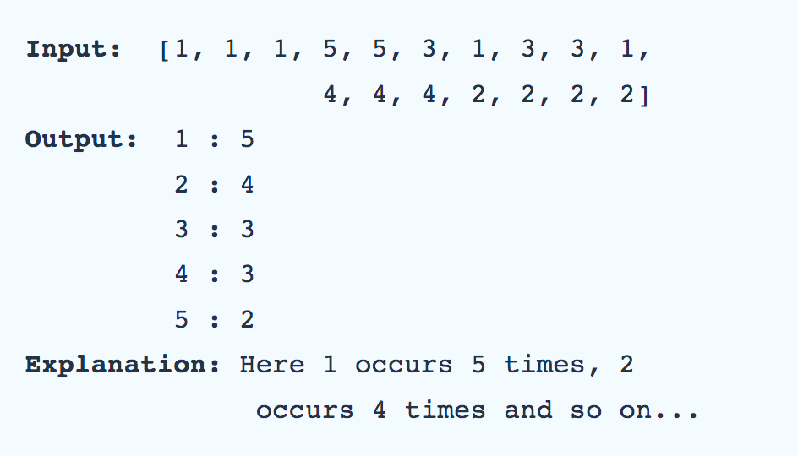
LETS GET CODING
Given an unsorted list of some elements(which may or may not be integers), write a function that finds the frequency of each distinct element in the list using a Python dictionary.
Notes:
Let’s trying putting all of that together and coding something simple
Given an unsorted list of some elements(which may or may not be integers), We need to find the frequency of each distinct element in the list using a Python dictionary
How do we do this?.

Slide 14
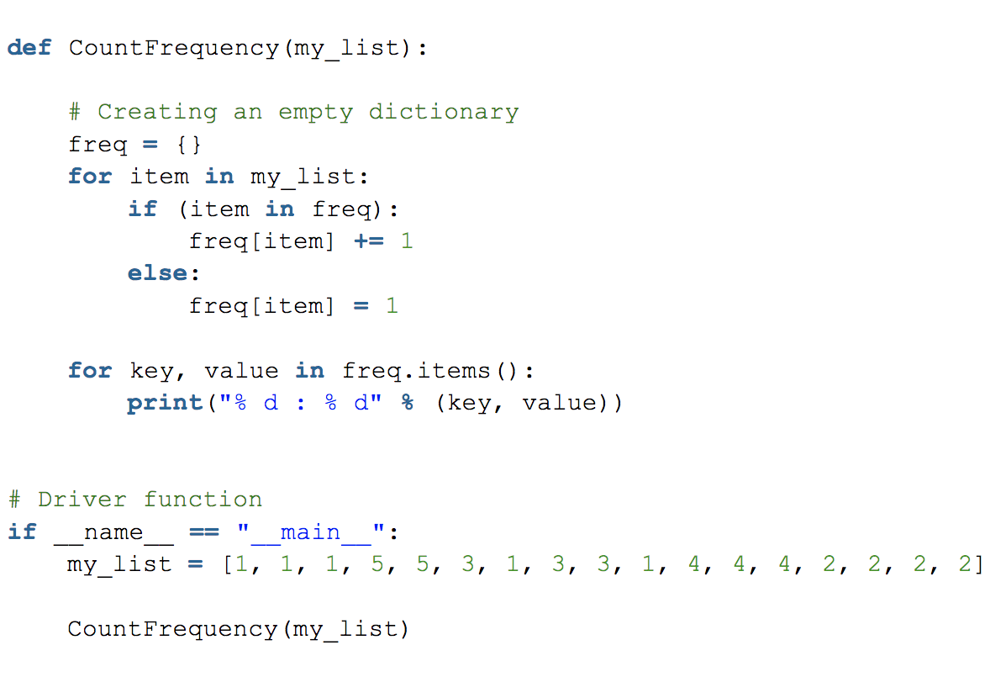
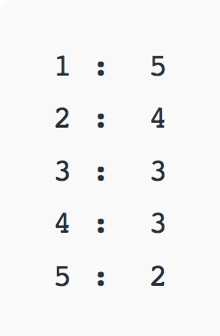
LETS GET CODING
OUTPUT
Notes:
Given the list my_list, we need to write a function called CountFrequency that finds the frequency of each distinct element in the list using a Python dictionary
What would be the first step here?
Define function
Then?
Create empty dictionary
Then
Loop over my_list
Then
`If item is already in dictionary, we increment its value
If not, we add it to the dictionary with a value of 1
Finally,
We loop over the dictionary and print out the keys & values

Slide 15
LEARNING OBJECTIVES
01
02
03
04
03
06
WEEK 3
Elements of Style
PEP8
Design Patterns
The theory behind coding standards and style
Python’s official style guide
Object-oriented Design Patterns
Debugging
Intro to IDEs
Virtual Environments
Print statements, breakpoints, etc.
How to effectively use IDEs
Theory of Anaconda virtual environments
WEEK 4
Notes:
That's the end of the refresher. hopefully that was somewhat uuseful
Moving on to coding style and design
This is what I have laid out so far
Today we will cover the first two topics so basic elements of coding style and pep8, which is pythons official style guild
Next week, we will cover design patterns, debugging, IDE usage and virtual environments

Slide 16
01
ELEMENTS OF PROGRAMMING STYLE

Slide 17
““Beautiful is better than ugly. Explicit is better than implicit. Simple is better than complex. Complex is better than complicated. Flat is better than nested. Sparse is better than dense. Readability counts. Special cases aren't special enough to break the rules. Although practicality beats purity. Errors should never pass silently. Unless explicitly silenced. In the face of ambiguity, refuse the temptation to guess. There should be one-- and preferably only one --obvious way to do it. Although that way may not be obvious at first unless you're Dutch. Now is better than never. Although never is often better than *right* now. If the implementation is hard to explain, it's a bad idea. If the implementation is easy to explain, it may be a good idea. Namespaces are one honking great idea -- let's do more of those!
— The Zen of Python (Tim Peters)
Notes:
The Zen of Python is a collection of guiding aphorisms for writing computer programs in Python
They capture the philosophy and design principles that, Tim Peters, a famous software developer believes make Python code more readable and maintainable.
The Zen of Python can be accessed by typing import this in a Python interpreter, and it's meant to encourage Python developers to write clean and understandable code.

Slide 18
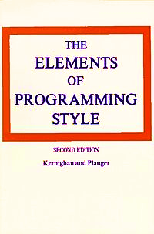
ELEMENTS OF PROGRAMMING STYLE
1974
Doesn’t describe how to write programs
Describes how to write efficient programs that can be read by computers and people
Why is it important that people can read your code?
Notes:
The style concepts I talk about here come from this book titled elements of programming style
Which is a guide that helps people write computer programs in a clear and organized way.
It offers tips and rules for making your code easy to read and understand.
It covers topics like choosing good variable names, using consistent formatting, and structuring your code logically.
It advocates the idea that computer programs should be written not only to satisfy the compiler or a personal programming "style", but also for "readability" by humans, specifically software maintenance engineers, programmers and technical writers.

Slide 19



ELEMENTS OF PROGRAMMING STYLE
CODING CONVENTIONS
CODING GUIDLINES
CODING STANDARDS
Coding conventions are coding styles that reflect how something is typically done
Coding guidelines are coding styles that are recommended by a company or community
Coding standards are coding style rules that are enforced by a company for a project
Notes:
There are three levels of coding styles
Coding conventions are informal and flexible. They usually cover naming conventions, indentation style, and other basic coding practices.
They provide recommendations on how to format and structure code for better readability and consistency.
They are not set in stone and can vary between projects or even among different developers within the same project.
Coding guidelines are more detailed and specific than conventions. They often include best practices and recommendations for coding in a particular language.
Guidelines cover a broader range of topics, such as error handling, documentation, and performance optimizations.
They are more formal than conventions but still leave room for some interpretation and flexibility.
Coding standards are formal and strict rules and regulations set by an organization, project, or industry.
They define the precise way code should be written, including naming conventions, formatting, and practices that must be followed without exception.
Adherence to coding standards is often mandatory and enforced, and violations may lead to code rejection or rework.

Slide 20
CODING CONVENTIONS, GUIDELINES & STANDARDS
Guidelines & rules for code style and documentation
They could be formal (IEEE) standards, company/group specific guidelines or informal personal conventions
The main objective is that everyone in your organization (or just you) can effectively understand and work on the code over time
They include:
Program design
Naming conventions
Formatting Conventions
Documentation
Use (or not) of language specific features
Notes:
Examples of conventions, standards and guidlines include using descriptive variable and function names, maintaining consistent indentation and whitespace, adding explanatory comments, organizing imports, and employing a consistent style for error handling and code formatting.
These conventions vary between languages and organizations but aim to improve code clarity and maintainability.

Slide 21
CODING CONVENTIONS, GUIDELINES & STANDARDS
Why bother with a coding style?
Consistency between developers
Ease of maintenance and development over time
Readability, usability
Converts your code from hackish one-offs to reusable gems of useful intellectual property
No style is perfect for every application.
If you deviate from the style for any reason, document it!
Notes:
Coding conventions and standards are important for many reasons:
Consistent and well-defined conventions make code easier to read and understand, not just for the original developer but for anyone who works on or maintains the code in the future. This can save time and reduce the likelihood of introducing errors when making changes.
When multiple developers work on a project, having a common set of coding conventions ensures that everyone is on the same page. It promotes collaboration and reduces misunderstandings.
Coding standards help ensure code quality. By adhering to established guidelines, code is less likely to contain bugs, vulnerabilities, or other issues. This can improve the overall reliability of software.
In larger projects, having conventions and standards becomes even more crucial. They provide a structured way to manage and scale the project, making it easier to integrate new features or components.
In some industries, like healthcare or finance, there are regulatory requirements that mandate coding standards. Adhering to these standards is not just good practice but a legal requirement.
When working on open-source projects or contributing to communities, following conventions and standards is essential for your code to be accepted and integrated into the project.
Coding conventions and standards can also serve as a form of documentation for developers, making it easier for them to understand and learn the codebase.
Overall, coding conventions and standards promote consistency, readability, and quality in code, making it easier to collaborate, maintain, and ensure the long-term success of software projects.

Slide 22
CODING STYLE GUIDES
Style guides document coding conventions, guidelines and standards for software development projects
Most medium and large software projects have a style guide to ensure different developers write code in a consistent way
Examples of popular style guides:
PEP8 – Style Guide for Python Code
Google Python Style Guide
The Hitchhiker’s Guide to Python (community-driven)
Notes:
Coding style guides document coding conventions, guidelines and standards for different software development projects
Coding style guides are often created and maintained by organizations, open-source communities, or industry groups to establish a common set of rules that developers should follow.
Sticking to a coding style guide helps ensure that code written by multiple developers is coherent and readable, making it easier to collaborate and maintain software projects.
Popular examples of style guides for python include
PEP 8 which is the official style guide for python
Google’s python style guide
The hitchhikers guide to python which is a community driven guide

Slide 23
CONSISTENCY
is key, always, forever
Notes:
In the end, It doesn’t super matter what style guide or coding conventions you choose to follow, but you need to be consistent about it within your projects
If you’re working on a project and you do not use a single consistent coding style or set of conventions, future you will absolutely hate past you
It’ll just be more difficult for you to understand, let alone update your own code in the future without a consistent style
And if you're working on it with other people, they’ll hate you more than you’ll hate you
So you better be consistent

Slide 24
02
PEP8: STYLE GUIDE FOR PYTHON CODE
Notes:
Now we’re going to dive into the PEP8 guildlines

Slide 25
PEP8 OUTLINE
Code Layout
String Quotes
Whitespaces
Trailing Commas
Comments
Naming Conventions
General Recommendations
Notes:
PEP 8 stands for "Python Enhancement Proposal 8,
PEP 8 is a set of coding guidelines that was created to make Python code more readable and maintainable, and it's widely followed in the Python community
It includes guidelines for code layout, stringquotes, whitespaces, trailing commas, comments, and naming conventions .
We’re going to go through key guidelines for each of these items

Slide 26
CODE LAYOUT
Use 4 spaces per indentation level.
Use spaces not tabs python disallows mixing tabs and spaces for indentation
Limit all lines to a maximum of 79 characters.
Should a line break before or after binary operator? In Python code, it is permissible to break before or after a binary operator, as long as the convention is consistent locally.
Surround top-level function and class definitions with two blank lines.
Code in the core Python distribution should always use UTF-8, and should not have an encoding declaration.
Imports should be grouped in the following order:
Standard library imports.
Related third party imports.
Local application/library specific imports.
Notes:
Starting with code layout
For indentation, we need to use 4 spaces for each level of indentation in your code. This makes it clear where one part of your code starts and ends.
We need to keep our code lines less than 80 characters long to ensure readability. If a line is too long, you can split it into multiple lines
We need to use blank lines to separate different parts of our code, like functions and classes.
We need to Import modules at the top of our files. If you need to import from multiple modules, group them by type and separate them with a blank line.
Also imports need to be grouped in a certain order, Standard library imports first, Related third party imports second and Local application/library specific imports last

Slide 27
STRING QUOTES
In Python, single-quoted strings and double-quoted strings are the same.
PEP does not make a recommendation for this.
Pick a rule and stick to it.
When a string contains single or double quote characters, however, use the other one to avoid backslashes in the string. It improves readability.
For example, "You're able to do this", or 'He said "Hi!"'
Notes:
In Python, single-quoted strings and double-quoted strings are the same.
PEP8 does not make a recommendation for this.
Pick a rule and stick to it. Consistency is key.
But When a string contains single or double quote characters, r, use the other one to avoid backslashes in the string. It improves readability.

Slide 28
WHITESPACES
Avoid trailing whitespace anywhere. Because it’s usually invisible, it can be confusing: e.g. a backslash followed by a space and a newline does not count as a line continuation marker.
Always surround these binary operators with a single space on either side: assignment (=), augmented assignment (+=, -= etc.), comparisons (==, <, >, !=, <>, <=, >=, in, not in, is, is not), Booleans (and, or, not).
Use whitespace to communicate order of operations. x = 12*y + 22*z.
Avoid excessive whitespace immediately inside of parenthesis, brackets, or braces.
Notes:
Use spaces consistently. For example, put a space after commas, around operators (like + and -), and after colons. This makes your code look clean
Avoid adding extra spaces at the end of lines. Trailing whitespaces can be confusing

Slide 29
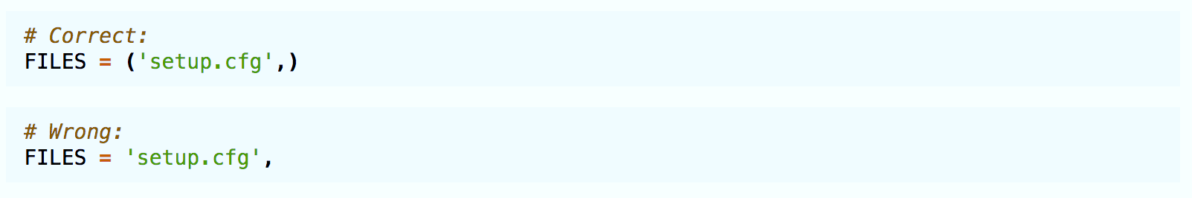
TRAILING COMMAS
Trailing commas are usually optional, except they are mandatory when making a tuple of one element. For clarity, it is recommended to surround the latter in parentheses:
Notes:
PEP 8 doesn't specifically address trailing commas, but trailing commas are a common practice in Python, especially when defining data structures like lists, tuples, and dictionaries
Trailing commas make it easier to add, remove, or reorder items in a data structure. When you add a new item or move an item within a list, you don't need to worry about adding or removing commas; just add the item,

Slide 30
COMMENTS
Each line of a block comment starts with a # and a single space.
Use inline comments only if it is unavoidable.
Write docstrings for all public modules, functions, classes, and methods.
Docstrings are not necessary for non-public methods, but you should have a comment that describes what the method does.
Notes:
Comments are used to explain the purpose, functionality, or logic of code. They provide context for readers, making it easier for them to understand what the code is doing.
Comments in Python typically start with the # symbol. A space is often placed after the # for better readability.
Inline Comments: Inline comments are short comments placed on the same line as the code they explain. While they can be helpful, it's important not to overuse them. Keep inline comments concise and relevant.
For functions, classes, and modules, Python has a special type of comment called a "docstring." Docstrings are used to provide documentation for these elements and can be accessed using tools like help() or documentation generators. They are enclosed in triple quotes and placed at the beginning of a function, class, or module. We’ll get into this more next week.

Slide 31
NAMING CONVENTIONS
Never use the characters ‘l’ , ‘O’ , or ‘I’ (uppercase letter eye) as single character variable names. In some fonts, these characters are indistinguishable from the numerals one and zero.
Class names should normally use the CapWords (CamelCase) convention.
Variables and function names should have all lowercase letters and underscores to separate words. (snake_case)
Constant should have all uppercase letters with words separated by underscores (SCREAMING_SNAKE_CASE)
Use the suffix “Error” on your exception names (if the exception actually is an error).
Use self for the first argument to instance methods or class methods.
Notes:
When it comes to naming conventions
Variables and function names should be descriptive and indicate the purpose of the variable. Use lowercase letters and separate words with underscores (snake_case).
Class names should follow the CapWords convention, also known as CamelCase, where the first letter of each word is capitalized without underscores
Constants, which are variables with values that should not change, are typically written in ALL_CAPS with words separated by underscores. This is called the screaming snake case
Module names should be short and lowercase, without underscores. If a name consists of multiple words, use a short and descriptive name.
Choose names that clearly convey the purpose of the variable, function, or class. Avoid cryptic abbreviations, and prioritize clarity over brevity
And again maintain consistency in naming throughout your codebase. This’ll help ensure that your code is uniform and easier to understand.

Slide 32
OTHER GENERAL RECOMMENDATIONS
Comparisons to singletons like None should always be done with is or is not, never the equality operators.
Use is not operator rather than not ... is for e.g if foo is not None rather than if not foo is None:
When catching exceptions, mention specific exceptions whenever possible instead of using a bare except.
Object type comparisons should always use isinstance() instead of comparing types directly.
Notes:
Other recommendations include:
Comparisons to singletons like None should always be done with is or is not, never the equality operators.
The is and is not operators check for identity, so they determine if two variables reference the same object in memory. On the other hand, the equality operators (== and !=) check for equality, meaning they compare the values of the variables, not their memory addresses.
In Python, certain objects, like None, are singletons. This means that there is only one instance of these objects in memory. Whenever you use None, you are referring to the same object.
To maintain consistency and clarity in your code, it's a recommended practice to use is or is not when checking for the presence or absence of singleton objects like None. It makes your intent explicit and prevents unexpected behavior.
Use is not operator rather than not ... is for e.g if foo is not None rather than if not foo is None:
The is not operator directly conveys your intent and is considered more readable and straightforward
We didn’t really cover exceptions today but for those who know what it is
When catching exceptions, you should mention specific exceptions whenever possible instead of using a bare except.
Using a bare except can catch unexpected exceptions, including those you might not have anticipated. This can lead to unexpected issues in your code.
Comparing object types using isinstance() is recommended over comparing types directly
Python supports polymorphism, which means that objects of different classes can be related through inheritance. Using isinstance() takes inheritance into account and allows you to check if an object is an instance of a specific class or any of its subclasses. Direct type comparison may not consider inheritance relationships.
We’ll cover inheritance next week when we go over object oriented design patterns

Slide 33
function names should have all lowercase letters and underscores to separate words
Each line of a comment starts with a # and a single space.
PEP8 COMPLIANCE
Use 4 spaces (not tabs) per indentation level
4
Avoid excessive whitespace immediately inside of parenthesis, brackets, or braces.
Always surround binary operators with a single space on either side
Limit all lines to a maximum of 79 characters
Variables should have all lowercase letters and underscores to separate words
61 < 80 Characters
Notes:
Considering all the PEP8 guidelines we just went over
IS the function we wrote in the beginning of class PEP8 compliant?
It looks like it uses 4 spaces per indentation level
Variables all have lowercase letters and underscores to separate words
Each line of a comment starts with a # and a single space
All lines are under 80 characters
There are no excessive whitespaces immediately inside parenthesis, brackets or braces
Binary operators are surrounded with a single space
BUT the function name is camelCase not snake case
So this function is not PEP8 compliant, but this isn’t necessarily a bad thing if we’re following a different style guide in which functions names are camelcase
Remember that when it comes to coding style, consistency is the most important thing too consider

Slide 34
PEP8 FORMATTERS & LINTERS
Linters:
Pycodestyle (Formerly PEP8) is the official linter tool to check the python code against the style conventions of PEP8 python.
Pylint is a python linter which checks the source code and also acts as a bug and quality checker. It has more verification checks and options than just PEP8(Python style guide).
Formatters:
black is a python code auto-formatter. Black reformats entire files in place and also formats the strings to have double-qoutes.
autopep8 automatically formats Python code to the PEP8 style. It fixes most of the formatting issues that are reported by pycodestyle.
Notes:
It can be a little overwhelming to remember and follow all these style guidelines and rules,
But we now have some very helpful tools that make it much easier to follow style guides
Linters are like code proofreaders,
Just like you'd use a grammar checker to find and fix mistakes in your writing, a linter looks at your code and finds potential errors or style problems.
It can catch things like missing semicolons, undefined variables, or unused code.
Linters help you write code that's less error-prone and follows coding standards.
"pylint" and ”Pycodestyle" are examples of Python linters that can check PEP 8 compliance.
Style formatters are tools that help you make your code look nice and organized.
Just as you use a formatting tool for your documents to set fonts, spacing, and headings, a style formatter helps you set the right style for your code.
Style formatters like "autopep8" or "Black" automatically format your Python code to adhere to the PEP 8 style guidelines.
Using linters and style formatters make it very easy to be consistent with or compliant to specific coding conventions and standards

Slide 35
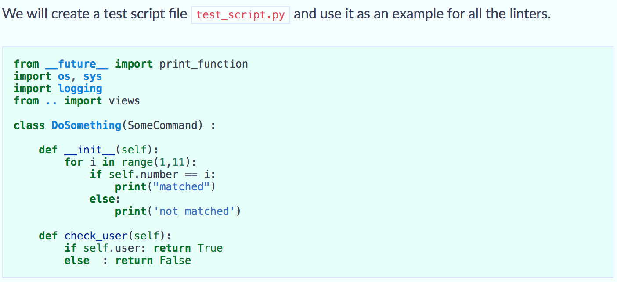
Pycodestyle (Formerly PEP8)
Notes:
We’ll look at formatters next week when we cover how to use integrated development environments or IDEs
But for now we’ll go into using pycodestyle, which is the official linter tool to check the python code against the style conventions of PEP8
Here’s a test file that contains some import statements in the incorrect order, a class definition with too many whitespaces, and some functions with more extra white spaces and other issues

Slide 36

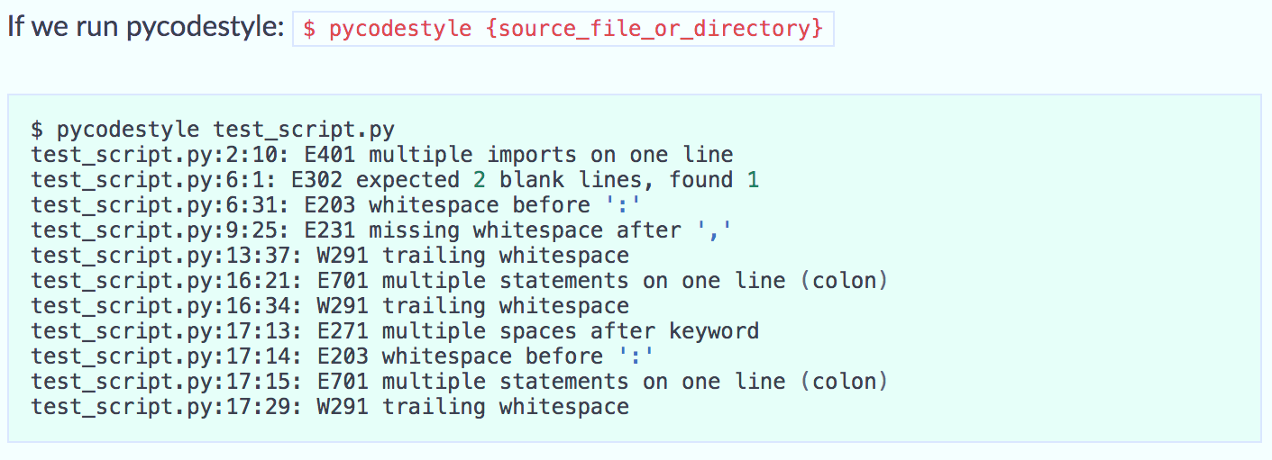
Pycodestyle (Formerly PEP8)
Notes:
Now if we install pycodestyle and run it against our test_scipt
We see that it spits out all the style problems associated with test_script

Slide 37
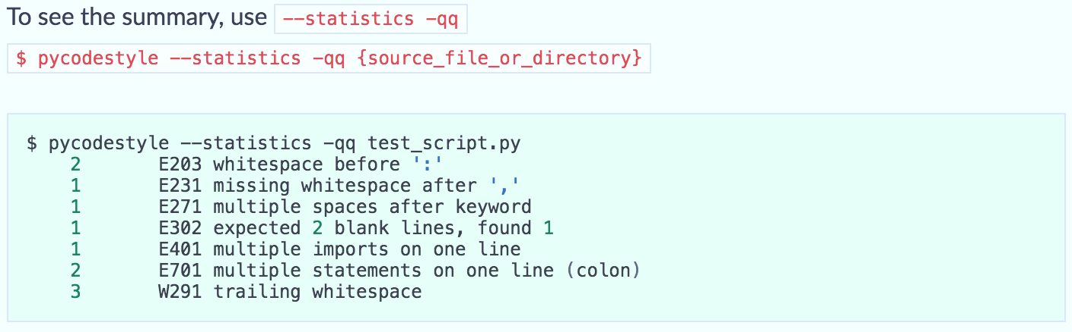
Pycodestyle (Formerly PEP8)
Notes:
We can also use the –statistics option to get a summary of the style errors
There are a lot oof whitespace issues with test_script

Slide 38
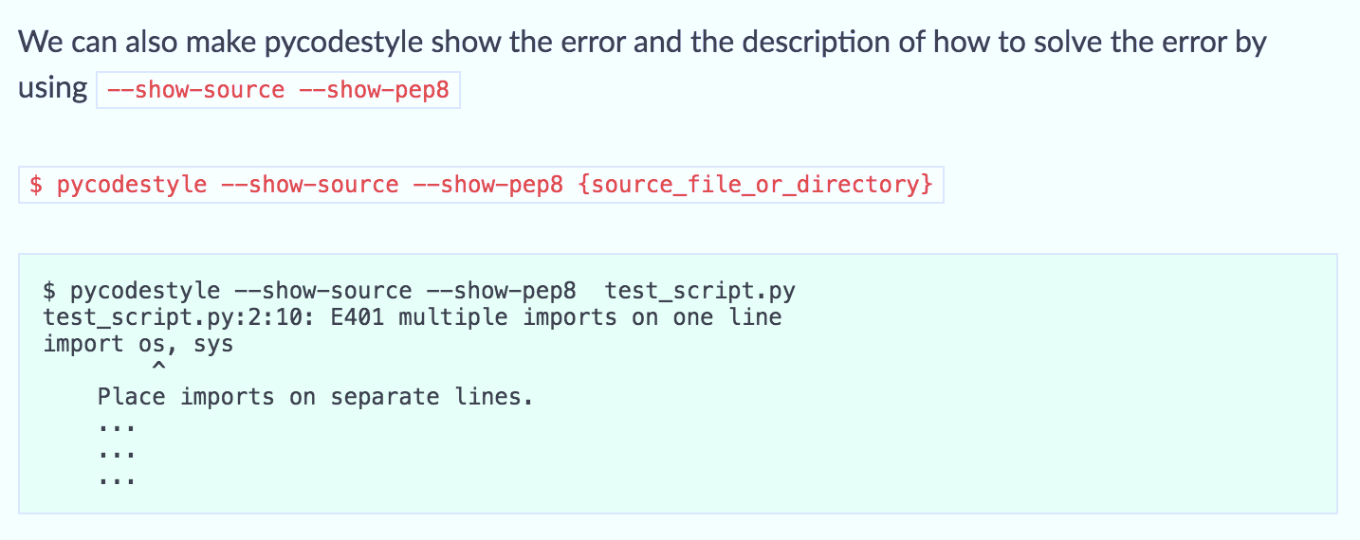
Pycodestyle (Formerly PEP8)
Notes:
And We can use the –show-source –show-pep8 options to show the errors and the description of how to solve them
So here pycodestyle is telling us to fix the multiple imports on one line error by placing imports on separate lines

Slide 39
ROCK, PAPER, SCISSORS!
Let’s create a simple command-line Rock-Paper-Scissor! In this game, the user gets the first chance to pick the option between Rock, paper, and scissors. After the computer select from the remaining two choices(randomly), the winner is decided as per the rules.
Winning Rules as follows:
Rock vs paper-> paper wins
Rock vs scissor-> Rock wins
paper vs scissor-> scissor wins.
Hint: Use randint(), an inbuilt function for generating random integer values within the given range.
Make sure it passes the Pycodestyle checker!!!
Notes:
That’s the end of lecture
We’re going to attempt an in-class activity or maybe homework depending on how much time we have left
We’re going to create a simple command-line Rock-Paper-Scissor game. In this game, the user gets the first chance to pick the option between Rock, paper, and scissors. After the computer select from the remaining two choices(randomly), the winner is decided as per the normal rules of the game.
The hint is that the computer will select choices using a random generator function
Your final code needs to be functional and must pass the pycodestyle checker

Slide 40
03
OBJECT-ORIENTED DESIGN PATTERNS

Slide 41
04
DEBUGGING

Slide 42
05
INTRODUCTION TO IDES

Slide 43
06
VIRTUAL ENVIRONMENTS

Slide 44
THANKS
Do you have any questions?
addyouremail@freepik.com
+91 620 421 838
yourcompany.com
Please keep this slide for attribution

