Slide 1
EVRC Python Course Training 2: What is Python? Background and Basic Module Structure
Aaron Rabinowitz, Vaishnavi Karanam

Slide 2
Section 0: Syllabus

Slide 3
Syllabus - Learning Objectives
Programming in Python:
Programming fundamentals
Python object structure and flow control
Data manipulation in Python
Leveraging Python site-packages
Run-time optimization
Programming Workflow:
Finding a development environment that works for you
Writing code others can use
Using the internet as a resource
Version control

Slide 4
Syllabus - Course Outline
Trainings:
What is Python? Background and Basic Module Structure (Aaron)
Data Types Deep Dive (Aaron)
CodeMari: Basic hacks to reduce coding chaos (Vaish)
Pandas and Beyond (Vaish)
Speeding up Code (Aaron, Vaish)
Version Control (Aaron)
Using Databases with Python (Vaish, maybe Kai)
Critical Internet-ing (TBD)
Advanced Topics at Request (TBD)

Slide 5
Section 1: Data Storage

Slide 6
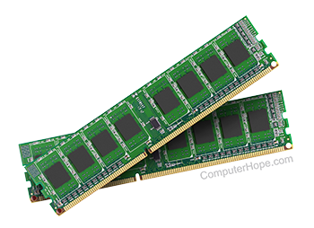
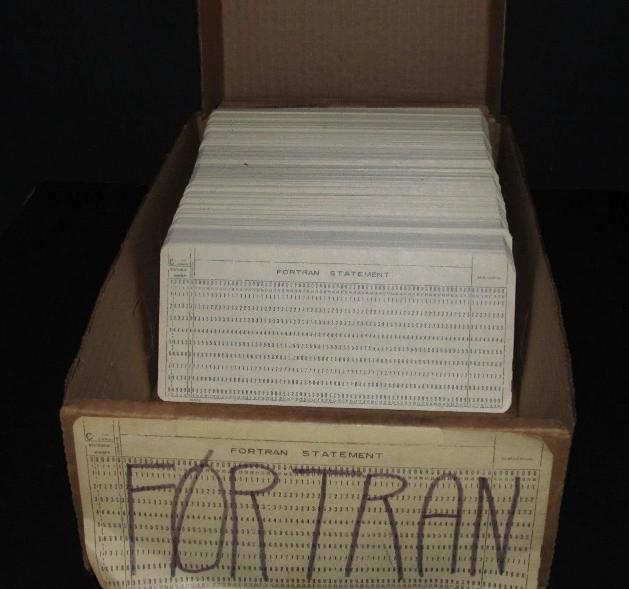
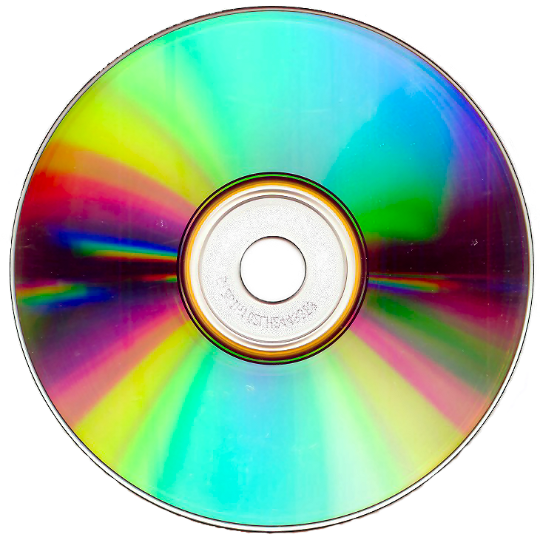
Data Storage - RAM vs. ROM
Computers store numbers in binary format using two types of memory:
Read-Only Memory (ROM)
Random Access Memory (RAM)
Physically the main difference is that ROM is stable* meaning that it will retain data if the power is turned off while RAM is unstable and data will be lost after the power is turend off for a sufficient duration
Generally speaking RAM has much higher throughput and most of the time processes will load data from ROM to RAM before processing
*Solid-state ROM is basically RAM with huge capacitance such that it can take years before data is lost - but it will eventually be lost. SSDs are used because they have high throughput compared to stable ROM

Slide 7
Data Storage - Addressing
Data in memory is only useful if it can be retreived
Each memory register has an unique address
Moden computers are generally “byte-accessible”
Data and instructions are sometimes stored together (flat-memory model) and sometimes stored separately (segmented-memory model)
Physical memory addressing is handled at the sub-operating-system level (BIOS and other firmware devices) and is inherently hardware-specific
Memory can be conceived as a table with addresses and values - this is what the BIOS maintains. All firmware devices (mouse, keyboard, flash memory, etc.) interact with the BIOS in order to access the memory table.
Physical Circuits
Computer Architecture
Stored Instructions
Operating System
Logical Code
Applications

Slide 8
Data Storage - Virtual Addressing
Fundmentally an Operating System (OS) is an abstraction: a “program which runs other programs”
In order to accomplish this, the OS cretes a virtual addressing scheme
Virtual addressing schema mean that programs which run in a given OS will run no matter what hardware is being used
Virtual addressing works by creating a virtual address table which maps to the physical address table used by the BIOS
The OS will also provide a file allocation scheme which assigns blocks of memory to files and folders and handles read, write, execute (rwx) permissions
When a high-level language writes data to an address the address is abstracted, at least once, by the OS virtual addressing scheme and possibly by the translator as well (in Python for example)
Any program which uses a virtual addressing scheme, such as CPython, can be described as a “Virtual Machine”
Physical Circuits
Computer Architecture
Stored Instructions
Operating System
Logical Code
Applications

Slide 9
Section 2: Taxonomy

Slide 10
Taxonomy - Values vs. Pointers
A value type maps directly to data at an address in memory
Changing the value of a value type means that the physical configuration of the memory register that stores the type changes:
a=1 => a++ => a=2
A pointer type references the address of a value type - multiple pointers can reference the same address
Changing a pointer changes the memory state at the address where the referenced value is held:
a=1 => b=a => b++ => b=a=2
If the referenced value type is changed, then so is the value associated with the pointer
a=1 => b=a => a++ => b=a=2

