Slide 1
Pmx_tool Test Report
Tested by Kevin

Slide 2
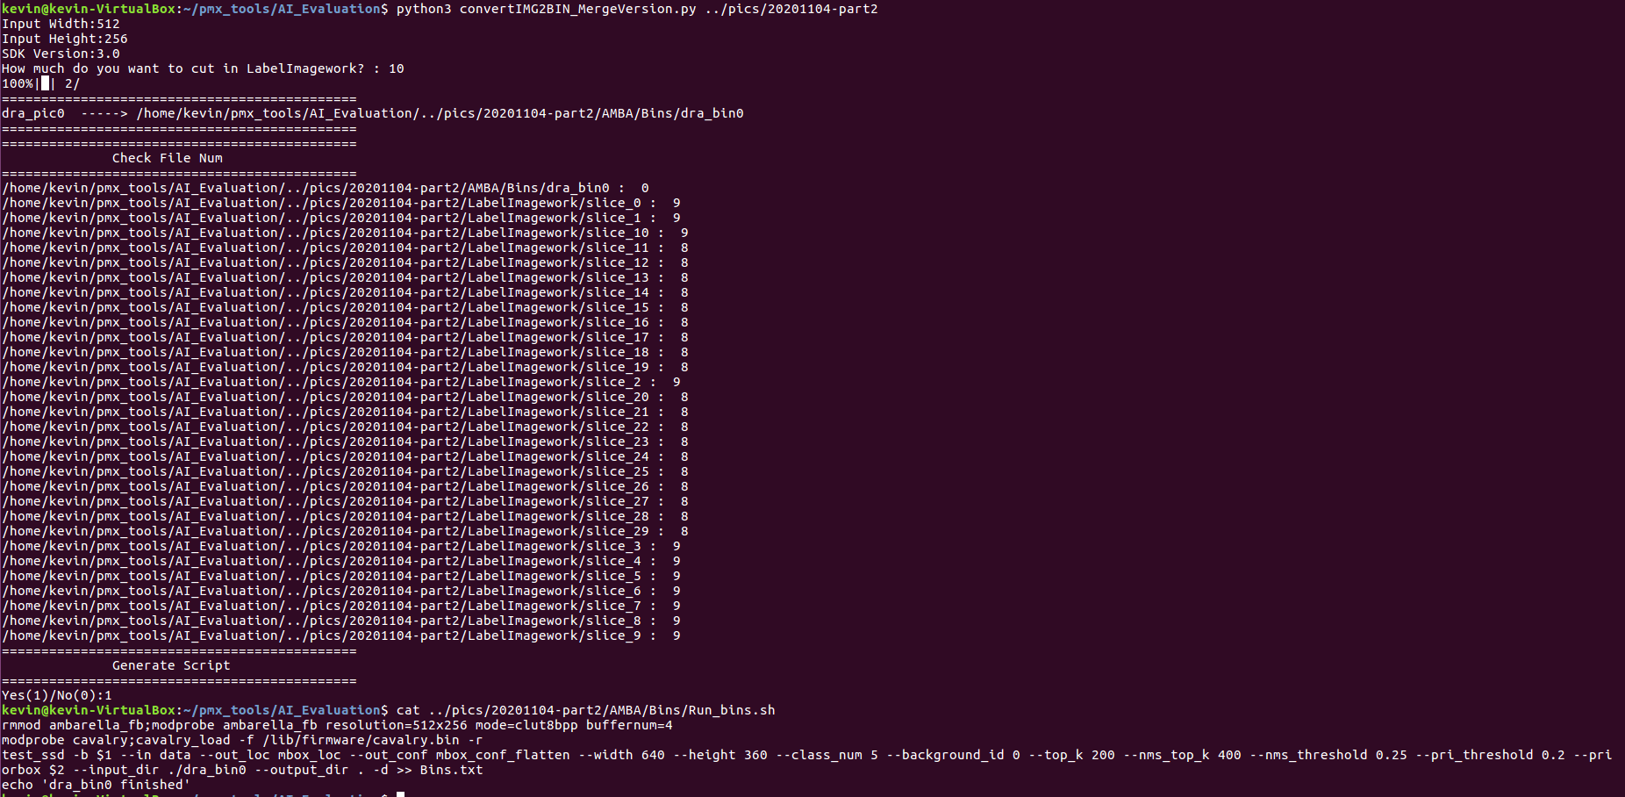
Convert images to bins(Failed 1)
Run_bins.sh show wrong resolution.

Slide 3
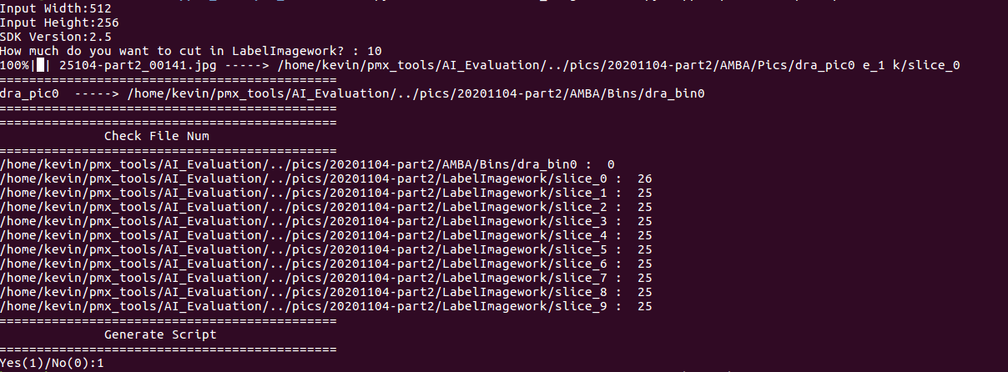
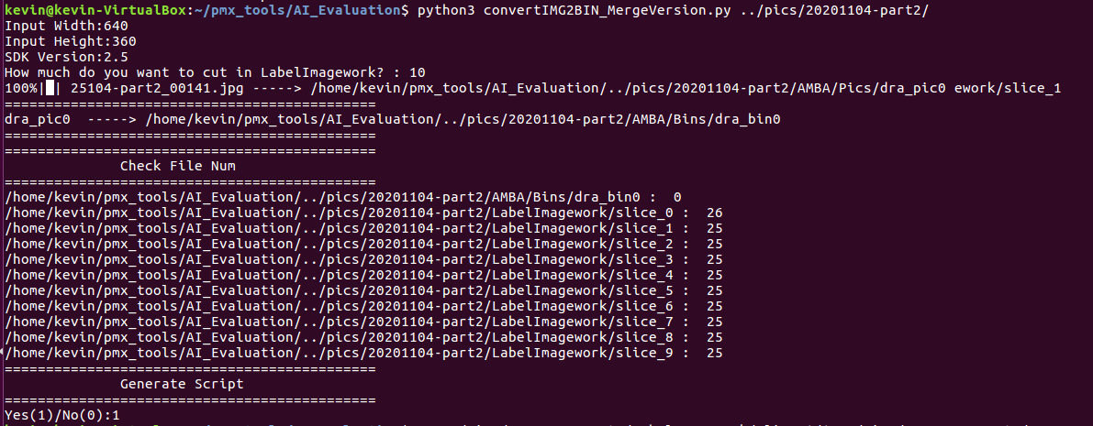
Convert images to bins(SDK2.5)
Confirm number of slices in LabelImgwork has been the same as input .

Slide 4
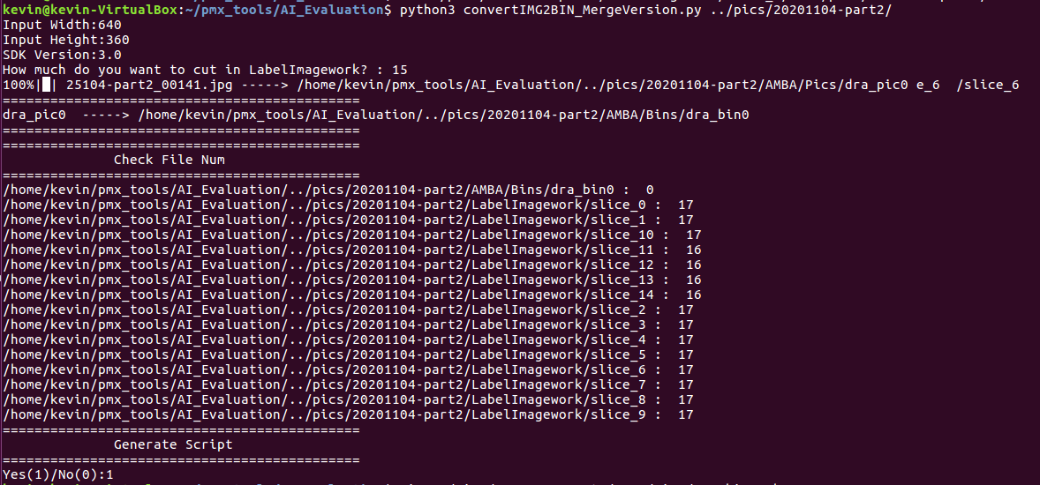
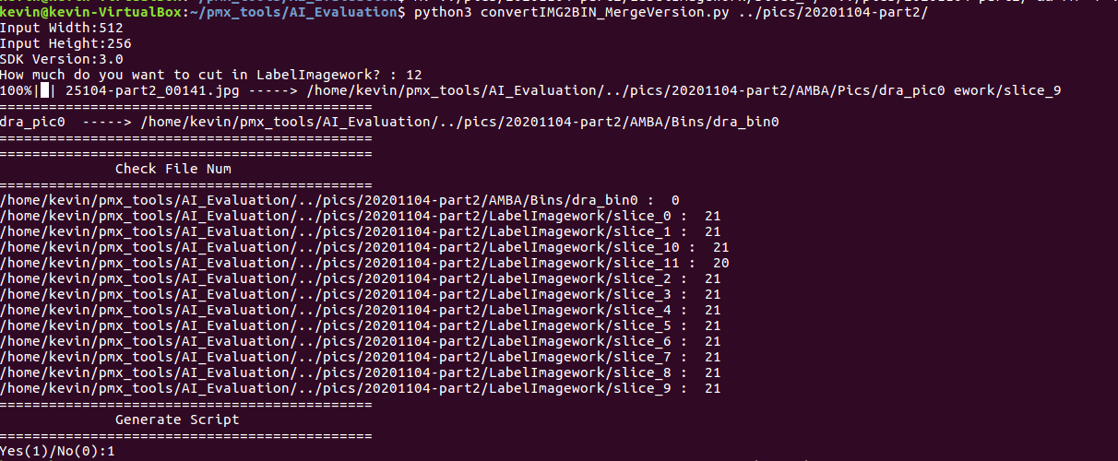
Convert images to bins(SDK3.0)
Confirm number of slices in LabelImgwork has been the same as input .

Slide 5

Convert SSD Log from Raw Log
SDK2.5
SDK3.0
Try to use other version.

Slide 6
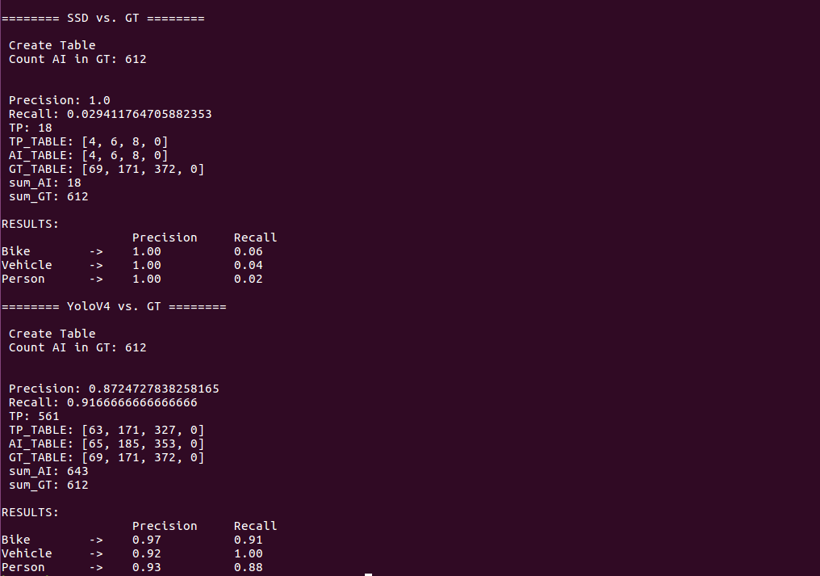
Evaluation of Precision and Recall
Vertex=None
Ensure GT_TABLE

Slide 7
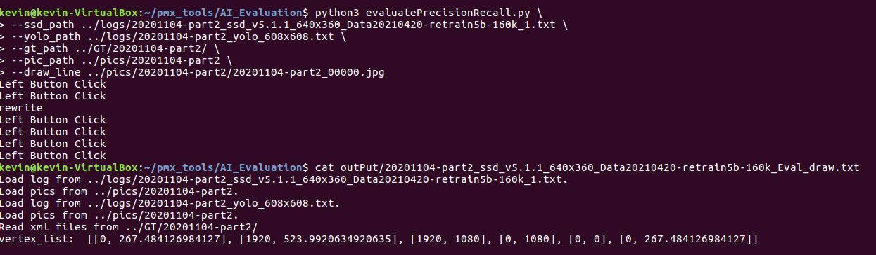
Evaluation of Precision and Recall
Set vertex by draw

Slide 8
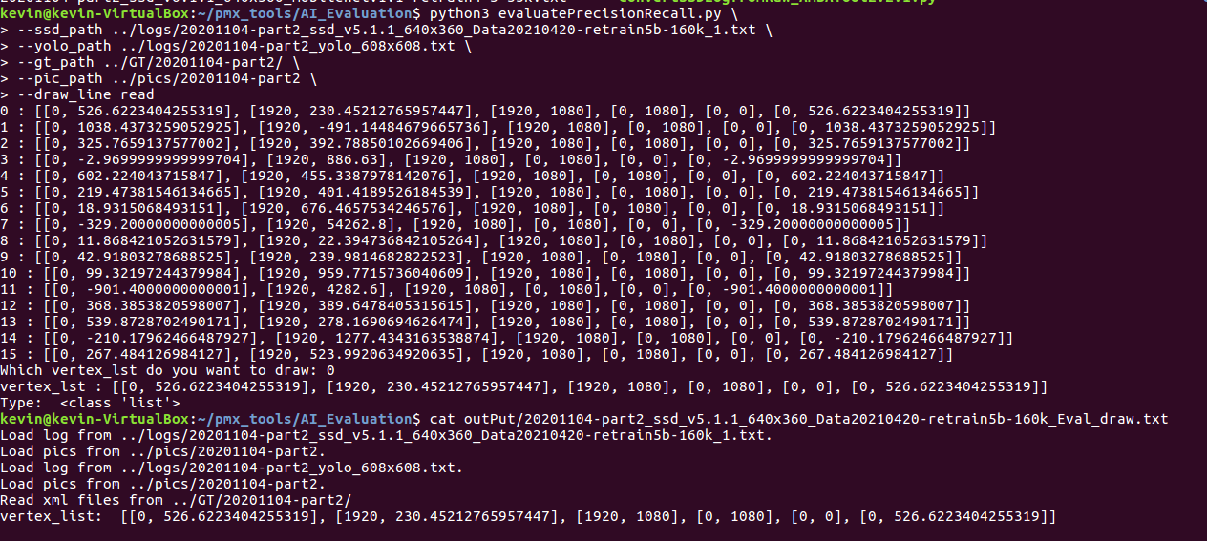
Evaluation of Precision and Recall
Set vertex by read

Slide 9
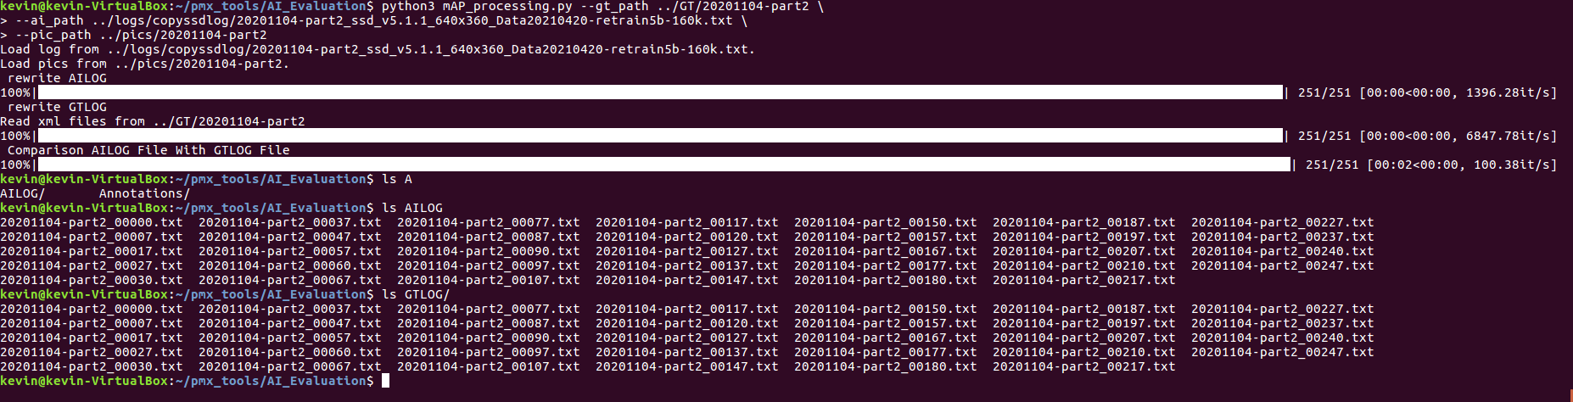
Calculation of mAP
Confirm that AILOG and GTLOG collect files with same filename

Slide 10
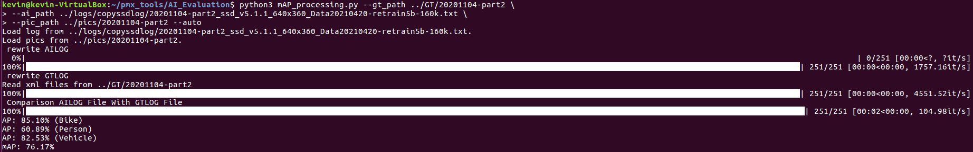
Calculation of mAP
Confirm auto-mode will calculate mAP and show it.

Slide 11
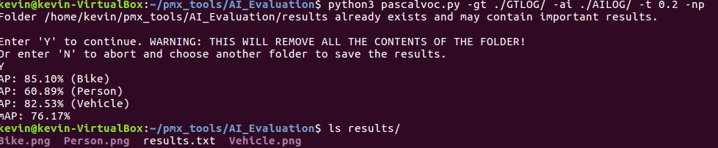
Calculation of mAP
Confirm pascalvoc.py will calculate mAP and PNG files at correct directory.

Slide 12
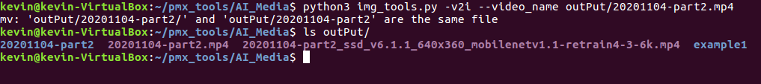
Transformation from video to images
Confirm picture at correct directory.

Slide 13
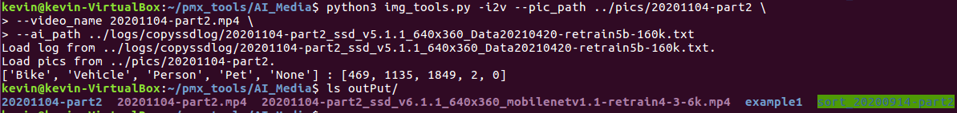
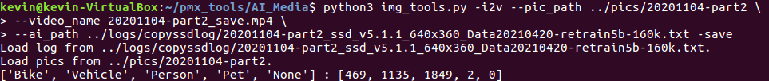
Transformation from images video
Confirm {-show} {-save} fuction and generate correct video.

