Slide 1



PERSONAL FINANCE TRACKER
Presented By,
KEVIN JACOB D (811722104075)
RAGHUL P (811722104116)
SACHIN B (811722104126)
Guided By,
Mr. A.Malarmannan, M.E.,
09/06/2025

Slide 2
ABSTRACT
The project is a responsive web-based designed to help users manage their income, expenses, and savings effectively.
Users can add, edit, and categorize transactions with details such as date, description, amount, and emotion tagging to reflect their state of mind
The application provides real-time balance updates and uses Chart.js to display category-wise and emotion-based spending through pie and bar charts.
It ensures easy access across devices and includes CSV/PDF export features for personal record-keeping and budget analysis.
09/06/2025

Slide 3
OBJECTIVE
Enable users to log income and expenses with emotion tagging.
Visualize spending patterns using category-wise and emotion-based charts.
Promote financial awareness through emotion-linked transaction tracking.
Provide a simple and responsive interface for easy daily use.
Help users reflect on financial habits through data-driven insights
09/06/2025

Slide 4
LITERATURE SURVEY
S.No. | Paper Title | Year | Remark
1 | Personal Finance Tracker | 2024 | A finance tracking application developed by a group of students, focusing on expense tracking, budget monitoring, and user-friendly financial planning tools.
2 | Money Talks: Tracking Personal Finances | 2014 | A study presenting the development and implementation of a finance tracker app with key features including budgeting, income-expense analysis, and charts.
3 | Personal Finance Management Application | 2024 | A concise and practical study on personal finance app development, highlighting key features for effective financial self-management.
09/06/2025

Slide 5
LITERATURE SURVEY
S.No. | Paper Title | Year | Remark
4 | The Design and Implementation of Personal Finance Management System Based on Android | 2016 | Android-based app for real-time expense tracking and account management; aims to prevent blind spending by offering daily/monthly/yearly insights.
5 | Personal Finance Management Application | 2024 | Android app under testing; supports budgeting, financial reporting, chart-based visualization, and barcode scanning; includes user-centered design based on feedback.
6 | Design of a Rule-based Personal Finance Management System based on Financial Well-being | 2021 | Focuses on improving financial well-being, especially post-COVID; rule-based system to help avoid poor financial decisions and increase financial security.
09/06/2025

Slide 6





EXISTING SYSTEM
MySQL Database
Data Input
Export As
User Interface
09/06/2025

Slide 7




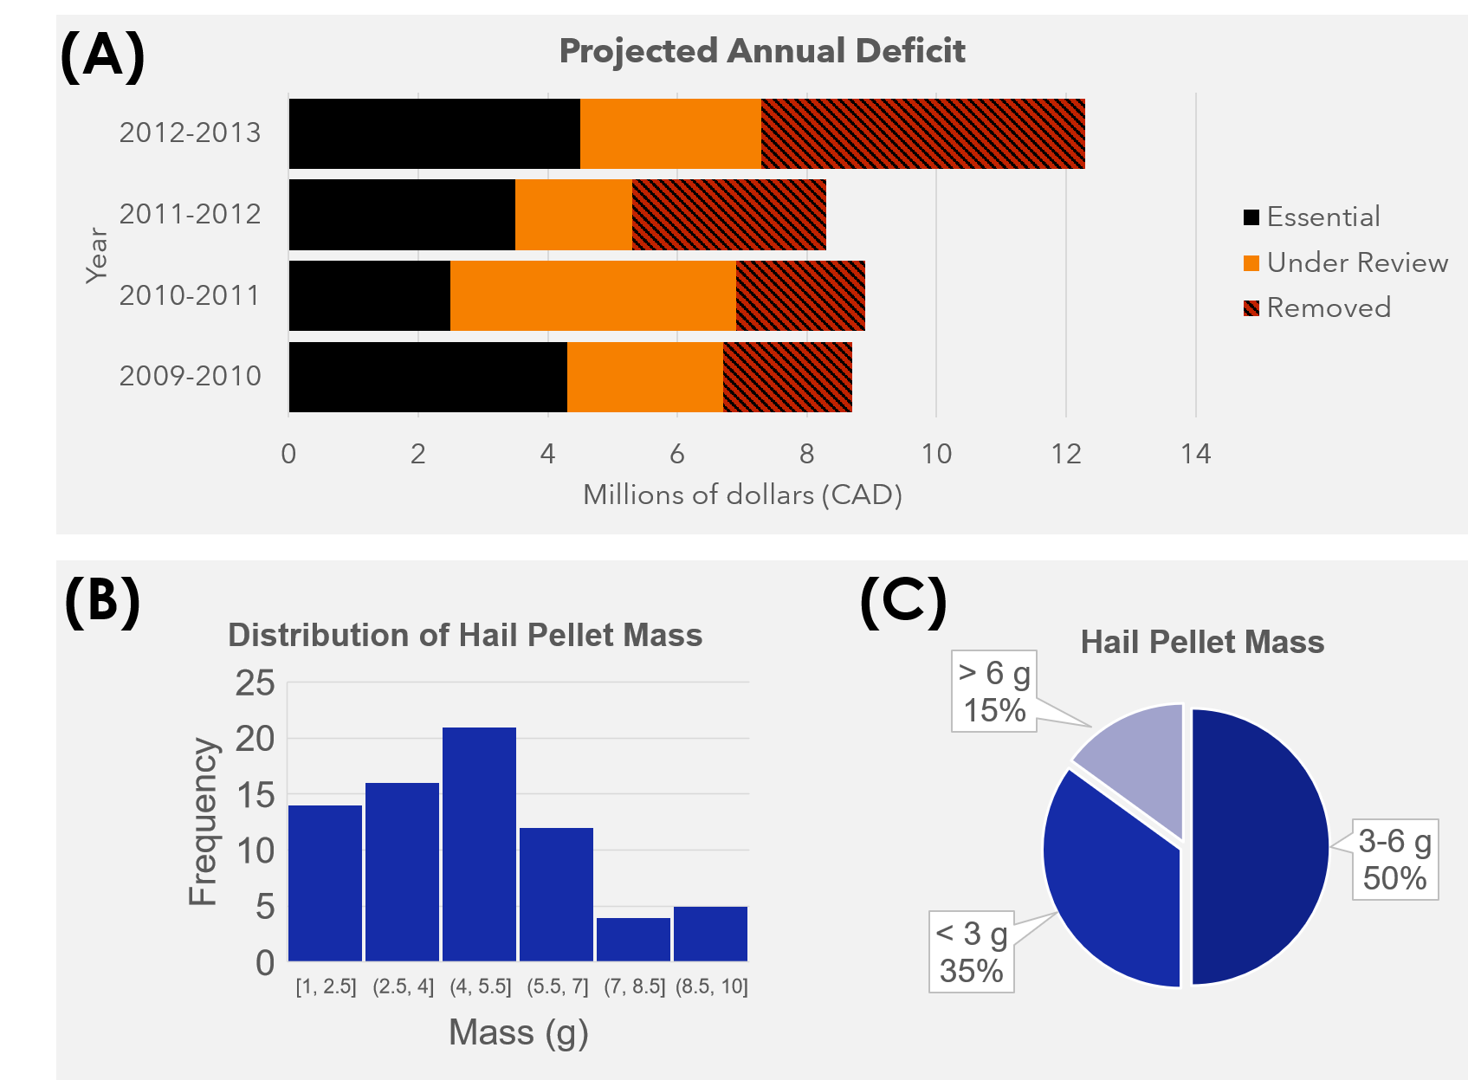
PROPOSED SYSTEM
User Interface
Authentication
Firebase /Netlify
Data Input
Import / Export
User Profile
Data Visuals
Postgresql Database
7
09/06/2025
This Photo by Unknown Author is licensed under CC BY-NC

Slide 8
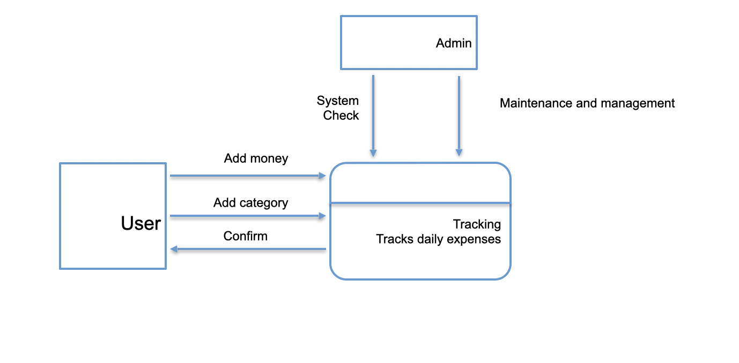
SYSTEM ARCHITECTURE
09/06/2025

Slide 9
MODULE 1 : USER INTERFACE MODULE
Technology: HTML, CSS, JavaScript
Offers an intuitive and visually appealing interface for seamless navigation.
Incorporates clear call-to-action buttons, form inputs, and layout components.
Utilizes responsive grid and flexbox designs for mobile and desktop compatibility.
Ensures accessible color contrast, readable fonts, and minimalistic design aesthetics.
09/06/2025

Slide 10
MODULE 2 : TRANSACTION MANAGEMENT MODULE
Technology: JavaScript, Firebase (Realtime Database / Firestore)
Allows users to add, edit, and delete income and expense entries in real-time.
Each transaction includes date, amount, category, tags, and optional notes.
Automatically categorizes entries to streamline organization and filtering.
Integrates validation to ensure accurate and complete transaction data.
09/06/2025

Slide 11
MODULE 3 : EMOTION TRACKING MODULE
Technology: JavaScript, HTML Forms
Enables users to tag each transaction with an emotion (e.g., happy, stressed).
Provides a dropdown or emoji-based selector for quick emotional input.
Associates emotional data with financial decisions for behavioral analysis.
Prepares emotion-tagged data for visualization and trend mapping.
09/06/2025

Slide 12
MODULE 4 : STATISTICS & VISUALIZATION MODULE
Technology: Chart.js, JavaScript
Generates dynamic charts showing income vs. expense trends, category-wise distribution, and emotional patterns.
Supports bar charts, pie charts, and line graphs for clear financial insights.
Allows filtering by date ranges, categories, and emotions.
Auto-updates charts based on user transactions in real-time.
09/06/2025

Slide 13
MODULE 5 : DATA PERSISTENCE AND EXPORT MODULE
Technology: Firebase, JavaScript
Stores all transaction and user data securely using Firebase services.
Supports real-time synchronization for consistent experience across devices.
Offers download/export options in CSV or JSON formats for backups or
external analysis.
Ensures persistence through user login-based storage, maintaining data integrity and privacy.
09/06/2025

Slide 14
OUTPUT
09/06/2025

Slide 15
OUTPUT
09/06/2025

Slide 16
CONCLUSION & FUTURE ENHANCEMENT
Add user authentication using Firebase Authentication for secure, individual financial tracking
Include advanced visualizations showing monthly trends and category-wise spending
Store transaction data securely in Firestore with user-specific collections
Add budget planning and alerts for monthly spending limits, savings goals, and reminders
Introduce dark mode and UI customization for improved accessibility and user preference
Enable recurring transaction scheduling for fixed monthly payments or subscriptions
Integrate AI-based insights to suggest saving tips, detect overspending, or recommend budgeting strategies
09/06/2025

Slide 17
REFERENCES
S. Verma, S. S. Kheda, and S. Kuwale, “Personal Finance Tracker,” International Research Journal of Modernization in Engineering Technology and Science, vol. 6, no. 5, pp. 10279–10286, May 2024.
J. J. Kaye, M. McCuistion, R. Gulotta, and D. A. Shamma, “Money Talks: Tracking Personal Finances,” in Proceedings of the SIGCHI Conference on Human Factors in Computing Systems, pp. 521–530, 2014.
T. Stefanov, M. Stefanova, S. Varbanova, and S. Temelkov, “Personal Finance Management Application,” TEM Journal, vol. 13, no. 3, pp. 2066–2075, 2024.
A. Althnian, “Design of a Rule-based Personal Finance Management System Based on Financial Well-being,” International Journal of Advanced Computer Science and Applications (IJACSA), vol. 12, no. 1, pp. 172–178, 2021.
V. Kozhevnikov, N. Slupko, and A. Sergeev, “Design and Development of Personal Finance Management System,” Theoretical & Applied Science, no. 6, pp. 110–115, 2019.
09/06/2025

Slide 18

DD/MM/YYYY

