Slide 1


SMART INDIA HACKATHON 2024
TITLE PAGE
Problem Statement ID –SIH1594
Problem Statement Title-Student Innovation
Theme-Transportation and Logistics
PS Category- Software
Team ID-
Team Name-Park Lordz

Slide 2
ONLINE APPLICATION FOR PARKING SLOT REGISTRATION
Park Lordz
To develop an online application for parking slot registration
To make parking more compatible by providing information about the parking slots availability
Making our application more user friendly by adding the features like wake up call before 15 mins of booking time and providing slot’s live route in the tickets which will be in QR form

Slide 3
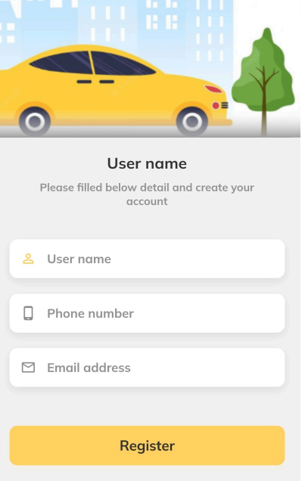
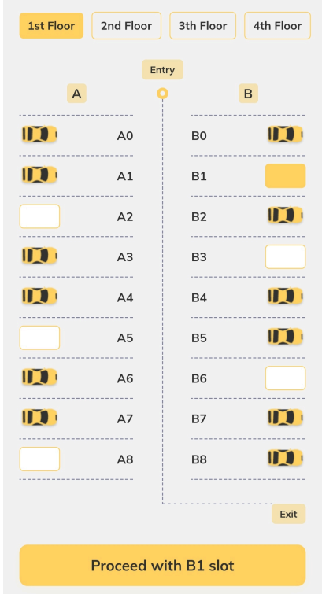
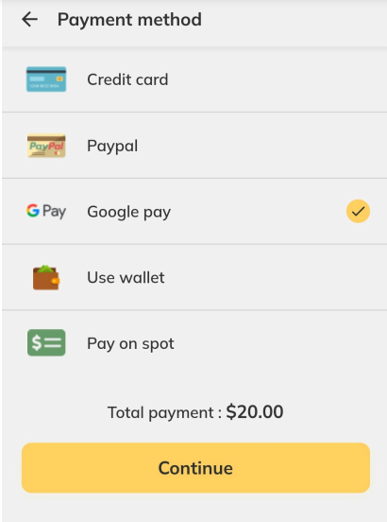
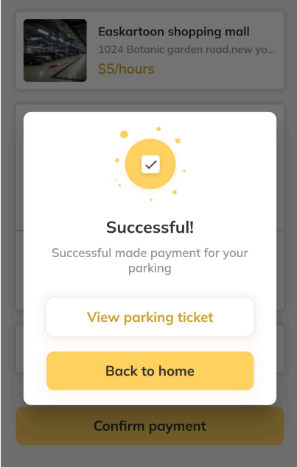
TECHNICAL APPROACH
Park Lordz
Programming Language – Dart ; Framework - Flutter
Methodology – It is working in the basis of TMS (Transcranial Magnetic Stimulation)
Flow Chart
Images
Working Prototype
Login
& verification
Verification
Search availability & status
Booking
Prior arrangement & payment
Vehicles details & surveillance
Confirmation
Confirmation tickets

Slide 4
FEASIBILITY AND VIABILITY
Park Lordz
Live surveillance of the parking vehicles through man power and Cloud storage of the users for enabling cookies and bookings history
The challenge of implementing surveillance system and cloud may result in the additional cost efficient
These can be rectified by made the subscription system and cost can be collected as monthly or yearly basis

Slide 5
IMPACT AND BENEFITS
Park Lordz
Potential impact on the target audience
Benefits of the solution (social, economic, environmental, etc.)

Slide 6
RESEARCH AND REFERENCES
Park Lordz
Automatic Car Parking System using PLC
This system will show the driver exact place to park his/her vehicle at the entry point of parking in the screen outside of the parking .This project is based on INDUSTRIAL AUTOMATION TECHNOLOGY.
https://doi.org/10.17577/ijertv9is060193
Design and Implementation of an Android Smart Parking Mobile Application
Smart parking is an important sector of smart city technologies . The efficient management of the available parking spaces is demonstrated and can be extended to cover other areas and venues.
https://doi.org/10.18421/tem94-06

Slide 7
IMPORTANT INSTRUCTIONS
Please ensure below pointers are met while submitting the Idea PPT:
Kindly keep the maximum slides limit up to six (6). ( Including the title slide)
Try to avoid paragraphs and post your idea in points /diagrams / Infographics /pictures
Keep your explanation precise and easy to understand
Idea should be unique and novel.
You can only use provided template for making the PPT without changing the idea details pointers (mentioned in previous slides).
You need to save the file in PDF and upload the same on portal. No PPT, Word Doc or any other format will be supported.
Note - You can delete this slide (Important Pointers) when you upload the details of your idea on SIH portal.

