Slide 1
NETFLIX
GROUP 6

Slide 2

Group 6
Sravitha Matlapudi Stefanie Gagnon Khanh Le

Slide 3

Agenda
Data Overview
Loading & Cleaning Dataset
Data Analysis and Visualizations
Conclusions

Slide 4
Data overview

Slide 5
Netflix
Netflix is one of the most popular subscription streaming services and production companies.
Netflix provides streaming services for movies and tv shows from many countries around the world.
In our data analysis, we’ll be exploring details about what Netflix has available in different categories.
Notes:
1. Do movies or tv shows have a higher average vote?
2. What are all the current ratings offered?* Which type of ratings have the largest titles?
3. How is quantity of contents by year?
4. What are all the current genres offered?* Which type of genres have the largest titles
5. How many countries have productions on Netflix? Which country is the largest content production on the Netflix
6. Is there any correlation between run time and Imdb scores?
7. How long (duration) are they?* How s average run time?

Slide 6
Data Analysis Process
Step 1
Importing Datasets
Step 2
Loading Datasets
Step 3
Data Overview
Step 4
Data Cleaning
Step 5
Exploratory Data Analysis and Visualization
Step 6
Conclusion

Slide 7
Loading and Cleaning datasets
Notes:
We used csv files for creating the 2005 and 2021 Netflix dataframes
We removed any rows that had null or missing values
Also removed columns that were not useful or relevant
List out the columns
(We can use a screen shot of na values) (summary)
Show the 2 pie graphs of the before and after comparing how many tv shows to movies
(Sources at the end)

Slide 8
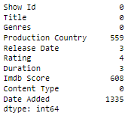
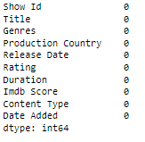
Data Clean up

Slide 9
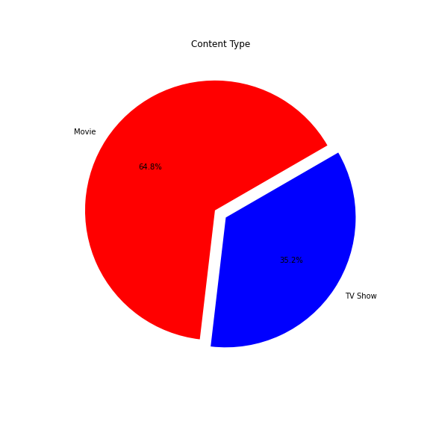
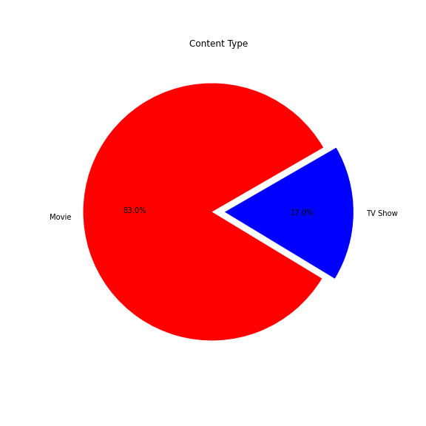
Before and After Data Clean-up
Notes:
First pie chart is before data clean up.
Second pie chart is when we first removed all the columns that we were not going to utilize and then removed all the NA’s.
We noticed that the percentage of tv shows dropped when we removed unnecessary, so we decided to focus on the more prevalent data which is movies.

Slide 10
Data analysis & visualization

Slide 11
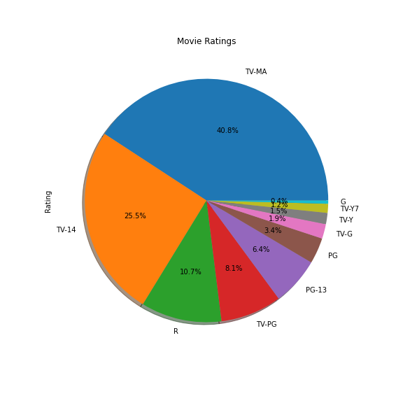
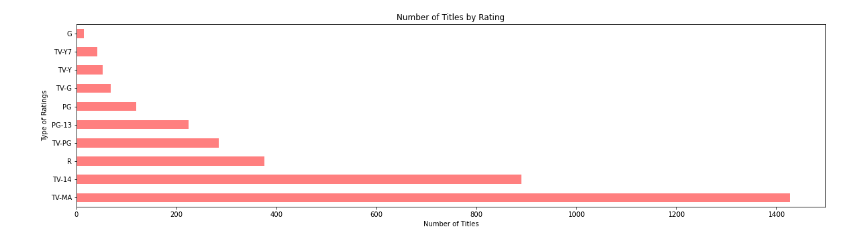
Content by rating
Movie rating types
Notes:
We may want to take out TV ratings, anything in the Rating types pie chart with TV in front of the rating

Slide 12
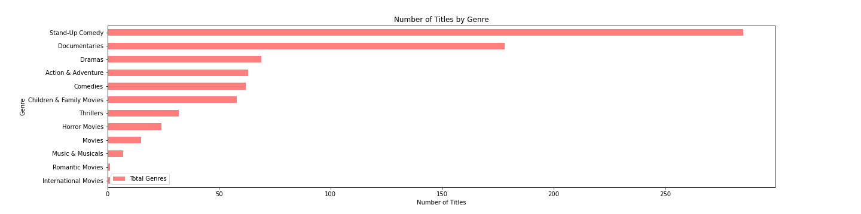
Top Genres with the largest number of titles

Slide 13
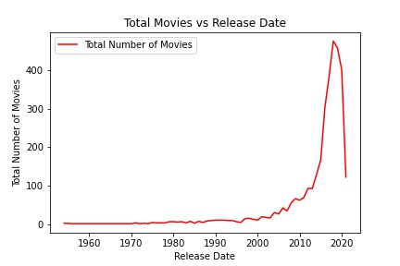
Number of movies per year

Slide 14
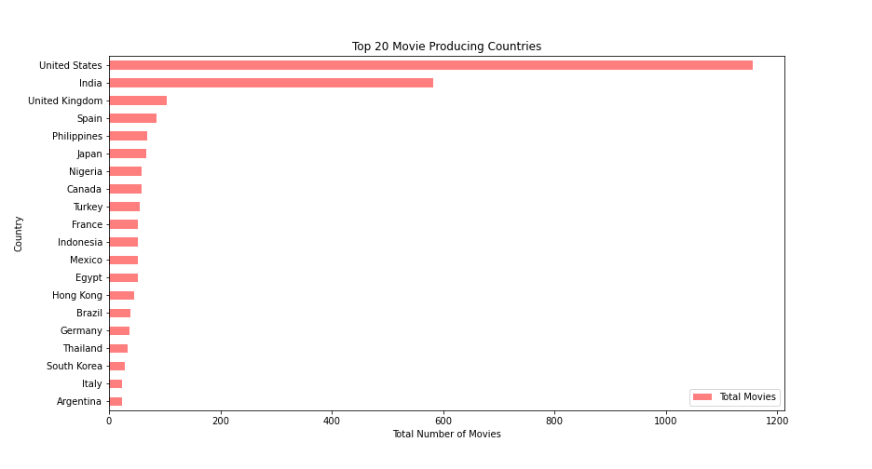
Top movie producing countries
Notes:
How many countries have productions on Netflix? Which country is the largest content production on the Netflix
**change out the graph (screen shot of new one)
Which countries produce the most number of movies
We also did a post clean up to remove rows that had multiple production countries.

Slide 15
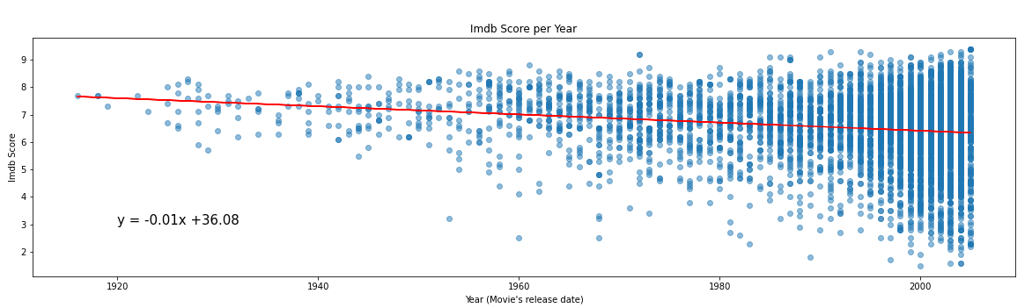
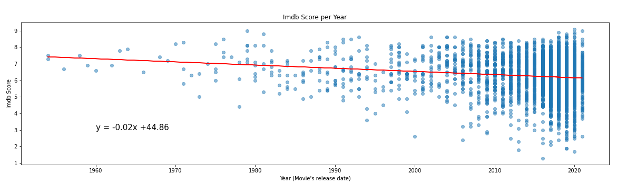
Ratings per year
IMDB rating of movies produced in the listed year
2005
2021
Notes:
2005 data and 2021 data
Comparing trends, looking at the regression line
Noting how they’re the same
Look at these data sets, we decided to remove tv shows for both, because…

Slide 16
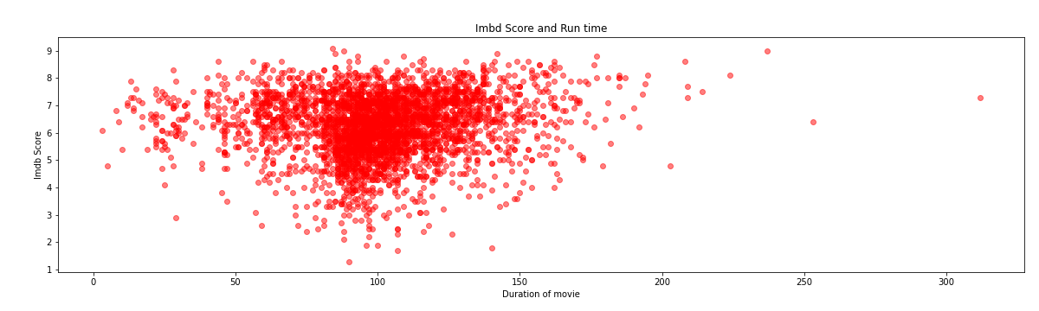
Imdb Score and Run time
Average run time for a movie is 101 mins
Notes:
As runtime nears 100 mins, avg is about 100 mins, there are more datapoints
We can see that with the cluster of data in the center
Look into finding the average (mean) runtime and also the mode

Slide 17
Conclusions

Slide 18
Findings
Possible Reasoning
Movie data
Top ratings: TV-MA, TV-14, TV-PG
Top genres: Stand-up comedy, documentaries, drama
Rapid increase in current movie titles since 2018
United States, India, United Kingdom
Little to no correlation for Imdb score and release date
Average run time 101 mins
Catering mostly to adults
More favorable for the subscriber
Transition to compete with HBO and Showtime
American publicly traded company
Nostalgic value of older movies
Notes:
Higher percentage of movie data available
Top 5 Rating types: TV-MA, TV-14, TV-PG, R, PG-13
Top 5 Genres with the most titles: Standup comedy, Documentaries, Drama, Action & Adventure, Comedies
Number of titles has increased year by year. And jumped rapidly since 2018
Top 5 movie producing countries: United States, India, United Kingdom, Spain & Japan
There is not much relationship between Imdb score and release date
Most of run times are from 50 -150mins , averaging 101 mins
Mode for movie ratings (Most frequently occurring movie rating, mode)
Average (mean) runtime for movie
1. Do movies or tv shows have a higher average vote?
2. What are all the current ratings offered?* Which type of ratings have the largest titles?
3. How is quantity of contents by year?
4. What are all the current genres offered?* Which type of genres have the largest titles
5. How many countries have productions on Netflix? Which country is the largest content production on the Netflix
6. Is there any correlation between run time and Imdb scores?
7. How long (duration) are they?* How s average run time?

Slide 19

Limitations
Questions for further Exploration
Sample
No analysis on tv shows
Missing exact number of viewers
Productions for Netflix by Netflix vs other producers
Add more older shows along with current content
Separate analysis on kids’ shows and trends

Slide 20
Thank you

Slide 21

References:
https://www.kaggle.com/datasets/satpreetmakhija/netflix-movies-and-tv-shows-2021
https://www.kaggle.com/datasets/akashguna/netflix-prize-shows-information
https://www.netflix.com/
https://matplotlib.org/stable/api/_as_gen/matplotlib.pyplot.scatter.html
https://matplotlib.org/stable/gallery/shapes_and_collections/scatter.html#sphx-glr-gallery-shapes-and-collections-scatter-py
https://stackabuse.com/change-figure-size-in-matplotlib/
https://pandas.pydata.org/docs/reference/api/pandas.DataFrame.sort_values.html
https://datascienceparichay.com/article/pandas-split-column-by-delimiter/
https://stackoverflow.com/questions/17097643/search-for-does-not-contain-on-a-dataframe-in-pandas
https://pandas.pydata.org/docs/reference/api/pandas.to_datetime.html

