Slide 1
NETFLIX
GROUP 6

Slide 2

Group 6
Sravitha Matlapudi Stefanie Gagnon Khanh Le

Slide 3

Agenda
Data Overview
Loading & Cleaning Dataset
Data Analysis and Visualizations
Conclusions

Slide 4
Data overview

Slide 5
Netflix
Netflix is one of the most popular digital streaming media service providers today.
Netflix provides streaming services for movies and tv shows from various countries in the world.
In our exploratory data analysis, we’ll be exploring details about what Netflix has available in different categories across the board.

Slide 6
Data Analysis Process
Step 1
Importing Datasets
Step 2
Loading Datasets
Step 3
Data Overview
Step 4
Data Cleaning
Step 5
Exploratory Data Analysis and Visualization
Step 6
Conclusion

Slide 7
Loading and Cleaning datasets
Notes:
We used csv files for creating the 2005 and 2021 Netflix dataframes
We removed any rows that had null or missing values
Also removed columns that were not useful or relevant
List out the columns
(We can use a screen shot of na values) (summary)
Show the 2 pie graphs of the before and after comparing how many tv shows to movies
(Sources at the end)

Slide 8
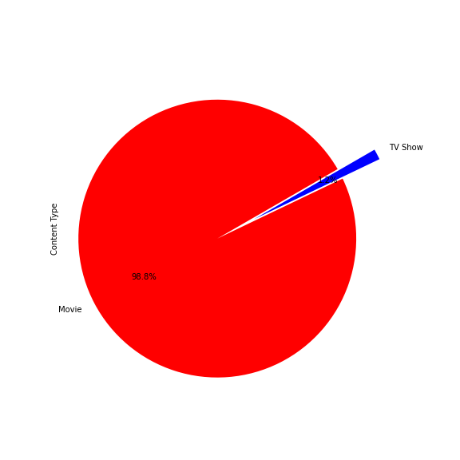
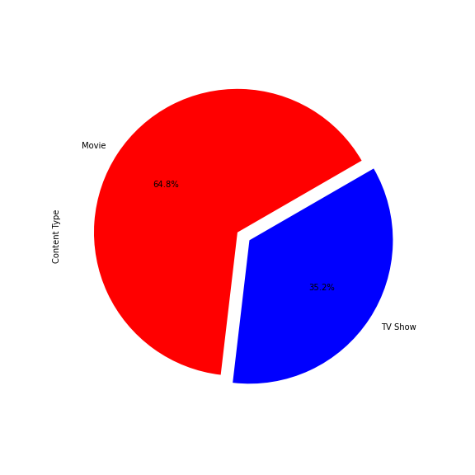
Before and After Data Clean-up

Slide 9
Data analysis & visualization

Slide 10
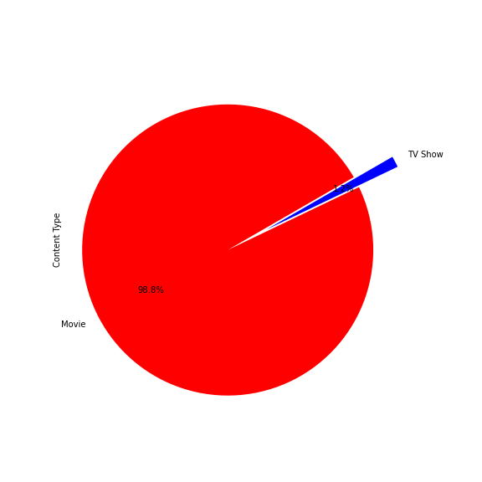
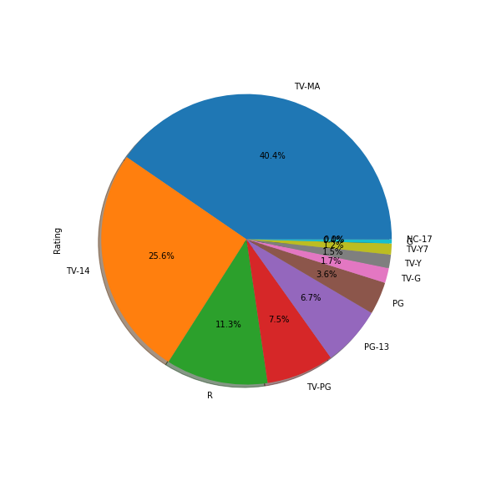
Percentages of
Content types
Rating types

Slide 11
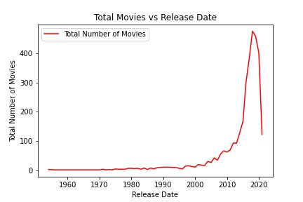
Number of movies per year

Slide 12
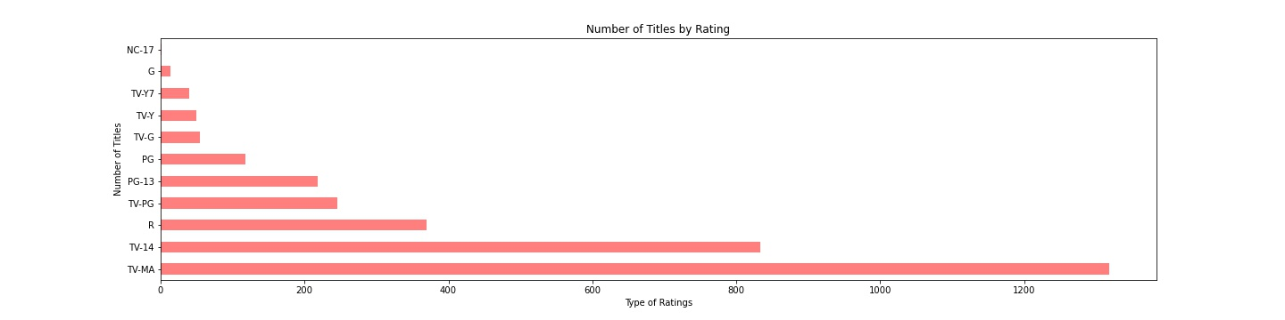
Number of content by rating

Slide 13
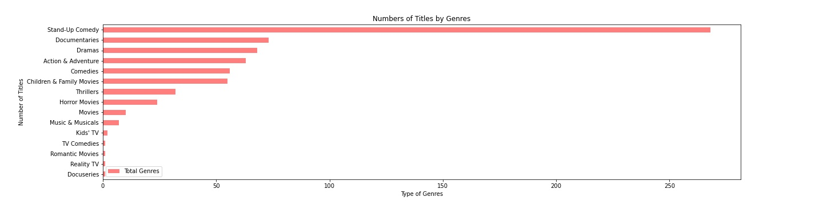
Top Genres with the largest number of titles

Slide 14
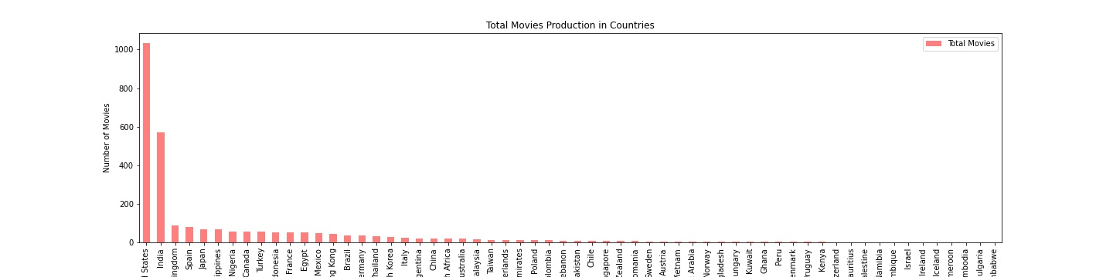
Top producing countries
Notes:
**change out the graph (screen shot of new one)
Which countries produce the most number of movies

Slide 15
Ratings per Year
Imbd rating of movies produced in the listed year

Slide 16
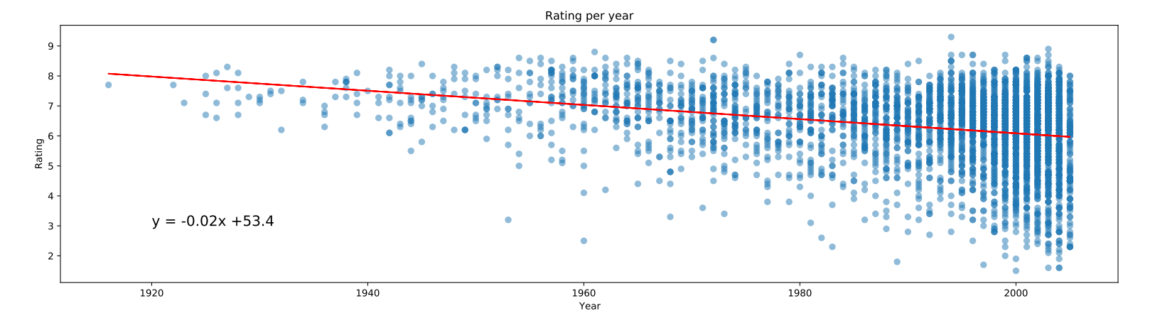
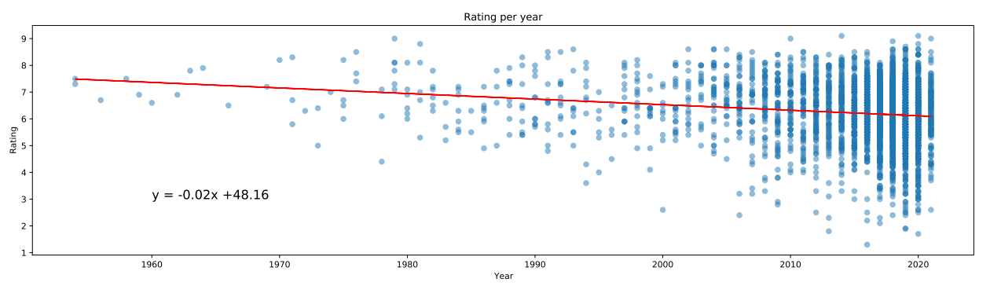
Ratings per year
Notes:
2005 data and 2021 data
Comparing trends, looking at the regression line
Noting how they’re the same

Slide 17
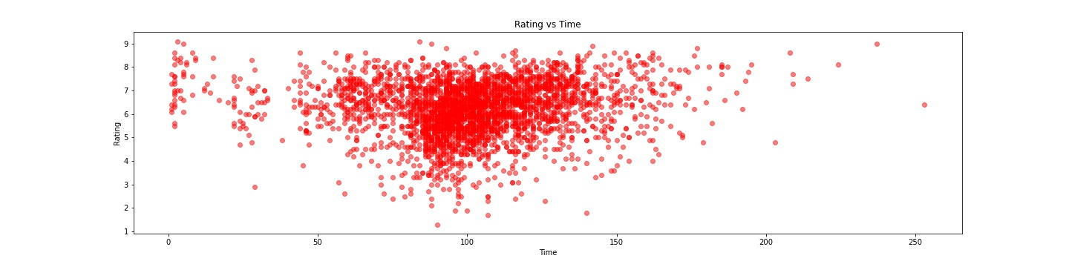
Ratings vs Run time
Notes:
As runtime nears 100 mins, avg is about 100 mins, there are more datapoints
We can see that with the cluster of data in the center

Slide 18
Findings

Slide 19
Ratings vs Run time
Top 5 countries which produce the largest numbers of titles on Netflix: United States, India, United Kingdom, Spain & Japan
Top 5 type of Genres with the largest of titles: Standup comedy, Documentaries, Drama, Action & Adventure, Comedies, Family & Children Movies.
Top 5 Rating types: TV_MA, TV-14, TV-PG, R, PG-13, TV-Y
Most of runtimes are from 50 -150mins
Percentage of Movies and TV shows are 98.8% & 1.2% (??) respectively
Notes:
As runtime nears 100 mins, avg is about 100 mins, there are more datapoints
We can see that with the cluster of data in the center

Slide 20
Conclusions

Slide 21
Conclusions:
United States is the country that produces the largest numbers of titles on Netflix.
Genre with the largest of titles: Standup comedy.
Rating with the largest of titles is TV_MA.
Quantity of content tiles increase rapidly from 2015 to 2019.
Notes:
As runtime nears 100 mins, avg is about 100 mins, there are more datapoints
We can see that with the cluster of data in the center

Slide 22
Thank you

