Slide 1
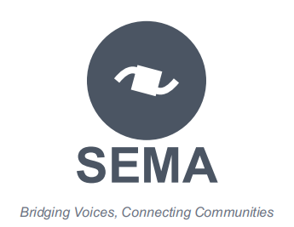
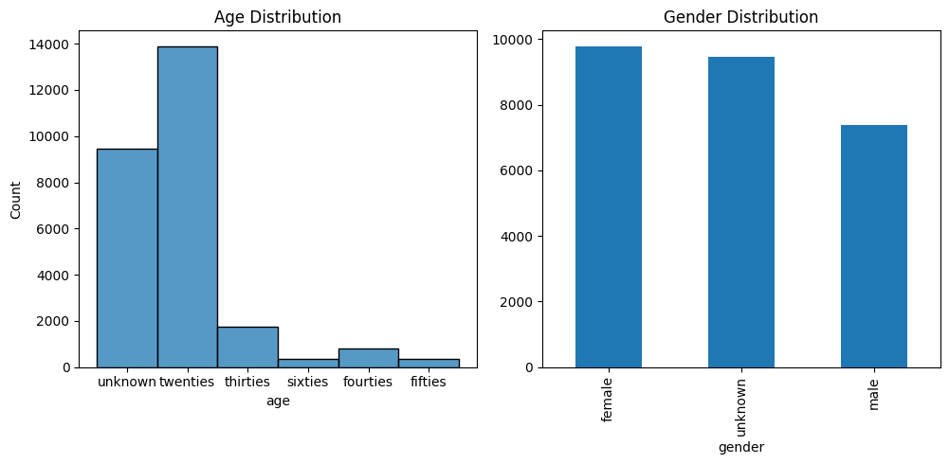
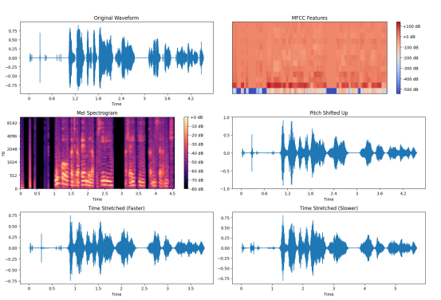
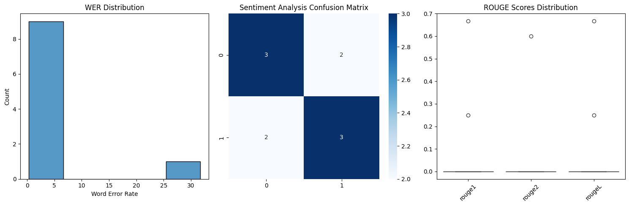
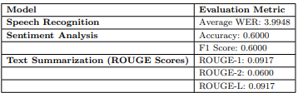
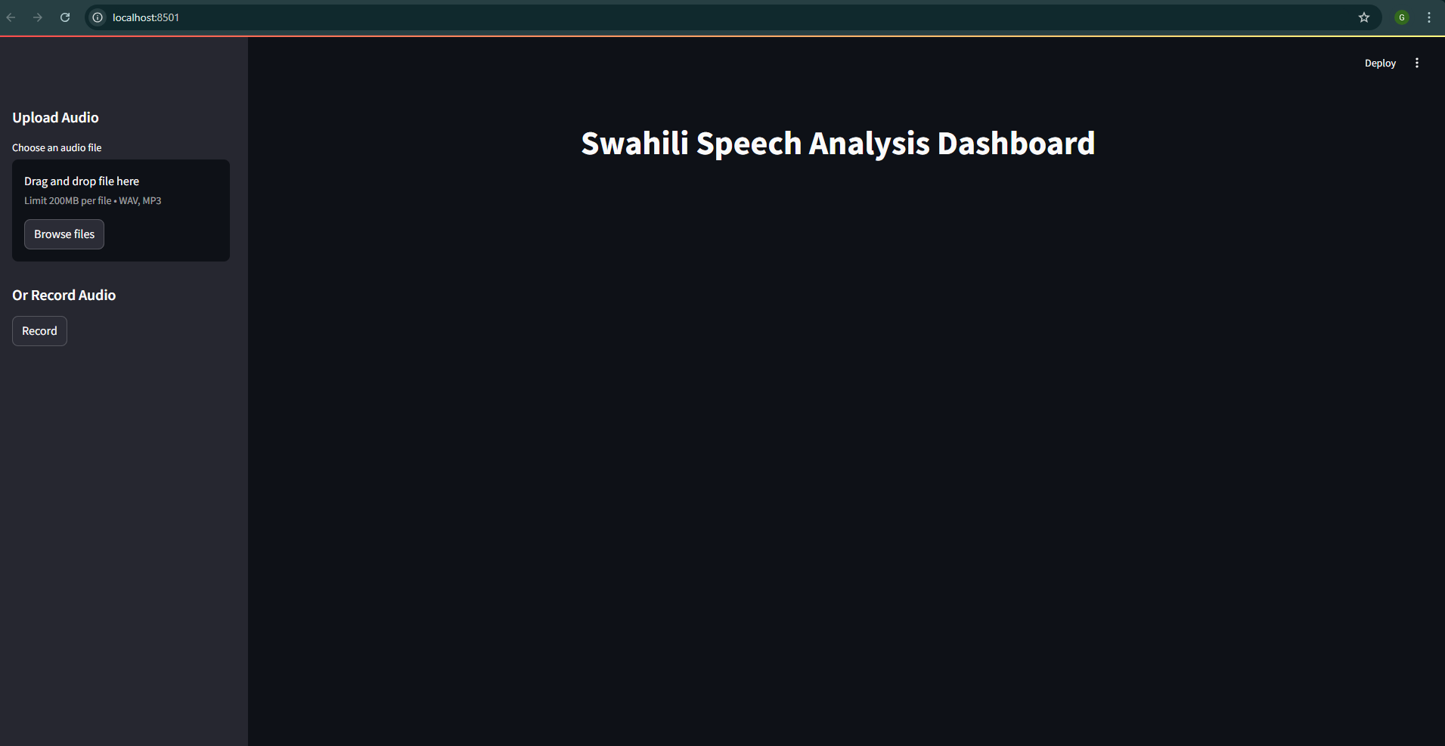
Real-Time Swahili Speech Analysis System
Bridging Communication Gap in Africa
Kevin Obote
Introduction
Background: Swahili, a widely spoken language in East Africa, has limited resources for advanced speech processing. This gap hinders the development of automated tools for speech-to-text conversion, sentiment analysis, and summarization.
Problem Statement: The lack of real-time Swahili speech analysis tools makes it difficult to extract meaningful insights from audio data, affecting fields such as education, business intelligence, and media monitoring.
Motivation: There is a growing need for analyzing Swahili audio data for customer feedback analysis, media monitoring, and educational support. This research aims to bridge the gap by developing a system capable of real-time speech processing.
Objectives:
Convert spoken Swahili into text using speech-to-text (STT) technology.
Analyze sentiment from transcribed speech.
Summarize transcriptions to extract key insights.
Data Analysis
Results
Findings:
The system successfully transcribed Swahili speech with high accuracy.
Sentiment classification identified emotions effectively.
Summarized text retained key information concisely.
Qualitative Analysis:
Users found the system efficient for real-time applications.
Generated summaries improved readability and accessibility.
Sentiment classification aligned well with expected emotional tones.
Fig1:Demographic Dynamics of the Data
Fig2:Feature Engineering
Conclusion
This research presents a pioneering approach to real-time Swahili speech processing, demonstrating the potential of AI in underrepresented languages.
Practical Applications:
Enables multilingual AI solutions for speech processing.
Improves accessibility in technology for Swahili speakers.
Supports further advancements in speech-driven analytics.
Methods
Data Source: The Mozilla Common Voice Swahili dataset (Version 11.0) was used, containing diverse speech samples from native Swahili speakers.
Data Collection & Preprocessing:
Noise reduction and silence trimming Feature extraction using Mel-Frequency Cepstral Coefficients (MFCCs) and spectral centroid. Text normalization, including punctuation removal and stopword elimination.
Model Selection:
Speech-to-Text: Whisper model by OpenAI, known for high transcription accuracy.
Sentiment Analysis: DistilBERT fine-tuned on SST-2 for sentiment classification.
Text Summarization: T5 model used for generating concise summaries
.
System Architecture:
Audio Input.
Preprocessing. Speech-to-Text..
Sentiment Analysis. Text Summarization.
Deployment:
A web interface was built using Streamlit for real-time interaction.
Fig3:Model Evaluation
References
Mozilla Foundation. Common Voice Dataset 11.0. [Online Resource]
OpenAI. Whisper Model for Automatic Speech Recognition.
Manning, C. D., et al. Introduction to Information Retrieval. Cambridge University Press.
Lin, C. Y. ROUGE: A Package for Automatic Evaluation of Summaries. ACL, 2004.
➡ Interpretation: The model performs well but can be improved by fine-tuning on Swahili-specific data.
Sema
Bridging Voices, Connecting Communities
Powered by Guild Code

