Slide 1
By,
Kevin prince Jayaraj D(211417104119)
Karthikeyan S(211417104110)
SMART WALKING STICK FOR BLIND
Co-ordinator:
Mr.S.A.K. JAINULABUDEEN, M.Tech
DEPARTMENT OF CSE
PANIMALAR ENGINEERING COLLEGE.

Slide 2
ABSRACT
Obstacle detection is one of the major concerns for a fully or a partially blind person. This paper describes guide blind walking stick based on ultrasonic sensor with the use of Arduino Uno. According to World Health Organization (WHO), 30 million peoples are permanently blind and 285 billion peoples with vision impairment. In this paper discuss about smart guide blind stick, which is proficient of detecting any obstruction, detect corners and even allow the user to find the stick if anyhow missed by the user by pressing a remote switch. The device is designed with an objective to sort out common issues faced by the blind people while using conventional sticks. With the electronics embed within the stick, it became a smart stick. Presented here is a smart guide blind stick using Arduino. The stick uses Ultrasonic sensors for obstacle detection. The main aim of this paper is to detect nearby obstacle and notify the user of the direction of that obstacle, thereby enabling the user to determine the corrective direction to head.

Slide 3
INTRODUCTION
Obstacle detection is one of the major concerns for a fully or a partially blind person. This paper describes guide blind walking stick based on ultrasonic sensor with the use of arduino uno.
In this paper discuss about smart guide blind stick which is proficient of detecting any obstruction, detect corners and even allow the user to find the stick if anyhow missed by the user by pressing a remote switch.
The device is designed with an objective to sort out common issues faced by the blind people while using conventional sticks. With the electronics embed within the stick, it became a smart stick.

Slide 4
LITERATURE SURVEY:
TITLE | AUTHORS | OBJECTIVE
Smart Stick for the Blind a complete solution | Nilima Sahoo and Hung-Wei Lin. | This system uses IR sensor, Ultrasound sensor and water sensor to detect the obstacle. This system does not use any location identifier or location indicator.
Pothole detection for visually impaired | Amy Nordrum | It uses a camera that captures image 15 frame per second and based on the concept of image processing the pothole is detected. The camera is expensive.
Smart Walking Stick for Blind describes about a Stick which use Raspberry Pi | Prashanthi S | ultrasonic sensor to detect objects and intruder, the system also has a camera embedded with it, and based on the images captured the objects are detected.

Slide 5
LITERATURE SURVEY CONTIUATION:
TITLE | AUTHORS | OBJECTIVE
Smart Belt for Blind uses a belt embedded with ultrasound sensor which detects the obstacle. | Cody Jackson J | The belt also has a buzzer which vibrates when obstacle is detected. The entire system is developed in such a way that the distance calculated is sent as an audio message for the blind person, where in which he hears the distance calculated using a speaker.
A wearable ultrasonic obstacle sensor for visually impaired. | V. Diana wilson | This system uses a couple of ultrasound sensor on either side over the strap of the goggles. This project can detect the intruder in front of the blind person who is wearing the goggles. This system is not robust as the sensor embedded with the goggles makes it heavier and also it cannot detect complex objects such as water, vehicle etc.

Slide 6

PROBLEM STATEMENT:
EXISTING SYSTEM | PROPOSED SYSTEM
In practice, the blind people uses a walking stick to detect the object in front of them. But they never knows about it. The blind people may injured while move towards staircase. Drawbacks The Blind people may injured. Time taken is more for walk. | In our proposed system, the blind people has camera enabled walking stick to examine which object it is. Here, we have distance sensor detects depth or height. Advantages The chances of injury are less. Time taken is less

Slide 7
Development Environment
HARDWARE REQUIREMENTS:
ARDUINO UNO
ULTRASONIC SENSOR
FIRE SENSOR
VIBRATION SENSOR
GSM
SOS BUTTON
LDR SENSOR
IR SENSOR
SOFTWARE REQUIREMENTS:
ARDUINO IDE
EMBEDDED C

Slide 8

SYSTEM ARCHITECTURE
POWER SUPPLY
ULTRASONIC SENSOR
BUZZER
IR SENSOR
GSM
ARDUINO MEGA
FIRE SENSOR
VIBRATION SENSOR
LDR SENSOR
SOS BUTTON

Slide 9
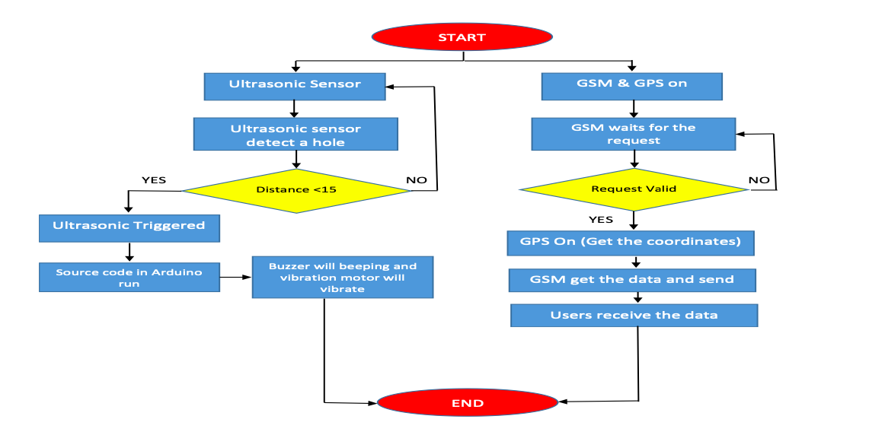
FLOW CHART:

Slide 10

MODULE DESCRIPTION
Project is designed in Two modules where each module is responsible for different aspects.
Module 1(Hardware):
Module 2 (Software):
Arduino board
GSM system
Sensors used in this project.
Fire sensor
Vibration sensor
Ultrasonic sensor
LDR sensor
IR sensor
Embedded C

Slide 11
Arduino board
Arduino board acts as the brain of the system.
It controls every other sensors.
Since it acts as a brain, any damage happens to it affect the whole system.

Slide 12
SENSORS USED:
Viberation sensor
LDR sensor
Fire sensor
IR sensor
Ultra sonic sensor

Slide 13
Ultrasonic Sensor:
Ultrasonic sensor detects the distance of the object.
In which it emits ultrasonic signals to detect the obstacles.
It is cheap when compared to other sensors.

Slide 14
IR SENSOR
IR sensors uses detects nearby obstacles.
IR sensor is a sensitive sensor
It emits IR radiations

Slide 15
Fire sensor:
Fire sensors detect the fire or substances with high temperature
Fire sensors allow the user to identify and alerts the user by giving a buzzer sound.

Slide 16
Vibration sensor:
Vibration sensor works by piezoelectric effect.
It analyses the difference in acceleration , sudden change of force .

Slide 17
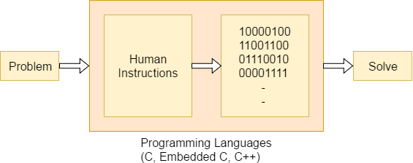
Embedded System Programming:
Function is a collection of statements that is used for performing a specific task and a collection of one or more functions is called a programming language.
The extension in C language is known as embedded C programming language.

Slide 18
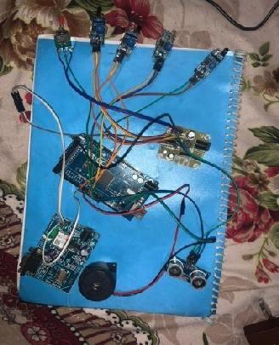
SCREEN SHOTs:
A.)

Slide 19
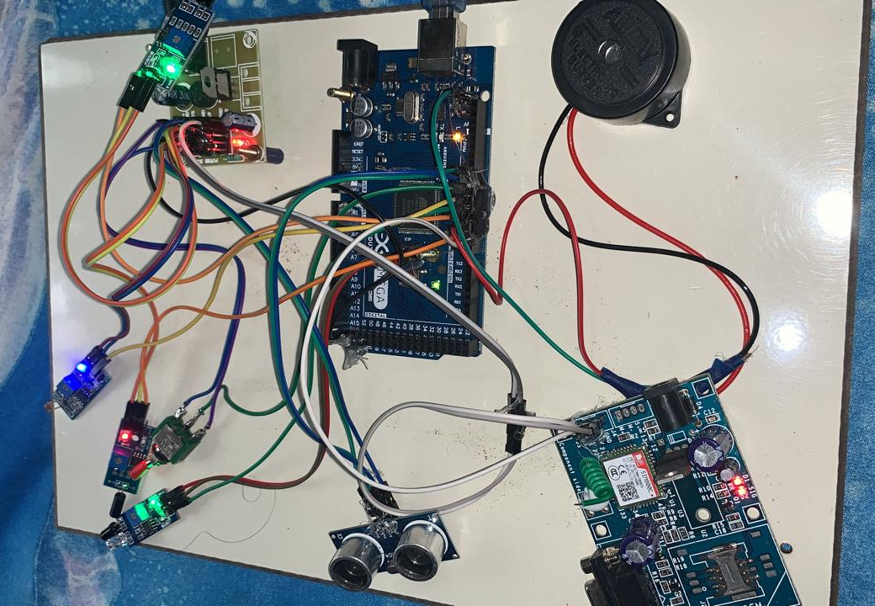
B)

Slide 20
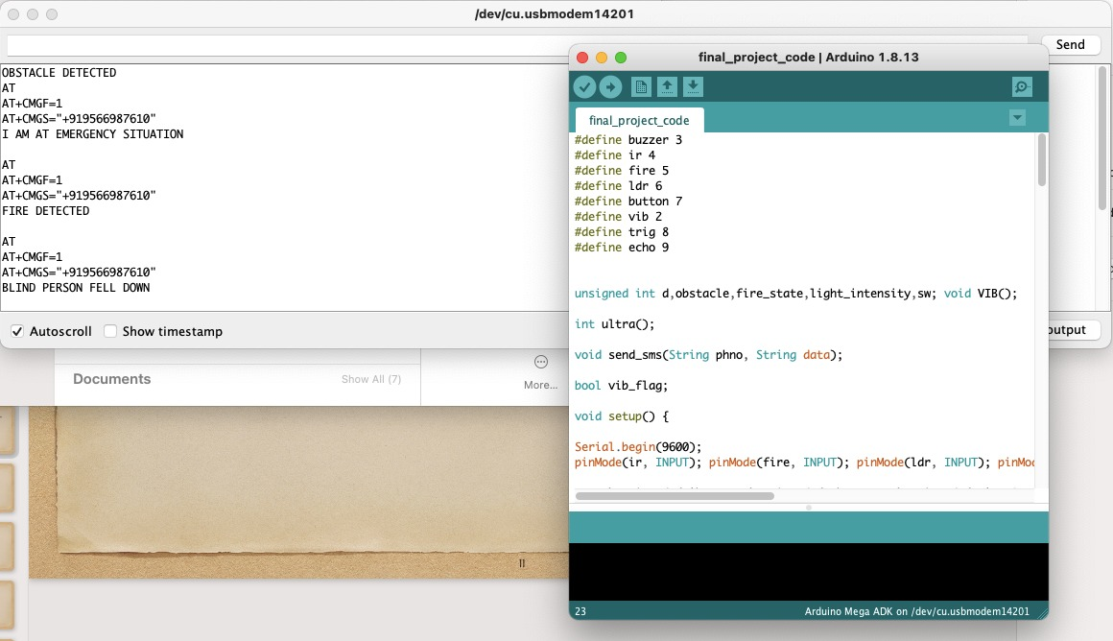
C)

Slide 21
TEST CASES:
Test case no. | Action | Expected output | Actual output | Result
1 | IR sensor connected to Arduino borad | To Detect nearby obstacles. | Detect nearby obstacles. | Pass
2 | Ultrasonic sensor connected to the Board | To detect far away obstacles. | Detects far away obstacles. | Pass
3 | Fire sensor connected to the board | To detect fire /Flames/objects with high temperature. | It detects the fire and High intense heat radiation. | Pass
4 | Viberation sensor connected | To monitor the user If the user fells down it should detect the accident | The vibration sensor detect intense vibration. | Pass

Slide 22
TEST CASES CONTINUES:
Test case no. | Action | Expected output | Actual output | Result
GSM SYSTEM | Passes message to the respective number and says the Location of the user. | To Send message to the respective person. | It sends the message to the respective person. | Pass
Emergency button | In case of emergency It sends the message to the number “911” | To Sends the message to the respective number | The button works and sends message to the respective number. | Pass
LDR sensor | LDR sensor connected to the Board | To alert he user when he enters dark places . | The kit alerts the user when he enter dark places | Pass

Slide 23
CONCLUSION
Blind people face lot of difficulties while travelling from one place to another. With the intention to help the blind, their difficulties, the smart blind stick is proposed.
The system consists of an LDR sensor to detect day and night and ultrasonic sensor to obstacle detection. The proposed system takes the blind person to reach the destination without any struggle in their path.
The system not only make them more free, but also liberate their minds and throw away many worries and doubts.

Slide 24
FUTURE SCOPE:
The project has a very good scope in future as well as in present.
The project can be implemented with the different sensor to guide the visually challenged people in the world.
The main theme of this project is to help the blind people and make them to interact with the physical world.
Then the device were placed in their clothes or hat to make the device more portable and easy to used by the blind people.

Slide 25
REFERENCES
[1] Yeong-Hwa Chang, Nilima Sahoo and Hung-Wei Lin. ―An Intelligent Walking Stick for the Visually Challenged People. In IEEE International Conference on Applied System Innovation, 2018.
[2] Nitish Ojha1, Pravin Kumar Pradhan, Prof. M.V.Patil. ―Obstacle Sensing Walking Stick for Visually Impaired. In International Research Journal of Engineering and Technology (IRJET), Volume: 04 Issue: 04, April 2017
[3] Muhammad Hanan Daudpota, Anwar Ali Sahito, Amir Mahmood Soomro, Faheem Shafeeque Channar. ―Giving blind a smart eye: Designing and Modeling of intelligent white cane for blind people. In IEEE International Conference, 2017.
[4] Sharang Sharma, Manind Gupta, Amit Kumar, Meenakshi Tripathi, Manoj Singh Gaur. ―Multiple Distance Sensors Based Smart Stick for Visually Impaired People. In IEEE International Conference, 2017.

Slide 26
Paper Published
Title of the paper:
Smart Walking Stick For Blind Using Arduino
Journal Name :
"International Journal for Science and Advance Research In Technology"
Paper ID: IJSARTV7I648880
Published in: Volume : 7, Issue : 6
Publication Date: 10th Jun 2021

Slide 27
Thank You

