Slide 1

React
Deep Biswas
Kevin Rivas
Richard LeBlanc
Alex Feldman

Slide 2
What is React
A JavaScript library developed by Meta
Used for building fast and interactive UIs
Focused on building reusable components
Based on a component-based architecture

Slide 3
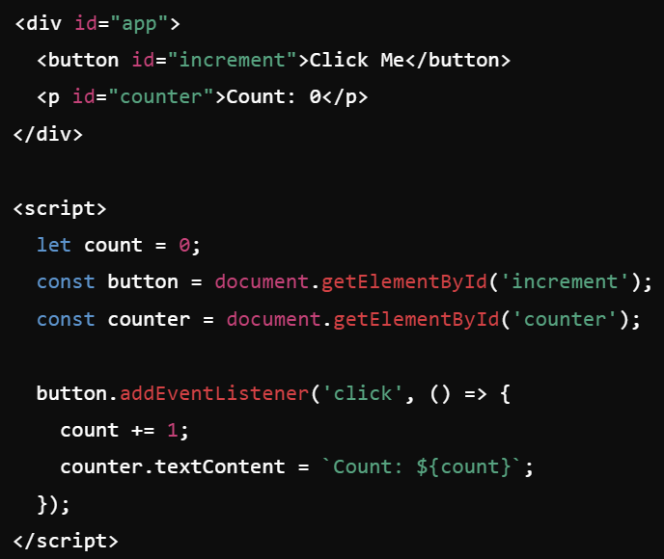
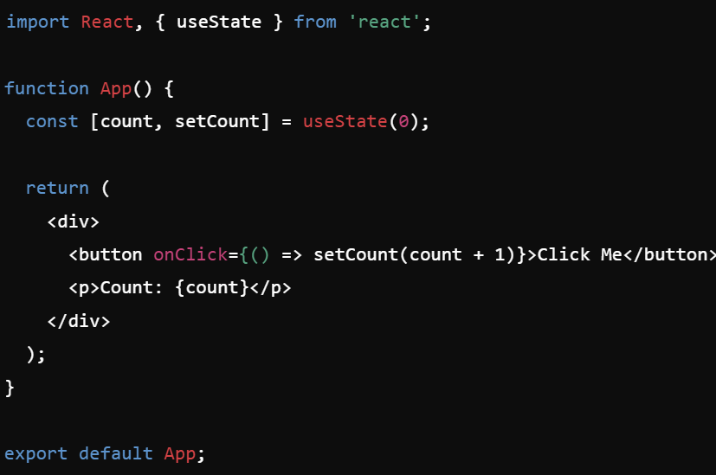
JS vs React
JavaScript is imperative.
This means that in JavaScript, you typically write code that explicitly tells the computer how to perform each step to achieve a desired outcome. You're essentially providing a sequence of instructions for the computer to follow.
React is declarative.
With React, you describe the desired end state of your UI, and React handles the details of how to get there. You're essentially telling the computer what you want, rather than how to do it.

Slide 4
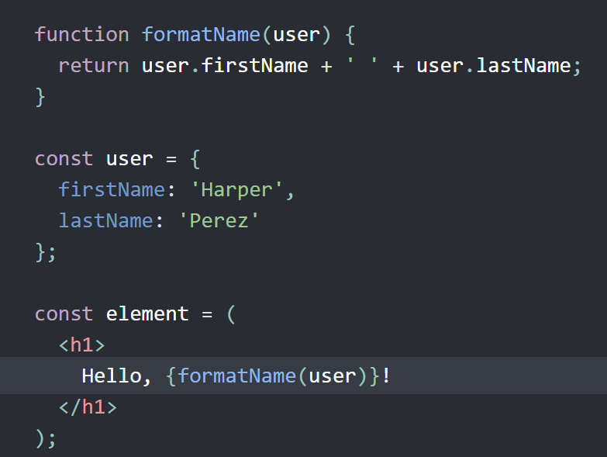
Key concepts: JSX
JSX is syntax extension for JavaScript that lets you write HTML-like markup inside JS file.
Rules
1. Return a single root element
2. Close all the tags
3. camelCase most of the things

Slide 5
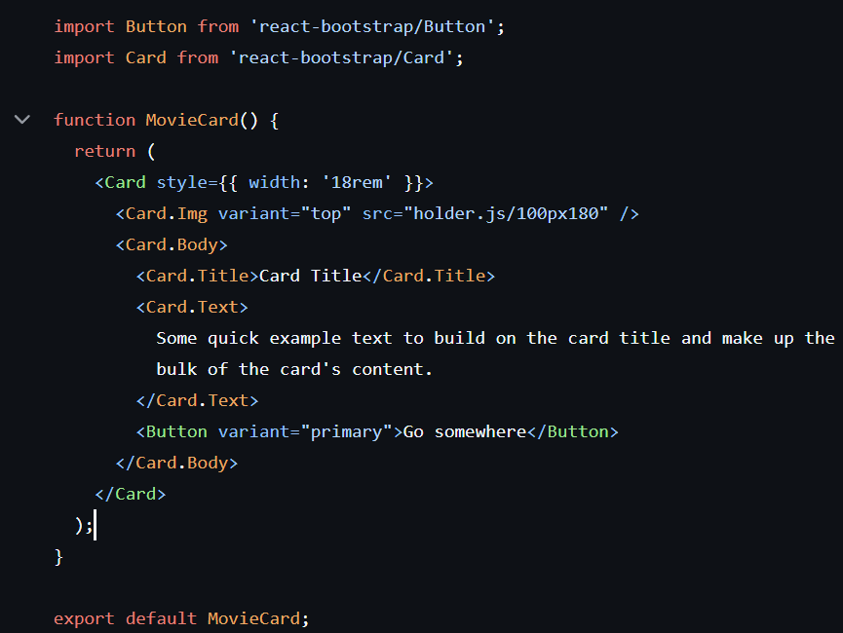
Key concepts: Component
Advantages:
Modularity – several developers can work on the same app
Scalability – components can be combined to handle bigger application
Maintainability – easier to maintain, update and debug

Slide 6
Key component: Virtual DOM
Step 1
Initial Rendering
Step 2
State and Props Changes
Step 3
Comparison Using Diff Algorithm
Step 4
Reconciliation Process
Step 5
Upgrade to the Real DOM
The in-memory representation of the real Document Object Model, which works faster and more efficient

Slide 7
Benefits of Virtual DOM
Simplified Development – you can write code in declarative style
Improved Performance – faster in complex applications
Enhanced UI – smooth, responsive and without full-page refreshes
Cross-Platform development – React Native is used for mobile apps

Slide 8

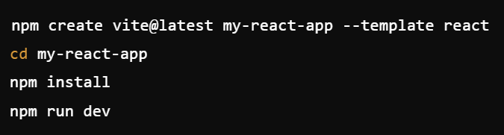
Vite
Vite is a next-generation front-end build tool that offers lightning-fast development and optimized builds
Recommended tool from React.js developers

Slide 9





Applications using React
Meta
Netflix
AirBnB
Uber
WhatsApp Web

Slide 10
Resources:
https://www.freecodecamp.org/news/what-is-the-virtual-dom-in-react/
https://vite.dev
https://lemon.io/blog/node-js-vs-react-comparison/
https://legacy.reactjs.org/docs/react-component.html
https://react.dev/learn/writing-markup-with-jsx

Slide 11
Demo
Clone repo
&
Install dependencies
Create a new component
Implement the component
Create Movie List

