Slide 1

数据库系统体系结构

Slide 2
数据库系统体系结构
考察数据库系统的体系结构可以有多种不同的层次或不同的角度
  从数据库管理系统角度看，是数据库系统内部的系统结构
  从数据库最终用户角度看 ，数据库系统的结构分为单用户结构、主从式结构、分布式结构、客户／服务器、浏览器／应用服务器／数据库服务器多层结构等。

Slide 3
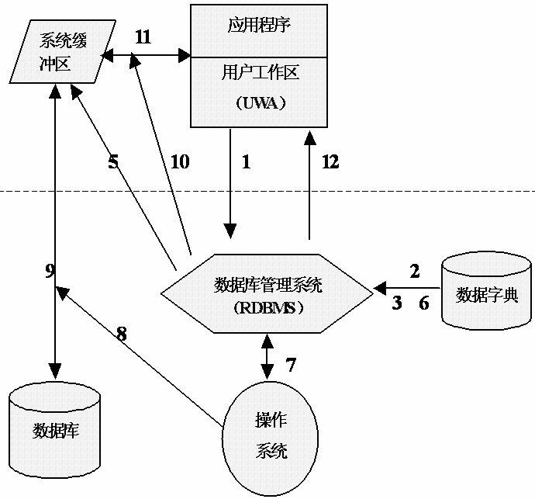
RDBMS的运行过程示例

Slide 4
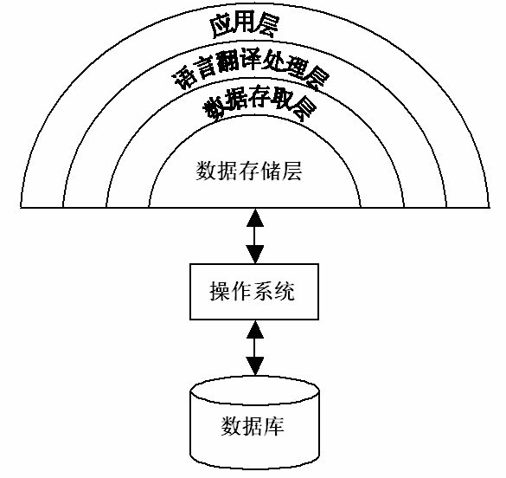
DBMS的层次结构
处理各种各样的数据库应用
是RDBMS与用户/应用程序的界面层
处理数据库语言，如SQL
向上提供的数据接口是元组的集合
处理单个元组
把集合操作化为单记录操作并执行
处理数据页和系统缓冲区

Slide 5
语言处理层
语言处理层的任务和工作
解释方法
3 预编译方法

Slide 6
1 语言处理层的任务和工作
转换
对DBMS内层可执行的基本存取模块的调用序列
接收DB语句
交互式方式下的SQL语句
嵌入宿主语言中的SQL语句
PL/SQL中的SQL语句

Slide 7
1 语言处理层的任务和工作（续）
DDL语句处理过程
  把它翻译成内部表示
  存储在系统的数据字典中
DCL语句处理过程
  与DDL的处理类似

Slide 8
DML 语句
多元组接口
语法分析
数 据 库
数据字典
语义检查
视图转换
DBMS
内层基本
模块库
查询语句
其他语句
查询优化
代码生成
单元组接口
对可执行的DBMS
内层基本存取模块
的调用序列

Slide 9
1 语言处理层的任务和工作（续）
将数据库DML语句转换成一串可执行的存取动作的过程，称为一个逐步绑定(bind)的过程。
绑定时间
执行前-- -- --执行时
  执行时----解释方法
  执行前----预编译方法
不同绑定时间的权衡
  早：系统效率高，数据独立性差
  晚：数据独立性高，执行效率差

Slide 10
语言处理
语言处理层的任务和工作
解释方法
预编译方法

Slide 11
2 解释方法
特点
  执行前，DML语句都以原始字符串的形式保存
  执行时，解释程序完成绑定过程，然后予以执行
优点
  数据独立性好
  灵活、应变性好
缺点
  效率比较低
适用
  交互式SQL

Slide 12
语言处理
语言处理层的任务和工作
解释方法
预编译方法

Slide 13
预编译方法
特点
  用户提交DML语句后，运行前对它进行翻译处理
  保存产生的执行代码
  运行时，取出执行代码加以执行
优点
  效率比较高

Slide 14
3 预编译方法（续）
预编译方法的问题
  应用规划失效（数据库结构改变、存取路径改变）
解决方法
  重编译
重编译进行时刻
  立即重编译
  被执行时才进行自动重编译
自动重编译技术的优点
  既拥有了编译时进行绑定所带来的高效率
  又具备了执行时绑定带来的数据独立性

Slide 15
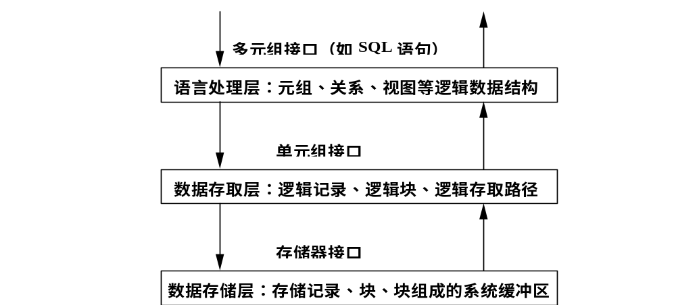
数据存取层的系统结构
数据存取层介于语言处理层和数据存储层之间，它向上提供单元组接口，向下则以系统缓冲区的存储器接口作为实现基础

Slide 16
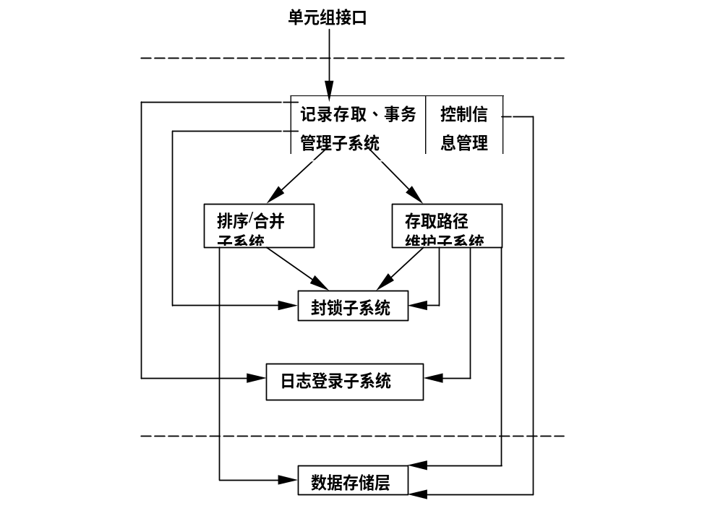
1 数据存取层的系统结构

Slide 17
存取层的任务
提供一次一个元组的查找、插入、删除、修改等基本操作
提供元组查找所循的存取路径以及对存取路径的维护操作，如对索引记录的查找、插入、删除、修改。若索引是采用B+树，则应提供B+树的建立、查找、删除、修改等功能
对记录和存取路径的封锁、解锁操作
日志文件的登记和读取操作
其他辅助操作，如扫描、合并/排序，其操作对象有关系、有序表、索引等

Slide 18
数据存储层
数据存储层的功能 -存储管理
  缓冲区管理
  内外存交换
  外存管理
系统缓冲区设立的原因
  提供DBMS的设备独立性
    外存设备的变更不会对它们造成影响
  提高存取效率
    异步读写：预先读，延迟写

Slide 19
缓冲区管理（续）
系统缓冲区的组成
  内存
  虚存
缓冲区管理
  缓冲区大小
    太大： 占据内存空间
    太小： 频频缺页调页，造成“抖动”，影响效率

Slide 20
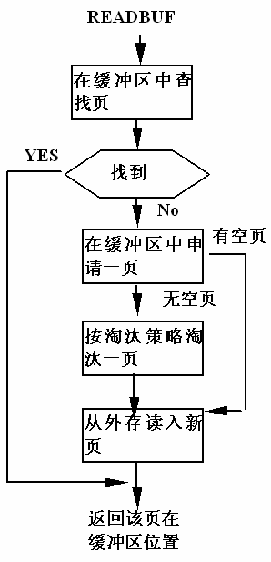
缓冲区管理
缓冲区查找算法
  顺序查找算法
  折半查找算法
  hash查找算法
缓冲区淘汰算法
  LRU算法
  FIFO算法
  时钟算法
  系统控制法
  混合算法
  ……

Slide 21
数据库物理组织
衡量数据组织优劣的标准
  存储效率高，节省存储空间；
  存取效率高，速度快，代价小
存储的数据包括
  数据描述
    即数据外模式、模式、内模式。
  数据本身
  数据之间的联系
  存取路径

Slide 22
数据库物理组织（续）
数据字典(DD)的组织
  数据量比较小
  使用频繁
  可简单地用顺序文件来组织
数据及数据联系的组织
  网状、层次数据库：邻接法和链接法
  关系数据库：表
存取路径的组织
  关系数据库：B树类文件结构和Hash文件结构

Slide 23
Oracle 的体系结构
Oracle体系结构
  存储结构:由逻辑存储、物理存储组成
  内存结构:由SGA、PGA组成
  进程结构:由用户进程和Oracle进程组成
其中，内存结构、进程结构合称为一起被称为Oracle实例；存储部分称为数据库。

Slide 24
Oracle 的体系结构
系统结构组件
存储结构
  逻辑存储结构
  物理存储结构
内存结构
进程结构

Slide 25
DB 服务器
DB 服务器:
由一个实例(instance) 和 一个数据库(database)
DB Server
Notes:
Oracle Server
The Oracle server can run on a number of different computers in one of the following ways:
Client-Application Server-Server
Client-Server
Host-Based
Client-Application Server-Server: (Three-tier) Users access the database from their personal computers (clients) through an application server, which is used for the application’s processing requirements.
Client-Server: (Two-tier) Users access the database from their personal computer (client) over a network, and the database sits on a separate computer (server).
Host-Based: Users are connected directly to the same computer on which the database resides.

Slide 26
主要组件概述
Instance
User
process
SGA
Shared pool
Library
cache
Database
buffer cache
Redo log
buffer cache
Server
process
Data Dict.
cache
PGA
PMON
SMON
DBWR
LGWR
CKPT
Others
Parameter
file
Data files
Control files
Redo log files
Archived
log files
Password
file
Database
Notes:
Overview of Primary Components
The Oracle architecture includes a number of primary components, which are discussed further in this lesson.
Oracle server: There are several files, processes, and memory structures in an Oracle server; however, not all of them are used when processing a SQL statement. Some are used to improve the performance of the database, ensure that the database can be recovered in the event of a software or hardware error, or perform other tasks necessary to maintain the database. The Oracle server consists of an Oracle instance and an Oracle database.
Oracle instance: An Oracle instance is the combination of the background processes and memory structures. The instance must be started to access the data in the database. Every time an instance is started, a System Global Area (SGA) is allocated and Oracle background processes are started. Background processes perform functions on behalf of the invoking process. They consolidate functions that would otherwise be handled by multiple Oracle programs running for each user. The background processes perform input/output (I/O) and monitor other Oracle processes to provide increased parallelism for better performance and reliability.
Oracle database: An Oracle database consists of operating system files, also known as database files, that provide the actual physical storage for database information. The database files are used to ensure that the data is kept consistent and can be recovered in the event of a failure of the instance.

Slide 27
实例
用于数据库访问，由内存结构和进程结构组成
参数文件用于配置实例，参数文件中的参数决定了实例的大小和组成
Instance
SGA
Shared pool
Memory structures
Library
cache
Database
buffer cache
Redo log
buffer cache
Data Dictionary
cache
Background structures
PMON
SMON
DBWR
LGWR
CKPT
Others
Notes:
Oracle Instance
An Oracle instance consists of the System Global Area (SGA) memory structure and the background processes used to manage a database. An instance is identified by using methods specific to each operating system. The instance can open and use only one database at a time.

Slide 28
Real Application Clusters (RAC:真正的应用集群):
多实例系统
实例只能打开一个数据库
一个数据库可以有多个实例. 比如 Oracle Real Application Clusters (RAC)
Real Application Clusters (RAC) 通过运行多个实例共享存储在共享磁盘的单个物理数据库
在很多应用中, RAC 使得多个用户可以在多台机上访问单个数据库而又有较好的性能

Slide 29
数据库
A database:
数据的集合
三种类型文件组成
  Control files(控制文件)
  Data files(数据文件)
  Redo log files(重做日志文件)
Header
Control
files
Data files
(includes
data
dictionary)
Online
redo log
files
Notes:
An Oracle Database
The general purpose of a database is to store and retrieve related information. An Oracle database has a logical and a physical structure. The physical structure of the database is the set of operating system files in the database. An Oracle database consists of three file types.
Data files containing the actual data in the database
Redo logs containing a record of changes made to the database to enable recovery of the data in case of failures
Control files containing information necessary to maintain and verify database integrity
Other Key File Structures
The Oracle server also uses other files that are not part of the database:
The parameter file defines the characteristics of an Oracle instance. For example, it contains parameters that size some of the memory structures in the SGA.
The password file authenticates users privileged to start up and shut down an Oracle instance.
Archived redo log files are offline copies of the redo log files that may be necessary to recover from media failures.

Slide 30
数据库与实例的启动和关闭
启动数据库有三个步骤:
  Start an instance (启动实例)
  Mount the database (装载数据库)
  Open the database (打开数据库)
启动数据库必须先用管理员权限连到数据库

Slide 31
启动数据库
OPEN
STARTUP
All files opened as described by the control file for this instance
MOUNT
Control file opened for this instance
NOMOUNT
Parameter file read
Instance started
SHUTDOWN
SHUTDOWN

Slide 32
启动和关闭数据库
Startup [force][restrict][pfile=filename][mount[dbname]|[open [open_option][dbname]]|[nomount]
Shutdown [normal|immediate|transactional|abort]
Shutdown数据库不同方式对比表
其中：A-Abort I-Immediate T-Transaction N-Nornal
关闭方式 | A | I | T | N
允许新的连接 | × | × | × | ×
等待直到当前会话中止 | × | × | × | √
等待直到当前事务中止 | × | × | √ | √
回退未提交事务, 强制检查点 | × | √

Slide 33
Oracle 的体系结构
系统结构组件
存储结构
  逻辑存储结构
  物理存储结构
内存结构
进程结构

Slide 34
数据库结构和存储管理
逻辑数据库结构
  Oracle 数据库的逻辑结构包括表空间 (tablespaces)，模式对象(schema objects)，数据块(data blocks)，区(extents) 和段(segments)。
物理数据库结构
  Oracle 数据库的物理结构包括数据文件(datafiles)， 重做日志文件(redo log files)和控制文件( control files)。

Slide 35
逻辑存储结构
逻辑存储结构指明怎么使用数据库的物理空间
逻辑存储结构是一个层次结构，由tablespaces, segments, extents和blocks组成。
Tablespace
Data file
Segment
Segment
Extent
Blocks
Notes:
在逻辑上将保存的数据划分为一个个小单元进行存储和保护。由小到大：
块：最小单元。数据库在输入输出时，都是以块为单位进行逻辑读写操作的。 一个块由一个或多个操作系统的块组成。块的大小在数据库创建时决定，以后不能更改。
区：
区由一系列连续的块组成。当用户在数据库中新建一个表，并且在表中插入数据时，数据库服务器需要在表空间中为这个表分配存储空间，分配时并不是一个一个块进行分配的，而是多个连续的块一起分配。在回收存储空间时，也是一起回收，它们就组成了一个区。
也就是说，数据库服务器在进行存储空间分配、回收和管理时是以块为基本单元的。
段：
段由多个区组成，这些区可以是连续的，也·可以是不连续的。当用户在数据库创建具有实际存储结构的对象时，如表，索引等，数据库服务器将为这些对象创建段。对象数据将全部保存在它的段中，一般情况下，一个对象只拥有一个段。
段有多种类型。例如，表所对应的段称为数据段，索引对应的段成为索引段。每个段在创建时都会分配一定数目的初始区，当段中的初始区的存储空间都使用完后，将继续为段分配新的区
表空间
最高一级的数据逻辑存储结构，数据库就是由若干个表空间组成的。段和它使用的区都存放在一个表空间中。通过使用表空间，数据库将
所有相关的逻辑结构和对象组合在一起。
通常会将属于某个应用的所有逻辑存储结构和数据库对象存放在独立的表空间中·，如SALE，HR等。这样可保证各个应用之间的数据相互独立。每个数据库由一个或多个表空间组成，在创建数据库时系统会自动·创建一个缺省的SYSTEM表空间。
Logical Structure
A logical structure hierarchy exists as follows:
An Oracle database is a group of tablespaces.
A tablespace may consist of one or more segments.
A segment is made up of extents.
An extent is made up of logical blocks.
A block is the smallest unit for read and write operations.
Tablespaces, segments, extents, and blocks are discussed further in later lessons.

Slide 36
数据库存储层次结构
Database
Schema
Tablespace
Data file
Logical
Segment
Physical
Extent
Oracle
block
OS block
Notes:
Database Architecture
The Oracle database architecture includes logical and physical structures that make up the database.
The physical structure includes the control files, online redo log files, and data files that make up the database.
The logical structure includes tablespaces, segments, extents, and data blocks.
The Oracle server enables fine-grained control of disk space use through tablespace and logical storage structures, including segments, extents, and data blocks.
Tablespaces
The data in an Oracle database are stored in tablespaces.
An Oracle database can be logically grouped into smaller logical areas of space known as tablespaces.
A tablespace can belong to only one database at a time.
Each tablespace consists of one or more operating system files, which are called data files.
A tablespace may consist of zero or more segments.
Tablespaces can be brought online while the database is running.
Except for the SYSTEM tablespace or a tablespace with an active undo segment, tablespaces can be taken offline, leaving the database running.
Tablespaces can be switched between read-write and read-only status.
Data Files
Each tablespace in an Oracle database consists of one or more files called data files. These are physical structures that conform with the operating system on which the Oracle server is running.
A data file can belong to only one tablespace.
An Oracle server creates a data file for a tablespace by allocating the specified amount of disk space plus a small amount of overhead.
The database administrator can change the size of a data file after its creation or can specify that a data file should dynamically grow as objects in the tablespace grow.
Segments
A segment is the space allocated for a specific logical storage structure within a tablespace. For example, all of the storage allocated to a table is a segment.
A tablespace may consist of one or more segments.
A segment cannot span tablespaces; however, a segment can span multiple data files that belong to the same tablespace.
Each segment is made up of one or more extents.
Extents
Space is allocated to a segment by extents.
One or more extents make up a segment.
When a segment is created, it consists of at least one extent.
As the segment grows, extents get added to the segment.
The DBA can manually add extents to a segment.
An extent is a set of contiguous Oracle blocks.
An extent cannot span a data file but must exist in one data file.
The Oracle server manages the storage space in the data files in units called Oracle blocks or data blocks.
At the finest level of granularity, the data in an Oracle database is stored in data blocks.
Oracle data blocks are the smallest units of storage that the Oracle server can allocate, read, or write.
One data block corresponds to one or more operating system blocks allocated from an existing data file.
The standard data block size for an Oracle database is specified by the DB_BLOCK_SIZE initialization parameter when the database is created.
The data block size should be a multiple of the operating system block size to avoid unnecessary I/O.
The maximum data block size is dependent on the operating system.

Slide 37
数据块
I/O最小单位
由一个或多个操作系统块组成
管理方式
  自动段空间管理(Automatic Segment-Space Management)
  手工管理(Manual Configuration):允许你配置数据块的参数,比如 PCTFREE, PCTUSED 等
Notes:
在自动管理方式，系统将使用位图（Bitmap）而不是可用块列表对段中已用块和空闲块进行管理，因此用户不必设置这两个参数。

Slide 38
数据块
Header
Free space
Data
Block space utilization parameters: INITRANS, MAXTRANS, PCTFREE, PCTUSED
Notes:
Data Blocks
Oracle data blocks contain:
Block header: The header contains the data block address, table directory, row directory, and transaction slots that are used when transactions make changes to rows in the block. Block headers grow from the top down.
Data space: Row data is inserted into the block from the bottom up.
Free space: The free space in a block is in the middle of the block: thus both the header and the row data space can grow when necessary. The free space in a block is contiguous initially. However, deletions and updates may fragment the free space in the block. The free space in the block is coalesced by the Oracle server when necessary.
PCTFREE参数：用于指定块中必须保留的最小空闲空间比例。之所以要保留，是因为在对块中存储的数据进行修改时（Update），有可能会需要更多的存储空间。这时如果块中存储空间不足，就必须分配新的块，这样会陈升记录链接现象（本来可以存储在一个块中的一行记录被存储到了两个块中），这样系统必须读取独个块才能获得一条完整的记录，这样会影响表的I/O性能。
PCTFREE 20 参数指定的是一个百分数，缺省为10。
设置较小：可以有效地利用存储空间，当可能产生大量地记录链接现象
较大：浪费存储空间，但带来地好处是可以提高Update地速度，因为不必花费时间来容纳增大后地记录，也可以避免在表中产生链接地记录。因此较大地PCTFREE参数适用于频繁进行修改地表。
PCTUSED：用于制定一个百分比，当块中已经使用地存储空间降低到这个百分比之下时，这个块才重新被标记为可用状态，否则认为块已满，不能再向其中插入数据
PCTUSED 40：
较小：提高update和delete地操作效率，当会增加空间浪费
较大，可以提高存储效率，但相对地降低Insert，update等操作地执行效率。
两者结合起来用。
Block Space Utilization Parameters
Block space utilization parameters can be used to control the use of space in data and index segments.
Parameters Controlling Concurrency
INITRANS and MAXTRANS specify the initial and the maximum number of transaction slots that are created in an index or a data block. The transaction slots are used to store information about transactions that are making changes to the block at a point in time. A transaction uses only one transaction slot, even if it is changing more than one row or index entry.
INITRANS, which defaults to 1 for a data segment and 2 for an index segment, guarantees a minimum level of concurrency. For example, if set to 3, INITRANS ensures that at least three transactions can concurrently make changes to the block. If necessary, additional transaction slots can be allocated from the free space in the block to permit more concurrent transactions to modify rows in the block.
MAXTRANS, which has a default value of 255, sets the limit for the number of concurrent transactions that can make changes to a data or an index block. When set, this value restricts use of space for transaction slots and therefore guarantees that there is sufficient space in the block for use by row or index data.

Slide 39
块空间的使用
PCTFREE=20 PCTUSED=40
80%
Inserts
Inserts
(off freelist)
1
2
80%
Inserts
Insert
(on freelist)
40%
3
4
Notes:
Block Space Usage
The following steps explain how space within a block is managed for a data segment with PCTFREE=20 and PCTUSED=40:
1. Rows are inserted into the block until the free space in the block is equal to or less than 20%. The block is no longer available for inserts when rows occupy 80% (100 - PCTFREE) or more of the available data space in the block.
2. The remaining 20% can be used when the size of a row increases. For example, a column that was originally NULL is updated to be assigned a value. Thus block utilization may be in excess of 80% as a result of updates.
3. If rows are deleted in the block or if rows decrease in size as a result of updates, block utilization may fall below 80%. However, a block is not used for inserts until the utilization falls below PCTUSED, which in this example, is 40%.
4. When the utilization falls below PCTUSED, the block is available for inserts. As rows are inserted into the block, the utilization of the block increases and the cycle repeats starting with step 1.
Note: Guidelines for setting PCTFREE and PCTUSED are discussed in the lessons on tables and indexes, “Managing Tables” and “Managing Indexes” respectively.

Slide 40
区
Data file
File header
Used extent
Free extent
CREATE TABLE user_table (…)
TABLESPACE user01
STORAGE (INITIAL 128k NEXT 128k PCTINCREASE 50)
PCTFREE 30 PCTUSED 50;
Notes:
Extents
When a tablespace is created, the data files in the tablespace contain a header, which is the first block or blocks in the file.
As segments are created, they are allocated space from the free extents in a tablespace. Contiguous space used by a segment is referred to as a used extent. When segments release space, the extents that are released are added to the pool of free extents available in the tablespace.

Slide 41
段的类型
段是表空间中一个指定类型的逻辑存储结构
Table
Index
Undo
segment
Temporary
segment
Notes:
Types of Segments
Segments are space-occupying objects in a database. They use space in the data files of a database. This section describes the different types of segments.
Table
A table is the most common means of storing data within a database. A table segment stores that data for a table that is neither clustered nor partitioned. Data within a table segment is stored in no particular order, and the database administrator has very little control over the location of rows within the blocks in a table. All the data in a table segment must be stored in one tablespace.
Table Partition
Scalability and availability are major concerns when there is a table in a database with high concurrent usage. In such cases, data within a table may be stored in several partitions, each of which resides in a different tablespace. The Oracle server currently supports partitioning by a range of key values or by a hashing algorithm. If a table is partitioned, each partition is a segment, and storage parameters can be specified to control them independently. Use of this type of segment requires the Partitioning option within the Oracle9i Enterprise Edition.

Slide 42
表空间
表空间是oracle数据库内部最高层次的逻辑存储结构, oracle 数据库即是由一个或多个表空间组成
一个表空间只属于一个数据库,每个表空间由一个或多个数据文件组成.

Slide 43
表空间的类型
System(系统表空间)存放关于表空间的名称、控制文件、数据文件等管理信息，是最重要的表空间。它属于Sys、System两个schema(方案)，仅被这两个或其他具有足够权限的用户使用。但是均不可删除或者重命名System表空间。
Sysaux(辅助系统表空间)用于减少系统负荷，提高系统的作业效率。
Temp(临时表空间) 临时表空间存放临时表和临时数据，用于排序。
Undotbs(撤销表空间)
Users(用户的表空间) 用户表空间，永久存放用户对象和私有信息，也被称为数据表空间。
用户可以创建自己的表空间

Slide 44
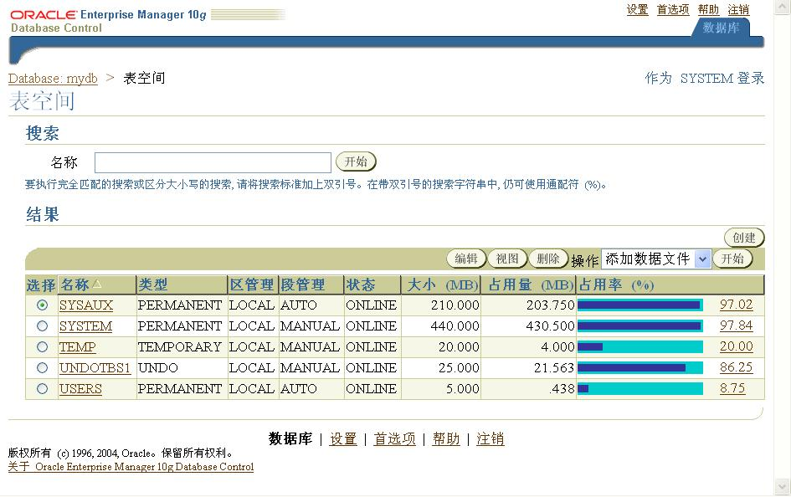
Enterprise Management: Tablespace

Slide 45
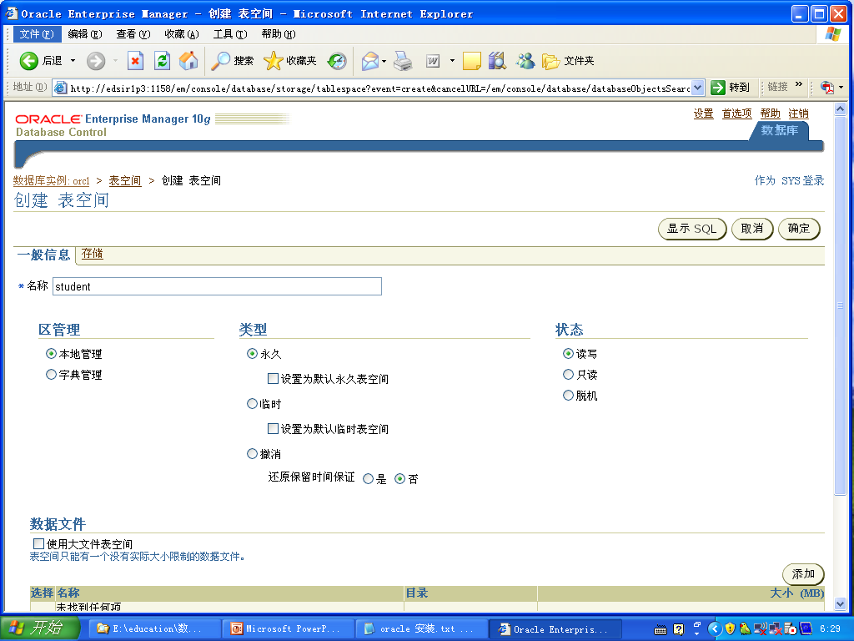

Slide 46
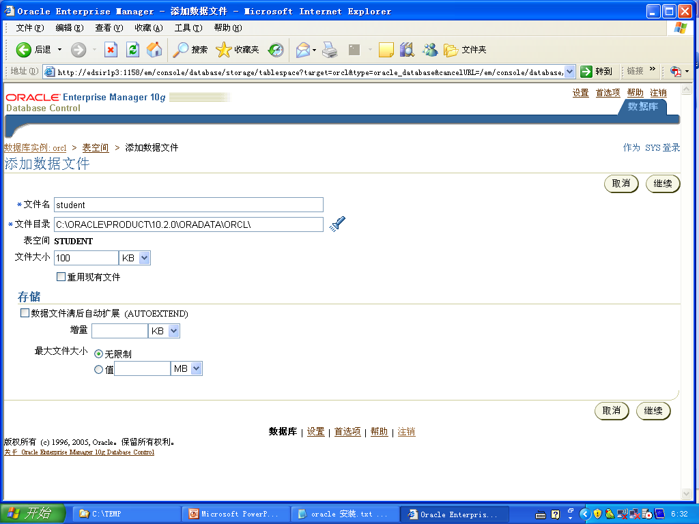

Slide 47
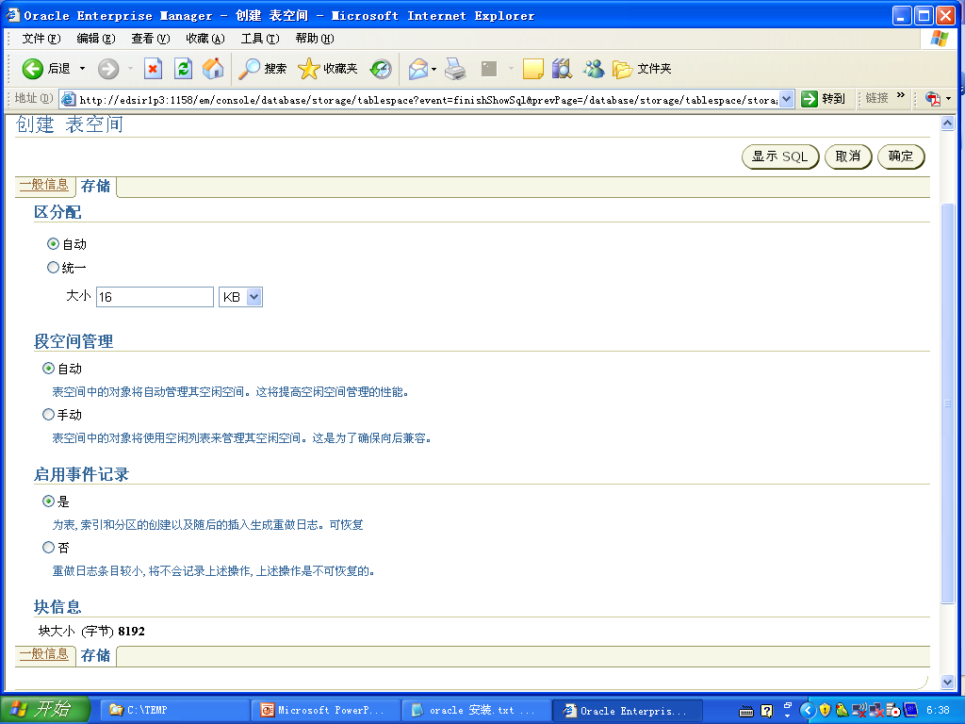
Notes:
CREATE SMALLFILE TABLESPACE "STUDENT" DATAFILE 'C:\ORACLE\PRODUCT\10.2.0\ORADATA\ORCL\student' SIZE 100K LOGGING EXTENT MANAGEMENT LOCAL SEGMENT SPACE MANAGEMENT AUTO
CREATE SMALLFILE TABLESPACE "STUDENT" DATAFILE 'C:\ORACLE\PRODUCT\10.2.0\ORADATA\ORCL\student' SIZE 100K LOGGING EXTENT MANAGEMENT LOCAL UNIFORM SIZE 16K SEGMENT SPACE MANAGEMENT AUTO
CREATE BIGFILE TABLESPACE "STUDENT" DATAFILE 'C:\ORACLE\PRODUCT\10.2.0\ORADATA\ORCL\student' SIZE 100M AUTOEXTEND ON NEXT 10K MAXSIZE UNLIMITED LOGGING EXTENT MANAGEMENT LOCAL SEGMENT SPACE MANAGEMENT AUTO

Slide 48
数据库模式对象
Object Description
Table Basic unit of storage; composed of rows and columns
View Logically represents subsets of data from one or more tables
Sequence Numeric value generator
Index Improves the performance of some queries
Synonym Gives alternative names to objects
Notes:
Database Objects
An Oracle database can contain multiple data structures. Each structure should be outlined in the database design so that it can be created during the build stage of database development.
Table: Stores data
View: Subset of data from one or more tables
Sequence: Numeric value generator
Index: Improves the performance of some queries
Synonym: Gives alternative names to objects
Oracle9i Table Structures
Tables can be created at any time, even while users are using the database.
You do not need to specify the size of any table. The size is ultimately defined by the amount of space allocated to the database as a whole. It is important, however, to estimate how much space a table will use over time.
Table structure can be modified online.
Note: More database objects are available but are not covered in this course.
Instructor Note
Tables can have up to 1,000 columns and must conform to standard database object-naming conventions.
Column definitions can be omitted when using the AS subquery clause. Tables are created without data unless a query is specified. Rows are usually added by using INSERT statements.

Slide 49
Storing User Data
Regular table
Partitioned
table
Index-organized
table
Cluster
Notes:
Using Different Methods for Storing User Data
There are several methods for storing user data in an Oracle database:
Regular tables
Partitioned tables
Index-organized tables
Clustered tables
Note: Partitioned tables, index-organized tables, and clustered tables are covered in other courses.
Regular Table
A regular table (generally referred to as a “table”) is the most commonly used form of storing user data. This is the default table and is the main focus of discussion in this lesson. A database administrator has very limited control over the distribution of rows in an unclustered table. Rows can be stored in any order depending on the activity on the table.

Slide 50
Data Types
Data type
User-defined
Built-in
Scalar
Collection
Relationship
CHAR(N),NCHAR(N)
VARCHAR2(N),
NVARCHAR2(N)
NUMBER(P,S)
DATE
TIMESTAMP
RAW(N)
BLOB,CLOB,
NCLOB,BFILE
LONG,LONG RAW
ROWID,UROWID
VARRAY
TABLE
REF
Notes:
Data Types
Data Type Description
VARCHAR2(size) Variable-length character data
CHAR(size) Fixed-length character data
NUMBER(p,s) Variable-length numeric data
DATE Date and time values
LONG Variable-length character data,up to 2 gigabytes
CLOB Character data up to 4 gigabytes
RAW and LONG RAW Raw binary data
BLOB Binary data up to 4 gigabytes
BFILE Binary data stored in an external file; up to 4 gigabytes
ROWID A 64 base number system representing the unique address of a row in its table

Slide 51
The create TABLE Statement
CREATE TABLE EMPLOYEES(
empno NUMBER(5) PRIMARY KEY,
ename VARCHAR2(15) NOT NULL,
job VARCHAR2(10),
hiredate DATE DEFAULT(sysdate))
TABLESPACE users
PCTFREE 20
PCTUSED 40
STORAGE(INITIAL 50K
NEXT 50K
MAXEXTENTS 10
PCTINCREASE 25);
Notes:
The ALTER TABLE Statement
After you create a table, you may need to change the table structure because: you omitted a column, your column definition needs to be changed, or you need to remove columns. You can do this by using the ALTER TABLE statement.
Alter table tablename drop constraints contraints_name

Slide 52
创建表的条件
1.用户在表空间有配额
CREATE USER USERNAME
IDENTIFIED BY PASSWORD
DEFAULT TABLESPACE users
TEMPORARY TABLESPACE temp
QUOTA 15m ON users;
2.用户有创建表的权限
Grant create table to USERNAME

Slide 53
序列(Sequence)
自动产生的唯一的数字
是一个共享对象
主要用于创建主键值
CREATE SEQUENCE sequence
[INCREMENT BY n]
[START WITH n]
[{MAXVALUE n | NOMAXVALUE}]
[{MINVALUE n | NOMINVALUE}]
[{CYCLE | NOCYCLE}]
[{CACHE n | NOCACHE}];
Notes:
What Is a Sequence? 序列或序列发生器
序列可以在多用户并发环境为各个用户生成不会重复的顺序整数。
A sequence is a user created database object that can be shared by multiple users to generate unique integers.
A typical usage for sequences is to create a primary key value, which must be unique for each row. The sequence is generated and incremented (or decremented) by an internal Oracle routine. This can be a time-saving object because it can reduce the amount of application code needed to write a sequence-generating routine.
Sequence numbers are stored and generated independently of tables. Therefore, the same sequence can be used for multiple tables.
将序列的定义存储在数据字典中，序列并不占用实际存储空间。

Slide 54
使用系列( Sequence)
定义 sequence
  NEXTVAL returns the next available sequence value. It returns a unique value every time it is referenced, even for different users.
  CURRVAL obtains the current sequence value.
例: Insert a order into order table.
例: View the current value for the orderno_seq sequence.
CREATE SEQUENCE orderno_seq
INCREMENT BY 1
START WITH 1200
INSERT INTO orders(orderno,month,cid,aid,
pid,qty,dollars)
VALUES (orderno_seq.NEXTVAL,
‘jul',’c006’,’a06’,’p01’,900,800.0);
SELECT orderno_seq.CURRVAL FROM dual;
Notes:
Using a Sequence
The example on the slide inserts a new department in the DEPARTMENTS table. It uses the DEPT_DEPTID_SEQ sequence for generating a new department number as follows:
You can view the current value of the sequence:
SELECT dept_deptid_seq.CURRVAL
FROM dual;
Suppose now you want to hire employees to staff the new department. The INSERT statement to be executed for all new employees can include the following code:
INSERT INTO employees (employee_id, department_id, ...)
VALUES (employees_seq.NEXTVAL, dept_deptid_seq .CURRVAL, ...);
Note: The preceding example assumes that a sequence called EMPLOYEE_SEQ has already been created for generating new employee numbers.

Slide 55
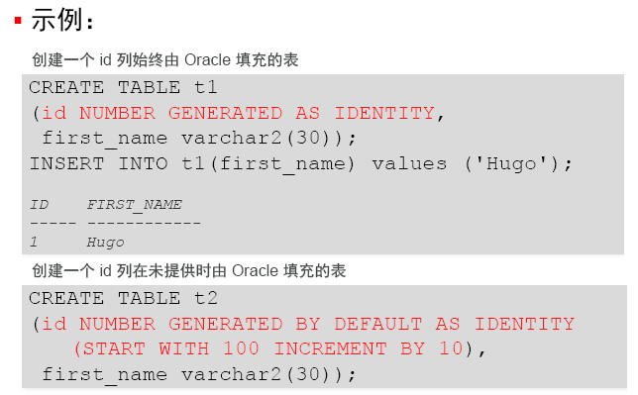
IDENTITY

Slide 56
同义词(Synonyms)
一个对象的另一个名字,用于简化对对象的访问.
  Ease referring to a table owned by another user
  Shorten lengthy object names
Example: Create a shortened name for the
agentsorders view
CREATE [PUBLIC] SYNONYM synonym
FOR object;
CREATE SYNONYM ord FOR agentorders;
Synonym Created.
Notes:
同义词：
（1）为重要的对象创建同义词，隐含名称
（2）在分布式数据库中，为存储在远程数据库中的对象创建同义词，使得用户可以象引用本地对象一样对远程对象进行操作。
（3）为名称很长的复杂的数据库对象创建同义词，以简化SQL语句。
公有同义词：为一个特殊用户组PUBLIC所拥有，数据库所有用户都可使用。
私有同义词：只为用户使用，并可控制别人使用
Creating a Synonym for an Object
To refer to a table owned by another user, you need to prefix the table name with the name of the user who created it followed by a period. Creating a synonym eliminates the need to qualify the object name with the schema and provides you with an alternative name for a table, view, sequence, procedure, or other objects. This method can be especially useful with lengthy object names, such as views.
In the syntax:
PUBLIC creates a synonym accessible to all users
synonym is the name of the synonym to be created
object identifies the object for which the synonym is created
Guidelines
The object cannot be contained in a package.
A private synonym name must be distinct from all other objects owned by the same user.
For more information, see Oracle9i SQL Reference, “CREATE SYNONYM.”

Slide 57
Oracle 的体系结构
系统结构组件
存储结构
  逻辑存储结构
  物理存储结构
内存结构
进程结构

Slide 58
物理存储结构
控制文件
数据文件
重做日志文件
Data files
Control files
Redo log files
Datafile1
Datafile2
Datafile3
Datafile4
System Tablespace
User1 Tablespace
User2 Tablespace
Notes:
数据库物理存储结构一共包括如下地三种类型的物理文件：
数据文件：表空间物理上对应一个或多个数据文件
控制文件：很小的操作系统文件，其中记录着系统的逻辑结构和物理结构等基本信息，是数据库的关键文件。每个数据库至少必须有一个控制文件。数据库实例再加载数据库时，必须读取控制文件以获得数据库的基本信息。
重做日志文件：保存redo信息的数据文件。重做信息记录了数据库中的已经发生的重要变化。重做信息的最初作用是为了实现数据库的“延迟写入”功能，即用户对数据库的修改并不是直接写入硬盘的，而是首先记录再内存中，等待某个时机成批写入硬盘，但是事务的重做信息会随时写入重做日志文件。
在发生故障时，可以利用重做信息来恢复内存中丢失的数据修改信息，以维护数据库的完整性和一致性。每一个Oracle数据库至少要求具有两个重做日志文件。

Slide 59
控制文件(Control File)
每个 数据库oracle都有一个控制文件,用于记录描述数据库的外部结构,包括
数据库的名称和建立时间
数据文件和重做日志文件的名称
及其位置
日志记录序列码
Database
Control files
Notes:
Control File
The control file is a small binary file necessary for the database to start and operate successfully. Each control file is associated with only one Oracle database. Before a database is opened, the control file is read to determine if the database is in a valid state to use. A control file is updated continuously by the Oracle server during database use, so it must be available for writing whenever the database is open. The information in the control file can be modified only by the Oracle server; no database administrator or end user can edit the control file. If for some reason the control file is not accessible, the database does not function properly. If all copies of a database’s control files are lost, the database must be recovered before it can be opened. At least one control file is required, but control files can be multiplexed up to eight times.

Slide 60
数据文件(Data File)
每一个数据文件只与一个数据库相联系。
一个表空间可包含一个或多个数据文件。
一个数据文件只能属于一个表空间。

Slide 61
重做日志文件
重做日志文件记录用户对数据库的所进行的修改操作,当数据库中的数据遭到破坏时, 可以用这些日志修复数据库 .
每个数据库至少需要两个重做日志文件.
Oracle 以循环方式向重做日志文件写入.
Database
Redo log files
Notes:
Purposes of the Redo Log Files
Redo log files provide the means to redo transactions in the event of a database failure. Every transaction is written synchronously to the redo log files in order to provide a recovery mechanism in case of media failure. (With exceptions such as: direct loads and direct reads done with the NOLOGGING option.) This includes transactions that have not yet been committed, undo segment information, and schema and object management statements. Redo log files are used in a situation such as an instance failure to recover committed data that has not been written to the data files. The redo log files are used only for recovery.

Slide 62
重做日志文件的结构
Group 1
Group 2
Group 3
Disk 1
Member
Member
Member
Member
Member
Member
Disk 2
Redo logs are used in a cyclic fashion.When a redo log file is full, LGWR will move to the next log group (called log switch).
  Checkpoint operation also occurs
  Information is written to the control file
Notes:
Structure of the Redo Log Files
The database administrator can set up the Oracle database to maintain copies of online redo log files to avoid losing database information due to a single point of failure.
Online Redo Log Groups
A set of identical copies of online redo log files is called an online redo log group.
The LGWR background process concurrently writes the same information to all online redo log files in a group.
The Oracle server needs a minimum of two online redo log file groups for the normal operation of a database.
Online Redo Log Members
Each online redo log file in a group is called a member.
Each member in a group has identical log sequence numbers and the same size. The log sequence number is assigned each time the Oracle server starts writing to a log group to identify each redo log file uniquely. The current log sequence number is stored in the control file and in the header of all data files.

Slide 63
Oracle 的体系结构
系统结构组件
存储结构
  逻辑存储结构
  物理存储结构
内存结构
进程结构

Slide 64
内存结构
Oracle 内存结构由两种内存区域组成:
System Global Area (SGA: 系统全局区): 在实例启动时分配, 是实例基本组件, 可由所有 server processes 和 background processes共享
Program Global Area (PGA: 程序全局区):在server process启动时分配，此区域是每个服务进程和后台进程所私有的；即每个进程都有一个属于自己的 PGA。
Notes:
System Global Area 是一块巨大的共享内存区域

Slide 65
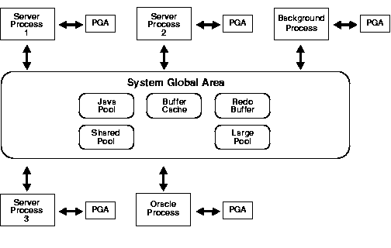

Slide 66
System Global Area (SGA)
SGA 由几个内存结构组成:
  Shared pool (共享池)
  Database buffer cache (数据库缓存/缓冲区高速缓存)
  Redo log buffer (重做日志缓存)
SGA 中有两个可选的内存结构:
  Large pool (大型池)
  Java pool (Java池)
Size based on SGA_MAX_SIZE in parameter file
Notes:
System Global Area
The SGA is also called the shared global area. It is used to store database information that is shared by database processes. It contains data and control information for the Oracle server and is allocated in the virtual memory of the computer where Oracle resides.
The following statement can be used to view SGA memory allocations:
SHOW SGA;
Total System Global Area 36437964 bytes
Fixed Size 6543794 bytes
Variable Size 19521536 bytes
Database Buffers 16777216 bytes
Redo Buffers 73728 bytes

Slide 67
Shared Pool(共享池)
shared pool 用于存储最近使用的 SQL 语句和最近使用数据定义，它由两个与性能相关的内存结构组成：
  Library cache (库缓存)
  Data dictionary cache (数据字典缓存)
Sized by the parameter SHARED_POOL_SIZE.
Shared pool
Library
cache
ALTER SYSTEM SET
SHARED_POOL_SIZE = 64M;
Data dictionary
cache
Notes:
Shared Pool
The shared pool environment contains both fixed and variable structures. The fixed structures remain relatively the same size, whereas the variable structures grow and shrink based on user and program requirements. The actual sizing for the fixed and variable structures is based on an initialization parameter and the work of an Oracle internal algorithm.
Sizing the Shared Pool
Since the shared pool is used for objects that can be shared globally, such as reusable SQL execution plans; PL/SQL packages, procedures, and functions; and cursor information, it must be sized to accommodate the needs of both the fixed and variable areas. Memory allocation for the shared pool is determined by the SHARED_POOL_SIZE initialization parameter. It can be dynamically resized using ALTER SYSTEM SET. After performance analysis, this can be adjusted but the total SGA size cannot exceed SGA_MAX_SIZE.

Slide 68
Library Cache(库缓存)
library cache 存储有关最近最常使用SQL and PL/SQL 语句.
使得可以共享SQL语句和在PL/SQL中写的过程化代码
由 least recently used (LRU) algorithm 管理
组成:
  Shared SQL area, private SQL areas (in the case of a shared server)
  Shared PL/SQL area
大小由共享池大小有关
Notes:
Library Cache
The library cache size is based on the sizing defined for the shared pool. Memory is allocated when a statement is parsed or a program unit is called. If the size of the shared pool is too small, statements are continually reloaded into the library cache, which affects performance. The library cache is managed by a least recently used (LRU) algorithm. As the cache fills, less recently used execution paths and parse trees are removed from the library cache to make room for the new entries. If the SQL or PL/SQL statements are not reused, they eventually are aged out.
The library cache consists of two structures:
Shared SQL: The Shared SQL stores and shares the execution plan and parse tree for SQL statements run against the database. The second time that an identical SQL statement is run, it is able to take advantage of the parse information available in the shared SQL to expedite its execution. To ensure that SQL statements use a shared SQL area whenever possible, the text, schema, and bind variables must be exactly the same.
Shared PL/SQL: The shared PL/SQL area stores and shares the most recently executed PL/SQL statements. Parsed and compiled program units and procedures (functions, packages, and triggers) are stored in this area.

Slide 69
Data Dictionary Cache(数据字典缓存)
data dictionary cache 存储最近最常使用的数据库定义信息.
It includes information about database files, tables, indexes, columns, users, privileges, and other database objects.
During the parse phase, the server process looks at the data dictionary for information to resolve object names and validate access.
Caching the data dictionary information into memory improves response time on queries.
Size is determined by the shared pool sizing.
Notes:
Data Dictionary Cache
The data dictionary cache is also referred to as the dictionary cache or row cache. Caching data dictionary information into memory improves response time. Information about the database (user account data, data file names, segment names, extent locations, table descriptions, and user privileges) is stored in the data dictionary tables. When this information is needed by the database, the data dictionary tables are read, and the data that is returned is stored in the data dictionary cache.
Sizing the Data Dictionary
The overall size is dependent on the size of the shared pool size and is managed internally by the database. If the data dictionary cache is too small, then the database has to query the data dictionary tables repeatedly for information needed by the database. These queries are called recursive calls and are slower than the queries that are handled by the data dictionary cache.

Slide 70
Database Buffer Cache(数据高速缓存)
数据高速缓存用于存储从数据文件（datafile）读出的数据块（data block）副本.
用于提高性能
由 least recently used (LRU)
algorithm 管理
由DB_CACHE_SIZE 决定大小
数据高速缓存大小可以用ALTER SYSTEM 命令动态改变
Database buffer
cache
ALTER SYSTEM SET DB_CACHE_SIZE = 96M;
Notes:
Database Buffer Cache
When a query is processed, the Oracle server process looks in the database buffer cache for any blocks it needs. If the block is not found in the database buffer cache, the server process reads the block from the data file and places a copy in the database buffer cache. Because subsequent requests for the same block may find the block in memory, the requests may not require physical reads. The Oracle server uses a least recently used algorithm to age out buffers that have not been accessed recently to make room for new blocks in the database buffer cache.

Slide 71
Database Buffer Cache (Cont.)
缓存类型
  Dirty buffers: contain data that has been modified but has not yet been written to disk
  Free buffers: available for use
  Pinned buffers (命中缓存块) : currently being accessed
SGA
DB buffer cache
LRU list
Write list
.
.
.
.
.
.
.
.
通过两个列表管理
  待写列表(Write list): holds dirty buffers
  最近最少使用列表(LRU list): holds free buffers, pinned buffers, and dirty buffers that have not yet been moved to the write list
Notes:
Database Buffer Cache (continued)
Sizing the Database Buffer Cache
The size of each buffer in the buffer cache is equal to the size of an Oracle block, and it is specified by the DB_BLOCK_SIZE parameter. The database buffer cache consists of independent sub-caches for buffer pools and for multiple block sizes. The parameter DB_BLOCK_SIZE determines the primary block size, which is used for the SYSTEM tablespace.
Three parameters define the sizes of the buffer caches:
DB_CACHE_SIZE: Sizes the default buffer cache size only, it always exists and cannot be set to zero.
DB_KEEP_CACHE_SIZE: Sizes the keep buffer cache, which is used to retain blocks in memory that are likely to be reused.
DB_RECYCLE_CACHE_SIZE: Sizes the recycle buffer cache, which is used to eliminate blocks from memory that have little change of being reused.
Multiple Block Sizes
An Oracle database can be created with a standard block size and up to four non-standard block sizes. Non-standard block sizes can have any power-of-two value between 2 KB and 32 KB.
Note: Multiple block sizing is covered further in the Oracle9i Performance Tuning course.

Slide 72
Redo Log Buffer Cache(重做日志缓存)
redo log buffer cache用来保存还没有写到磁盘的redo日志内容.
主要用于恢复.
以重做条目（redo entry）的形式进行存储.
SGA 内一块被循环使用的缓冲区
大小由LOG_BUFFER
决定
Redo log
buffer cache
Notes:
Redo Log Buffer Cache
The redo log buffer cache is a circular buffer that contains changes made to data file blocks. This information is stored in redo entries. Redo entries contain the information necessary to recreate the data prior to the change made by INSERT, UPDATE, DELETE, CREATE, ALTER, or DROP operations.
Sizing the Redo Log Buffer Cache
The size of the redo log buffer cache is defined by the initialization parameter LOG_BUFFER.
Note: Sizing the Redo Log Buffer Cache is covered in further detail in the Oracle9i Performance Tuning course. Refer to the Managing Redo Log Files lesson for details regarding redo log files.

Slide 73
Large Pool(大型池)
large pool是可选内存区域，供一次性大量的内存分配使用
主要用于Oracle 备份与恢复操作，I/O 服务进程，及并行执行缓存所需的存储空间.减少这些操作给共享池带来的负担.
不像shared pool, 不使用LRU 列表.
大小由LARGE_POOL_SIZE决定.
ALTER SYSTEM SET LARGE_POOL_SIZE = 64M;
Notes:
By allocating session memory from the large pool for shared server, Oracle XA, or parallel query buffers, Oracle can use the shared pool primarily for caching shared SQL and avoid the performance overhead caused by shrinking the shared SQL cache.
In addition, the memory for Oracle backup and restore operations, for I/O server processes, and for parallel buffers is allocated in buffers of a few hundred kilobytes.
The large pool is better able to satisfy such large memory requests than the shared pool.
The large pool does not have an LRU list. It is different from reserved space in the shared pool, which uses the same LRU list as other memory allocated from the shared pool.
Java Pool
Java pool memory is used in server memory for all session-specific Java code and data
within the JVM. Java pool memory is used in different ways, depending on what mode
the Oracle server is running in.
Large Pool
When users connect through the shared server, Oracle needs to allocate additional space in the shared pool for storing information about the connections between the user processes, dispatchers, and servers. The large pool relieves the burden on areas within the shared pool. The shared pool does not have to give up memory for caching SQL parse trees in favor of shared server session information, I/O, and backup and recover processes. The performance gain is from the reduction of overhead from increasing and shrinkage of the shared SQL cache.
Backup and Restore
Recovery Manager (RMAN) uses the large pool when the BACKUP_DISK_IO= n and BACKUP_TAPE_IO_SLAVE = TRUE parameters are set. If the large pool is configured but is not large enough, the allocation of memory from the large pool fails. RMAN writes an error message to the alert log file and does not use I/O slaves for backup or restore.
Sizing the Large Pool
The large pool is sized in bytes defined by the LARGE_POOL_SIZE parameter.

Slide 74
Java 池
供各会话内运行的 Java 代码及 JVM 内的数据使用的。

Slide 75
Oracle 的体系结构
系统结构组件
存储结构
  逻辑存储结构
  物理存储结构
内存结构
进程结构

Slide 76
Process Structure(进程结构)
Oracle 系统中的各种进程可以被分为两大类：.
用户进程:当用户运行一个应用程序（例如 Pro*C 程序）或 Oracle 工具（例如企业管理器或 SQL*Plus）时启动
Oracle 进程：
  Server process: Connects to the Oracle Instance and is started when a user establishes a session.
  Background process: Available when an Oracle instance is started

Slide 77
User Process(用户进程)
当用户运行一个应用程序或 Oracle 工具时，
Oracle 将创建一个用户进程（user process）来运行用户的应用程序
用户通过用户进程与 Oracle 实例建立的连接
用户进程通过服务进程和DB server通信
Server
process
User
process
Connection
established
Database user
Notes:
User Process
A database user who needs to request information from the database must first make a connection with the Oracle server. The connection is requested using a database interface tool, such as SQL*Plus, and beginning the user process. The user process does not interact directly with the Oracle server. Rather it generates calls through the user program interface (UPI), which creates a session and starts a server process.

Slide 78
Server Process(服务进程)
服务进程处理连接到实例的用户进程提交的请求.
解析、运行应用程序提交的 SQL 语句
如果数据在 SGA 中不存在，则将所需的数据块从磁盘上的数据文件读入 SGA 的数据缓存区（shared database buffer）
以应用程序能理解的形式返回 SQL 语句的执行结果.
Server
process
Connection established
Session created
User
process
Oracle server
Database user
Notes:
Server Process
Once a user has established a connection, a server process is started to handle the user processes requests. A server process can be either a dedicated server process or a shared server process. In a dedicated server environment, the server process handles the request of a single user process. Once a user process disconnects, the server process is terminated. In a shared server environment, the server process handles the request of several user processes. The server process communicates with the Oracle server using the Oracle Program Interface (OPI).
Note: Allocation of server process in a dedicated environment versus a shared environment is covered in further detail in the Oracle9i Performance Tuning course.

Slide 79
Background Processes(后台进程)
后台进程用于实现为多用户提供服务且保证系统性能.
主要后台进程
    DBWn PMON CKPT
    LGWR SMON
可选后台进程
    ARCn RECO
Notes:
Background Processes
The Oracle architecture has five mandatory background processes that are discussed further in this lesson. In addition to the mandatory list, Oracle has many optional background process that are started when their option is being used. These optional processes are not within the scope of this course, with the exception of the ARCn background process. Following is a list of some optional background processes:
RECO: Recoverer
QMNn: Advanced Queuing
ARCn: Archiver
LCKn: RAC Lock Manager—Instance Locks
LMON: RAC DLM Monitor—Global Locks
LMDn: RAC DLM Monitor—Remote Locks
CJQ0: Snapshot Refresh
Dnnn: Dispatcher
Snnn: Shared Server
Pnnn: Parallel Query Slaves

Slide 80
数据写入进程(Database writer: DBWn)
在下列情况下, DBWn 写数据:
检查点
脏缓存达到阈值
没有空闲缓存
超时
RAC (Real Application Cluster) ping 请求
表空间设为脱机
表空间设为只读
DROP 或 TRUNCATE 表
表空间 BEGIN BACKUP
Instance
SGA
Database
buffer
cache
DBWn
Data files
Control files
Redo log files
Database
Notes:
Database Writer
The server process records changes to rollback and data blocks in the buffer cache. Database Writer (DBWn) writes the dirty buffers from the database buffer cache to the data files. It ensures that a sufficient number of free buffers—buffers that can be overwritten when server processes need to read in blocks from the data files—are available in the database buffer cache. Database performance is improved because server processes make changes only in the buffer cache.
DBWn defers writing to the data files until one of the following events occurs:
Incremental or normal checkpoint
The number of dirty buffers reaches a threshold value
A process scans a specified number of blocks when scanning for free buffers and cannot fine any.
Timeout occurs.
A ping request in Real Application Clusters environment.
Placing a normal or temporary tablespace offline.
Placing a tablespace in read only mode.
Dropping or Truncating a table.
ALTER TABLESPACE tablespace name BEGIN BACKUP

Slide 81
日志写入进程(log writer :LGWR)
Instance
在下列情况下, LGWR 写日志:
事务提交
每 3 秒写入一次
当重做日志缓冲区的使用容量超过总容量的 1/3
当 DBWn 进程向磁盘写入脏缓冲区时（且相关的重做日志还没有写入磁盘）
SGA
Redo log
buffer
DBWn
LGWR
Data files
Control files
Redo log files
Database
Notes:
LOG Writer
LGWR performs sequential writes from the redo log buffer cache to the redo log file under the following situations:
When a transaction commits
When the redo log buffer cache is one-third full
When there is more than a megabyte of changes records in the redo log buffer cache
Before DBWn writes modified blocks in the database buffer cache to the data files
Every 3 seconds.
Because the redo is needed for recovery, LGWR confirms the commit only after the redo is written to disk.
LGWR can also call on DBWn to write to the data files.
Note: DBWn does not write to the online redo logs.

Slide 82
检查点进程(checkpoint : CKPT)
Instance
在检查点启动 DBWn 进程
用检查点信息更新所有数据文件的文件头
用检查点信息更新所有控制文件的文件头
Instance
SGA
SGA
Redo Log
Buffer
DBWn
LGWR
DWW0
LGWR
CKPT
Data files
Control files
Redo log files
Notes:
Checkpoint
An event called a checkpoint occurs when the Oracle background process DBWn writes all the modified database buffers in the SGA, including both committed and uncommitted data, to the data files.
Checkpoints are implemented for the following reasons:
Checkpoints ensure that data blocks in memory that change frequently are written to data files regularly. Because of the least recently used algorithm of DBWn, a data block that changes frequently might never qualify as the least recently used block and thus might never be written to disk if checkpoints did not occur.
Because all database changes up to the checkpoint have been recorded in the data files, redo log entries before the checkpoint no longer need to be applied to the data files if instance recovery is required. Therefore, checkpoints are useful because they can expedite instance recovery.

Slide 83
系统监控进程(System Monitor :SMON)
Instance
Instance
定期地检查系统中是否存在问题
实例恢复:
  根据日志前滚
  打开数据库让用户访问
  回滚未提交事务
合并空闲空间
清除系统中不再使用的临时段
SGA
SGA
SMON
SMON
Data files
Control files
Redo log files
Database
Notes:
System Monitor
If the Oracle instance fails, any information in the SGA that has not been written to disk is lost. For example, the failure of the operating system causes an instance failure. After the loss of the instance, the background process SMON automatically performs instance recovery when the database is reopened. Instance recovery consists of the following steps:
1. Rolling forward to recover data that has not been recorded in the data files but that has been recorded in the online redo log. This data has not been written to disk because of the loss of the SGA during instance failure. During this process, SMON reads the redo log files and applies the changes recorded in the redo log to the data blocks. Because all committed transactions have been written to the redo logs, this process completely recovers these transactions.
2. Opening the database so that users can log on. Any data that is not locked by unrecovered transactions is immediately available.
3. Rolling back uncommitted transactions. They are rolled back by SMON or by the individual server processes as they access locked data.
SMON also performs some space maintenance functions:
It combines, or coalesces, adjacent areas of free space in the data files.
It deallocates temporary segments to return them as free space in data files. Temporary segments are used to store data during SQL statement processing.

Slide 84
进程监控进程(Process Monitor:PMON)
定期地检查系统中是否有问题需要处理。当一个用户进程失败后，对其进行恢复
回滚事务
清除相关的数据缓存区
释放被此用户进程使用的资源
释放锁
重新启动停止运行的进程
Instance
SGA
PMON
PGA area
Notes:
Process Monitor
The background process PMON cleans up after failed processes by:
Rolling back the user’s current transaction
Releasing all currently held table or row locks
Freeing other resources currently reserved by the user
Restarts dead dispatchers
Dispatchers are covered in further detail in the DBA Fundamentals II course.

Slide 85
归档进程( Archiver ：ARCn)
可选的后台进程
发生日志切换（log switch）时将重做日志文件复制到指定的存储设备中
当数据库运行在 ARCHIVELOG 模式下，且自动归档功能被开启时，系统才会启动 ARCn 进程。
ARCn
Data files
Control files
Redo log files
Archived Redo log files
Notes:
The Archiver Process
All other background processes are optional, depending on the configuration of the database; however, one of them, ARCn, is crucial to recovering a database after the loss of a disk. As online redo log files fill, the Oracle server begins writing to the next online redo log file. The process of switching from one redo log to another is called a log switch. The ARCn process initiates backing up, or archiving, of the filled log group at every log switch. It automatically archives the online redo log before the log can be reused, so that all of the changes made to the database are preserved. This enables the DBA to recover the database to the point of failure, even if a disk drive is damaged.
Archiving Redo Log Files
One of the important decisions that a DBA has to make is whether to configure the database to operate in ARCHIVELOG or in NOARCHIVELOG mode.
NOARCHIVELOG Mode: In NOARCHIVELOG mode, the online redo log files are overwritten each time a log switch occurs. LGWR does not overwrite a redo log group until the checkpoint for that group is complete. This ensures that committed data can be recovered if there is an instance crash. During the instance crash, only the SGA is lost. There is no loss of disks, only memory. For example, an operating system crash causes an instance crash.

Slide 86
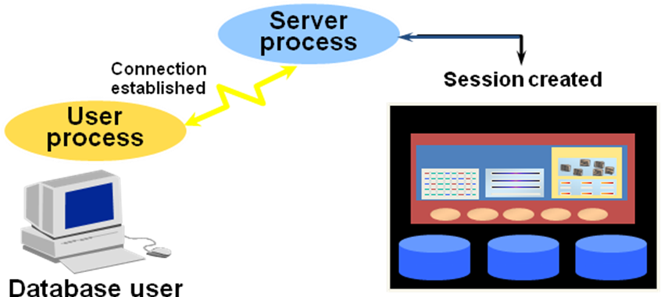
Oracle是怎样工作的

Slide 87
1. 在运行Oracle的计算机上启动一个实例（这台计算机也被称为主机（host）或数据库服务器（databaseserver））。
2. 运行应用程序的计算机（也被称为本地计算机（local computer）或客户端工作站（client workstation））中启动了用户进程（userprocess）。客户端应用程使用与所在网络环境相匹配的Oracle网络服务驱动与服务器建立连接。
3. 数据库服务器也运行与网络环境相匹配的Oracle网络服务驱动。当服务器监听到应用程序的请求后，就建立专用服务器进程为对应的用户进程提供服务。
4. 用户执行SQL语句、提交事务（transaction）。例如，用户改变数据表内某一行的数据。

Slide 88
5. 服务进程收到用户提交的语句后，先在共享池（shared pool）中查找是否存在与此语句相同的共享SQL区（shared SQL area）。如果存在，服务进程就检查用户是否有访问所请求数据的权限，满足权限要求的话，就使用已有的共享SQL区来处理SQL语句。如共享SQL区不存在，服务进程要为用户提交的SQL语句创建新的共享SQL区，用来解析、处理此语句。
6. 服务进程从数据文件（逻辑上看就是数据表）或SGA中获得所需的数据。
7. 服务进程修改SGA中的数据。由于事务已经提交，LGWR进程立即在重做日志文件（redo log file）中记录此事务。而DBWn进程则在适当的时机将修改过的数据块写入磁盘。

Slide 89
8. 如事务成功，服务进程通过网络通知应用程序。如不成功，则向应用程序提交错误信息。
9. 在整个过程中，还有一些未提到的后台进程在运行，她们对整个过程进行监控，在需要时参与进来。此外数据库服务器还要管理其它用户的事务，防止请求相同数据的事务之间产生竞争（contention）。

