Slide 1
软件架构理论及实践
华南理工大学计算机学院
gaoying@scut.edu.cn

Slide 2
课 程 内 容
◇ 软件体系结构概论
◇ 软件体系结构建模
◇ 软件体系结构风格
◇ 软件体系结构描述
◇ 动态软件体系结构
◇ Web服务体系结构
◇ 基于体系结构的软件开发
◇ 软件体系结构的分析与测试
◇ 软件体系结构评估
◇ 软件产品线体系结构

Slide 3
第4章 软件体系结构描述
4.1 软件体系结构描述方法
◇ 描述方法的种类
◎ 图形表达工具
◎ 模块内连接语言
◎ 基于软构件的系统描述语言
◎ 软件体系结构描述语言

Slide 4
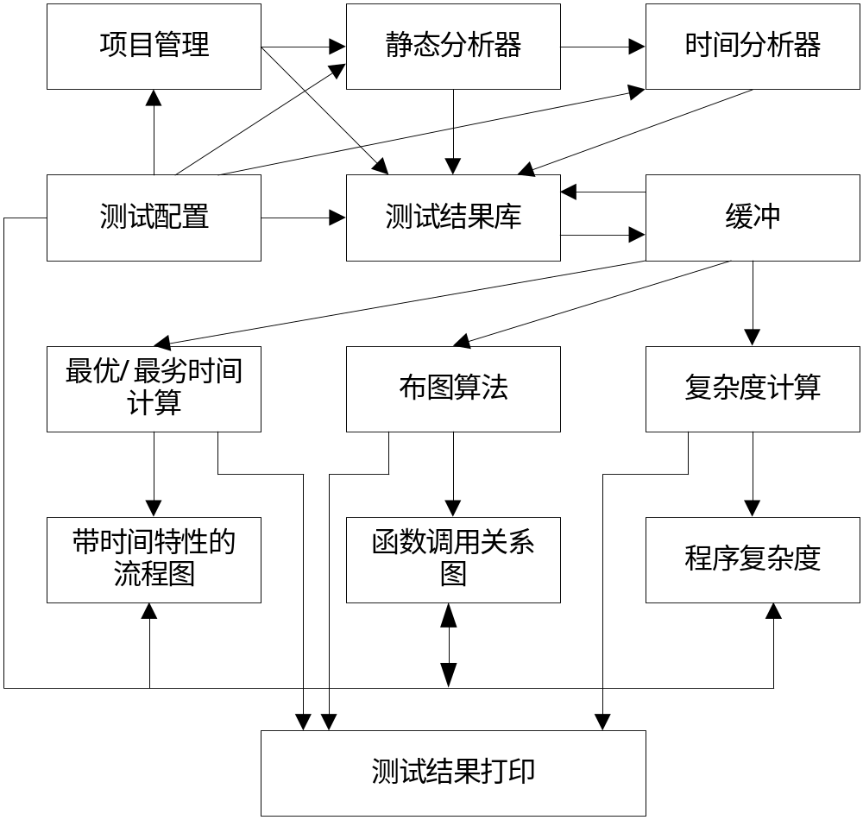
第4章 软件体系结构描述
4.1 软件体系结构描述方法
◇ 图形表达工具

Slide 5
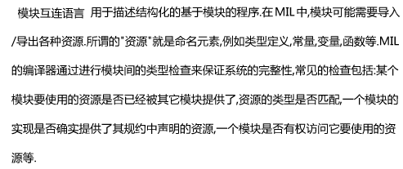
第4章 软件体系结构描述
4.1 软件体系结构描述方法
◇ 模块内连接语言

Slide 6
These early module interconnection languages require considerable prior agreement between the developers of different modules:
all modules are written in the same language;
all modules are available during system construction;
module interfaces describe the other modules with which they interact.
Newer work has begun to soften these restrictions:
modules can be dynamically instantiated and bound at runtime
These modules can be implemented in multiple programming languages
the machinery needed to connect them can be richer than the usual procedure linkage, for example, a software bus

Slide 7
第4章 软件体系结构描述
4.1 软件体系结构描述方法
◇ 基于软构件的系统描述语言
◎ 基于软构件的系统描述语言将软件系统描述成一种是由许多以特定形式相互作用的特殊软件实体构造组成的组织或系统。
◎ 这种表达和描述方式虽然也是较好的一种以构件为单位的软件系统描述方法，但是他们所面向和针对的系统元素仍然是一些层次较低的以程序设计为基础的通信协作软件实体单元，而且这些语言所描述和表达的系统一般而言都是面向特定应用的特殊系统，这些特性使得基于软构件的系统描述仍然不是十分适合软件体系结构的描述和表达。

Slide 8

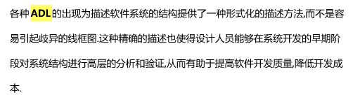
第4章 软件体系结构描述
4.1 软件体系结构描述方法
◇ 软件体系结构描述语言

Slide 9
modeling a component formally is a more precise, and often more concise, way of specifying its functionality.
Furthermore, such specifications could assist in automating the task of locating components in a software component marketplace.
a formal specification of a component can be input to a code generation tool.

Slide 10
第4章 软件体系结构描述
4.1 软件体系结构描述语言
ADL是在底层语义模型的支持下，为软件系统的概念体系结构建模提供了具体语法和概念框架。基于底层语义的工具为体系结构的表示、分析、演化、细化、设计过程等提供支持。其三个基本元素是：构件、连接件、体系结构配置。
主要的体系结构描述语言有Aesop、MetaH、C2、Rapide、SADL、Unicon和Wright等，尽管它们都描述软件体系结构，却有不同的特点。
这些ADL强调了体系结构不同的侧面，对体系结构的研究和应用起到了重要的作用，但也有负面的影响。每一种ADL都以独立的形式存在，描述语法不同且互不兼容，同时又有许多共同的特征，这使设计人员很难选择一种合适的ADL，若设计特定领域的软件体系结构又需要从头开始描述。

Slide 11
Software architectures are multi-dimensional entities that can be fully understood only when viewed at four levels of abstraction:
  internal functionality of a component
  the interface(s) exported by the component to the rest of the system
  interconnection of architectural elements in an Architecture
  rules of the architectural style

Slide 12
Architectural design environments
can provide a platform on which designers can construct an architectural model of a software system
have that model checked for syntactic and semantic correctness
receive domain-specific feedback about various
design qualities, keep track of unfinished steps in the design process, and generate running programs for that system,

Slide 13
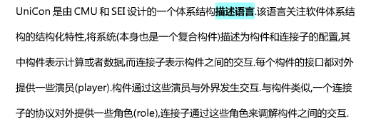
Unicom: Language for Universal Connector Support

Slide 14
UniCon is based on two complementary kinds of constructs: the component and the connector. Their structures are symmetric, except that composite connectors are not yet supported. Each has:
a Name
a specification (called an Interface for a component, a Protocol for a connector)
a component or connector Type
a set of global assertions in the form of a Property List
a collection of association units: Players for components, Roles for connectors.
an Implementation

Slide 15
Components
Components define computational capabilities. A component consists of an interface that specifies the capabilities the component exports and an implementation, which may be primitive or composite.
The interface of a component must be consistent with its implementation. In the case of a primitive implementation, such as a source file or executable, this is the responsibility of the programmer. In the case of a composite implementation, the interface must be consistent with the interfaces of its member components and the protocols of its connectors; its semantics should be derivable from the interfaces of its constituents.

Slide 16
The interface must include:
  the component type
  assertions and constraints that apply to the entire component
  the players defined by the component, which each consist of a name and type and optional attributes like signature, functional specifications, constraints on use, or information required specifically by a component type

Slide 17
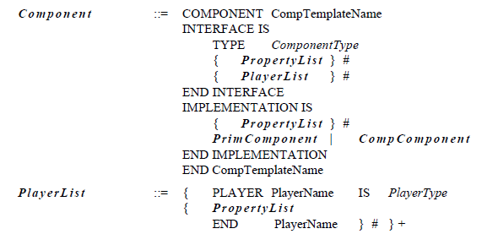

Slide 18

The system supports multiple versions of implementations. The primary current use is for providing source, object, and executable representations. It will also support different implementation variants for debugging, performance monitoring, different libraries, and different performance characteristics. When a component is instantiated, it may supply an attribute to select a variant.

Slide 19
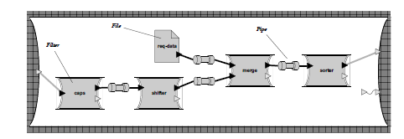
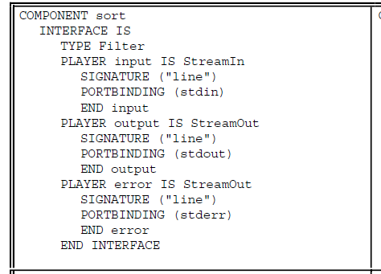
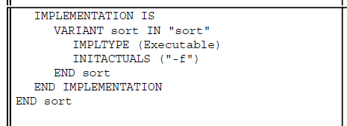

Slide 20
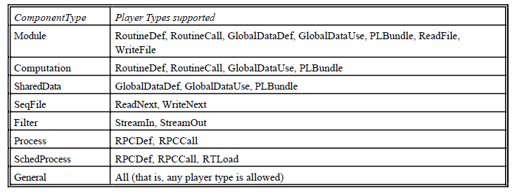
Built-in component types and their players
Component types and player types are currently defined by enumeration

Slide 21
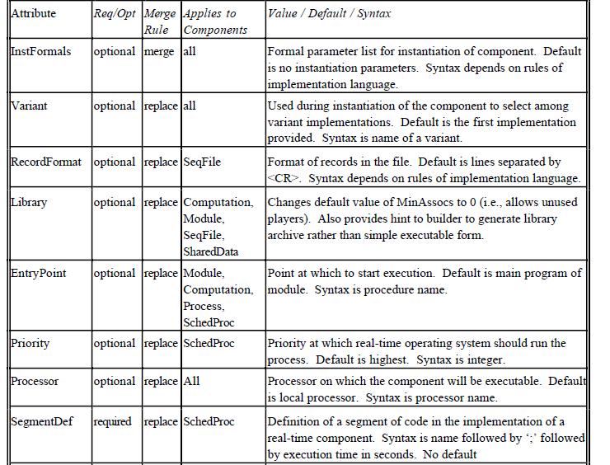
Attributes that apply to components

Slide 22
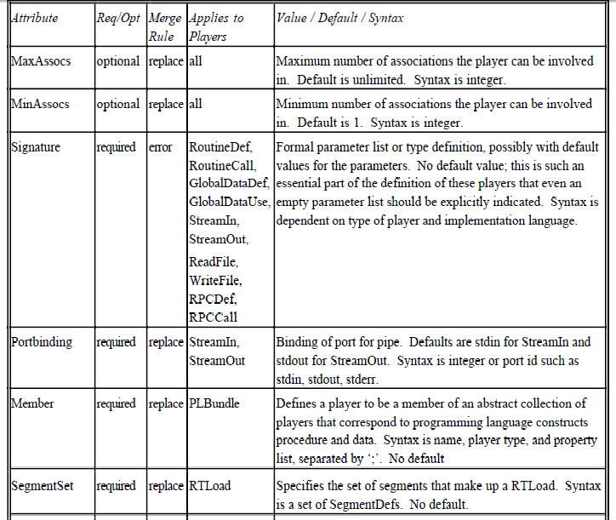
Attributes that apply to Players

Slide 23
Implementation of Primitive Components
Since multiple representations for a component may be available (for example, both source and object code), UniCon allows multiple representations, called variants, to be specified. When a primitive component is instantiated, the Variant attribute can be used to select the preferred variant.

Slide 24
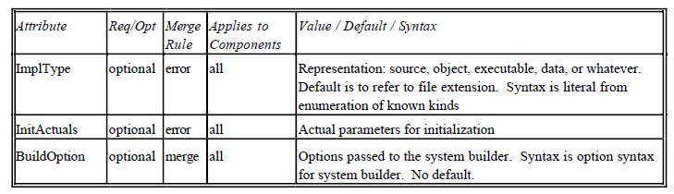
Attributes defined for primitive implementations OF components

Slide 25
Implementation of Composite Components
Composite components provide the capability of building up progressively larger subsystems from components of (potentially different) types. A composite implementation must provide three kinds of information:
  The parts: Instantiations of the components and connectors from which the composite component is constructed.
  The configuration: Specification of how the instantiations of connectors link the instantiations of components, i.e. the associations between players and roles.
  The abstraction: Specification of how the players of the interface will be associated with players of the implementation

Slide 26
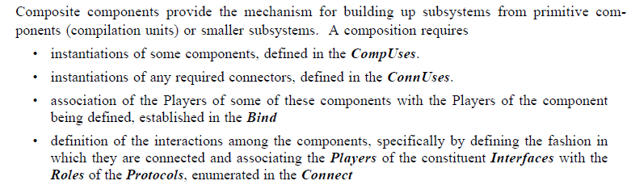
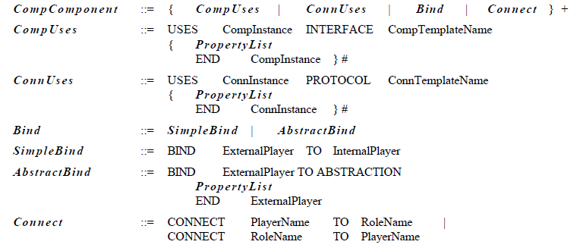

Slide 27
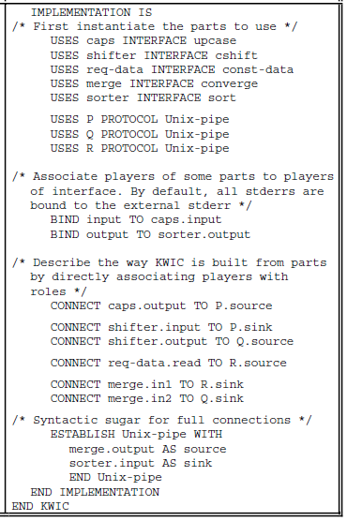
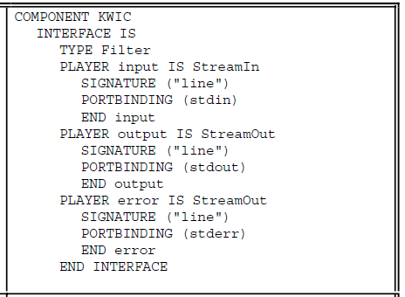

Slide 28
Connectors
Connectors mediate interactions among components. A connector consists of a protocol that specifies the class of interactions the connector provides and an implementation.
The protocol must include:
  the connector type;
  assertions that constrain the entire connector (for example, rules about timing or ordering);these are the commitments about the interaction that the protocol supports;
  the roles that participate in the protocol; each consists of a name and type and optional attributes like signature, functional specifications, or constraints on their use;

Slide 29
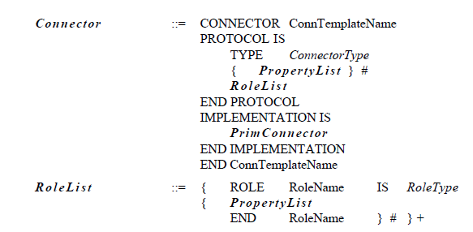
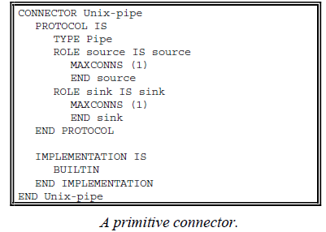
At present, only primitive implementations of connectors are supported.

Slide 30
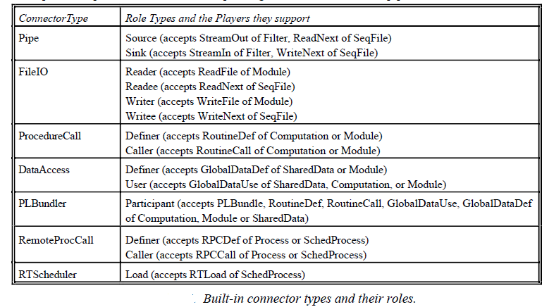
Built-in Connector Types

Slide 31
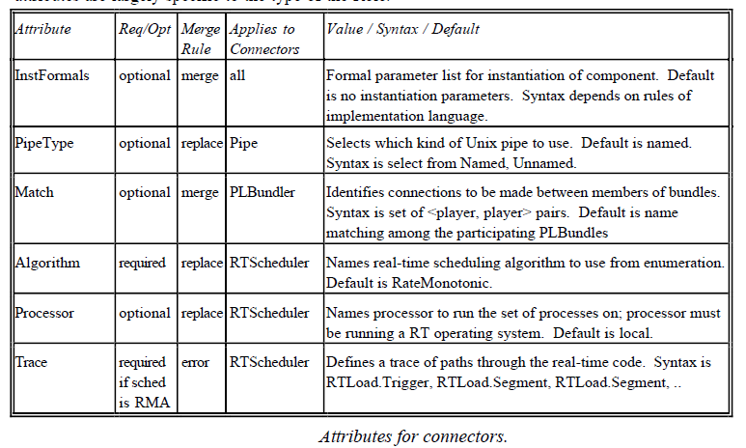
Attributes for connectors

Slide 32
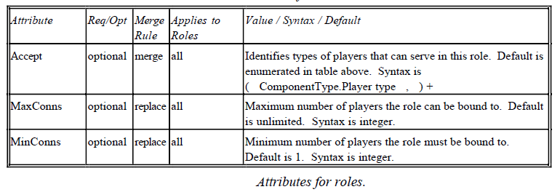
Attributes for roles

Slide 33
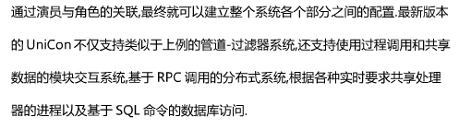
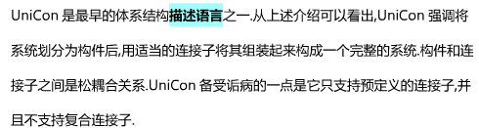

Slide 34
第4章 软件体系结构描述
4.4 典型软件体系结构描述语言
◇ C2概述(1)
C2 is a component- and message-based architectural style designed to support the particular needs of applications :
  have a graphical user interface aspect, with potential for supporting other types of applications;
  components may be written in different programming languages;
  components may be running in a distributed, heterogeneous environment without shared address spaces;
  architectures may be changed dynamically;
  multiple users may be interacting with the system;
  multiple toolkits may be employed;
  multiple media types may be involved.

Slide 35
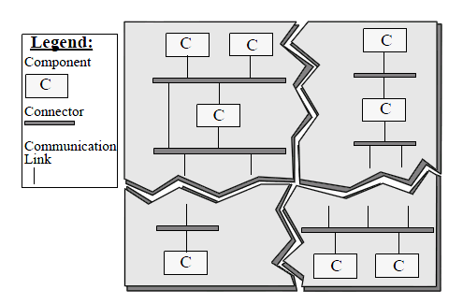
第4章 软件体系结构描述
4.4 典型软件体系结构描述语言
◇ C2概述(2)
The top domain specifies the set of notifications to which a component responds, and the set of requests that the component emits up an architecture.
The bottom domain specifies the set of notifications that this component emits down an architecture and the set of requests to which it responds.
All communication between components is solely achieved by exchanging messages.

Slide 36
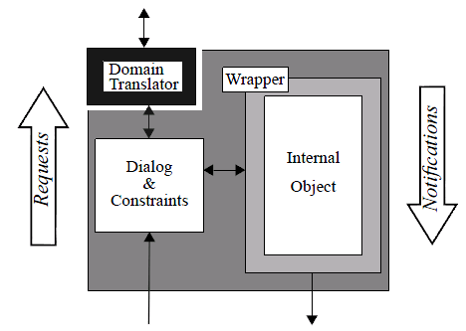
Substrate independence has a clear potential for fostering substitutability and reusability of components across architectures.
Domain translation is a transformation of the requests issued by a component into the specific form understood by the recipient of the request, as well as the transformation of notifications received by a component into a form it understands.

Slide 37
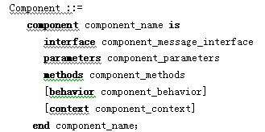
第4章 软件体系结构描述
4.4 典型软件体系结构描述语言
◇ C2对构件接口的描述
“::=” means “is defined as”;
“|” means “or”;
“[...]” denotes an optional item;
“{...}” a repetitive item.
single character terminals, such as a semicolon.

Slide 38
第4章 软件体系结构描述
4.4 典型软件体系结构描述语言
◇ C2对构件的描述
component_message_interface ::=
top_domain_interface
bottom_domain_interface
top_domain_interface ::=
top_domain is
out interface_requests
in interface_notifications
bottom_domain_interface ::=
bottom_domain is
out interface_notifications
in interface_requests
interface_requests ::=
{request；} | null；
interface_notifications ::=
{notification；} | null；
request ::=
message_name(request_parameters)
request_parameters ::=
[to component_name][parameter_list]
notification ::=
message_name[parameter_list]

Slide 39
component_behavior ::=
startup
cleanup
{internal_state_change|message_transition}
message_transition ::=
received_messages
[invoked_methods] generated_messages
received_messages ::=
received_messages
[notification_sequence] [request_sequence]
invoked_methods::=
invoke_methods method_name {, method_name};

Slide 40
generated_messages ::=
[message_generation_frequency request_sequence]
[message_generation_frequency notification_sequence]
message_generation_frequency ::=
always_generate | may_generate
request_sequence ::=
request_name {logical_operator request_name};
notification_sequence ::=
notification_name {logic_operator notification_name};

Slide 41
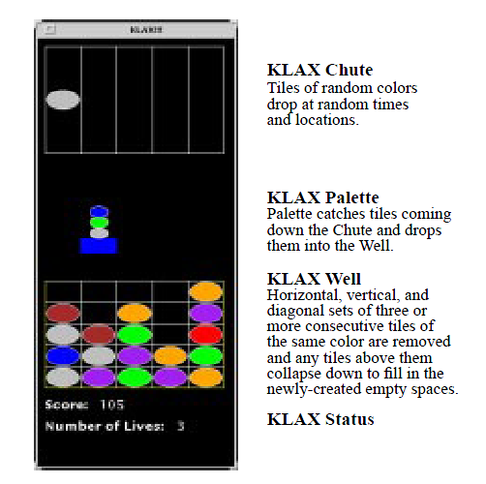

Slide 42
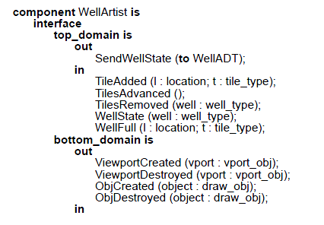
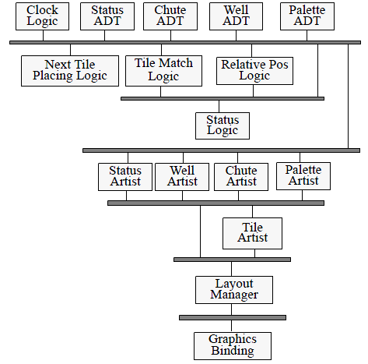
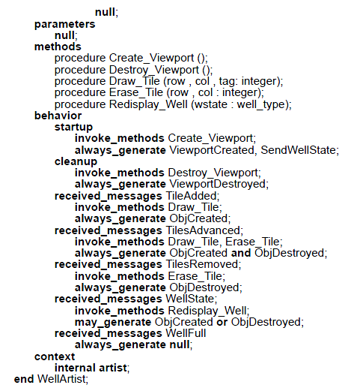

Slide 43
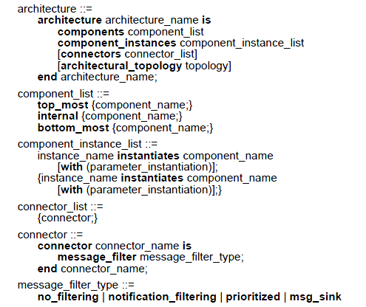
Architectural Description
no_filtering policy:
a simple message router.
Notification_filtering:
a means of message Registration in C2.
Prioritized message :
broadcast allows a connector to define a priority ranking over its connected components whereby a notification is sent to each component in order of priority until a termination condition
has been met.
the msg_sink:
filtering policy allows a connector to ignore each message sent to it

Slide 44
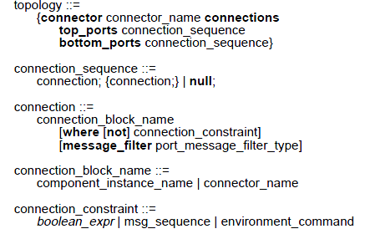
The topology of a C2 architecture is specified as follows:

Slide 45
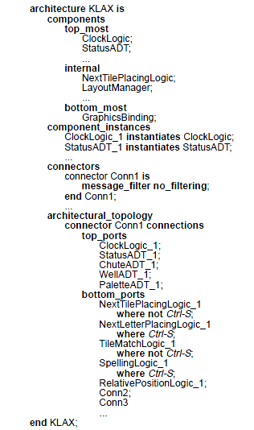
“Ctrl-S” represents :
an example of the
environment_command connection constraint. This example depicts the dynamic substitution of two of three components

Slide 46
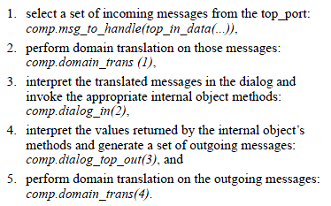

Slide 47
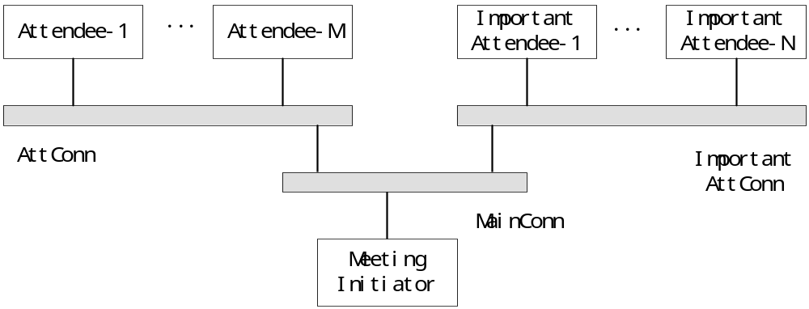
会议安排系统的C2风格

Slide 48
C2对MeetgingInitiator构件的描述(1)
component MeetingInitiator is
interface
top_domain is
out
GetPrefSet()；
GetExclSet()；
GetEquipReqts()；
GetLocPrefs()；
RemoveExclSet()；
RequestWithdrawal(to Attendee)；
RequestWithdrawal(to ImportantAttendee)；
AddPrefDates()；
MarkMtg(d:date；l:lov_type)；

Slide 49
C2对MeetgingInitiator构件的描述(2)
in
PrefSet(p:date_mg)；
ExclSet(e:data_mg)；
EquipReqts(eq:equip_type)；
LocPref(l:loc_type)；
behavior
startup always_generate GetPrefSet， GetExclSet， GetEquipReqts，
GetLocPrefs；
received_messages PrefSet may_generate RemoveExclSet xor
RequestWithdrawal xor MarkMtg；
received_messages ExclSet may_generate AddPrefDates xor RemoveExclSet
xor RequestWithdrawal xor MarkMtg；
received_messages EquipReqts may_generate AddPrefDates xor
RemoveExclSet xor RequestWithdrawal xor MarkMtg；
received_messages LocPref always_generate null；
end MeetingInitiator；

Slide 50
C2对Attendee构件的描述(1)
component Attendee is
interface
bottom_domain is
out
PrefSet(p:date_mg)；
ExclSet(e:date_mg)；
EquipReqts(eq:equip_type)；
in
GetPrefSet()；
GetExclSet()；
GetEquipReqts()；
RemoveExclSet()；
RequestWithdrawal()；
AddPrefDates()；
MarkMtg(d:date；l:loc_type)；

Slide 51
C2对Attendee构件的描述(2)
behavior
received_messages GetPrefSet always_generate PrefSet；
received_messages AddPrefDates always_generate PrefSet；
received_messages GetExclSet always_generate ExclSet；
received_messages GetEqipReqts always_generate EqipReqts；
received_messages RemoveExclSet always_generate ExclSet；
received_messages ReuestWithdrawal always_generate null；
received_messages MarkMtg always_generate null；
end Attendee；

Slide 52
C2对ImportantAttendee构件的描述
component ImportantAttendee is subtype Attendee(in and beh)
interface
bottom_domain is
out
LocPrefs(l:loc_type)；
ExclSet(e:date_mg)；
EquipReqts(eq:equip_type)；
in
GetLocPrefs()；
behavior
received_messages GetLocPrefs always_generate LocPrefs；
end ImportantAttendee；

Slide 53
C2对体系结构的描述
architecture MeetingScheduler is
conceptual_components
Attendee；ImportantAttendee；MeetingInitiator；
connectors
connector MainConn is message_filter no_filtering；
connector AttConn is message_filter no_filtering；
connector ImportantAttConn is message_filter no_filtering；
architectural_topology
connector AttConn connections
top_ports Attendee；
bottom_ports MainConn；
connector ImportantAttConn connections
top_ports ImportantAttendee；
bottom_ports MainConn；
connector MainConn connections
top_ports AttConn；ImportantAttConn；
bottom_ports MeetingInitiator；
end MeetingScheduler；

Slide 54
C2对会议安排系统的描述
system MeetingScheduler_1 is
architecture MeetingScheduler with
Attendee instance Att_1，Att_2，Att_3；
ImportantAttendee instance ImpAtt_1，ImpAtt_2；
MeetingInitiator instance MtgInit_1；
end MeetingScheduler_1；

Slide 55
参考文献：
Medvidovic, N. Formal definition of the chiron-2 software architectural style. UCI-ICS Technical Report UCI-95-24, University of California, Irvine, July 1995.

Slide 56
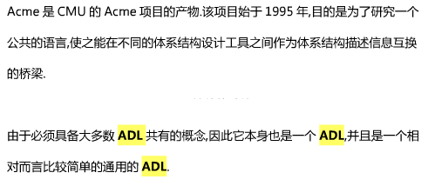

Acme: Architectural Description of Component-Based Systems

Slide 57
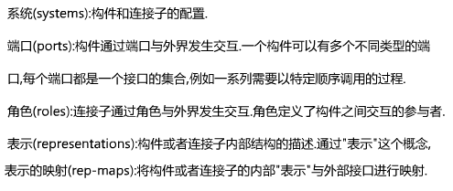
Architectural structure is dened in Acme using seven core types of entities: components, connectors, systems, ports, roles, representations, and rep-maps.

Slide 58
Acme components represent computational elements and data stores of a system. A component may have multiple interfaces, each of which is termed a port. A port identies a point of interaction between the component and its environment.
Acme connectors represent interactions among components. Connectors also have interfaces that are dened by a set of roles.

Slide 59
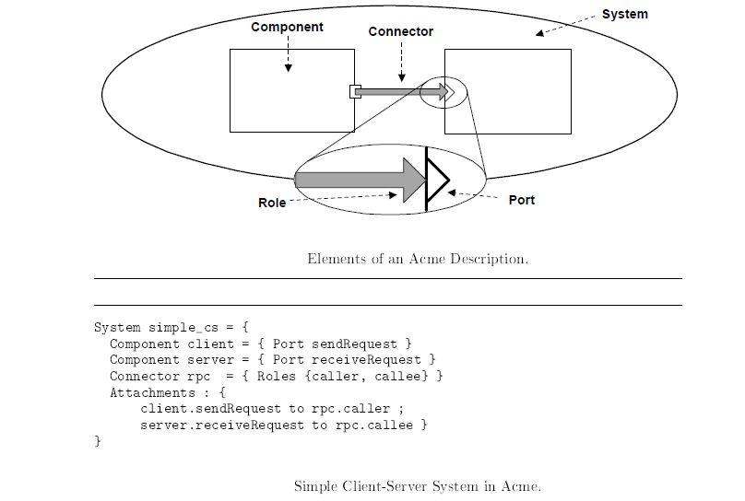

Slide 60
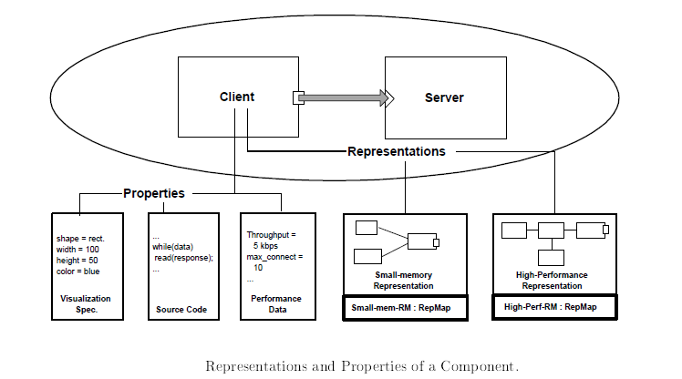
To support hierarchical descriptions of architectures, Acme permits any component or connector to be represented by one or more detailed, lower-level descriptions.Each such description is termed a representation.

Slide 61
When a component or connector has an architectural representation there must be some way to indicate the correspondence between the internal system representation and the external interface of the component or connector that is being represented. A rep-map (short for \representation map") denes this correspondence. In the simplest case a rep-map provides an association between internal ports and external ports.

Slide 62
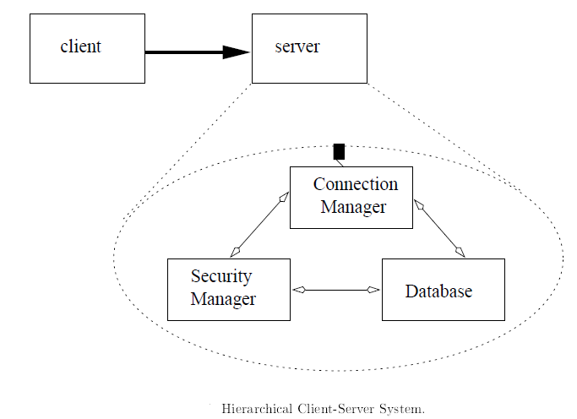
the server component is elaborated by a more detailed architectural representation.

Slide 63
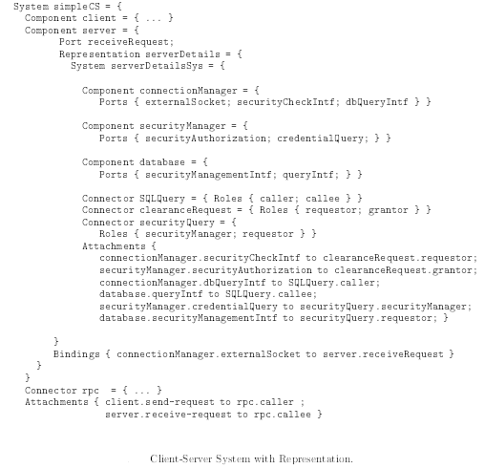

Slide 64
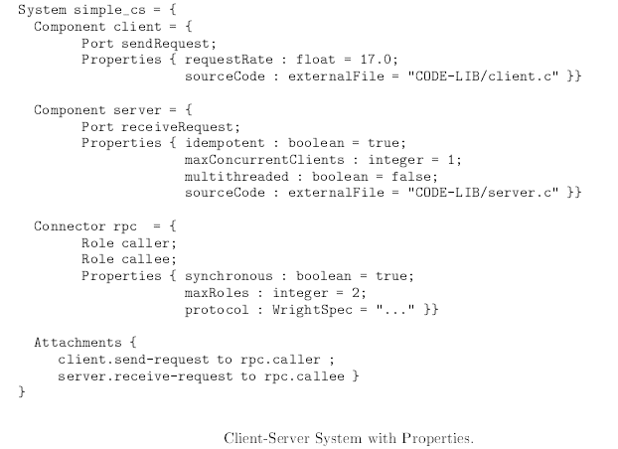
Properties

Slide 65
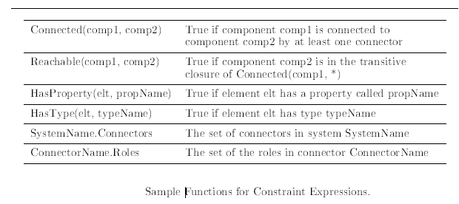
Design Constraints

Slide 66
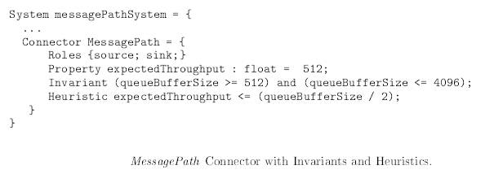


Slide 67

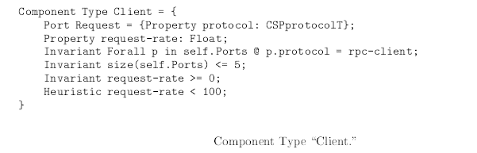

Slide 68
Types and Styles
In Acme an architect can defined three kinds of types: property types, structural types, and styles.
Structural types make it possible to defined types of components, connectors, ports,and roles.

Slide 69
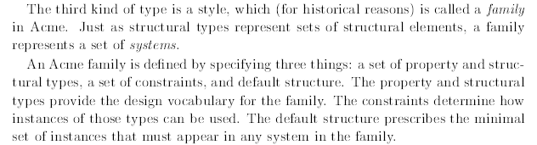

Slide 70
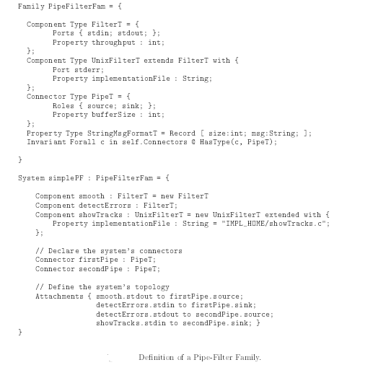

Slide 71
第4章 软件体系结构描述
4.5 软件体系结构与UML
◇ UML简介
◎ UML(Unified Modeling Language)是下面这些最好的建模方法中最好部分的集成:
◇ 商务流程模型(Work Flow)
◇ 对象建模方法
◇ 软构件建模思想
◎ UML是一种用可视化方法对软件系统进行描述、实施和说明的标准语言。
◎ 支持用不同实现技术进行的软件开发全过程。

Slide 72
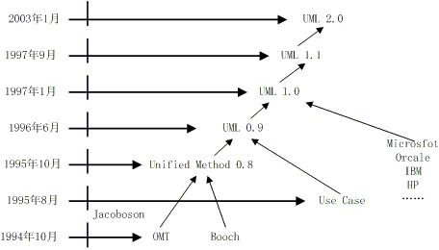
第4章 软件体系结构描述
4.5 软件体系结构与UML
◇ UML简介

Slide 73
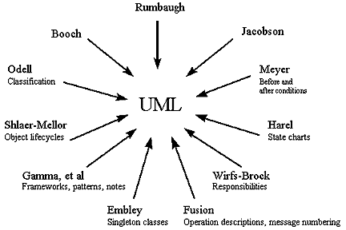
第4章 软件体系结构描述
4.5 软件体系结构与UML
◇ UML简介

Slide 74
第4章 软件体系结构描述
4.5 软件体系结构与UML
◇ UML简介
State
Diagrams
State
Diagrams
类图
Use Case
Diagrams
Use Case
Diagrams
State
Diagrams
Use Case
Diagrams
用例图
State
Diagrams
Use Case
Diagrams
对象图
序列图
Scenario
Diagrams
UML
State
Diagrams
Scenario
Diagrams
State
Diagrams
协作图
构件图
Scenario
Diagrams
Component
Diagrams
Scenario
Diagrams
Component
Diagrams
状态图
部署图
活动图

Slide 75
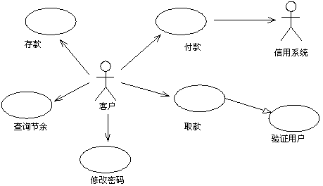
第4章 软件体系结构描述
4.5 软件体系结构与UML
◇ 用例图
用于显示若干角色以及这些角色与系统提供的用例之间的连接关系。用例是系统提供的功能的描述

Slide 76

第4章 软件体系结构描述
4.5 软件体系结构与UML
◇ 类图
表示系统中的类和类与类之间的关系，它是对系统静态结构的描述

Slide 77

第4章 软件体系结构描述
4.5 软件体系结构与UML
◇ 序列图
用来反映若干个对象之间的动态协作关系，也就是随着时间的推移，对象之间是如何交互的

Slide 78

第4章 软件体系结构描述
4.5 软件体系结构与UML
◇ 协作图
描述对象间的协作关系，协作图跟序列图相似，显示对象间的动态合作关系。
如果强调时间和顺序，则使用序列图；如果强调上下级关系，则选择协作图。这两种图合称为交互图。

Slide 79

第4章 软件体系结构描述
4.5 软件体系结构与UML
◇ 状态图
描述类的对象所有可能的状态以及事件发生时状态的转移条件。通常，状态图是对类图的补充

Slide 80

第4章 软件体系结构描述
4.5 软件体系结构与UML
◇ 活动图
描述满足用例要求所要进行的活动以及活动间的约束关系，有利于识别并行活动

Slide 81

第4章 软件体系结构描述
4.5 软件体系结构与UML
◇ 构件图
描述代码构件的物理结构及各构件之间的依赖关系

Slide 82

第4章 软件体系结构描述
4.5 软件体系结构与UML
◇ 部署图
部署图定义系统中软硬件的物理体系结构

Slide 83

第4章 软件体系结构描述
4.5 软件体系结构与UML
◇ 直接使用UML建模
元-元模型层定义了元模型层的规格说明语言，元模型层为给定的建模语言定义规格说明，模型层用来定义特定软件系统的模型，用户对象用来构建给定模型的特定实例。

Slide 84
第4章 软件体系结构描述
4.5 软件体系结构与UML
◇ 直接使用UML建模
◎ 语义约束
由对象约束语言OCL表示，OCL基于一阶谓词逻辑，每一个OCL表达式都处于一些UML模型元素的背景下（由“self”引用），可使用该元素的属性和关系作为其项（term），同时OCL定义了在集合（sets）、袋(bags)等上的公共操作集和遍历建模元素间关系的构造，因此，其它建模元素的属性也可以作为它的项。

Slide 85
第4章 软件体系结构描述
4.5 软件体系结构与UML
◇ 直接使用UML建模
◎ UML中的通用表示
（1）字符串：表示有关模型的信息；
（2）名字：表示模型元素；
（3）标号：不同于编程语言中的标号，是用于表示或说明图形符号的字符串；
（4）特殊字符串：表示某一模型元素的特性；
（5）类型表达式：声明属性、变量及参数，含义同编程语言中的类型表达式；
（6）实体类型：它是UML的扩充机制，运用实体类型可定义新类型的模型元素；

Slide 86
第4章 软件体系结构描述
4.5 软件体系结构与UML
◇ 直接使用UML建模
◎ UML语义部分
◇ 通用元素：主要描述UML中各元素的语义。通用元素是UML中的基本构造单位，包括模型元素和视图元素，模型元素用来构造系统，视图元素用来构成系统的表示成分；
◇ 通用机制：主要描述使UML保持简单和概念上一致的机制的语义。包括定制、标记值、注记、约束、依赖关系、类型-实例、类型-类的对应关系等机制；
◇ 通用类型：主要描述UML中各种类型的语义。这些类型包括布尔类型、表达式类型、列表类型、多重性类型、名字类型、坐标类型、字符串类型、时间类型、用户自定义类型等。
三部分不是相互独立的，而是相互交叉重叠、紧密相连，共同构成了UML的完整语义。

Slide 87

第4章 软件体系结构描述
4.5 软件体系结构与UML
◇ 直接使用UML建模
◎ 会议安排系统的类图

Slide 88

第4章 软件体系结构描述
4.5 软件体系结构与UML
◇ 直接使用UML建模
◎ 会议安排系统类接口

Slide 89

第4章 软件体系结构描述
4.5 软件体系结构与UML
◇ 直接使用UML建模
◎ C2连接件模型

Slide 90

第4章 软件体系结构描述
4.5 软件体系结构与UML
◇ 直接使用UML建模
◎ 细化的类图

Slide 91

第4章 软件体系结构描述
4.5 软件体系结构与UML
◇ 直接使用UML建模
◎ 会议安排系统的协作图

Slide 92
第4章 软件体系结构描述
4.5 软件体系结构与UML
◇ 使用UML扩展机制
自学

Slide 93
第4章 软件体系结构描述
本章作业与思考题
1、体系结构描述有哪些方法？有哪些标准和规范？
2、体系结构描述语言与程序设计语言有什么区别？
3、选择一个规模适中的系统，使用UML为其建模。

