Slide 2
300.155 → 415.182 → 528.266 → 599.303 → 793.38 → 850.405 → 978.464 → 1107.506 → 1206.575 → 1606.869
{VEA}
D
I
A
{GH}
G
Q
E
V
{LIR}
300.155 → 415.182 → 528.266 → 599.303 → 793.38 → 850.405 → 978.464 → 1107.506 → 1206.575 → 1606.869
401.287 , 499.234 + 100.069, 500.355, 693.315 + 100.069, 814.478, 1007.437 + 100.069, 1008.558, 1106.506 + 100.069
300.155 → 415.182 → 528.266 → 599.303 → 793.38 → 850.405 → 978.464 → 1107.506 → 1206.575 → 1606.869
501.356, 599.303, 793.384, 914.547, 1108.627, 1206.575

Slide 3


300.155 → 415.182 → 528.266 → 599.303 → 793.38 → 850.405 → 978.464 → 1107.506 → 1206.575 → 1606.869
175.119, 288.203, 370.191 + 229.11, 401.287, 427.213, 500.355, 564.272 + 229.11, 621.293 + 229.11, 629.398, 749.352 + 229.11, 757.457, 814.478, 878.394 + 229.11, 951.537, 977.463 + 229.11, 1008.558, 1090.547, 1203.631
{300.155, 415.182, 528.266, 599.303, 793.38, 850.405, 978.464, 1107.506, 1206.575, 1606.869}
$$⋃$$
{401.287, 499.234, 693.315, 814.478, 1008.558, 1106.506}
+100.069
$$⋃$$
{175.119, 288.203, 370.191, 401.287, 427.213, 500.355, 564.272, 621.293, 629.398, 749.352, 757.457, 814.478, 878.394, 951.537, 977.463, 1008.558, 1090.547, 1203.631}
+229.112

Slide 4
300.155 → 415.182 → 528.266 → 599.303 → 793.38 → 850.405 → 978.464 → 1107.506 → 1206.575 → 1606.869
404.229, 517.313, 599.301, 630.397, 656.323, 729.465, 793.382, 850.403, 858.508, 978.462, 986.567, 1043.588, 1107.504, 1180.647, 1206.573, 1237.668, 1319.657, 1432.741

Slide 5
Theoretical Intensity Distribution
Low Similarity
High Similarity
Low Similarity
Predicted Monoisotopic Values
Observed Intensity Distribution

Slide 6
Theoretical Intensity Distribution
1000.50
1001.50
1002.50
1003.50
1000.50
1001.50
1002.50
1003.50
1001.50
1002.50
1003.50
1002.50
1003.50
Low Similarity
E3
E2
Low Similarity
High Similarity
Low Similarity
E0
E1
Predicted Monoisotopic Values
Observed Intensity Distribution

Slide 7
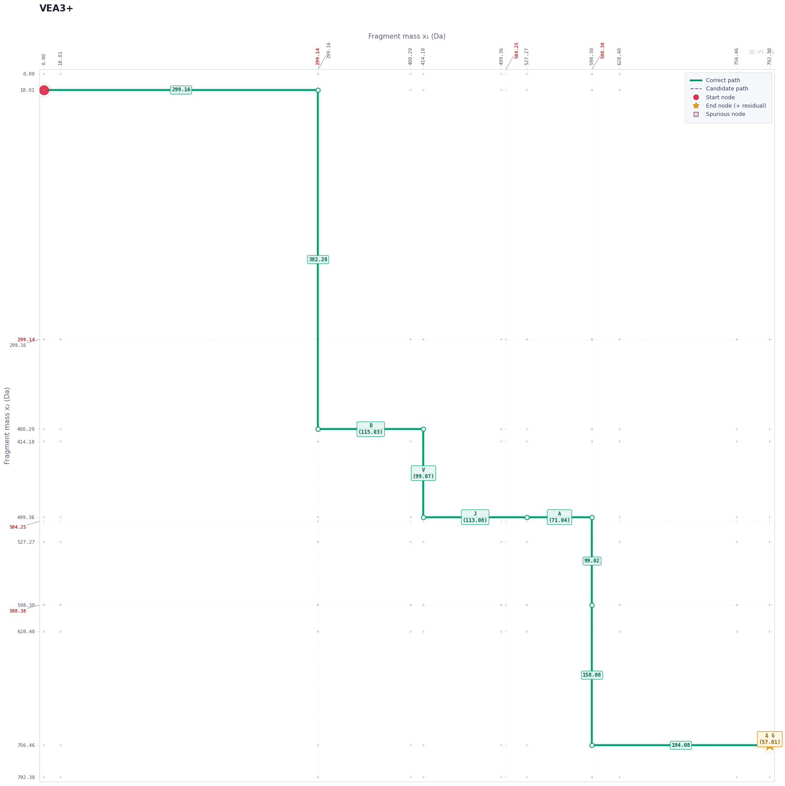
VEA - DIA – GH - GQEV - LIR
299.15 - DJA - 194.08 - GQEV - 382.27
GH
-
GQEV
-
VEA
-
JJR
DJA
-

Slide 8
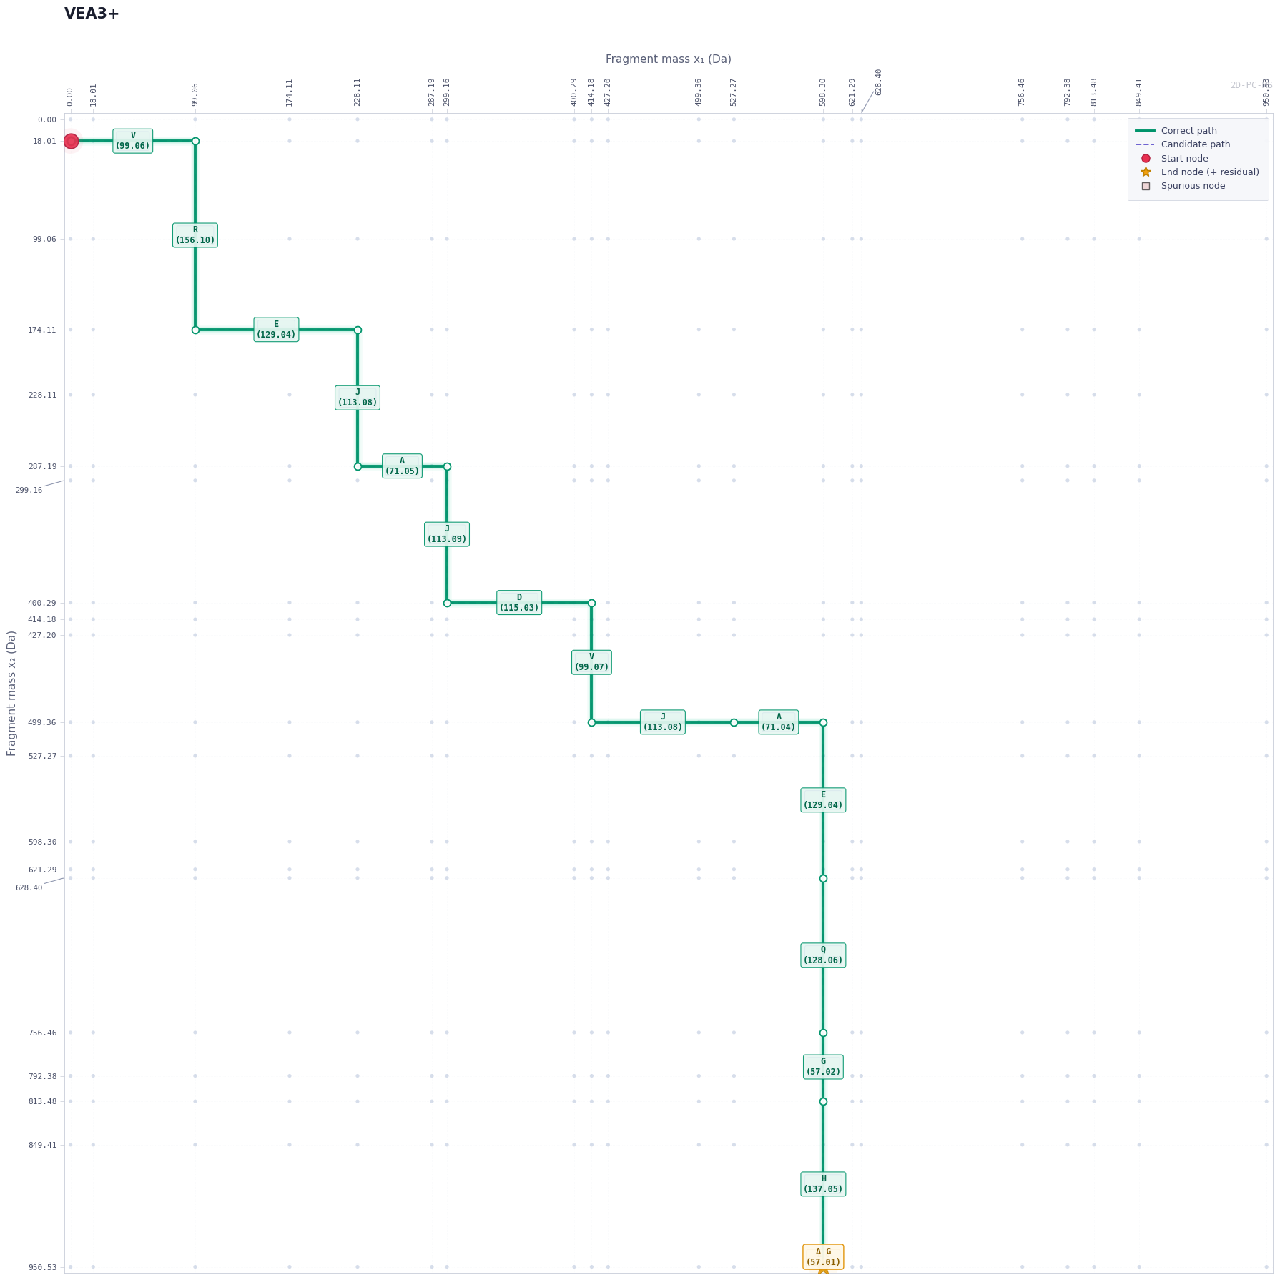
VEADJAGHGQEVJJR
VEADJAGHGQEVJJR

Slide 9
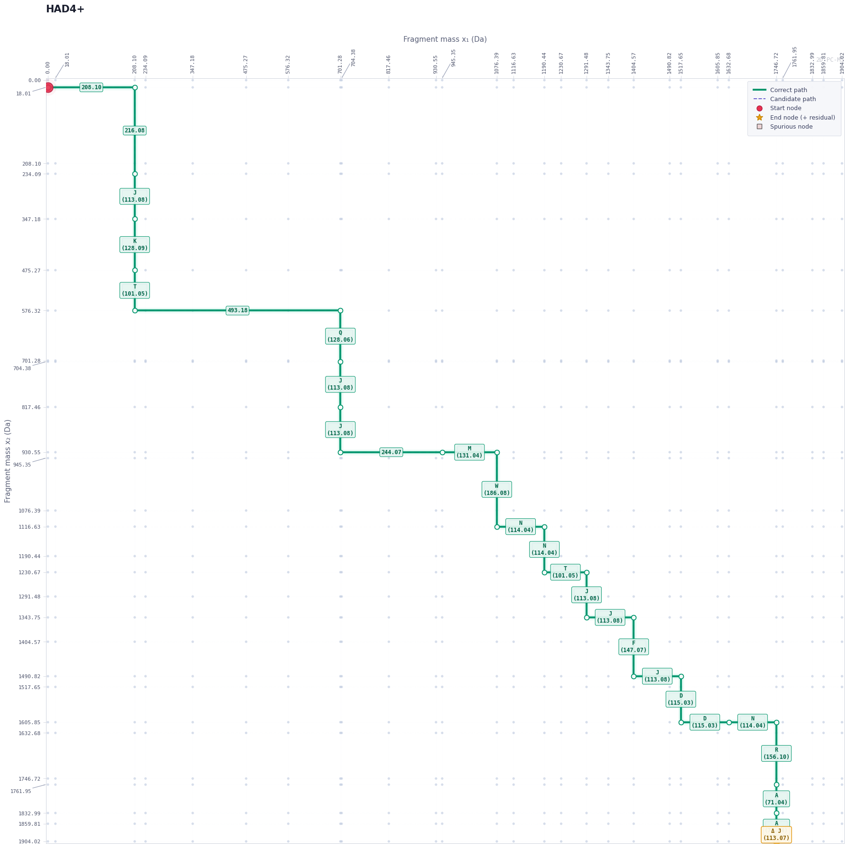
HA – DGSFS - DE - MNTILDNLAARDFINWLIQTKI - TD
208.10 - 493.16 - 244.07 - MNTJJDNJAARDFJNWJJQTKJ - 216.08
-
MNTJJDNJAARDFINWLIQTKJ
HA
-
-
DE
-
TD
DGSFS

