Slide 1
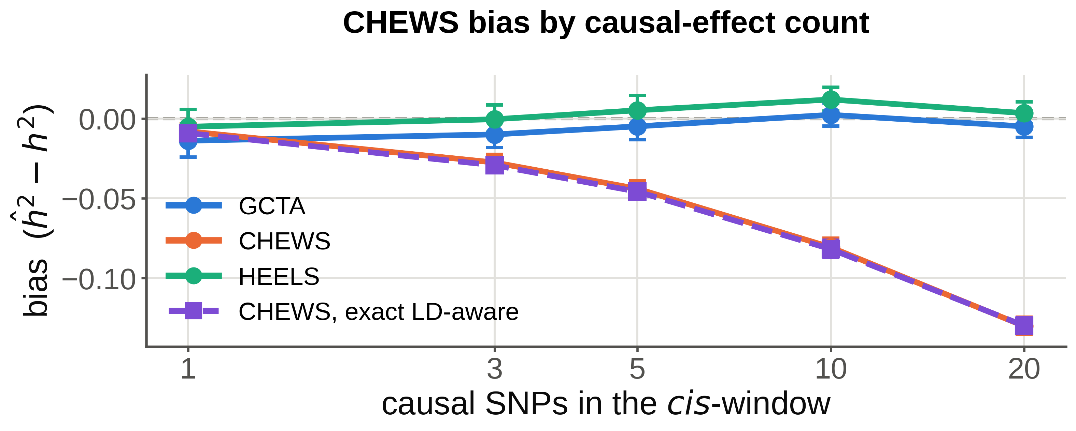
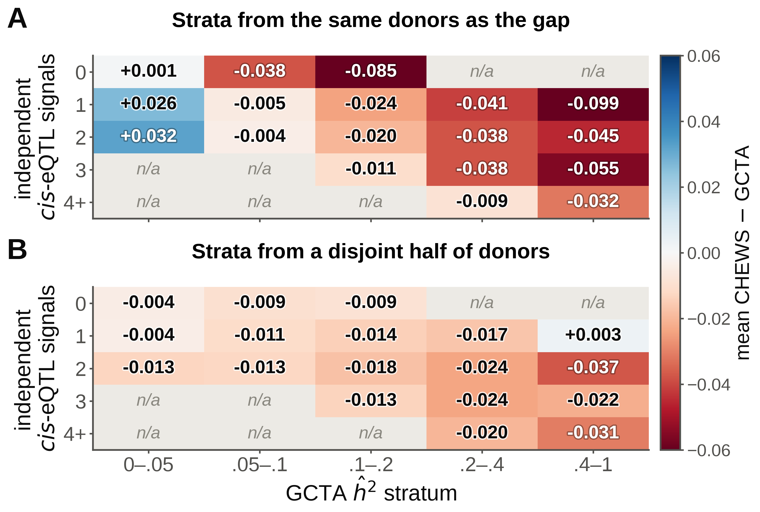
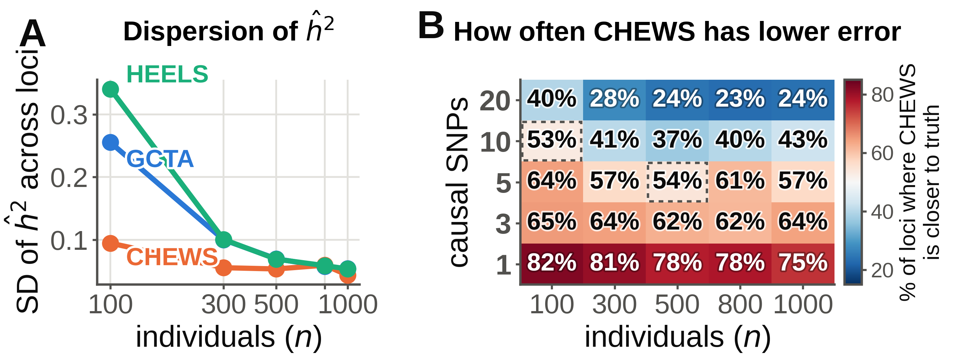
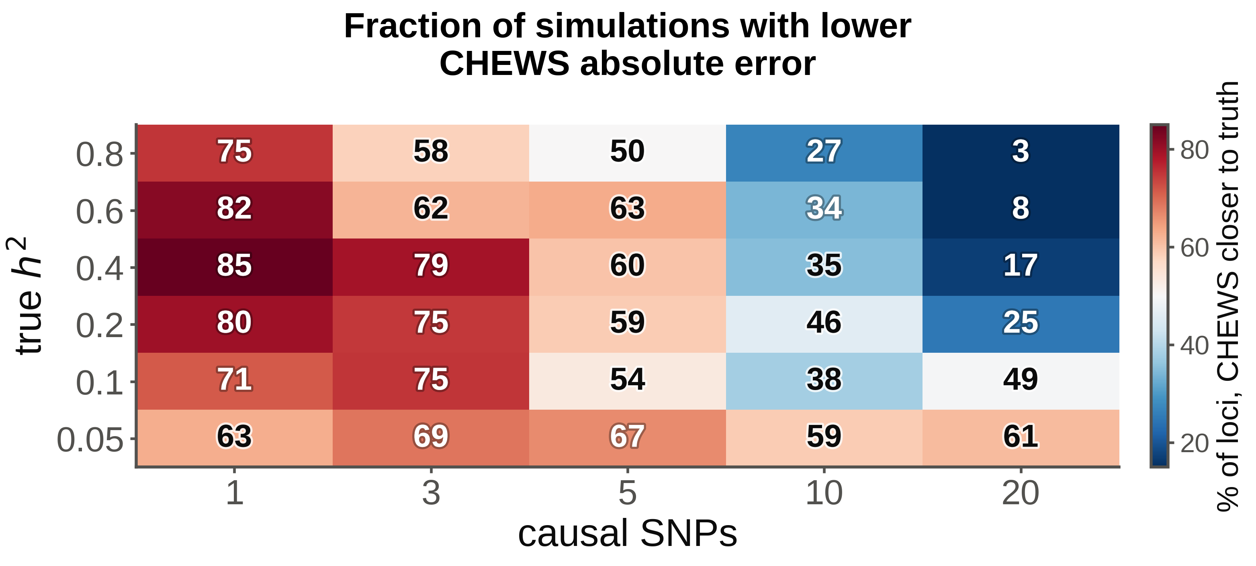
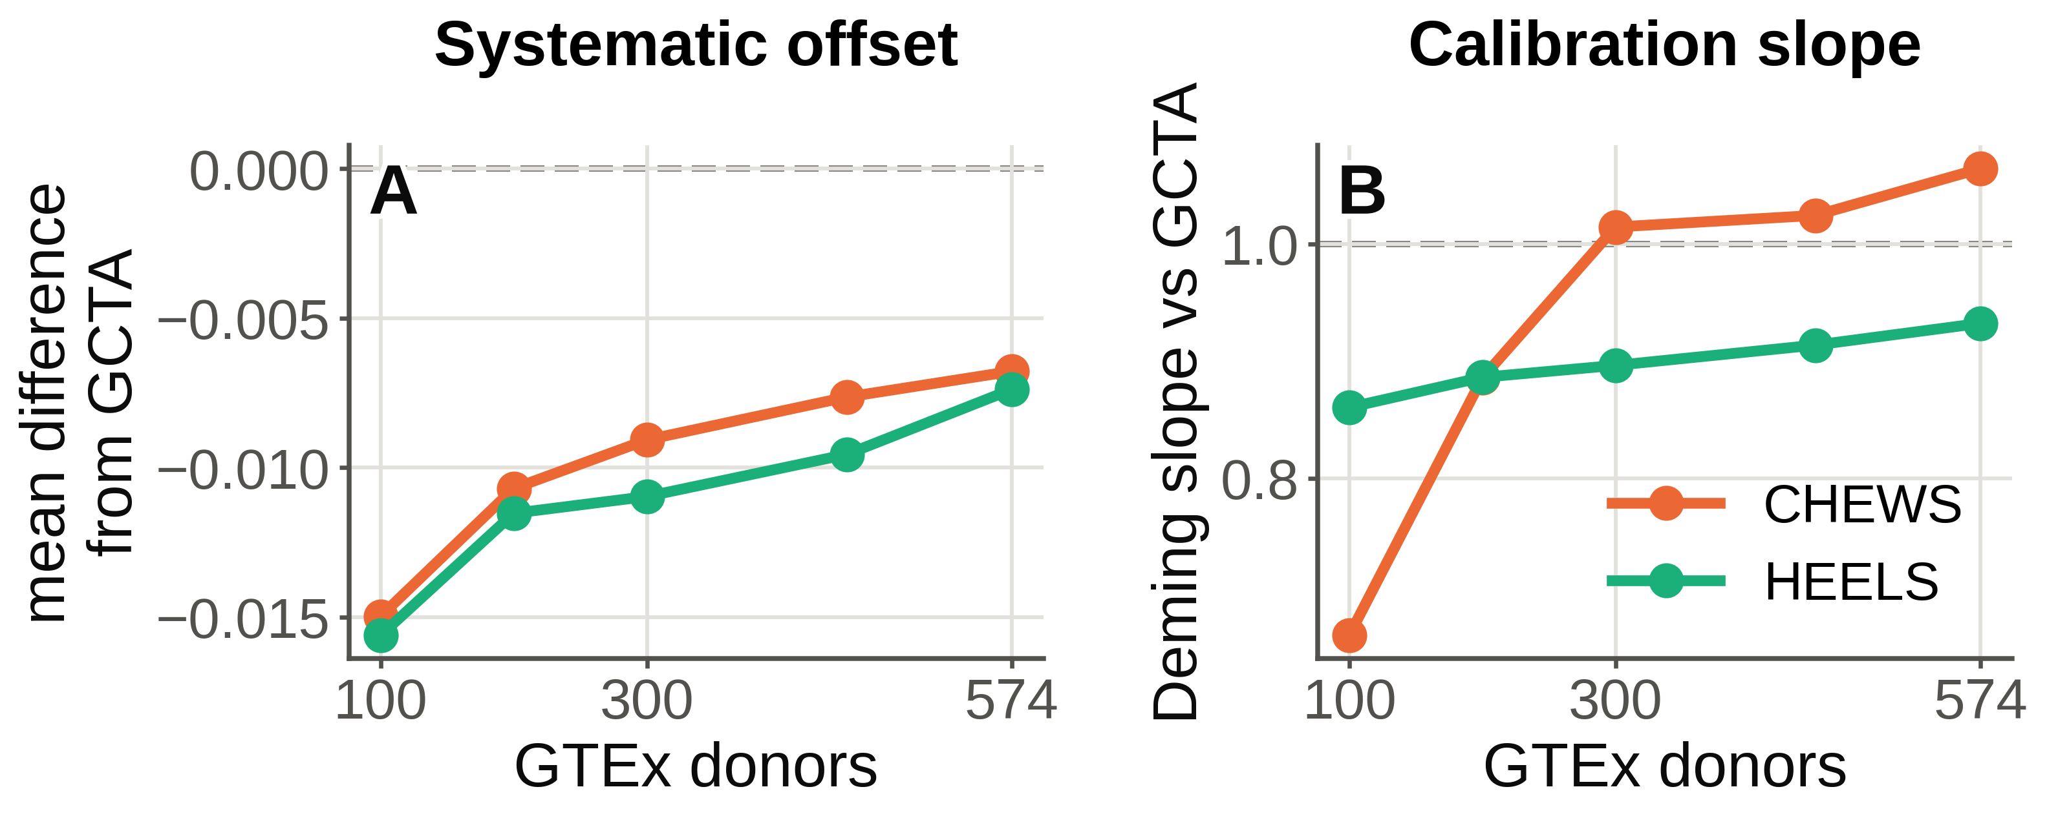

CHEWS improves cis-heritability precision over individual-level
GCTA for sparse regulation in small samples
Sunan Xu¹ · Stephen Golzari² · Tiffany Amariuta-Bartell³⁴
¹Bioinformatics and Systems Biology Program · ²Shu Chien-Gene Lay Department of Bioengineering · ³Department of Medicine · ⁴Halıcıoğlu Data Science Institute — University of California San Diego, La Jolla, CA, USA
Estimator performance depends jointly on regulatory architecture, sample size and LD source. CHEWS lowers error in small samples with concentrated effects, and underestimates h² as effects become diffuse.
CHEWS = Cis-Heritability Estimation With SuSiE
1 The question
7 A conditioning artefact
Cis-SNP heritability (cis-h²) quantifies how strongly a gene is genetically regulated. GCTA/GREML needs individual-level genotypes; consortium data are increasingly summary statistics only.
Accuracy — closeness to truth; bias and MAE, in simulation only. Precision — sampling variability; SD over repeated phenotypes at a fixed locus. Agreement — similarity of values; offset, slope, RMSE. Reliability — reproducibility; split-half correlation.
Bias pooled over the h² grid, n = 300; 95% region-clustered bootstrap intervals (2,000 resamples). Dashed purple is the exact LD-aware estimator (§2); it lies on the trace form.
2 What CHEWS estimates
One causal SNP: CHEWS nearly unbiased (−0.008), closer on 76% of loci. At twenty, both CHEWS forms underestimate h² by ≈0.13 while GCTA and HEELS stay near zero, so the LD cross terms do not explain it. Consistent with the sparse-effect model — but CHEWS and HEELS also differ in LD source (§5), so that attribution is provisional.
Truth is the quadratic form βᵀRβ. SuSiE writes β = Σₗ βₗ, one single-effect vector per component, each selecting exactly one variant. Let mₗ = E[βₗ] = αₗ⊙μₗ and sₗ = E[βₗᵀRβₗ]. Then
Mean CHEWS − GCTA within joint strata; 50–9,572 genes per cell, <30 blank.
E[βᵀRβ | data] = μᵀRμ − Σₗ mₗᵀR mₗ + Σₗ sₗ
5 Sample size cuts both ways
Strata from the same donors manufacture much of the pattern (mean |A − B| = 0.023); (B) uses disjoint donors. No Simpson's paradox is claimed. With genotypes permuted (true h² = 0), GCTA and CHEWS both average 0.013, so a higher GCTA floor alone does not explain CHEWS's lower values below 0.05.
The subtraction removes within-component cross products that cannot occur. The pipeline has always reported the trace form Σⱼ(μⱼ²+σⱼ²), which is what this reduces to at R = I; the exact form is checked against brute-force tr(R·E[ββᵀ]) to 2e−16.
8 Robustness across donors
At n = 300 the two forms track each other on average — r = 0.996, median |difference| 0.002, and the mean bias curves overlap at every causal count (§4). Per locus they can still differ: 95th percentile 0.034, maximum 0.368. The exact form was evaluated at n = 300 only; §5–6 use the trace form.
(A) SD of ĥ² across loci; a within-locus design agrees to ≤0.007. (B) h² 0.05–0.8 pooled, ~300 paired fits per cell; dotted: 95% CI spans 50%.
Two disjoint halves of 287 donors, Pearson r on common genes:
With 25 independent phenotypes per locus (30 regions), CHEWS's sampling SD is 0.108 against GCTA's 0.246 at n = 100, one causal SNP — 2.3×, and 2–4× across conditions. With one causal SNP CHEWS is closer to truth on 75–82% of loci at every sample size; what shrinks with n is the margin (MAE −73% at n = 100, −58% at n = 1,000). At twenty causal SNPs GCTA is closer on 72–77% of loci for n ≥ 300.
gene set | GCTA | CHEWS | HEELS
all genes (18.5–19.4k) | 0.865 | 0.912 | 0.870
prespecified ≥1 eQTL (9.7k) | 0.850 | 0.898 | 0.857
post-hoc ĥ²>0.05 (4.2k) | 0.848 | 0.892 | 0.855
3 Benchmark
In this one donor split CHEWS had the higher split-half correlation on all three gene sets; repeated donor partitions are needed to quantify robustness to the split itself. A paired bootstrap over genes gives Δr = +0.050, but resamples genes, not splits. Reliability is precision, not accuracy.
estimator | data needed | model assumed
GCTA / REML | individual genotypes | infinitesimal
CHEWS (here) | summary stats + LD | sparse causal set
HEELS | summary stats + LD | infinitesimal
HEELS is not a clean sparsity control as run: it received in-sample LD while CHEWS received reference-panel LD, so the two differ in model and LD source — the matched factorial is on the methods page. At n = 100 (p/n ≈ 70) it converges on 100% of fits but 46% of estimates exceed ĥ² = 0.9: saturation, not non-convergence.
▪
350 random 1000 Genomes EUR cis-regions (±500 kb, median 8,200 SNPs). Effects rescaled so βᵀRβ = h², so only their distribution varies. Swept: n, h², causal count, effect prior, causal MAF, regional LD.
9 How to choose
▪
20,400 replicates attempted; 20,294 complete method triplets (unconstrained GCTA/GREML failed in 106). Intervals resample whole regions.
6 GTEx: agreement, not truth
situation | interpretation (current evidence)
In-sample sufficient stats | HEELS targets the same REML equations
Reference-panel LD | assess LD match; not isolated here
Small n, concentrated | CHEWS may lower MAE despite bias
Diffuse signal | CHEWS underestimates h²
Strong MAF dependence | stratified GRM, but validate first
19,432 genes, 574 EUR donors, five nested subsets; covariates as REML fixed effects, in-sample LD; GCTA returned on 96.5–98.6%. No ground truth here — this measures disagreement, not accuracy.
4 Architecture decides
Updated after abstract submission: covariates now enter REML directly rather than pre-residualizing expression. The values here replace the submitted GTEx estimates; the degrees-of-freedom explanation is on the methods page.
10 Limitations · References
▪
Nominal 95% Wald intervals under-covered (68–87%). Screen fine-mapping h² against [0,1] — rare fits read 3–5 while reporting clean convergence.
▪
Simulated genotypes are multivariate normal: pairwise LD preserved, discrete counts and haplotypes not. One tissue, one donor split.
▪
Semi-synthetic GTEx simulation missed the real strata beyond its pre-set tolerance; §7 is disagreement, not error.
% of 2,990 paired fits at n = 300 where CHEWS is closer to truth; ~100 per cell. A win rate; §5 reports error magnitude. Median and mean absolute error agree, so rare bad fits drive neither.
1. Yang J. GCTA. AJHG 2011;88:76. 2. Wang G. SuSiE. JRSS-B 2020;82:1273. 3. Zou Y. susie_rss. PLoS Genet 2022;18:e1010299. 4. Li H, Mazumder R, Lin X. HEELS. Nat Commun 2023;14:7954. 5. GTEx. Science 2020;369:1318.
Agreement with GCTA, 18,747–19,169 complete-case genes per subset.
Methods, full result tables,
code and sensitivity analyses
At n = 574, 19,169 complete-case genes, HEELS tracks REML closely but not exactly: r = 0.9996, slope 0.93, offset −0.0074, RMSE 0.012. CHEWS is shrunk at n = 100 (slope 0.67), reaching unit slope by n = 574.
Amariuta Lab, UC San Diego · Contact: sux002@ucsd.edu

