Slide 1
训练集
混合图的构造
位置
编码
线性
映射
测试集
每个epoch: 如果L <= B, 挑选新的节点
中心度计算
（PageRank）
density计算
（Kmeans）
entropy计算
图学习
分类器
相加融合
辅助模型
Graph Transformer Layer
新增的边
回归器
删除的边
新挑选的节点
细胞状态数据集
训练集中的节点

Slide 2
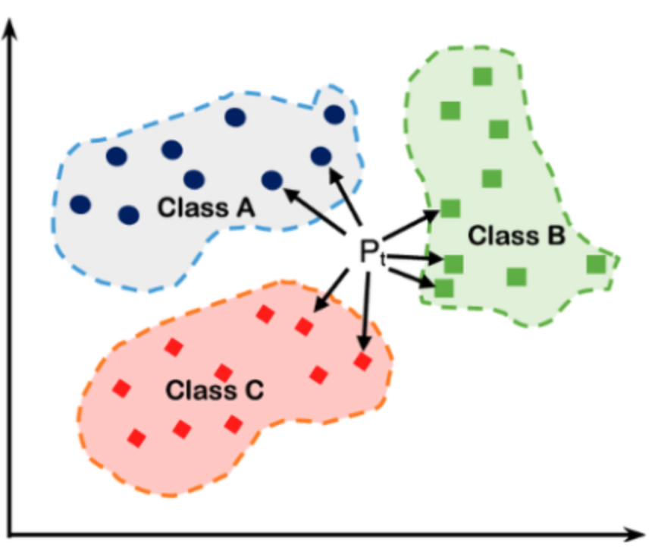

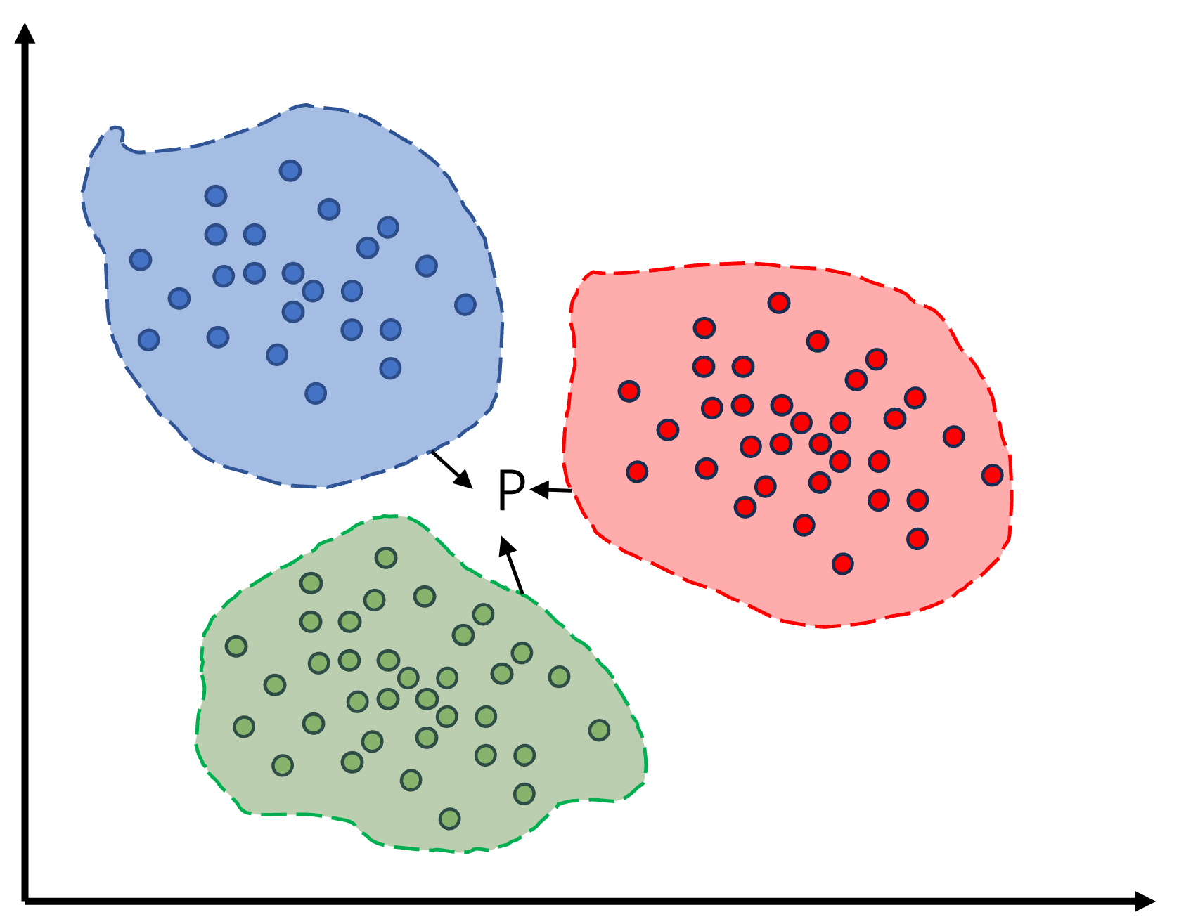
P

Slide 3
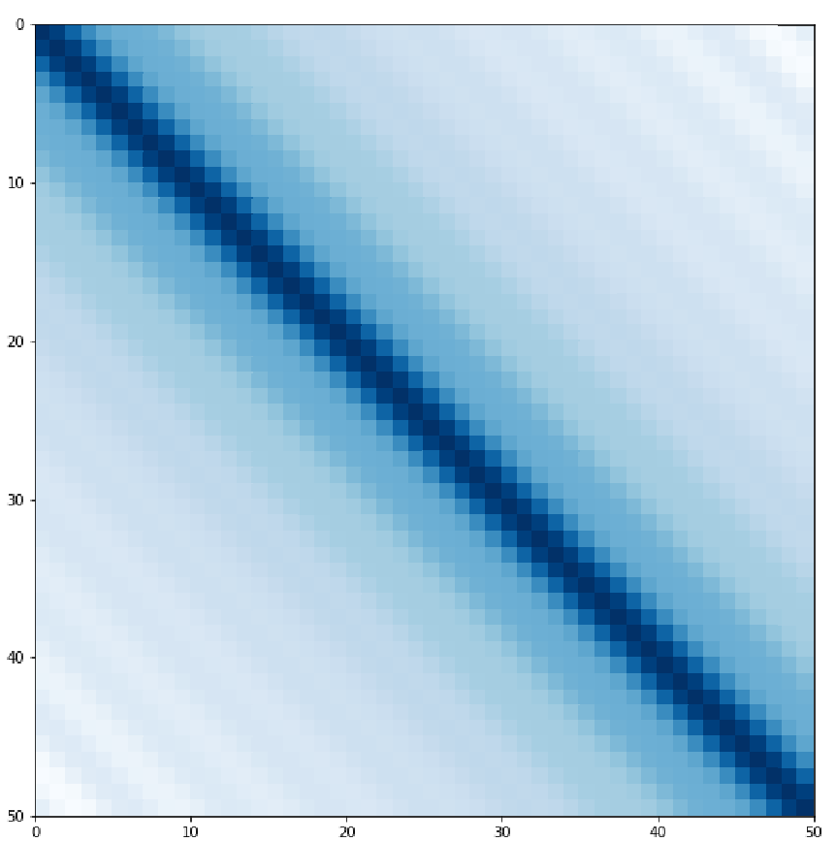

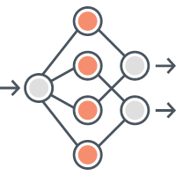


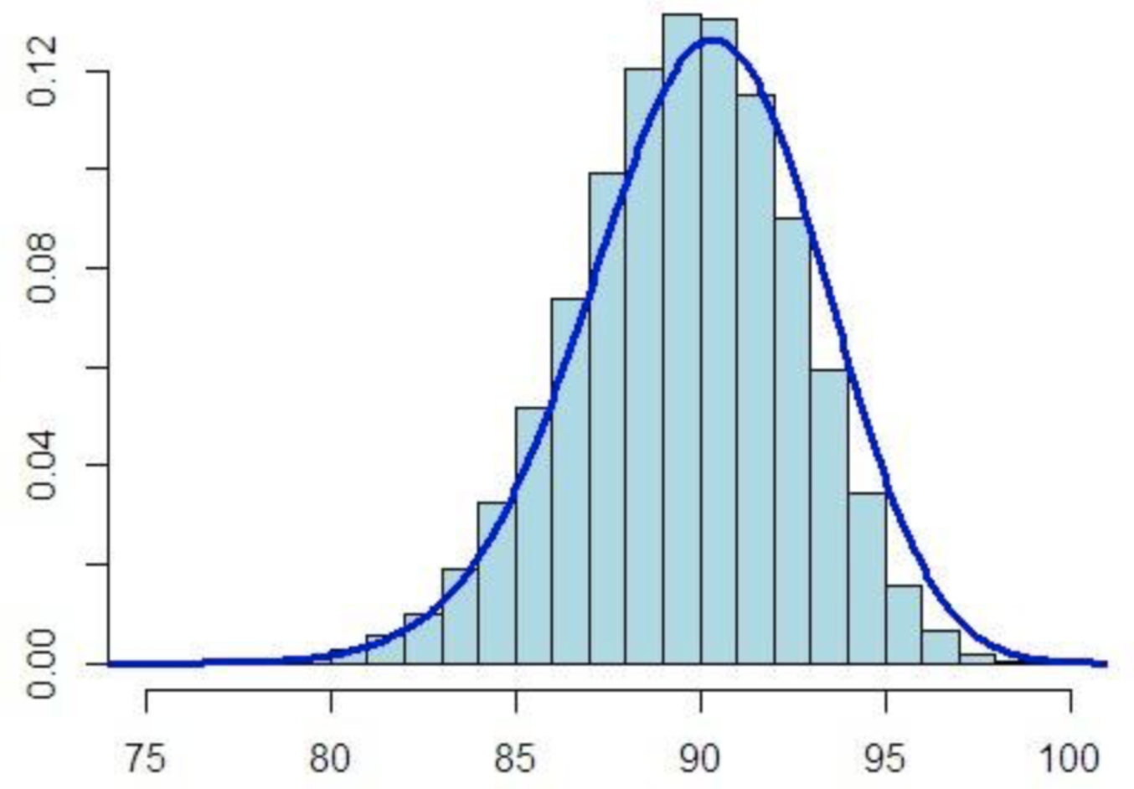










Training Set
distance-aware information
(Laplacian positional encoding)
Test set
concatenate
Graph
Pre-construction
(KNN or ... )
Linear projection
Linear projection
Graph structure learning
Randomly
sample
Active Learning
Centrality: using pagerank to calculate the node centrality
Density:
distance between node and center of cluster
Uncertainty: using cross-entropy to calculate information uncertainty
adjacency matrix
Training
Bucket
Picked node
is training
bucket full?
NO
$$P_{B}$$
Bernoulli Distribution
$$Q$$
$$K$$
Matmul
Scaling
Softmax
Sum
Classifier
$$L_{GNN}+L_{rank}+L_{sparsity}$$
stochastic gradient descent，SGD
$$V$$
× N Heads
update
Bernoulli sample
Inject cell state information
Classification result
$$P_{B}$$
N Layers
Cell state data
$$Q$$
$$K$$
Matmul
Scaling
Softmax
Sum
Regressor
$$V$$
× N Heads
Helper module
N Layers
Update parameters
Graph
construction

