Slide 1
Tips to take AZ-300 exam
Cloud Solution Architect
Prakash Sundarshaw psundars@microsoft.com
May 2019

Slide 2
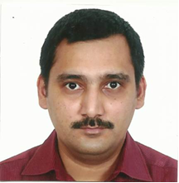
Your PEAT Team Contacts & How to Engage
Prakash Sundarshaw – Cloud Solution Architect – PEAT - psundars@microsoft.com
Contact directly on email or Teams – we’ll manage the complexity for you.

Slide 3
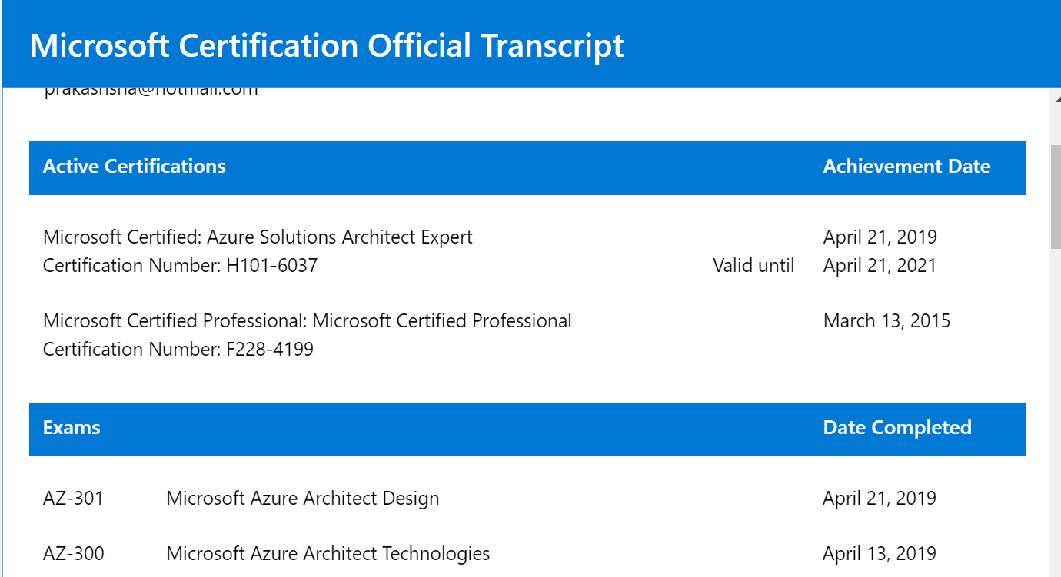
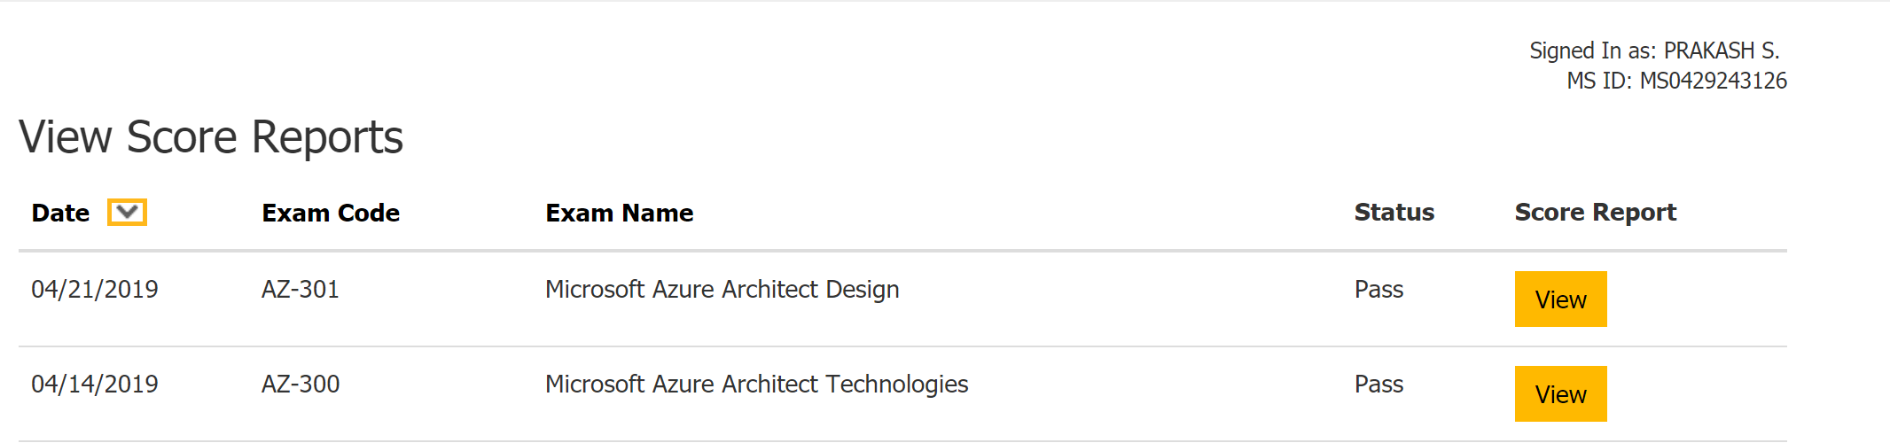
Transcripts

Slide 4
Note
This deck doesn’t guarantee to pass this exam
This deck might be incompatible with latest exam

Slide 5
What’s AZ-300 Microsoft Azure Architect Technologies
Deploy and configure infrastructure (25-30%)
Implement workloads and security (20-25%)
Create and Deploy Apps (15-20%)
Implement authentication and secure data (5–10%)
Develop for the cloud and for Azure storage (20-25%)

Slide 6
Exam Format
Total Time : 150 Minutes
Contains 39 Questions
2 Labs
Each lab contains 8 to 7 Tasks

Slide 7
LAB - 1
Create Storage account with cheap replication cost?
LRS, GRS,ZRS, RA-GRS
Create Storage account that can be accessed by VM and have a maximum size of 1GB?
Create storage blob and ensure that container can be accessible (anonymous or non-anonymous)
Create an Ubuntu Linux VM
Create ubuntu Linux and ensure its available for 99.95%?
Create VM and ensure its available for 99.99%?
Create VNET Peering
Create NSG → Enable only HTTPS, Disable HTTP

Slide 8
LAB - 1
Create Storage Account → Ensure only Particular IP address can access
Create VNET, create Subnet, Ensure that Internet is not accessible
Site to Site / Express Route → What’s the first step you would do? There would be a VNET and Subnet also available. you need to prepare the environment
Create Storage Account, cost is not an issue.

Slide 9
LAB - 2
Create Function
Create Slot in Webapp and Zero downtime
Create Appservice Plan
Change appservice plan? Slots available.
IP Restrictions – Webapp
VNET & DNS Zone → https://docs.microsoft.com/en-us/powershell/module/az.dns/new-azdnszone?view=azps-2.0.0
Create 3 VNET (e.g. vnet1,vnet2,vnet3), make sure that it all network goes via VNET2 and minimize peering
Create VM, create 15 TB data disk, IO OPS – 2000 , Minimize cost
$ResVirtualNetworkId = "/subscriptions/00000000-0000-0000-0000-000000000000/resourceGroups/testresgroup/providers/Microsoft.Network/virtualNetworks/YYYY"
$Zone = New-AzDnsZone -Name "myprivatezone.com" -ResourceGroupName "MyResourceGroup" -ZoneType Private -ResolutionVirtualNetworkId @($ResVirtualNetworkId)

Slide 10
LAB - 2
Create Public Load Balancer, Select Basic if its 99.95, standard – 99.99%
Create Internal Load Balancer
Create public IP address
Create a group and provide delegated admin access to the ResourceGroup “RG2”
Switch Default Directory

Slide 11
RESOURCES
HTTP://AKA.MS/AZ300

Slide 12
Partner Admin Link

Slide 13
Creating a Link
A valid MPN ID is required
Per user credential, per tenant
Update 1560887 at any time
Controlled by account owner
1
PowerShell
2
Command Line Interface (CLI)
3
Azure Management Portal UI

Slide 14
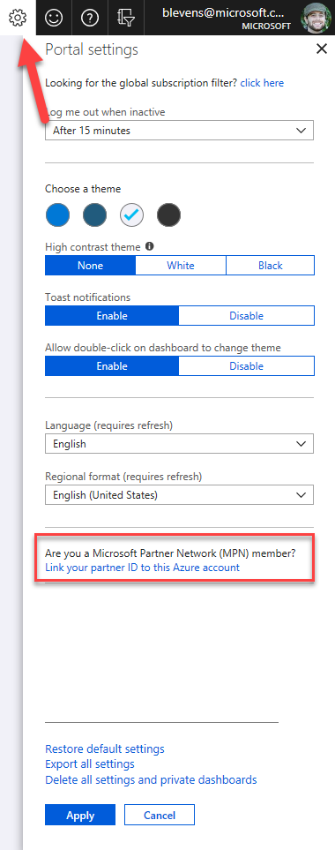
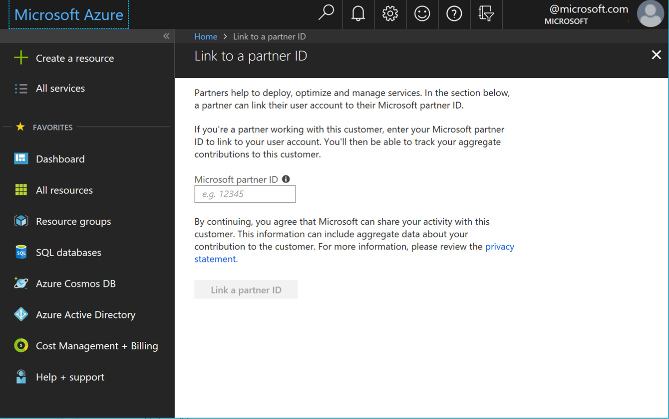
Creating a Link: Azure Portal
Now available
1
Log into a customer’s Azure environment
2
Access the Azure Management Portal user settings
Add and validate the MPN ID
3
4
IBM MPNID : 1560887
https://ms.portal.azure.com/#blade/Microsoft_Azure_Billing/managementpartnerblade

Slide 15
Thank You

