Slide 1
Conway’s Game of Life
Alex Buchanan – Kevin Holmes – George Le – James Testa

Slide 2
Goals
Implement the standard algorithm for cellular automata
Enable interaction by the user with the simulation, not just watching it, but modifying it
Allow users to save interesting cell grids, or segments of that grid to a SQL database

Slide 3
Current status
Cut, copy, paste, and paint to modify active simulation
Fragments of database management and pasting in progress
Ability to clear DB of all saves via options dropdown
Finalizing project for completion

Slide 4
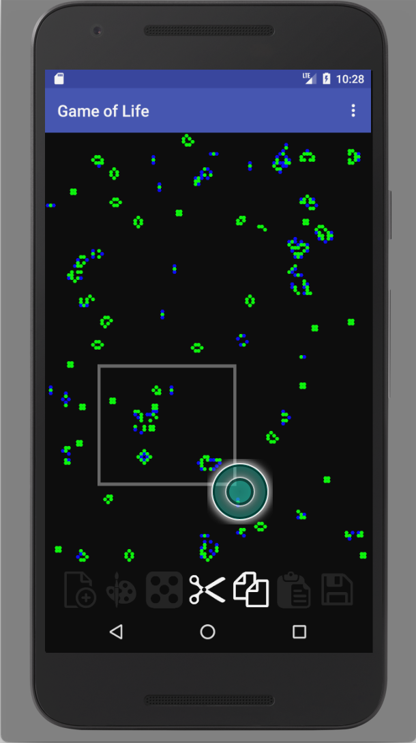
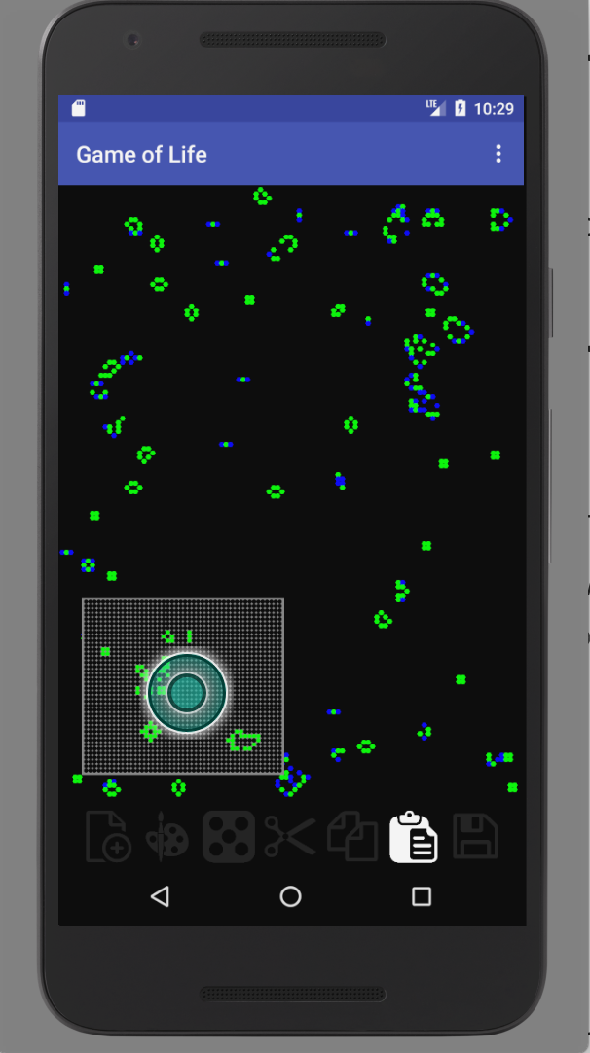
Screenshots

Slide 5
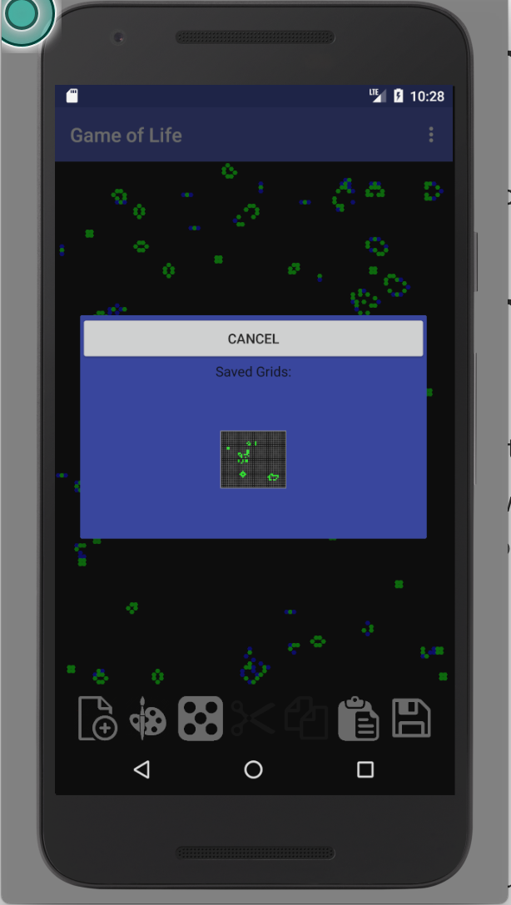
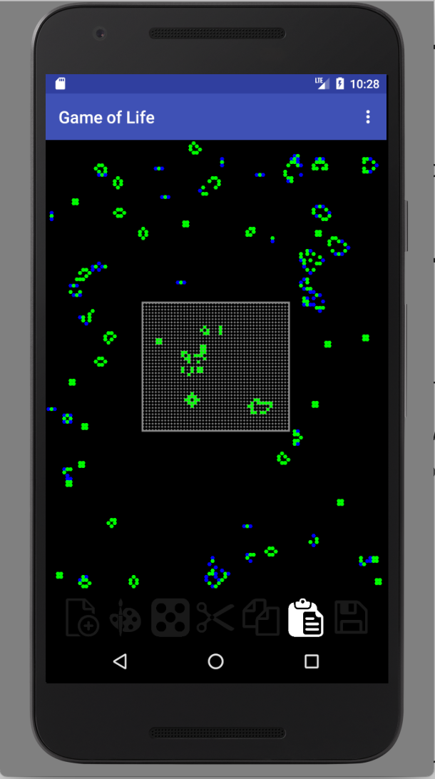
More screenshots

Slide 6
Roles & Responsibilities
Alex – Database management
Fixed bugs and crashes that arose from using the database.
George – Fragments and UI work
Worked on fragment to allow for deleting of bitmaps from the database
Added dialog confirmation messages to avoid accidental actions.

Slide 7
Roles & Responsibilities
James – Miscellaneous
Redesigning some of the menus so they are visually appealing and consistent.
Working on bugs in selecting bitmaps from the database.
Kevin –
Changed the implementation of a Pair to a SerializableCellGrid in various parts of the project.
General bug fixing on the main application.
Cleaning up the codebase and fixing code that is still causing us problems.

Slide 8
Current Challenges
Very similar to last week
Bugfixing crashes and bugs.
Changing style to create a more appealing and usable user interface.

