Slide 1
Conway’s Game of Life
Final Project
Alex Buchanan - Kevin Holmes
James Testa - George Le

Slide 2
Overview
Conway’s Game of Life is a simple algorithm that can make complex patterns.
It simulates cellular automata in varying scales, while allowing interaction with the user to change how the system evolves over time
The basic idea is that there is a grid where each cell of the grid is either active or inactive. On each tick of the algorithm each cell checks its number of neighbors (all 8 of them). If there are 3 to 5 the cell either becomes active or stays active, if there are more than 5 or less than 3, the cell becomes inactive or stays inactive.

Slide 3
Components – Main Screen
Functions accessed by tapping on the appropriate button along the bottom of the screen.
Functions
Create Blank Grid – creates a blank grid, can be used to overwrite current grid.
Randomize – randomizes the grid
Paint – allows the user to paint directly onto the canvas
Select – by tapping and dragging on the screen user can select a portion of the grid
Cut – takes selection and saves it in the database and removes it from the grid
Copy – takes the selection and saves it to the database
Paste – opens up a dialog to allow for load from database. Lets the user select where on the grid they want the saved selection to go.
Save All – saves a copy of the entire grid to the database.

Slide 4
Components – Options Menu
Accessed via the triple dots in the top right corner of the screen.
Functions
Manage Saves – brings up a dialog that allows the user to delete and browse the saves currently in the database.
Set Speed – allows the user to change the time between each tick of the algorithm.
Set Size – allows the user to change the size of the grid
Clear Saves – Deletes all the saves from the database

Slide 5
Components – Database Backend
SQLite database is used to persist saves, saves are persisted in the database as a byte array (representing the Boolean 2d array used in the main grid.
Functions
Save Previews – List of bitmaps that are used to represent the saves in the database
Request Save – gets a save from the database
Save Grid – Takes a selection from the main screen and saves it to the database
Clear Save – Clears a specific save from the database
Clear All Saves – Clears all the saves from the database
(De)Serialize Cell Grid – serialize and deserialize functions take data from the grid and turns it into something that can be stored in the database, and takes data from the database and turns it into what the main grid cares about.

Slide 6
Video

Slide 7


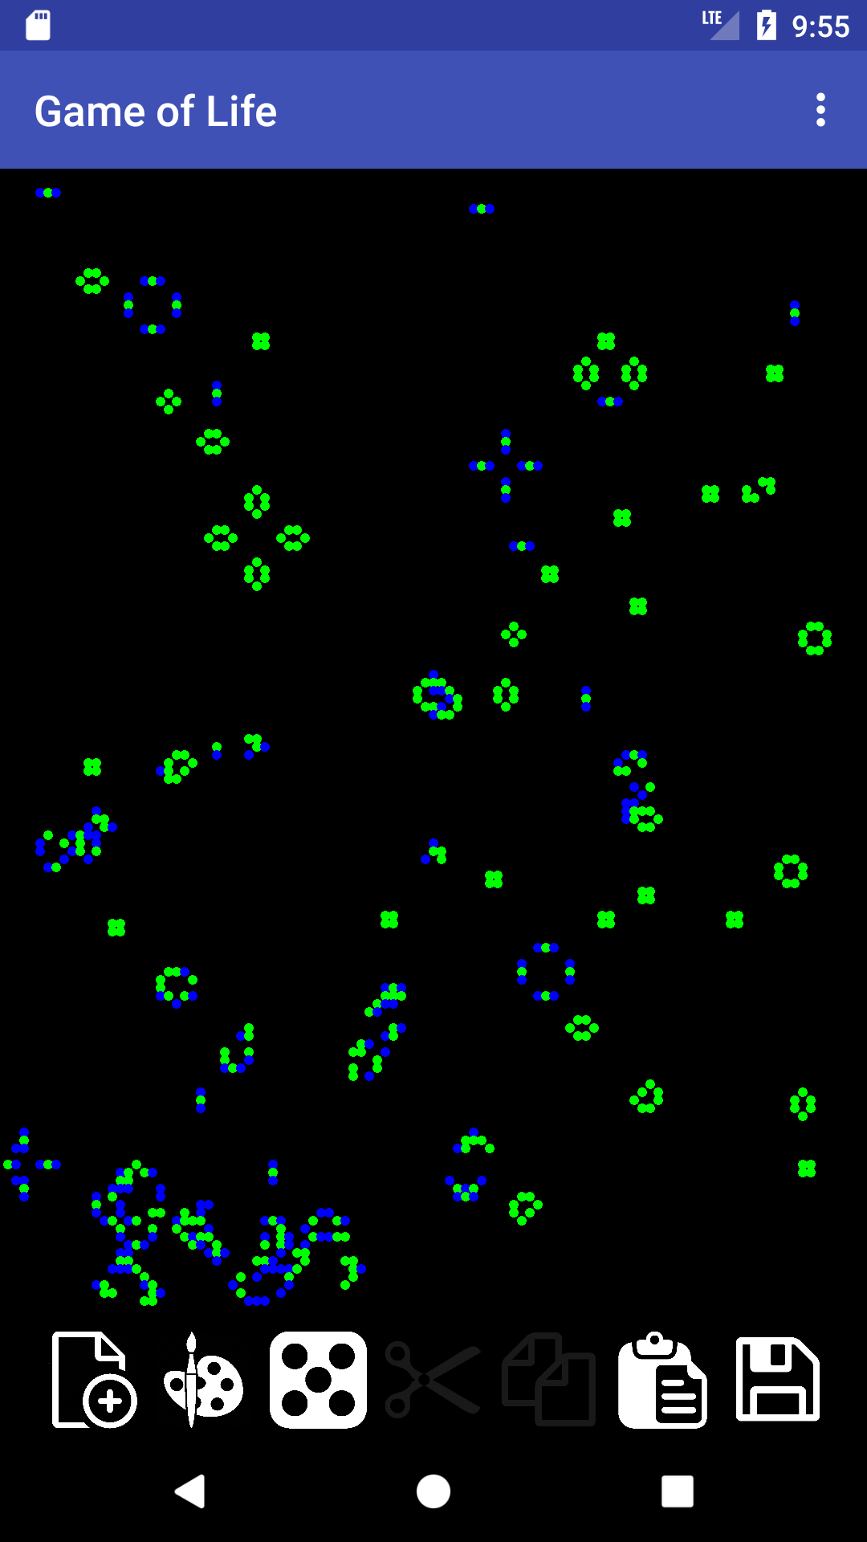
Main Interface

Slide 8
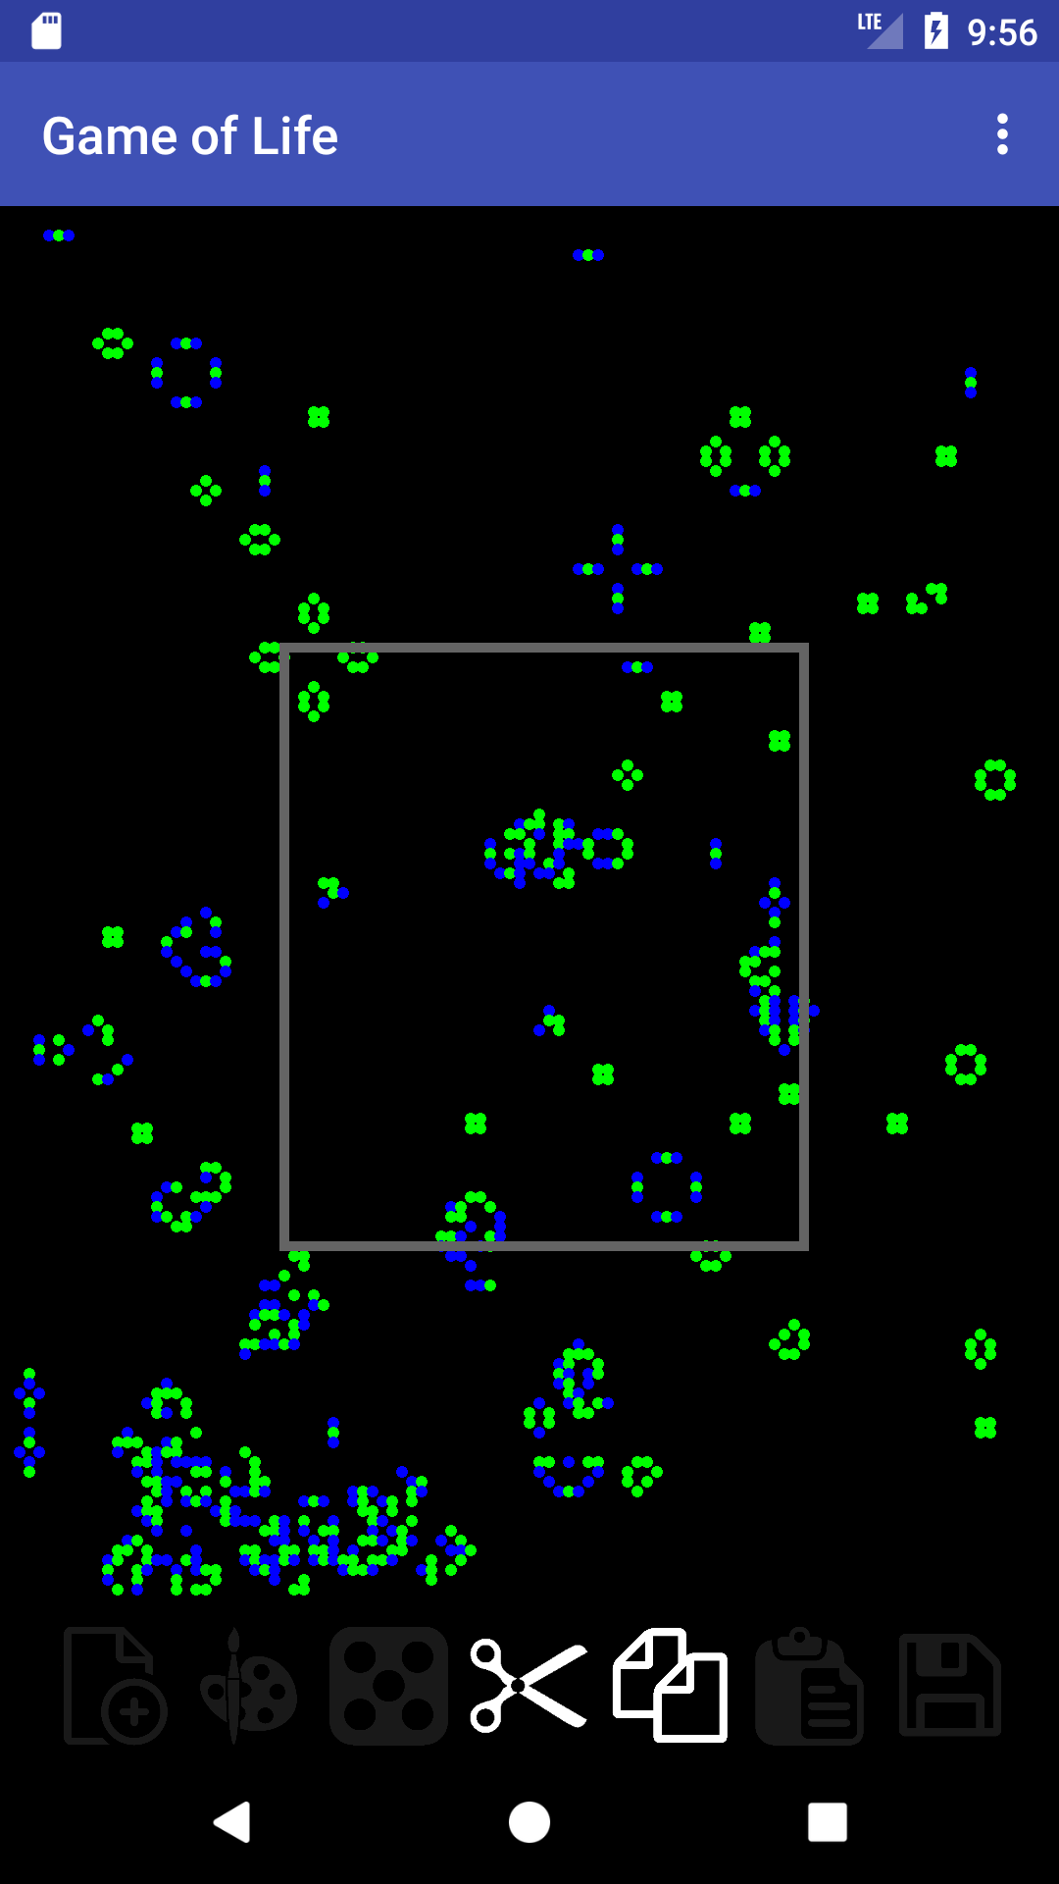
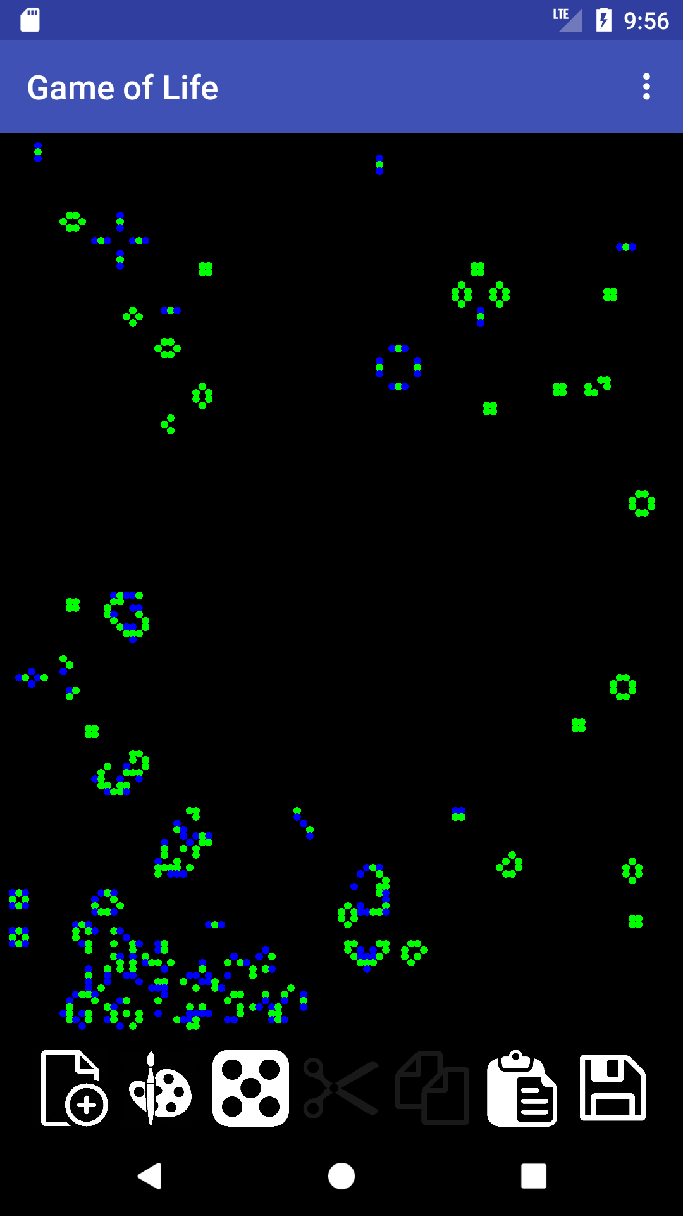
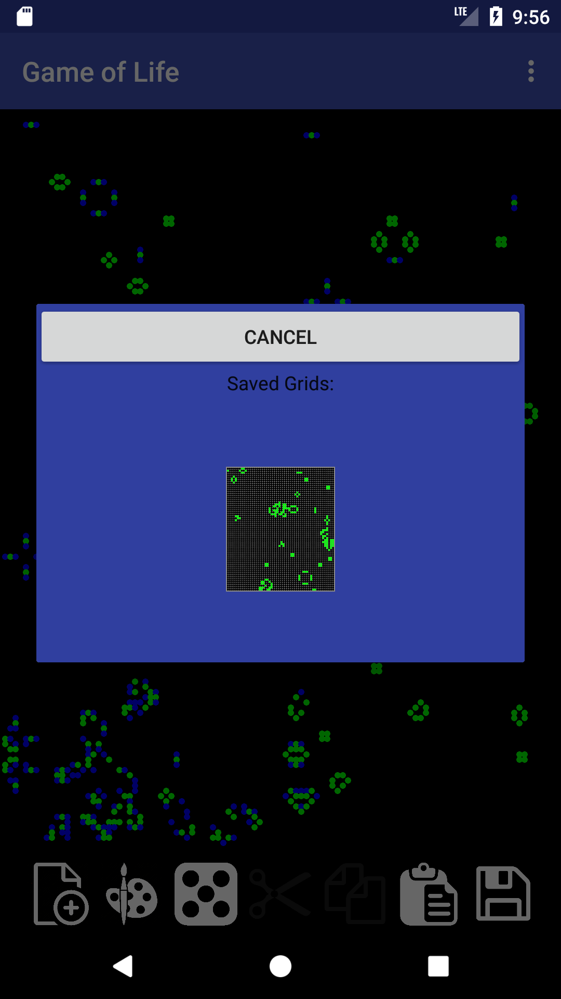
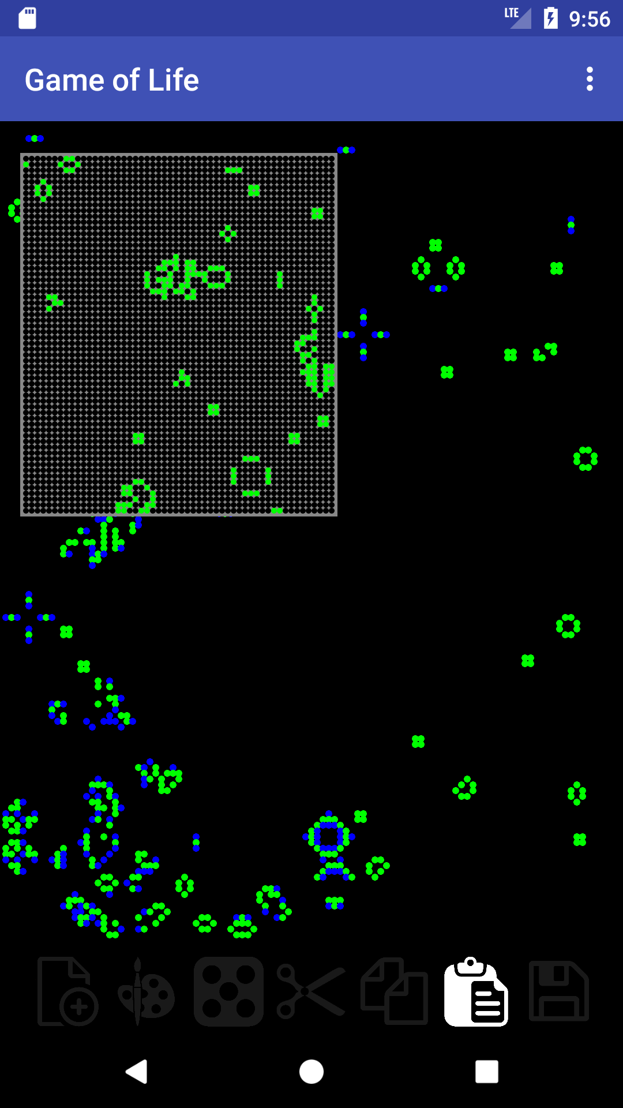
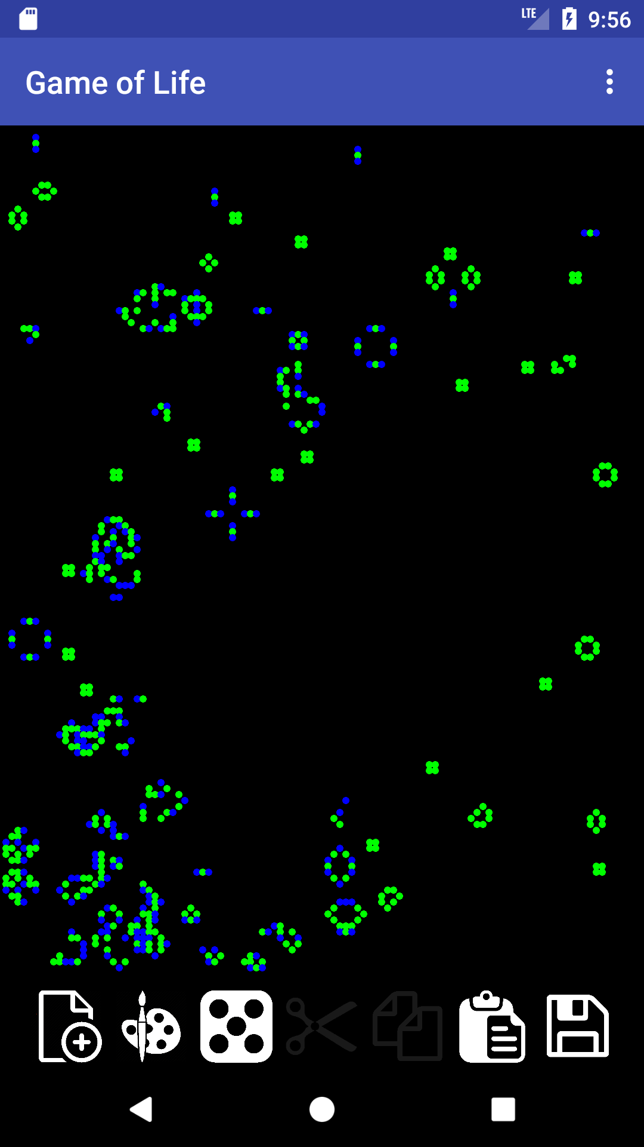
Cut and Paste Operation

Slide 9
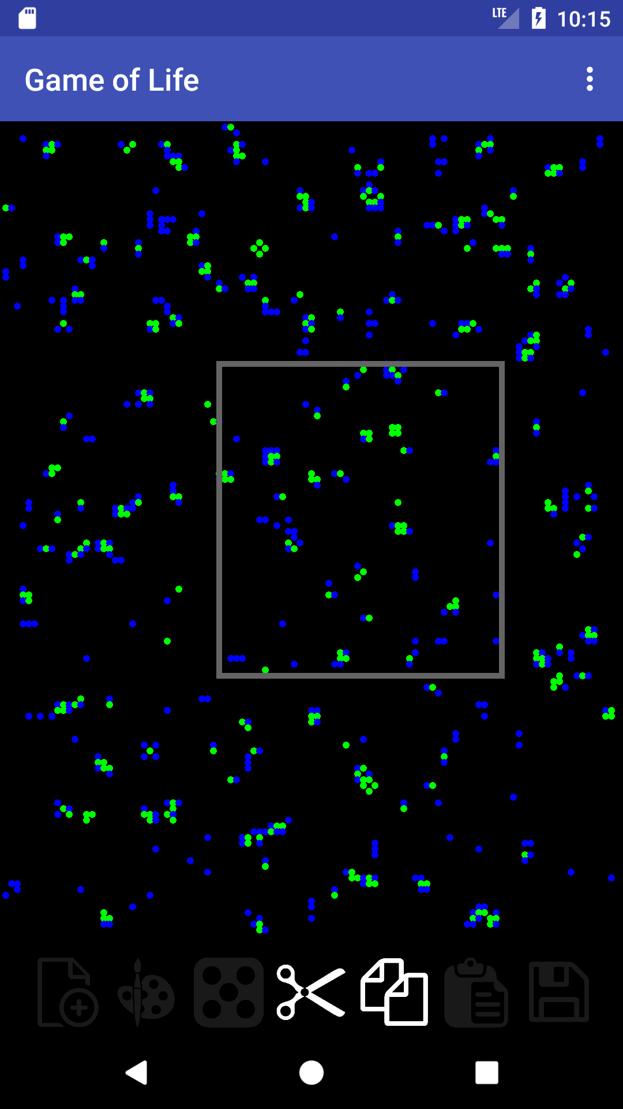
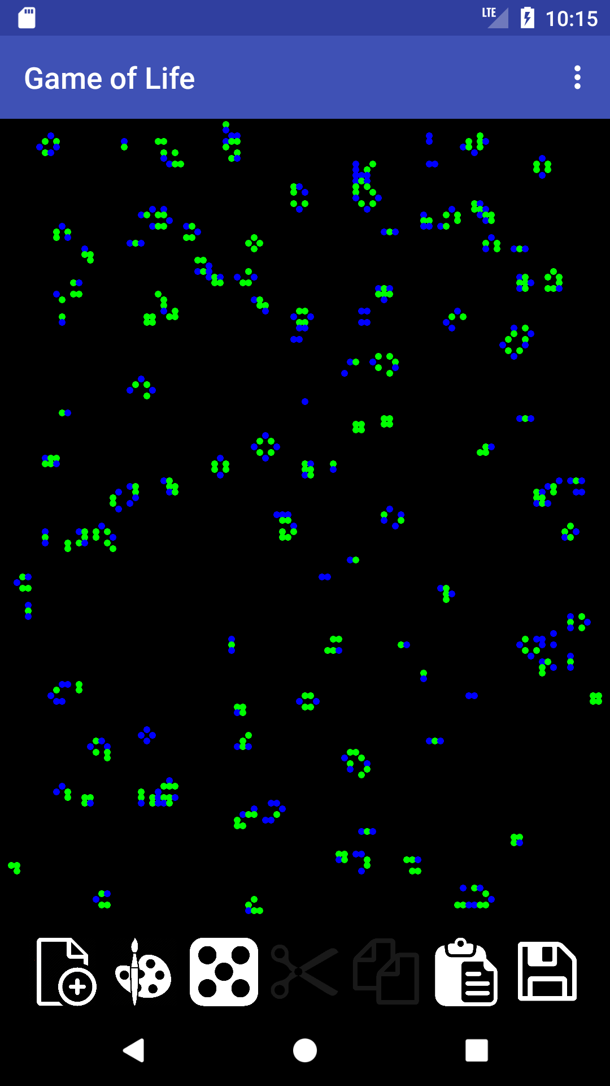
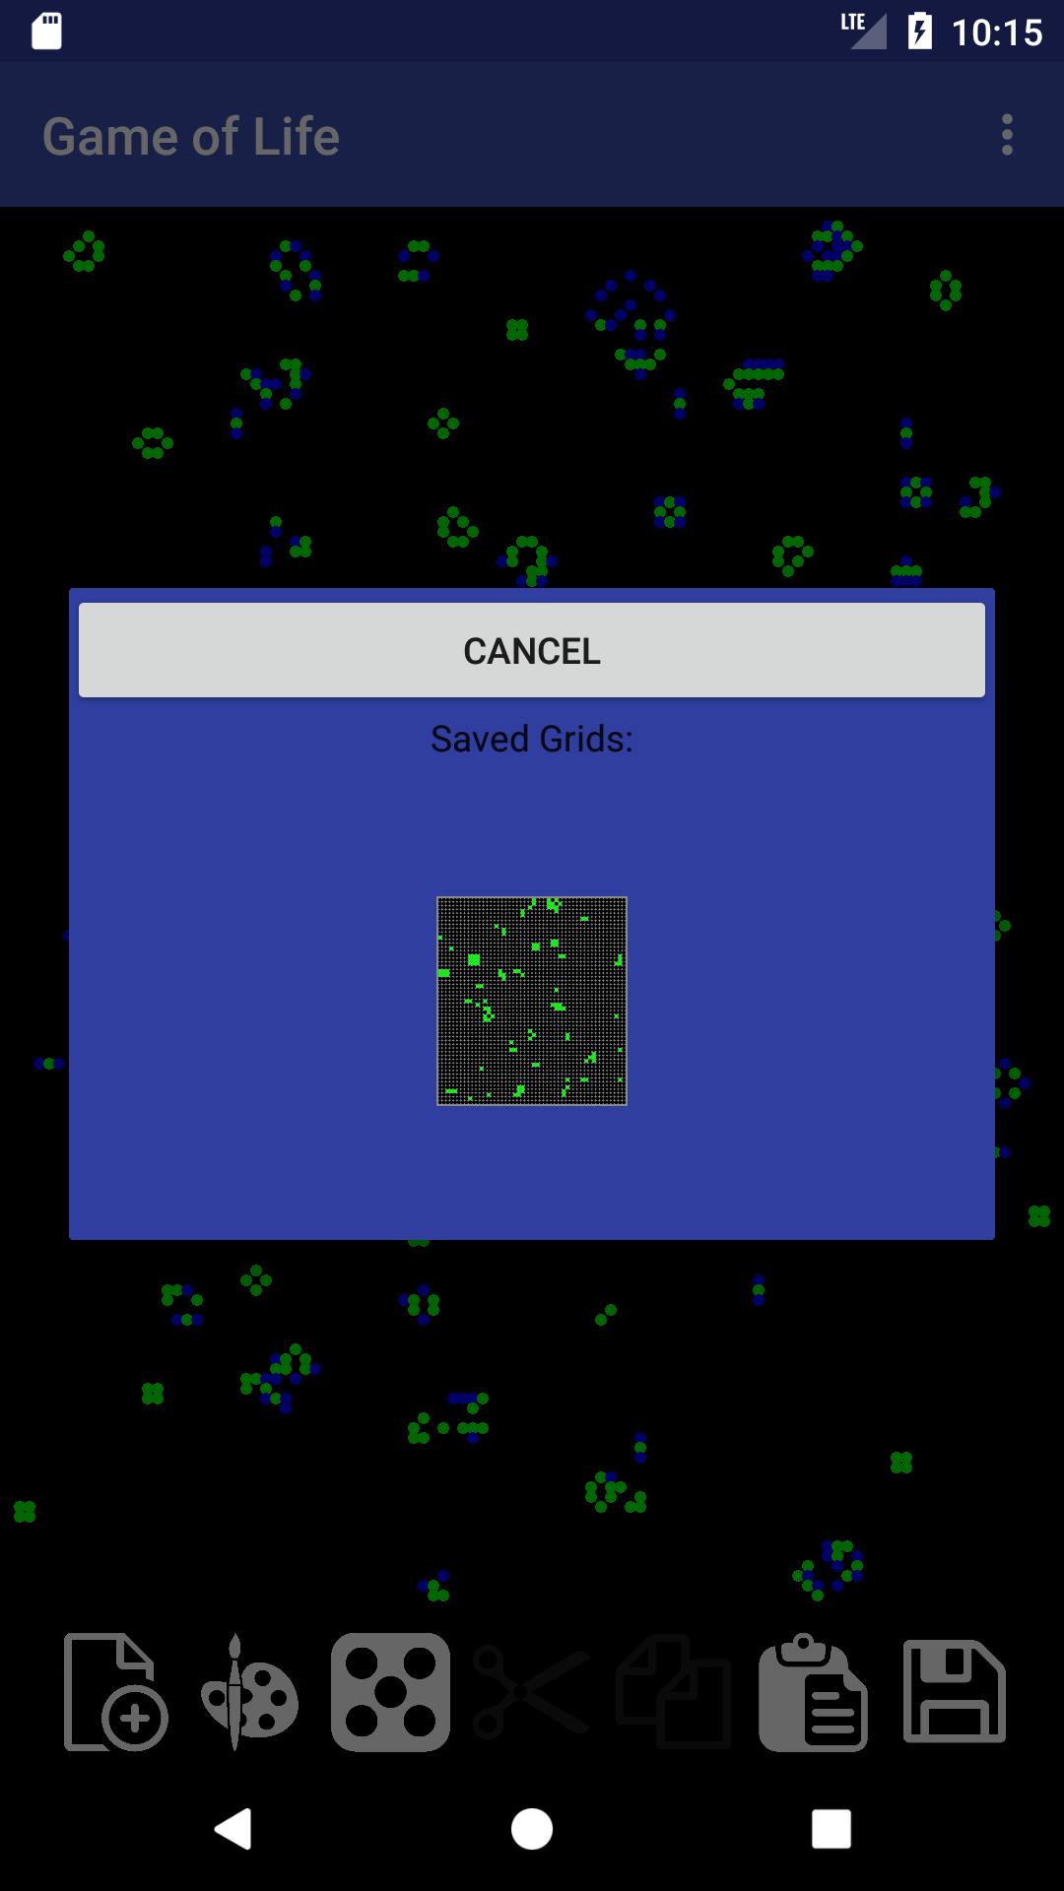
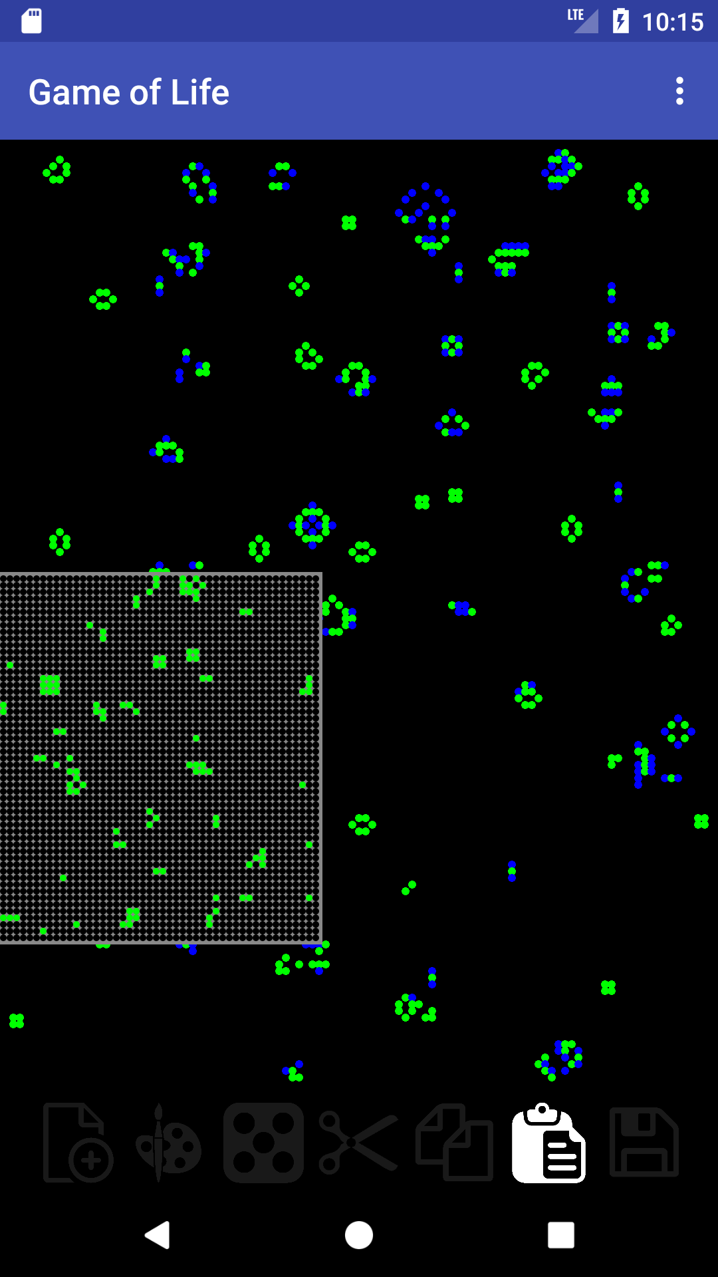
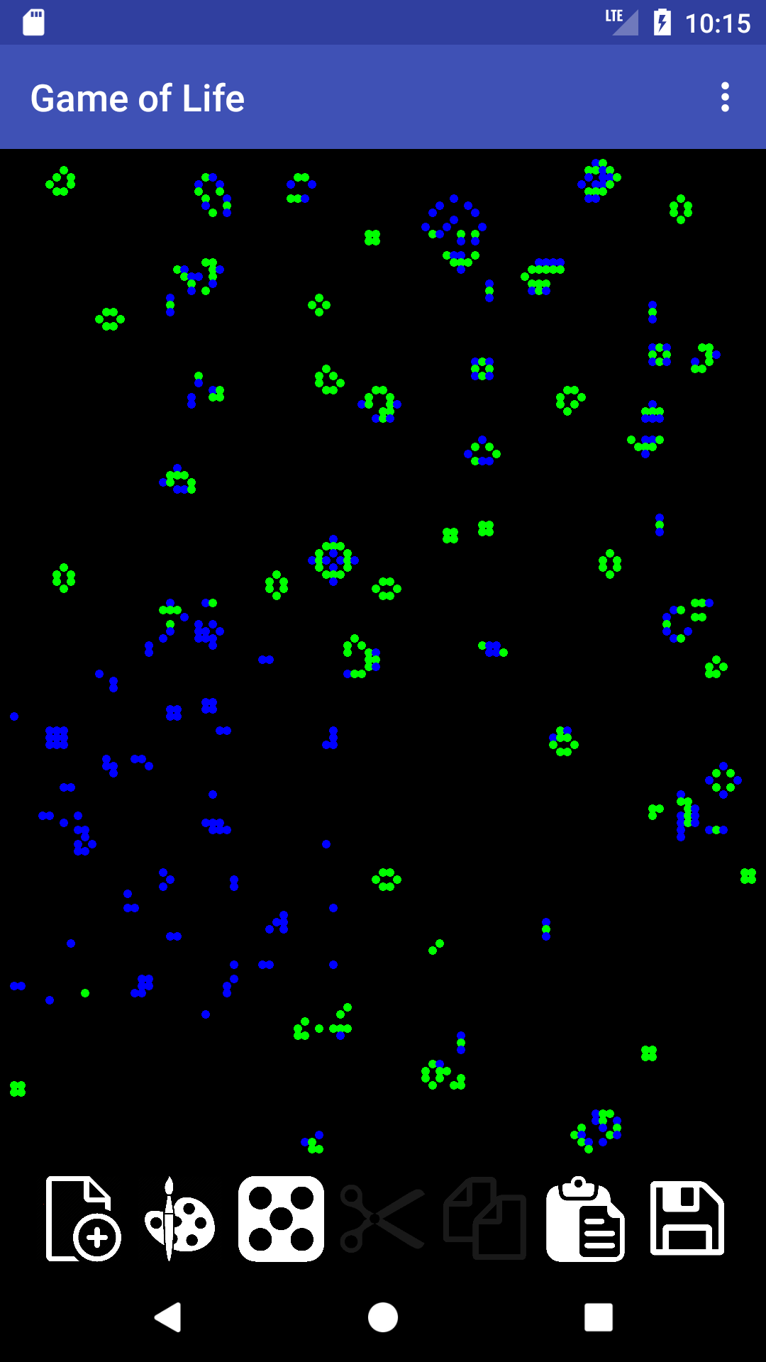
Copy and Paste Operation

Slide 10
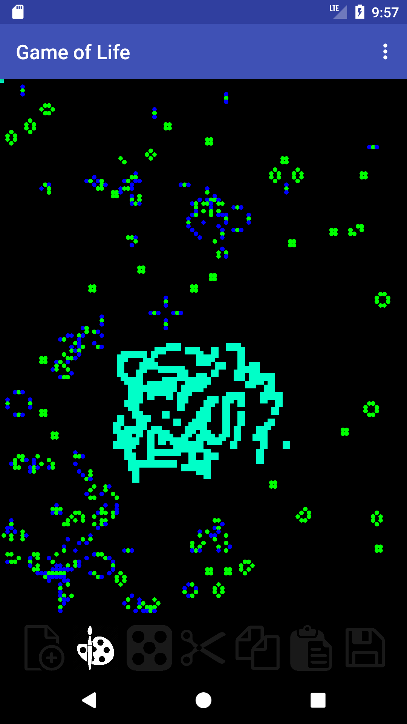
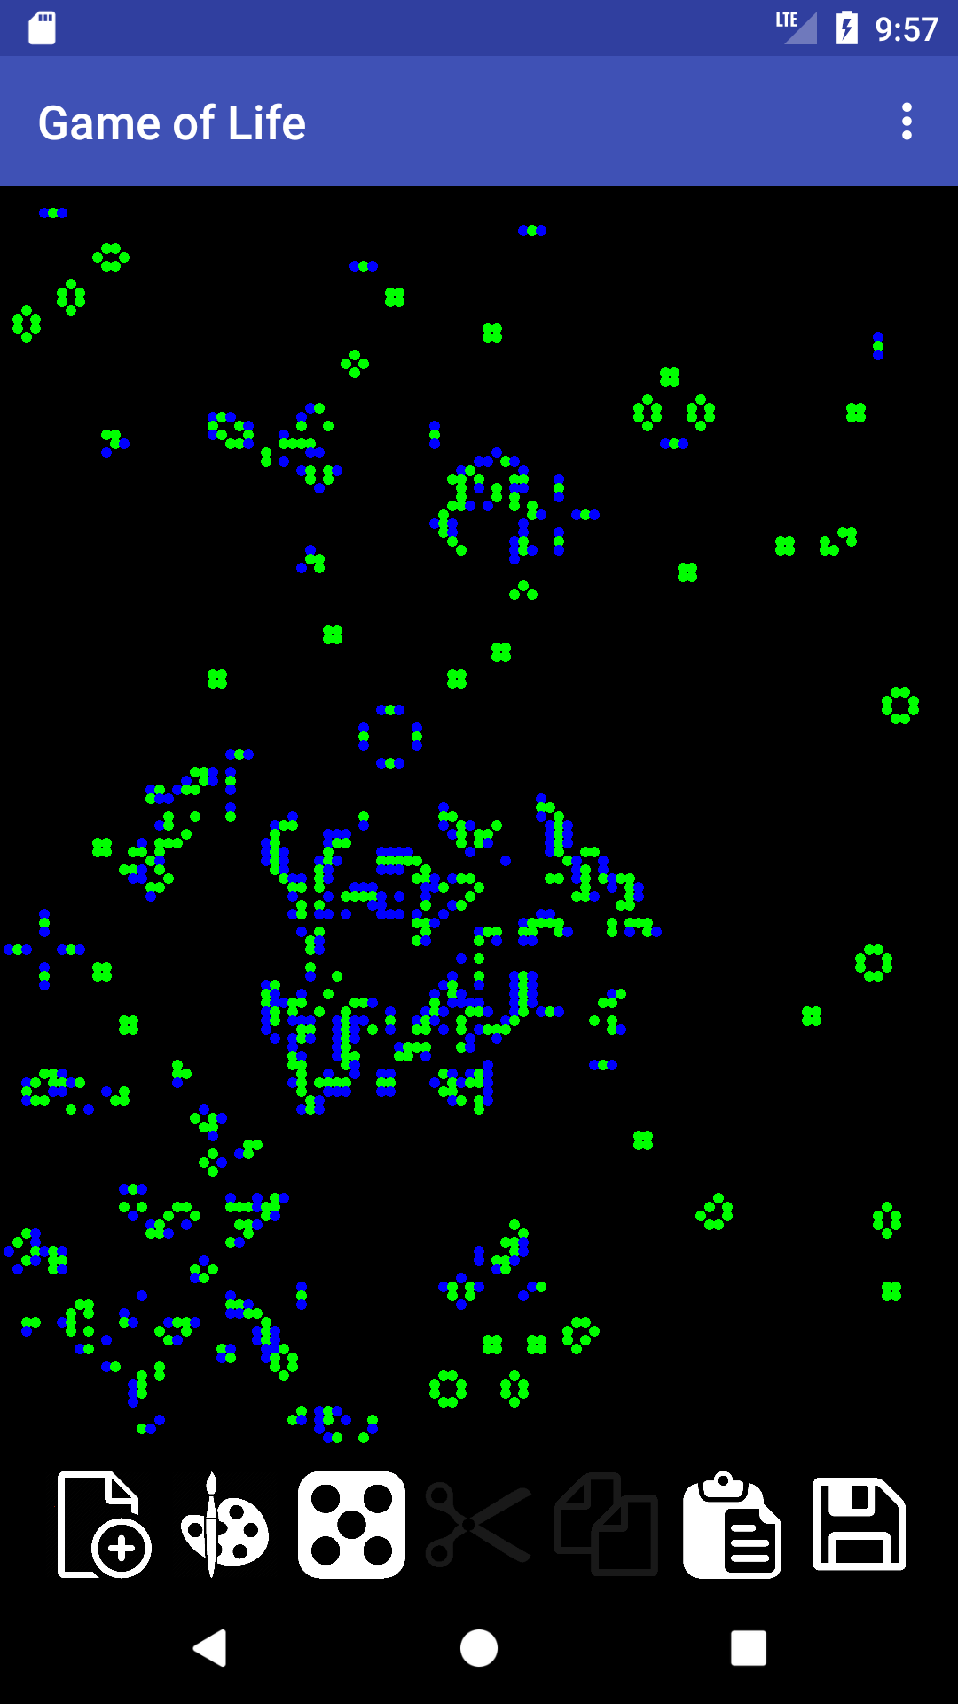
Painting

Slide 11
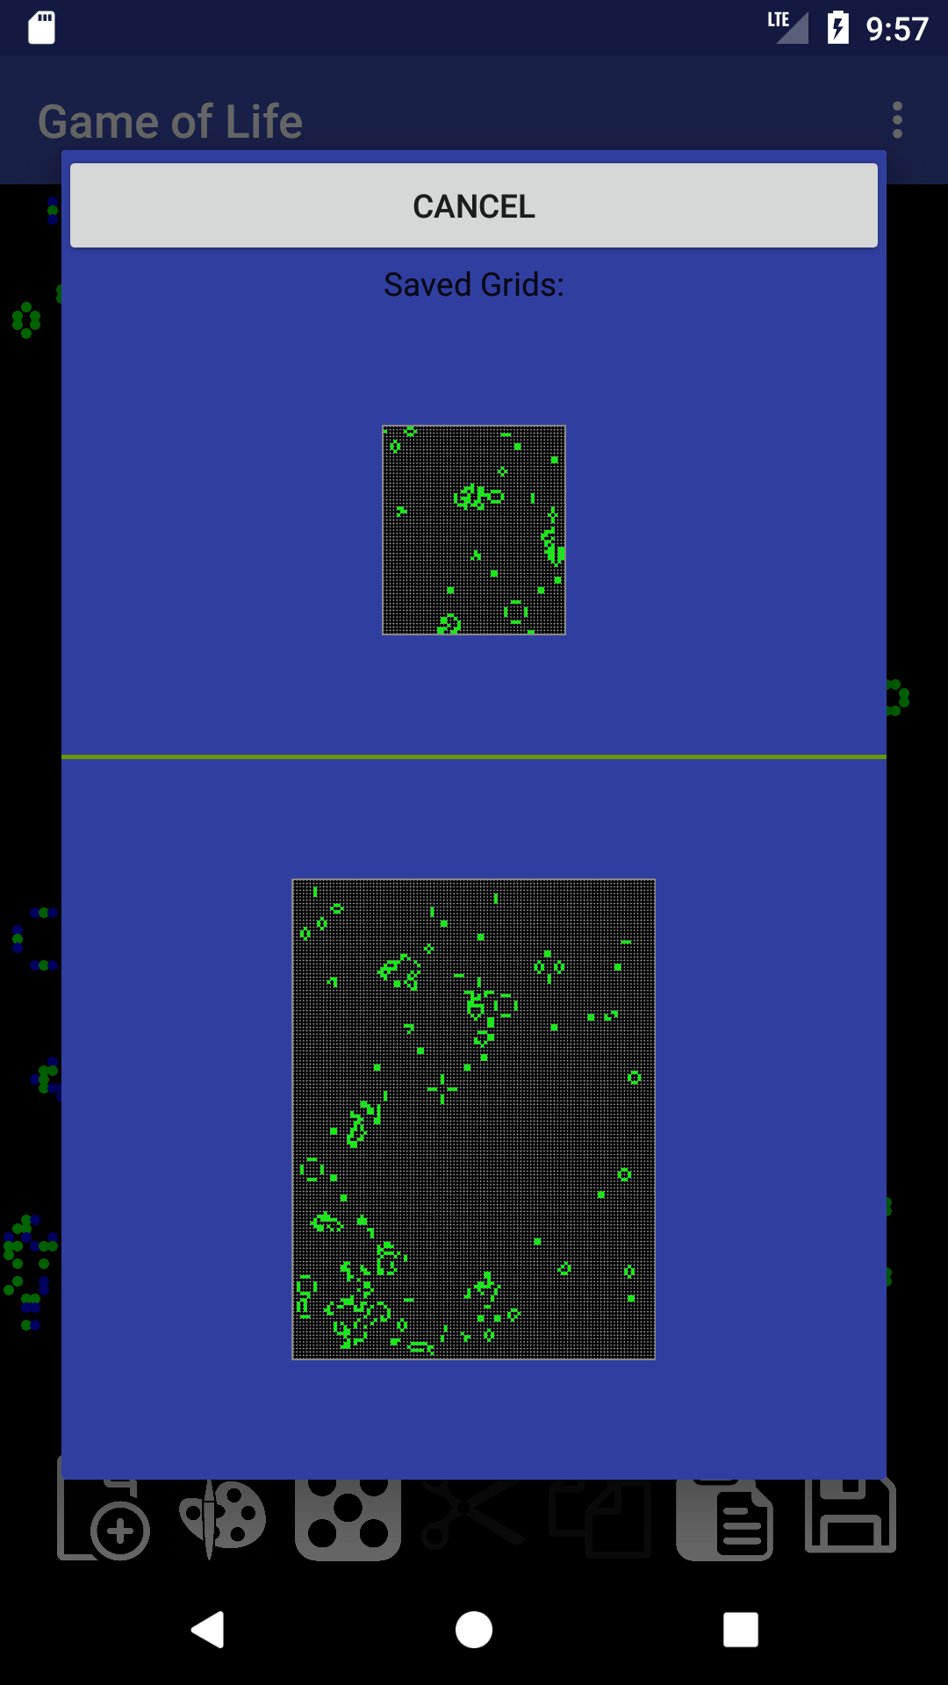
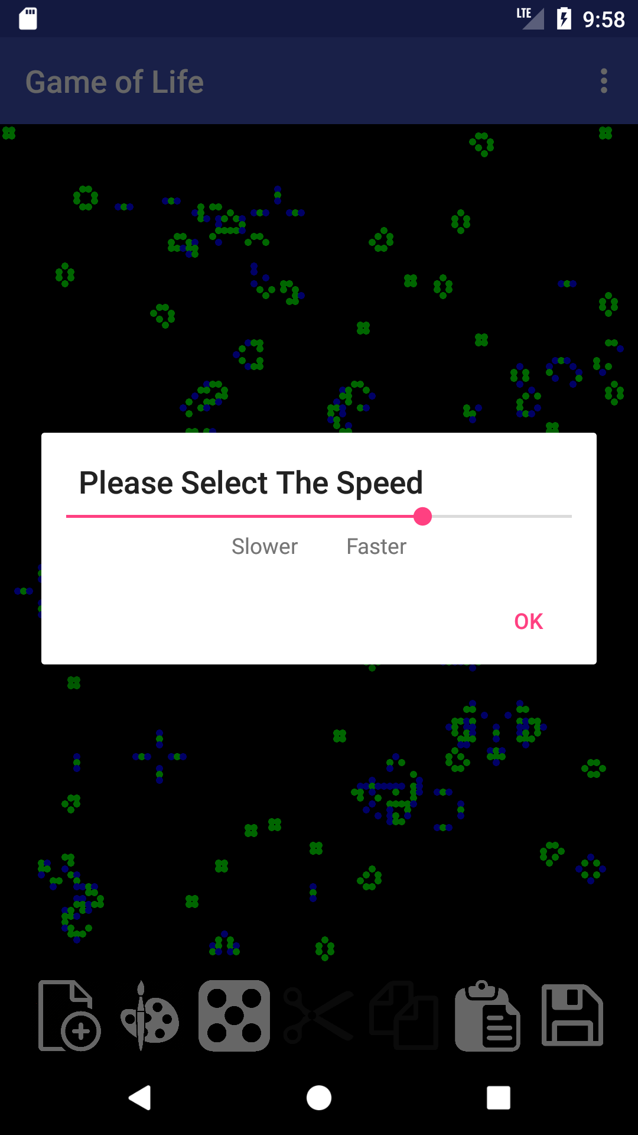
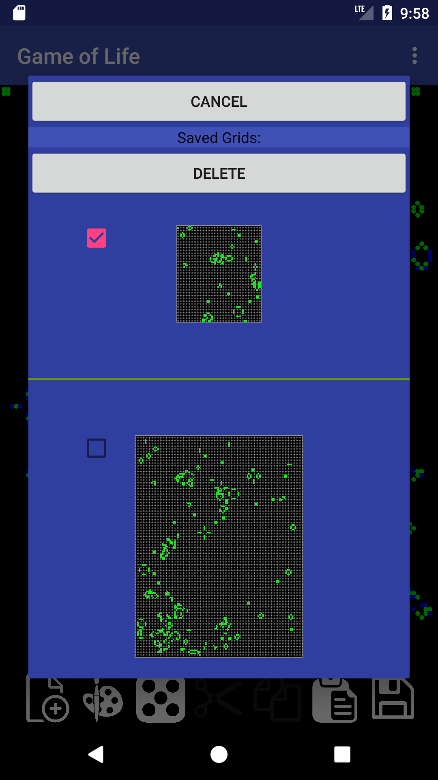
Other Features
Whole Grid Saving
Speed Selection
Database Management

Slide 12
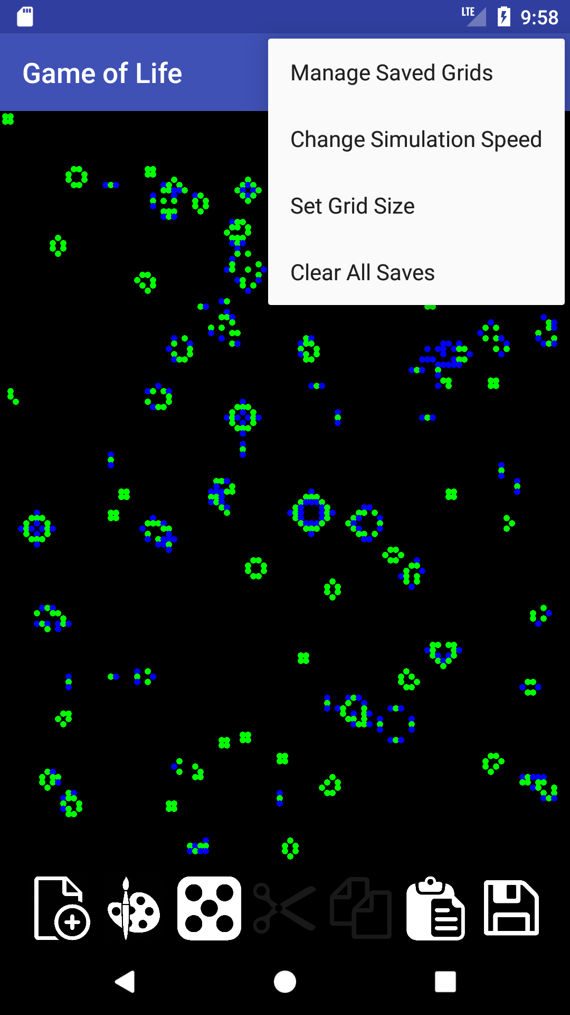
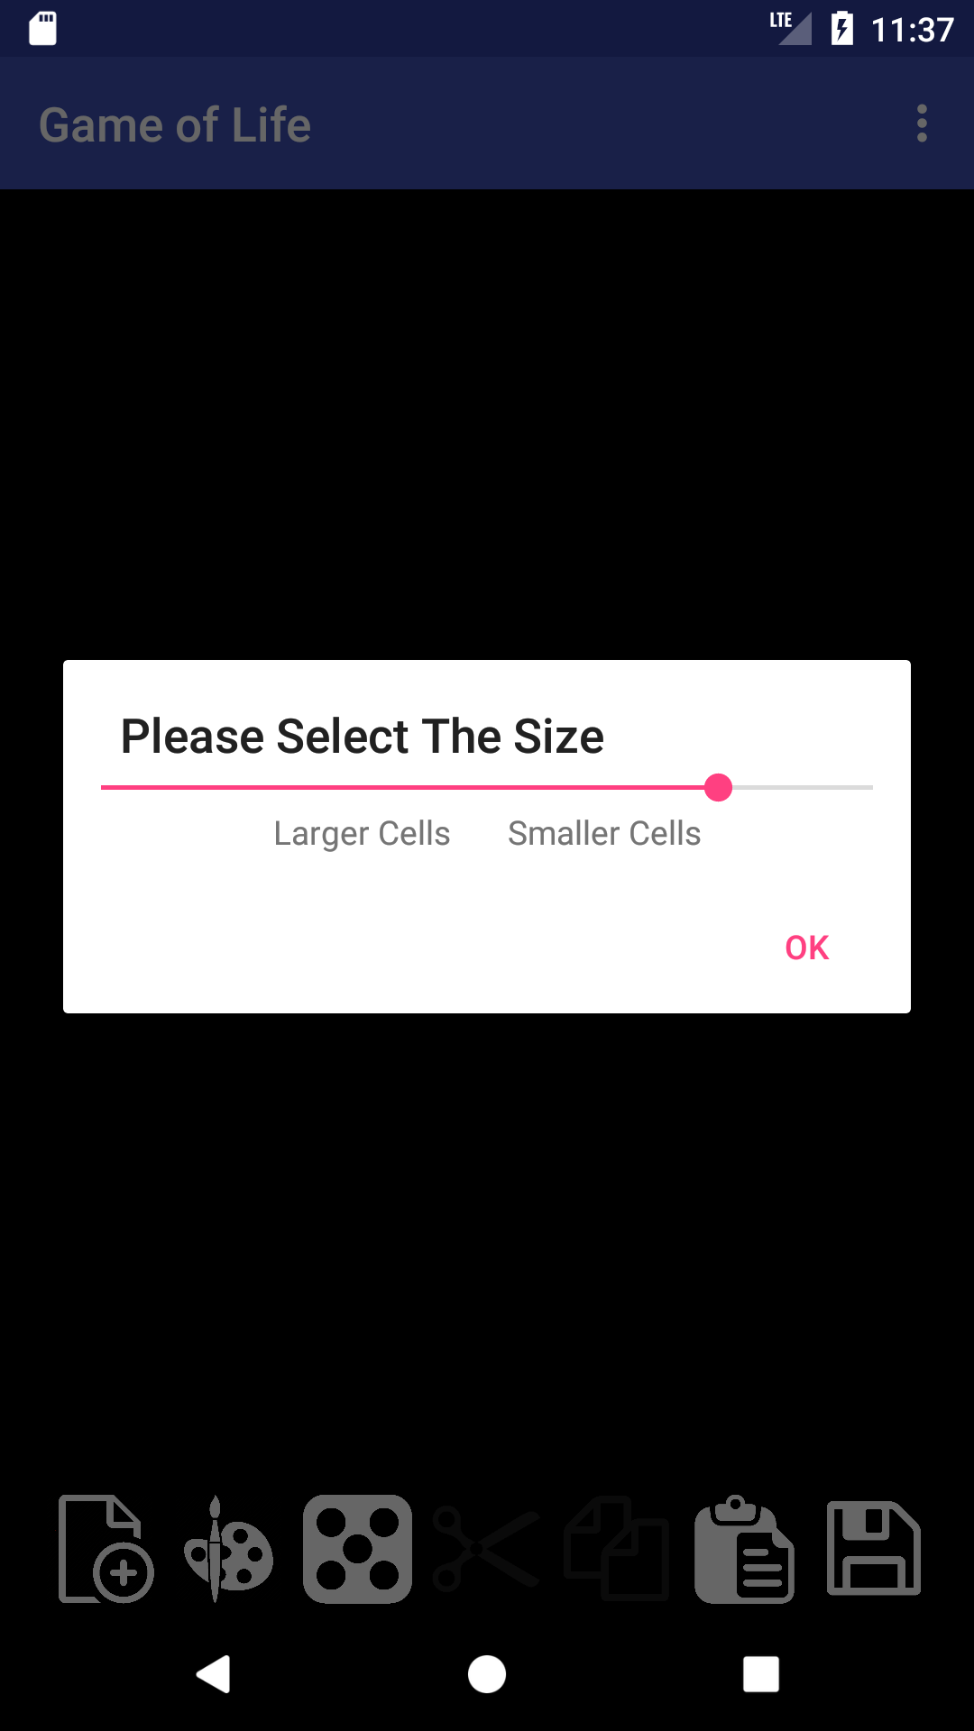
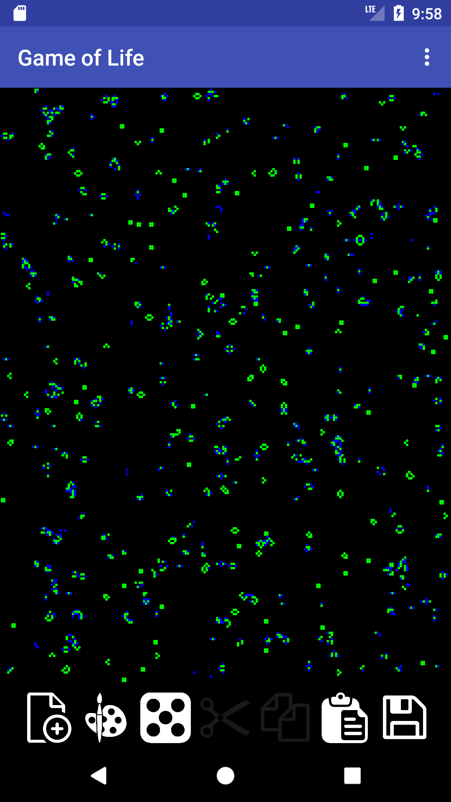
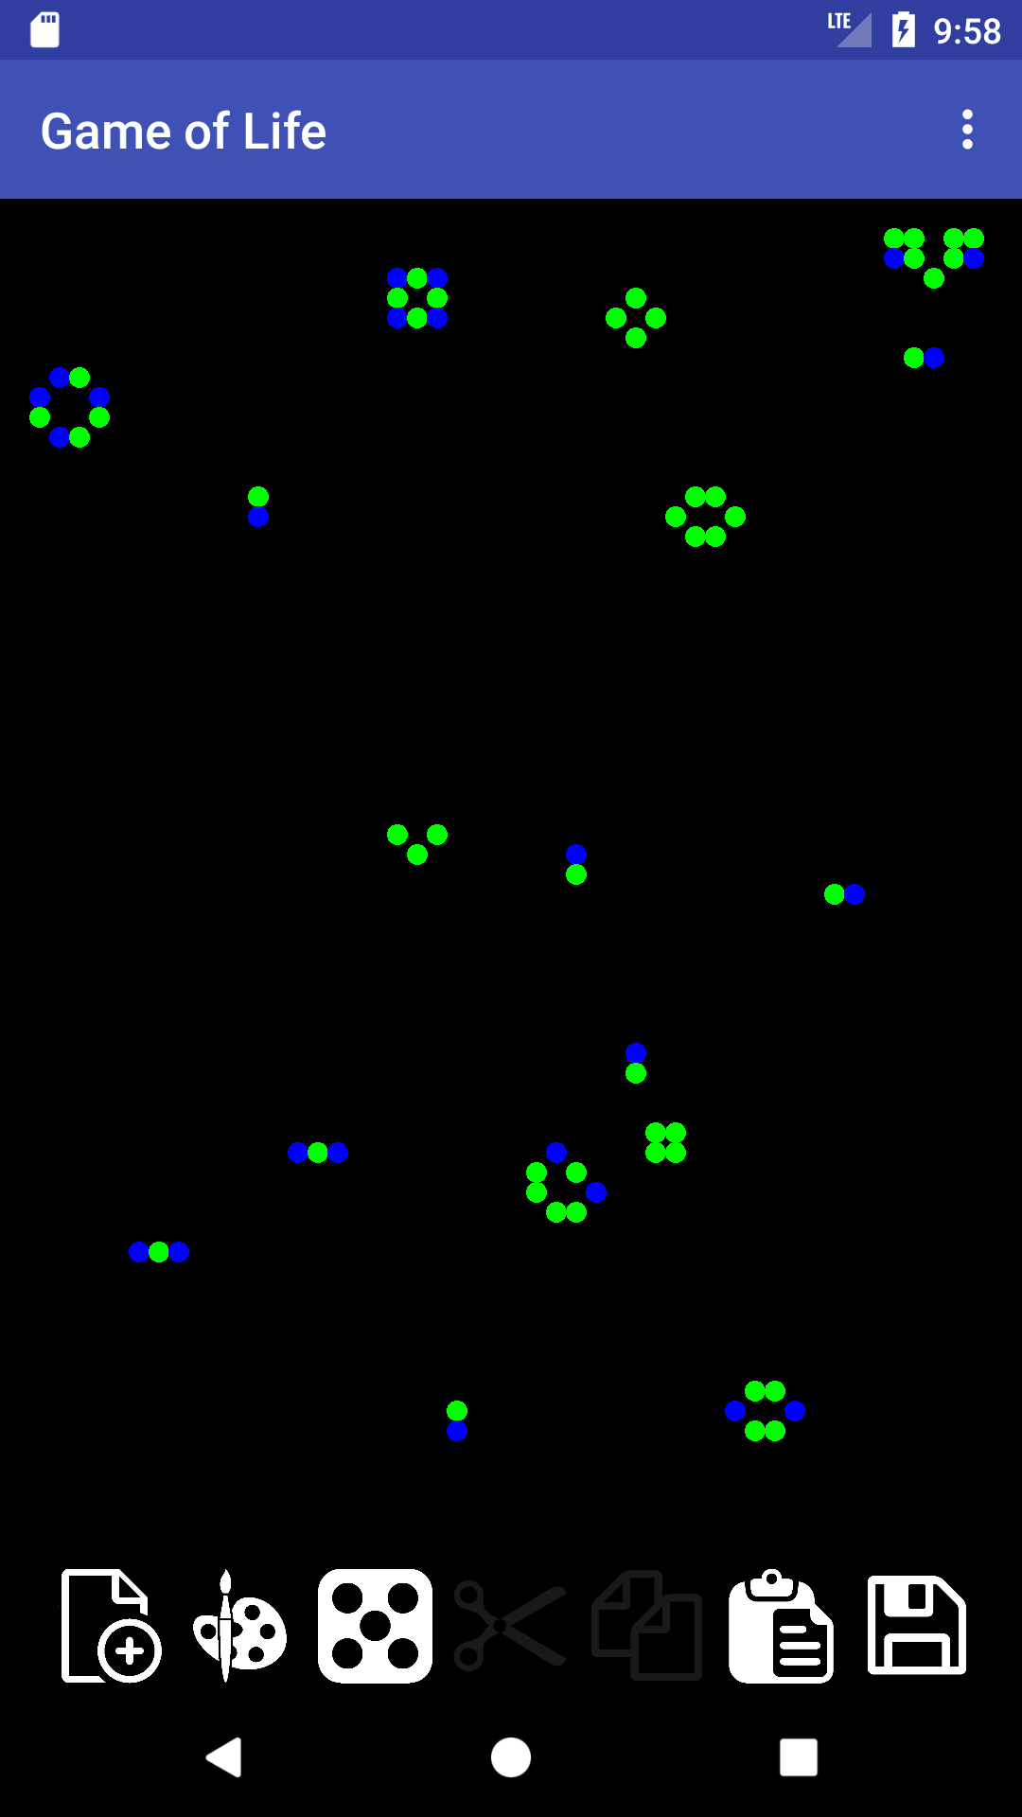
Other Features
Settings Menu
Size Modifier

