Slide 1
Conway’s Game of Life
Alex Buchanan – kevin holmes – George LE – James Testa

Slide 2
Goals
Implement the standard algorithm for cellular automata
Enable interaction by the user with the simulation, not just watching it, but modifying it
Allow users to save interesting cell grids, or segments of that grid to a SQL database

Slide 3
Current status
Random generation and canvas painting to initialize grid
Cut, copy, paste, and paint to modify active simulation
Fragments of database management and pasting in progress

Slide 4
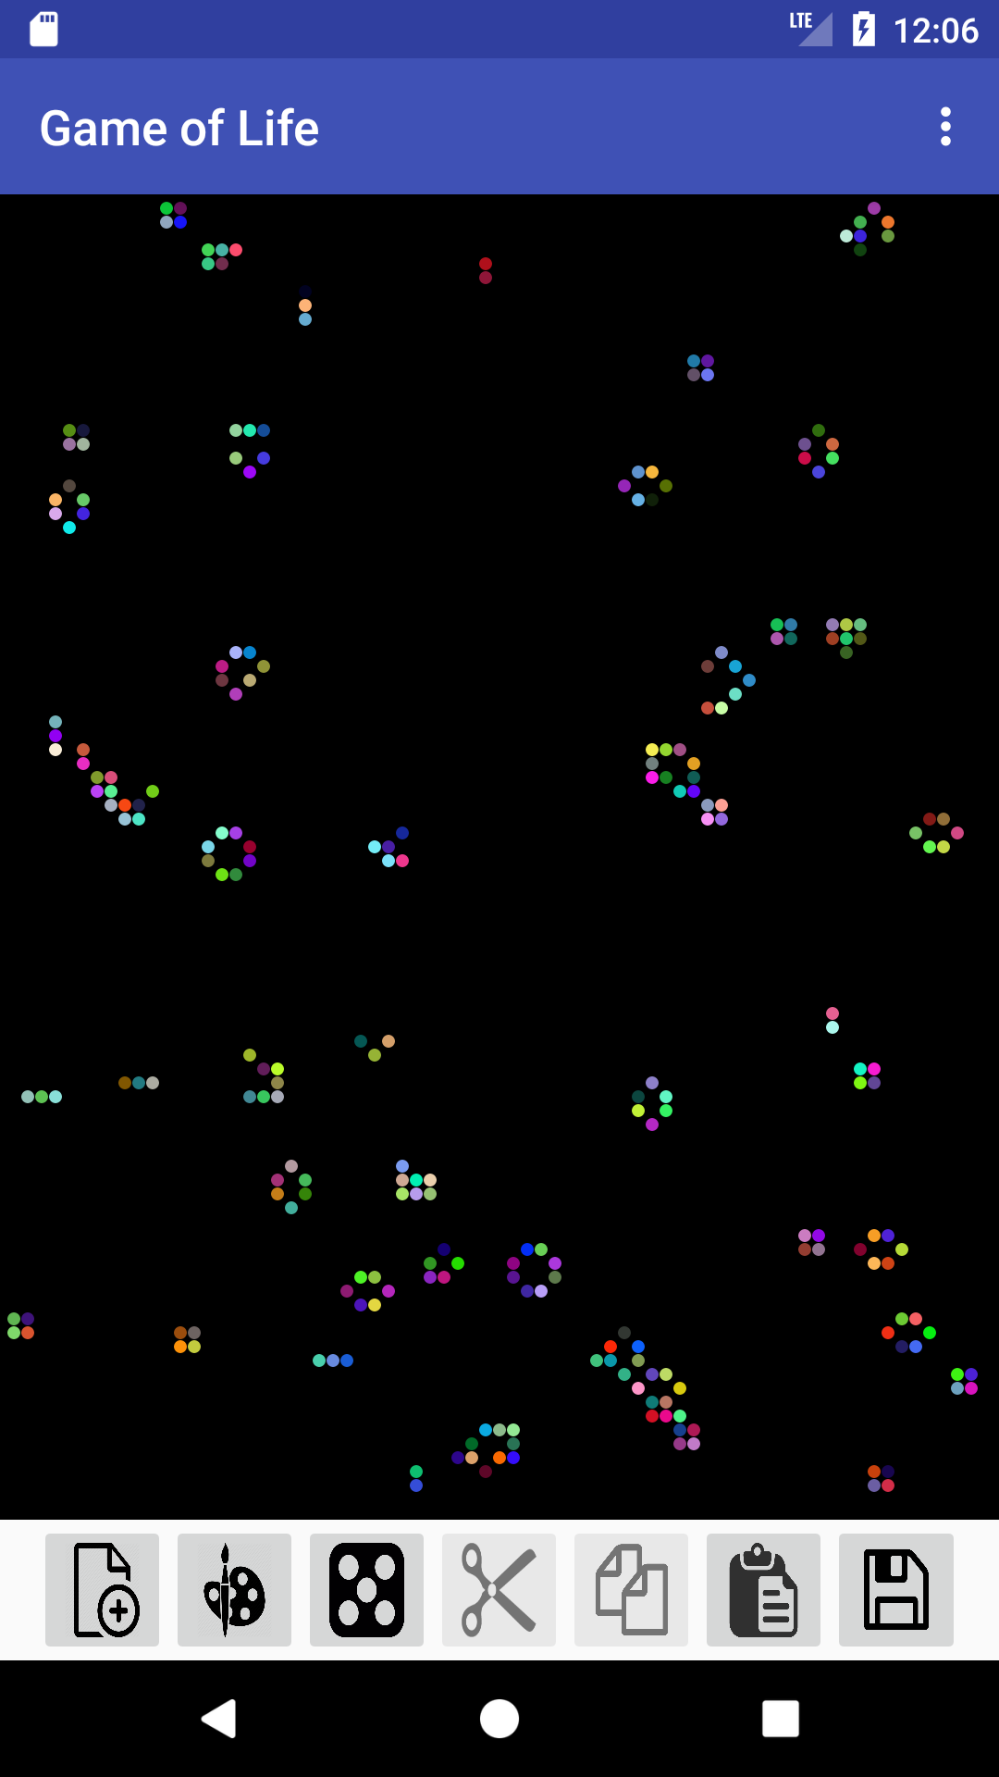
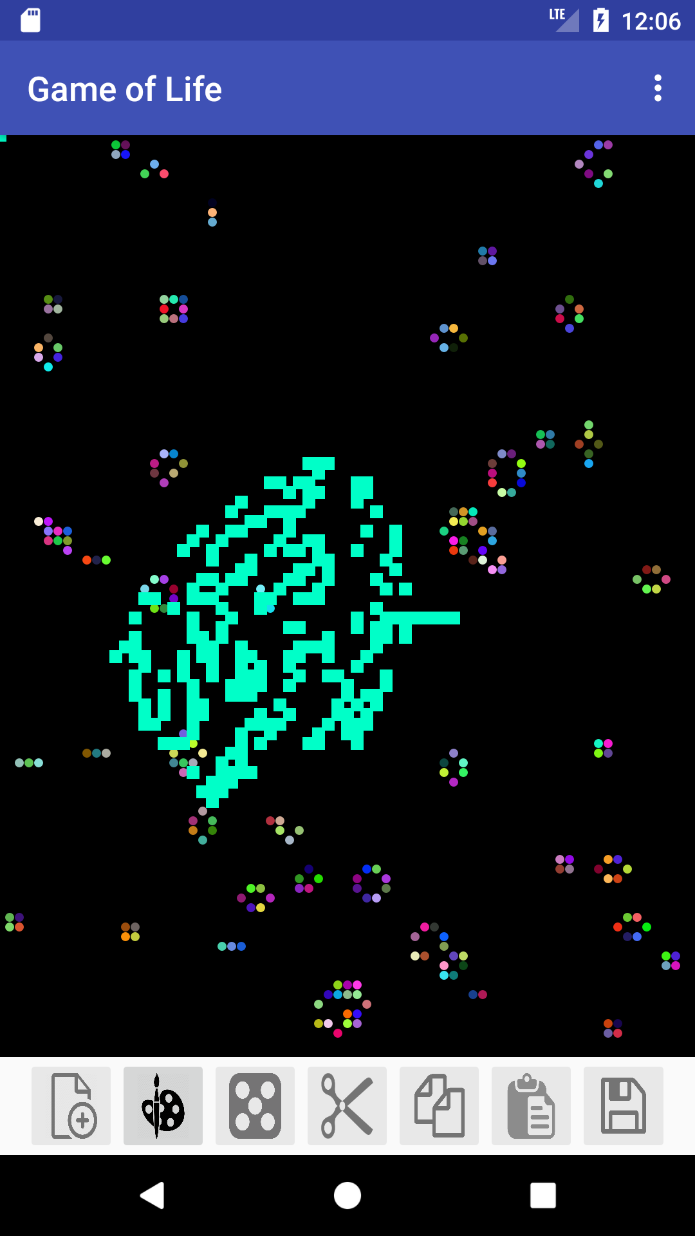
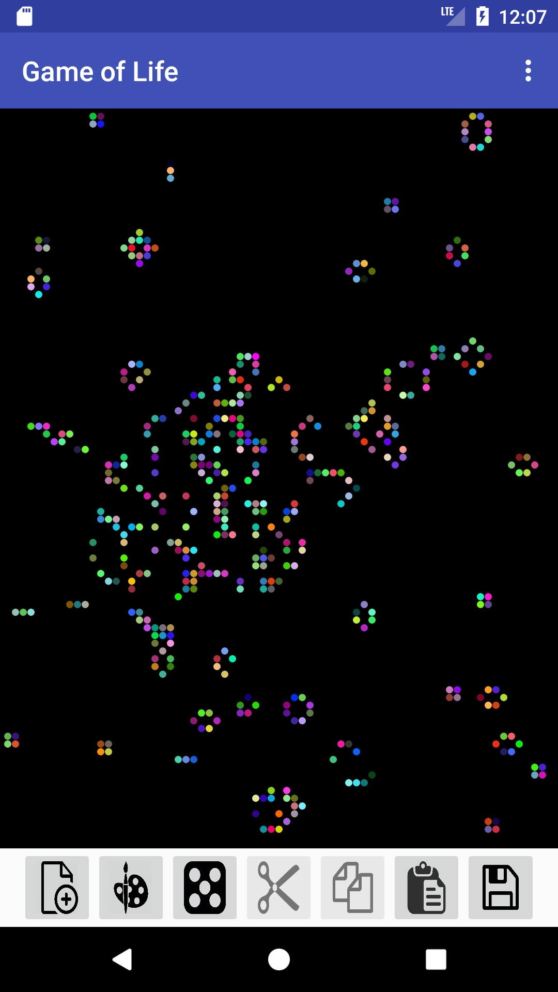

Slide 5
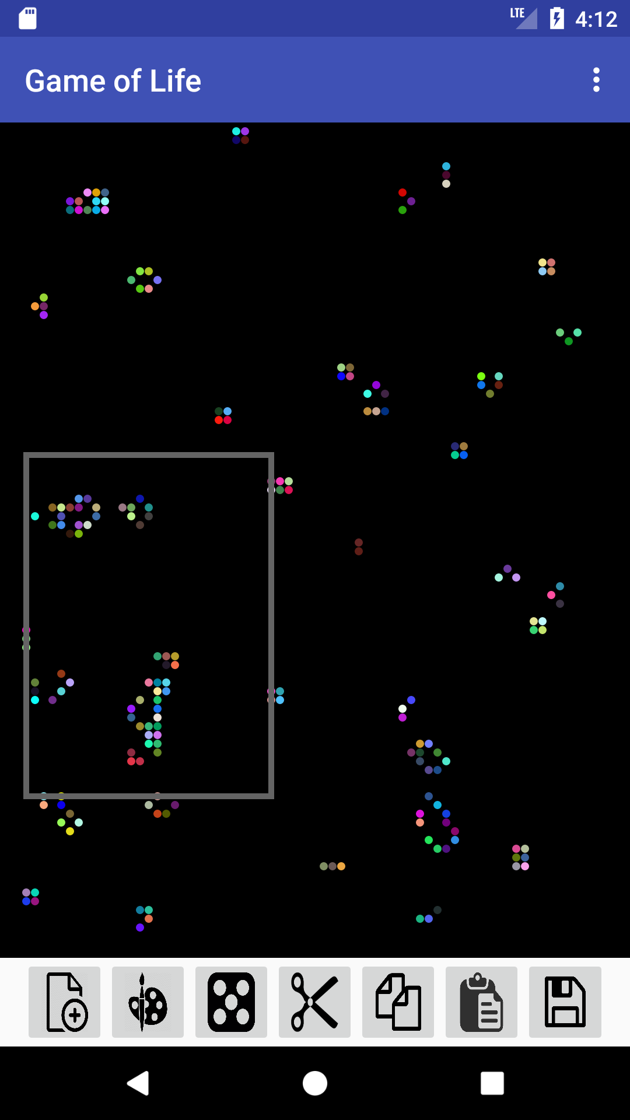
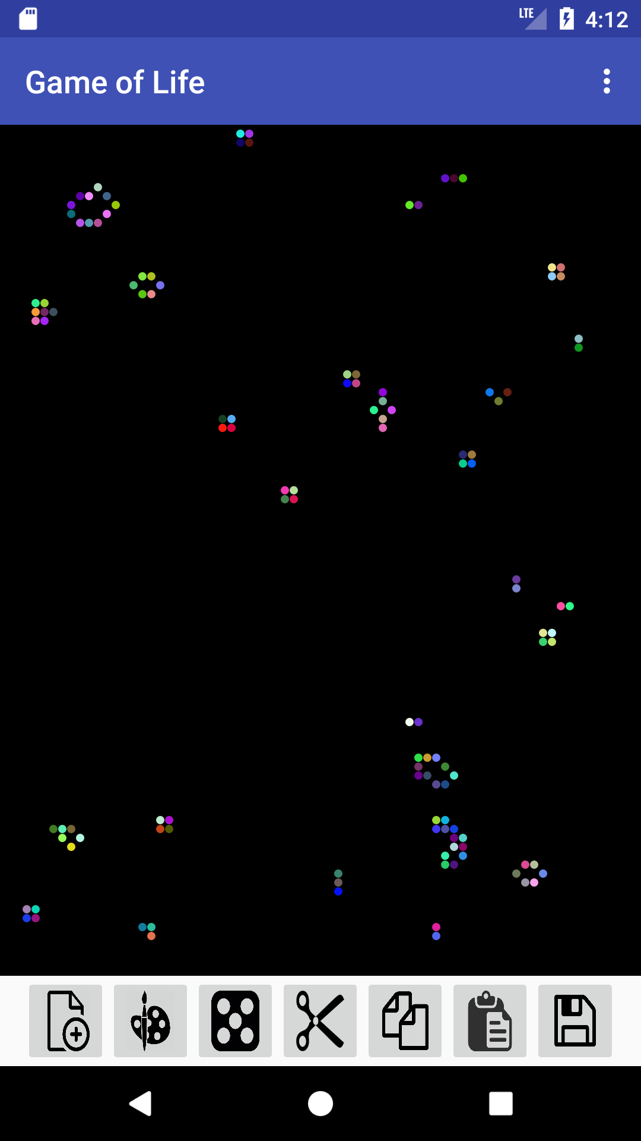

Slide 6
Roles & Responsibilities
Alex – Database management
Implemented DB save functionality
Implemented DB request functionality
Keeping everyone in the loop
George – Fragments and UI work
Added a fragment that can access and display contents of database
Added a ListView container that will display items in the database

Slide 7
Current Challenges
A bit ahead of schedule in some portions, behind in others. This causes a lot of blocking issues that require coordination around busy schedules
Drawing on android isn’t always a linear process; performance is a major issue depending on how you implement what you’re going to draw onto
Making the app “feel” good: creating preview bitmaps for saved segments, and then drag and dropping those saved segments requires a lot of adjustments
Managing two different coordinate systems: actual screen coordinates and grid coordinates
The actual grid in charge of drawing and defining each cell’s status needs adjustments to its dimensions, otherwise we end up iterating over a 1920x1080 (or other large size) 2D array. That means each redraw would require 2,073,600 iterations. We limited the maximum dimension to be 1/15 of the normal screen size, and draw the cells larger to compensate

Slide 8
Roles & Responsibilities
James – Miscellaneous
Added selection box drawing
Created cut/copy functions for selection box grabbing cells from grid
Fixed a bunch of array indexing errors throughout rest of code
Kevin – Drawing and Planning
Randomize and Paint grid drawing
Overall simulation algorithm along with stepper and drawing functions
Added SerializableCellGrid class, for converting objects representing cellgrids to bytestreams for easier database management
General planning and coordination

