Slide 1
Conway’s Game of Life
Alex Buchanan – Kevin Holmes – George Le – James Testa

Slide 2
Goals
Implement the standard algorithm for cellular automata
Enable interaction by the user with the simulation, not just watching it, but modifying it
Allow users to save interesting cell grids, or segments of that grid to a SQL database

Slide 3
Current status
Random generation and canvas painting to initialize grid
Cut, copy, paste, and paint to modify active simulation
Fragments of database management and pasting in progress
Ability to set the speed of the simulation via options dropdown
Ability to Change the size of the grid via options dropdown
Ability to clear DB of all saves via options dropdown
Colors on the grid more representative (blue for new, green for old)

Slide 4
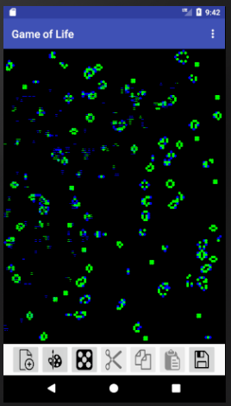
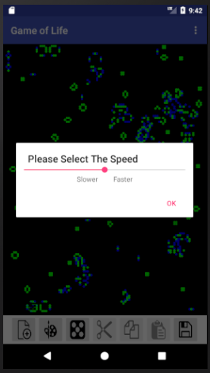
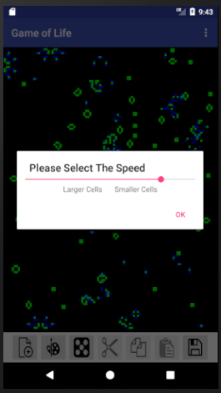
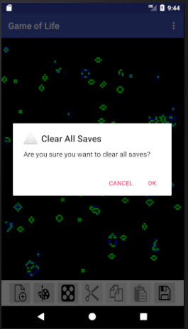

Slide 5
Roles & Responsibilities
Alex – Database management
Implemented delete individual save function
Implemented delete all saves function and added appropriate option to options dropdown menu
Reworked DB functions to no longer care about the color grid (as there is logic Kevin put in place to determine color as opposed to the old randomness)
George – Fragments and UI work
Worked on allowing users to load saves based on a bitmap preview image.

Slide 6
Roles & Responsibilities
James – Miscellaneous
Implemented speed selector in options dropdown that lets the user change the speed of the simulation
Kevin – Drawing and Planning
Reworked the way color works on the grid. Currently the cell will be blue if its new, and green if it isn't
Added ability to change the size of the grid to the options menu

Slide 7
Current Challenges
Bugfixing the small stuff can take a while
Making sure everything fits together in a way that makes sense and is clear to the user
Making sure the save and load functionalities aren’t over taxing the database
Since the grid can be huge performance is a big issue, we have to make sure that we are doing won’t impact performance in too much of a negative way.

