Slide 1
Conway’s Game of Life
Mobile App Development
Final Project
Group members: Kevin Holmes, Alex Buchanan, George Le, James Testa

Slide 2
Conway’s Game of Life App
Simulates cellular automata in varying scales, while allowing interaction with the user to change how the system evolves over time

Slide 3
Why?
Conway’s Game of Life is a stable in Computer Science; it’s been ported to most languages and run on most platforms.
Despite being a miniscule algorithm, they complexity of the systems it can produce is staggering
It looks pretty cool.

Slide 4
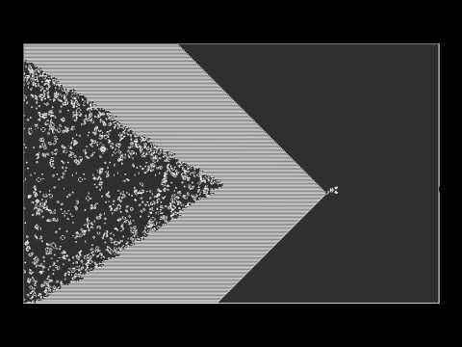

Slide 5
Similar Apps?
Only one in the Play Store
Doesn’t allow cutting and pasting, just saving entire simulations
Lacks the interactive level where you can modify the simulation to see how it would change the outcome.

Slide 6
App Features
Paints results of each step in simulation to screen, modified by the mode set by the user (speed value, step, or pause)
Allows user input for drawing the initial state of cells, as well as cut/copy/paste sections of the grid to make the simulation interactive
Allows saving of grid’s state to SQLite database, as well as segments of the grid that the user selects. This means copying interesting formations and objects from the app to the database, and injecting those structures into other simulations.
Users can change the speed of simulation as well as pause and step through each transformation

Slide 7
Responsibilities
Kevin Holmes – Graphics and general algorithm
Alex Buchanan – Network and SQL
George Le – Layout and user interactivity
James Testa – Gluing all the code together and misc. necessary portions

