Slide 1
Game of Death
Alex Buchanan, Jess Lai, Kevin Holmes, Mike Danino

Slide 2
Conway’s Game of Life Strategy Game - Game of Death
Modify Conway’s Game of Life into a turn-based strategy game

Slide 3
Pro’s
2 of us on the team have previous experience with Conway’s Game of Life from Mobile App 1.
Fun and interesting game that would provide a good challenge to both implement and play.
Really haven’t seen the simulation turned into a game before.

Slide 4
Con’s
Taking the already existing algorithm and creating a game that is both easy enough for a player understand while still staying faithful enough to the original algorithm while require a lot of testing and adjustments
The logic involved in manipulating the algorithm to have opposing sides is a complex topic and difficult task.

Slide 5
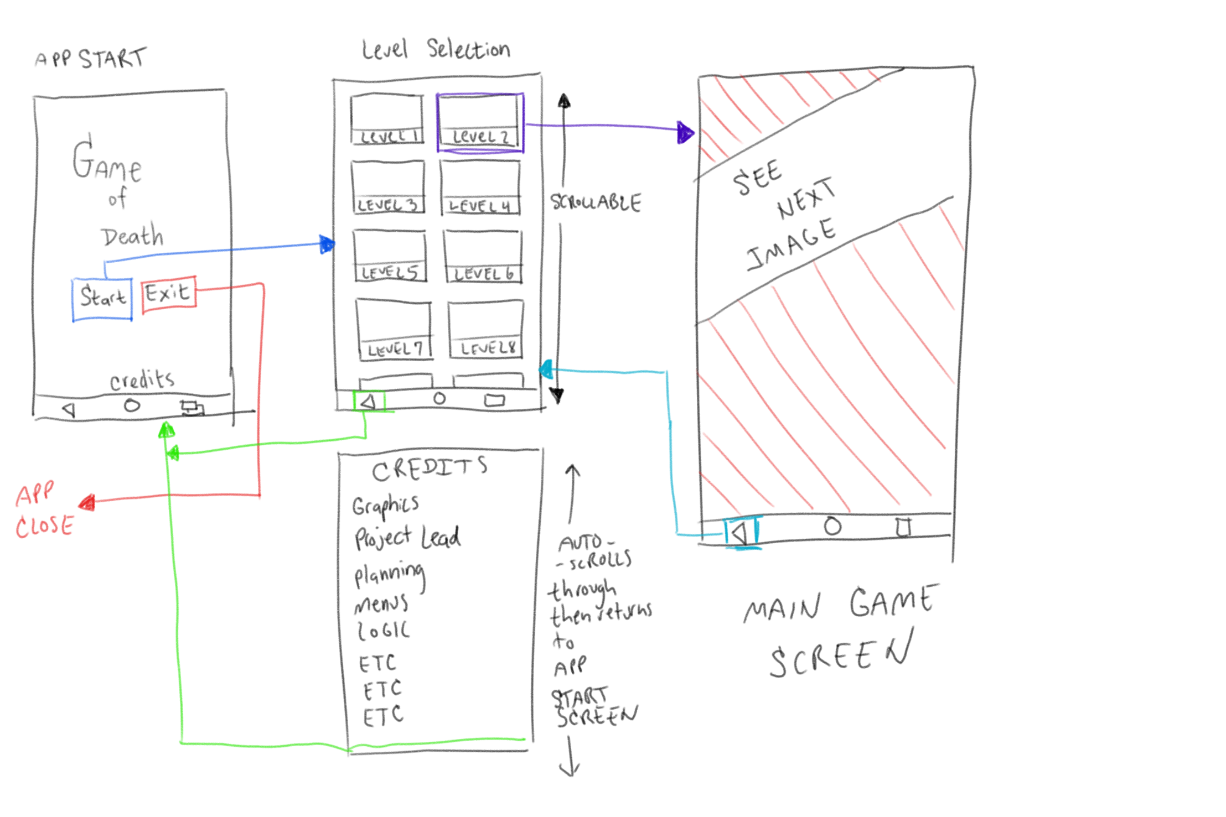
Mockups

Slide 6
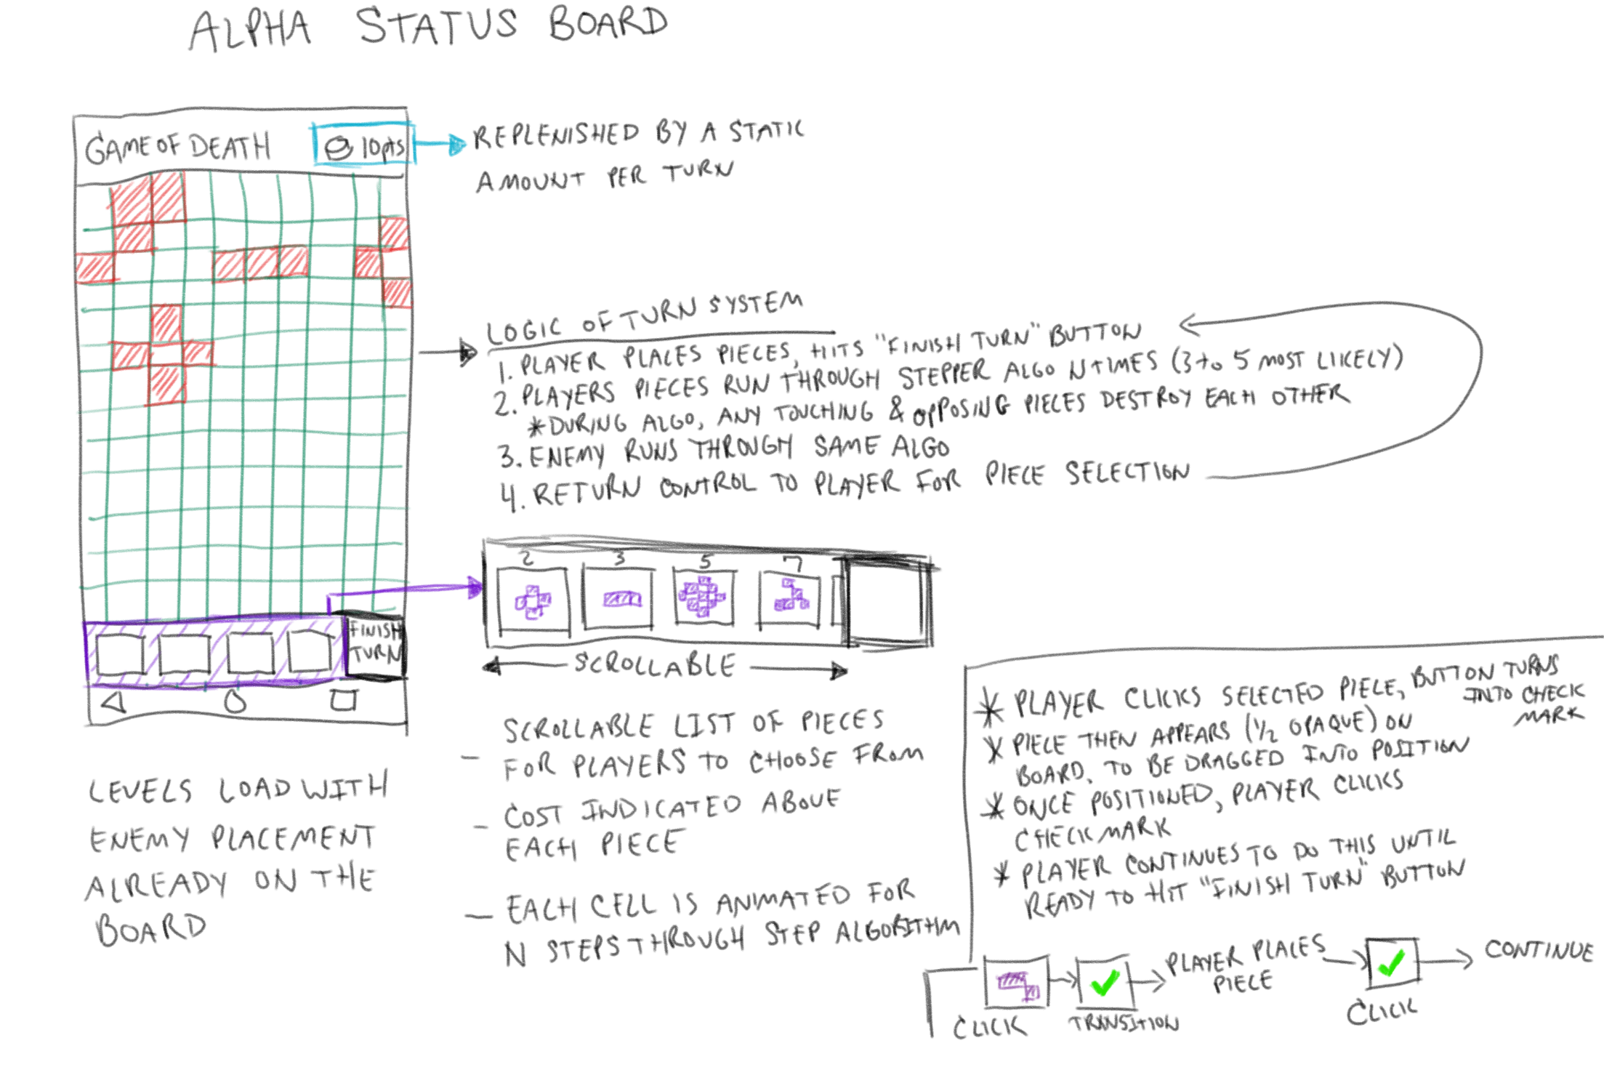
Mockups

Slide 7
Game Logic
Player is given currency at the beginning of the game, which replenishes by a constant, small amount on every turn. Currency is used to buy “seeds” (shown in next slide)
Enemy is not AI – All enemy seeds are placed on the board at the beginning of a round
Win condition – After a given number of rounds, the side with the most cells alive wins
Features
Opposing cells annihilate one another
Terrain – background art will be added, with certain grid locations being blocked off and inaccessible
Multiple levels which ramp up difficulty
Animated seed selection allows the player to see how any given seed evolves over the course of multiple turns
Challenge is for the player to anticipate how those cells will come together against the enemy; or possibly do themselves harm.

Slide 8
Seed examples
http://web.stanford.edu/~cdebs/GameOfLife/

Slide 9
Technical aspects
The stepper algorithm in charge of the individual cells won’t have to iterate as much as the previous app.
Previous app allocated a grid size with a 1:4 pixels to cell ratio. A modern (mid-range) phone’s resolution is 1920x1080. That’s a lot of iterations. The look and feel of this version allows for much larger cells, and less performance issues.
The main game board implements the SurfaceView class
This enables OpenGL acceleration, allowing for further refinements to the overall look and feel of the game; shaders, textures, etc.
Drawing thread is separate from the logic thread, which allows the application to proceed without ever blocking itself.
Touch input handlers are applied to the main thread, which lets the drawing thread give user the previews of where the the seeds will be dropped. This preview paste object will snap into the grid locations as the user moves their finger about the screen.

Slide 10
Alpha
Expected near end of February/beginning of March
1 initial (easy mode) level
Core gameplay implemented
At least 3 seeds available
Opposing cells annihilate each other
Pieces can be dragged and pasted by the player
Currency implemented
“Finish Turn” button implemented and allows normal progression of game

Slide 11
Beta
Expected near end of March/beginning of April
More than 1 level available, with increasing difficulty
Gameplay features refined
At least 10 seeds available
Currency system stabilized to what seems fair but remaining challenging
Multiple terrains available
Seed buttons animated
Initial artwork applied to menus, cells, and terrain

Slide 12
Final
Expected at end of semester
All levels available, goal is ~6-8
Gameplay features completed
All expected and strategy-worthwhile seeds implemented
Scoring system refined and highscores implemented
Terrains refined to final forms
Artwork for terrain, menus, and cells completed

