Slide 1
Political Violence
Kevork Sulahian

Slide 2
R Markdown
ACLED collects real-time data on the locations, dates, actors, fatalities, and types of all reported political violence and protest events https://acleddata.com/.

Slide 3
A preview of the dataset
 | event_date | event_type | actor1 | admin1 | source
1 | 05 March 2021 | Protests | Protesters (Armenia) | Yerevan | A1+
2 | 05 March 2021 | Protests | Protesters (Armenia) | Shirak | Factor
3 | 04 March 2021 | Protests | Protesters (Azerbaijan) | Yerevan | A1+
4 | 04 March 2021 | Protests | Protesters (Armenia) | Yerevan | A1+
5 | 03 March 2021 | Protests | Protesters (Armenia) | Shirak | Factor

Slide 4
Unique event types that are found in the dataset
Protests
Riots
Explosions/Remote violence
Strategic developments
Violence against civilians
Battles

Slide 5
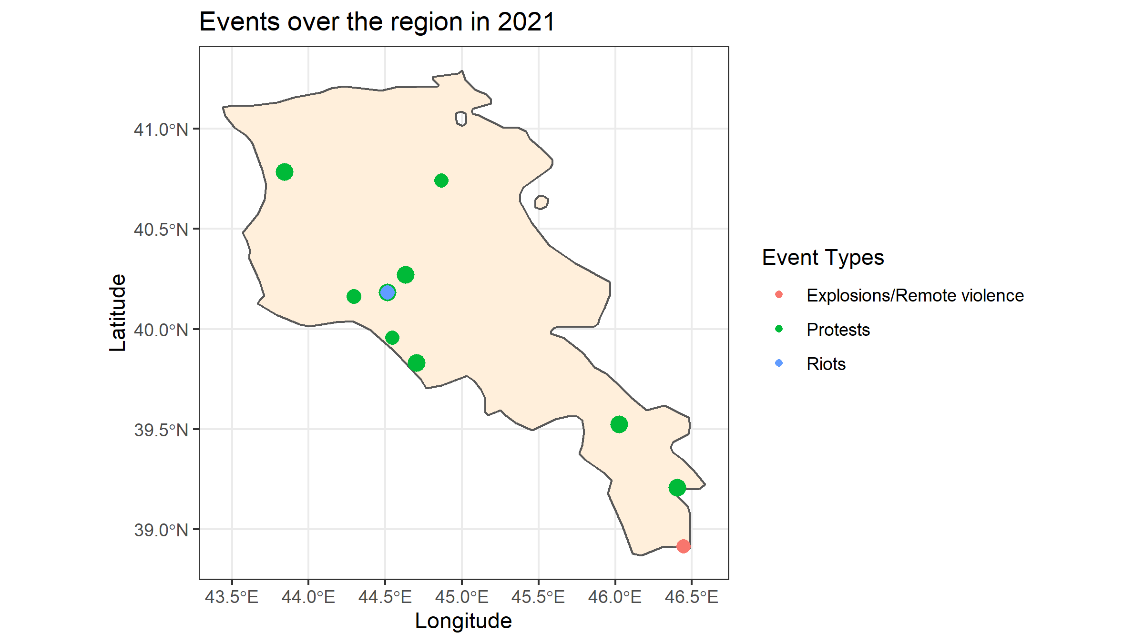
Events over the region in 2021

Slide 6
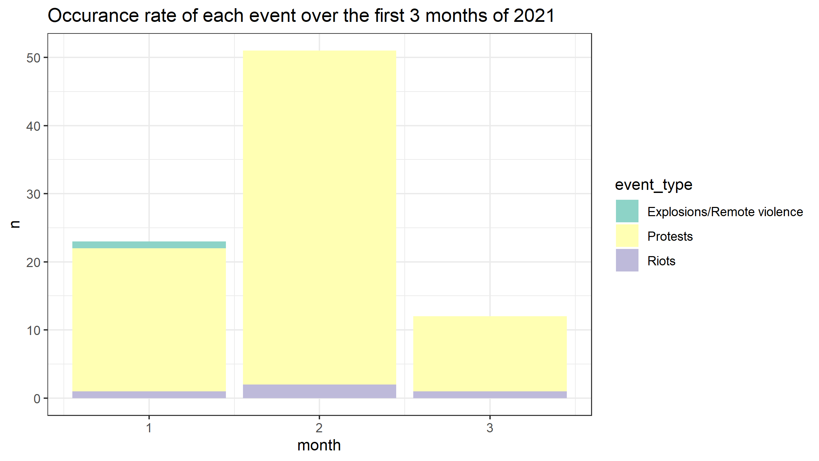
Occurance rate of each event over the first 3 months of 2021

Slide 7
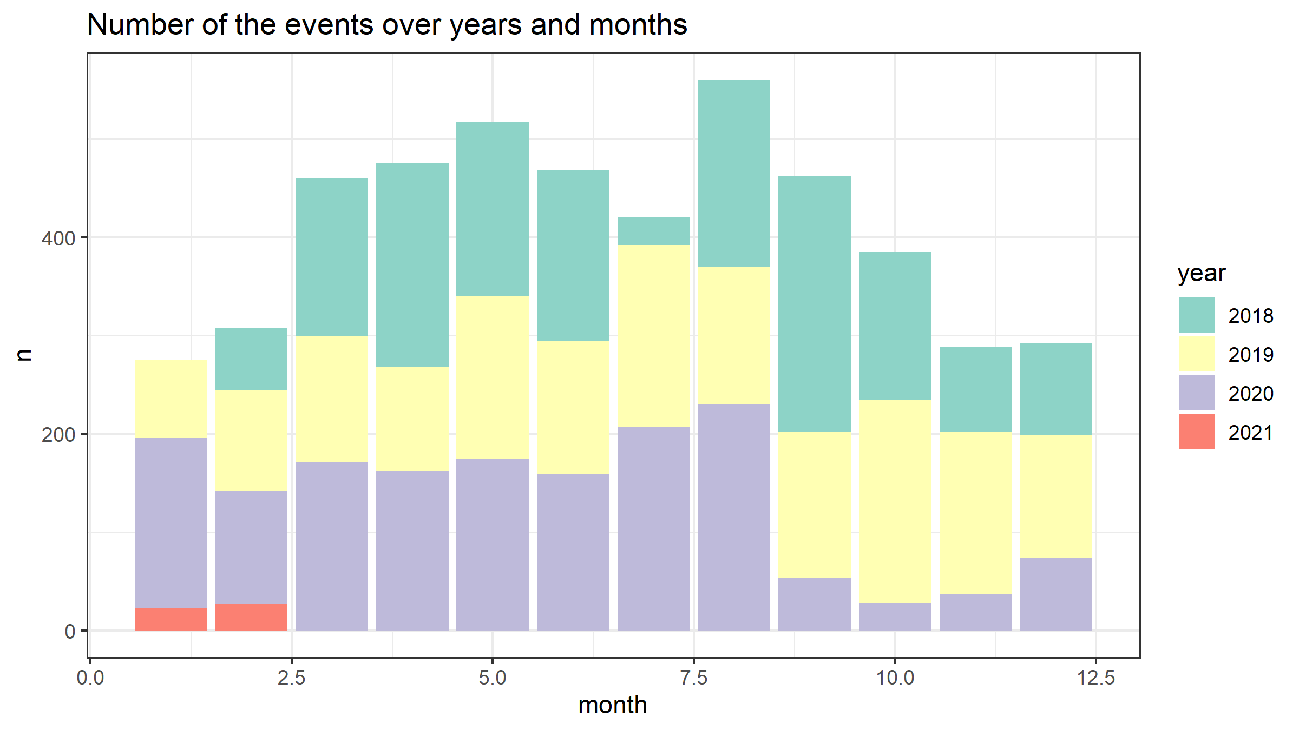
Number of the events over years and months

Slide 8
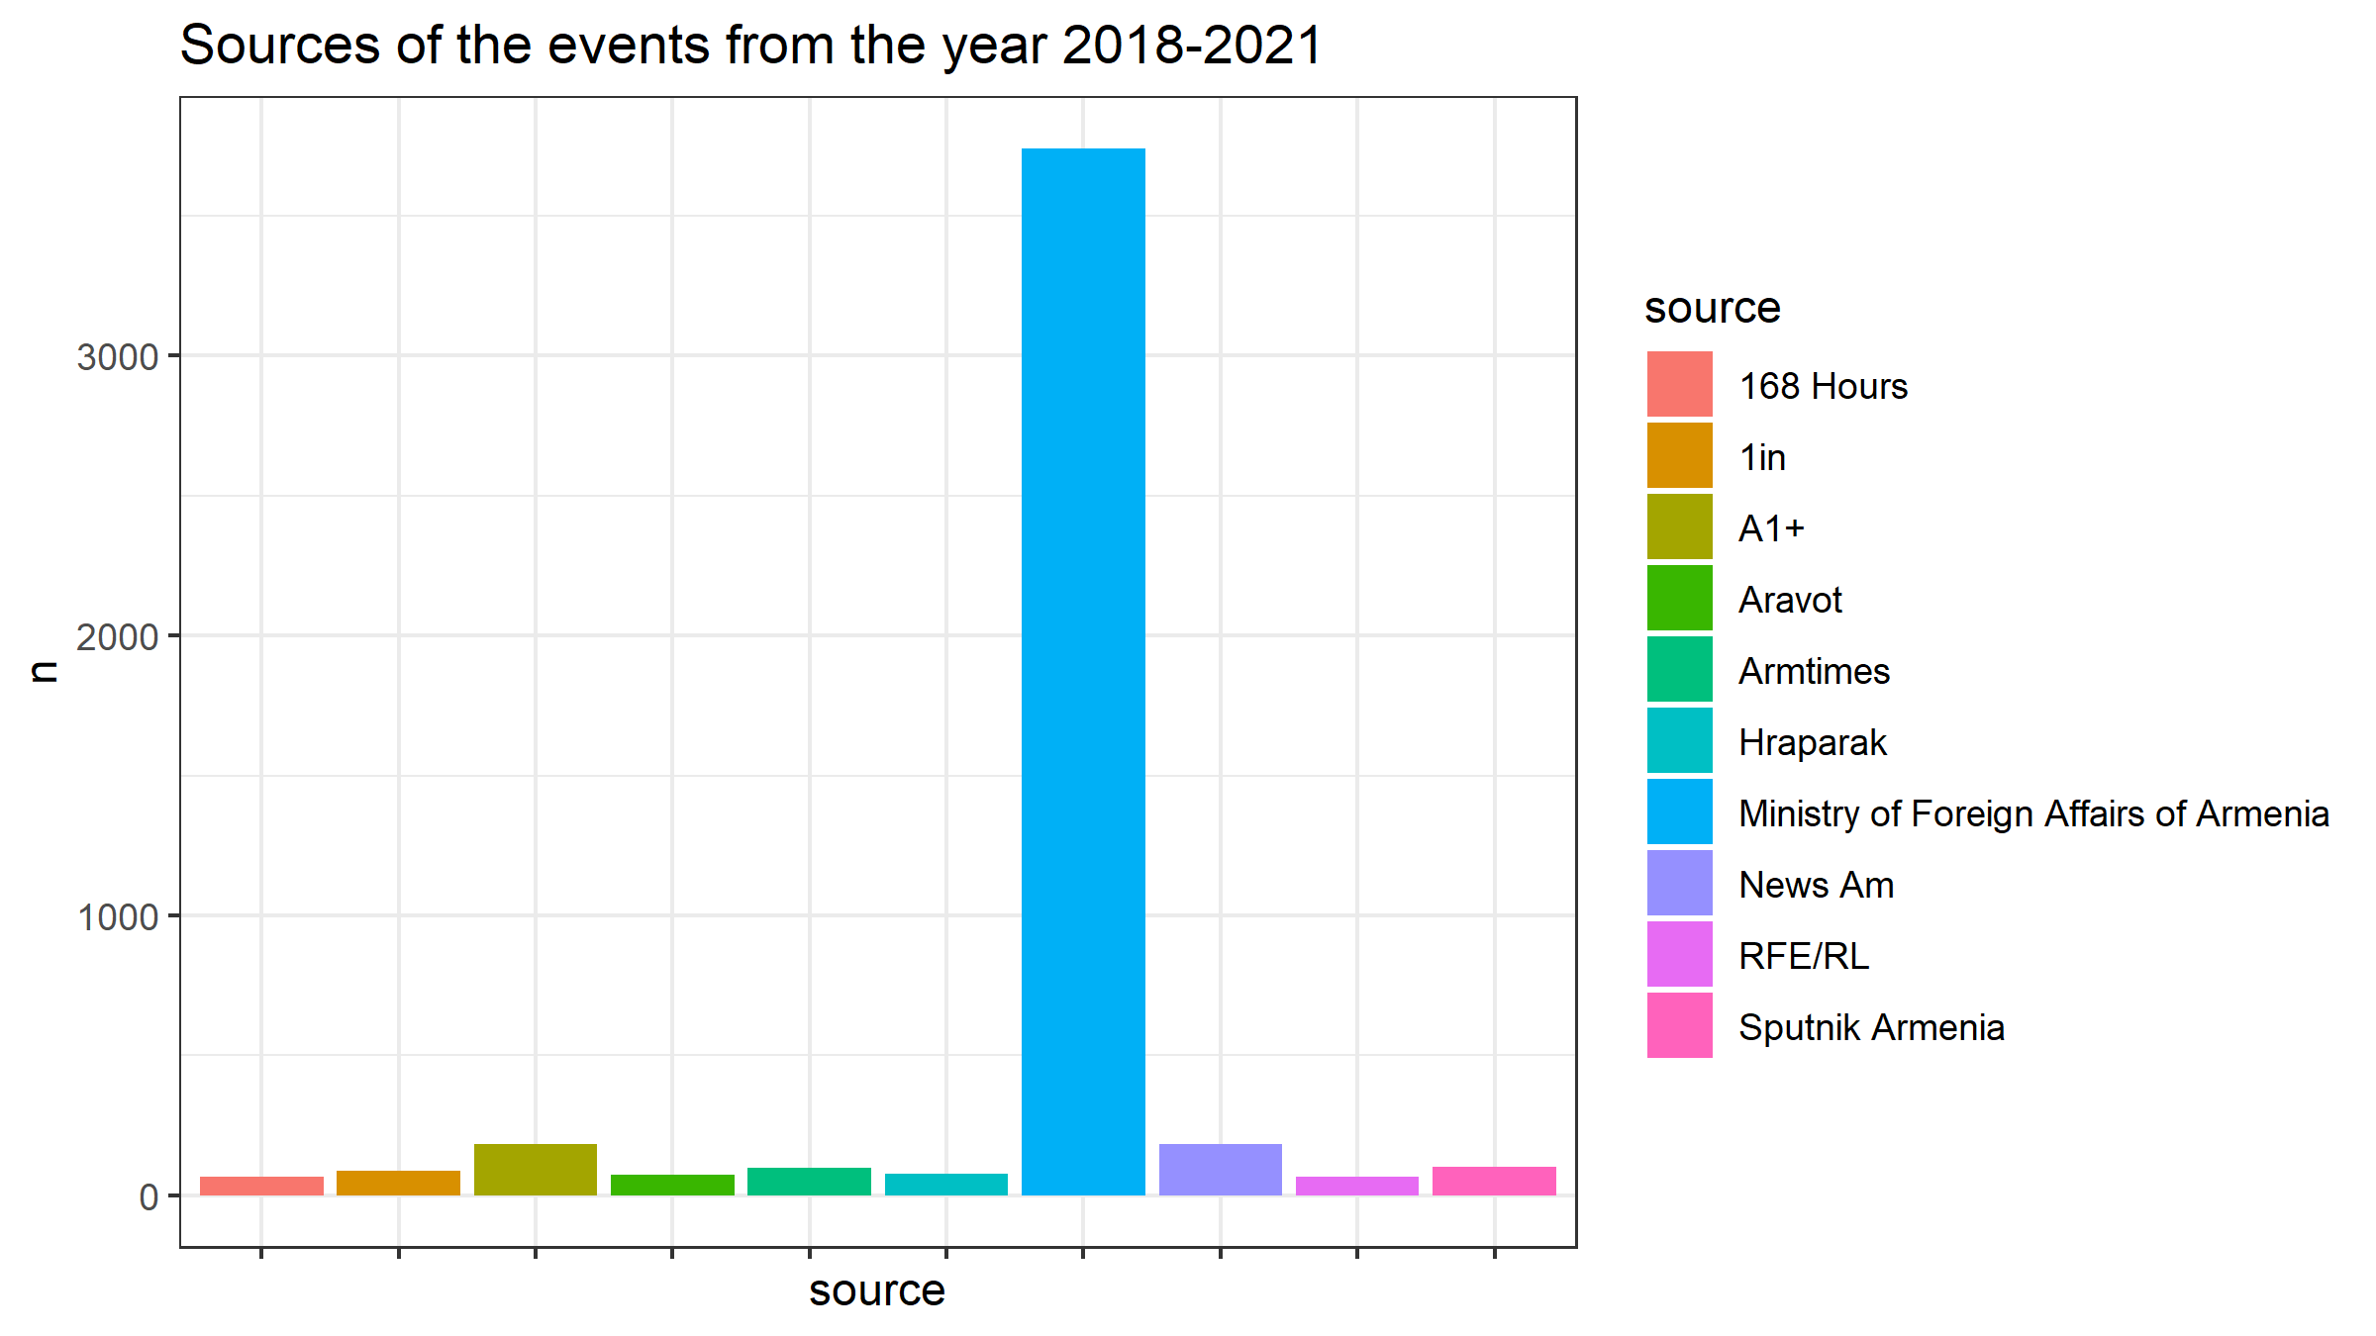
Sources of the events from the year 2018-2021

Slide 9
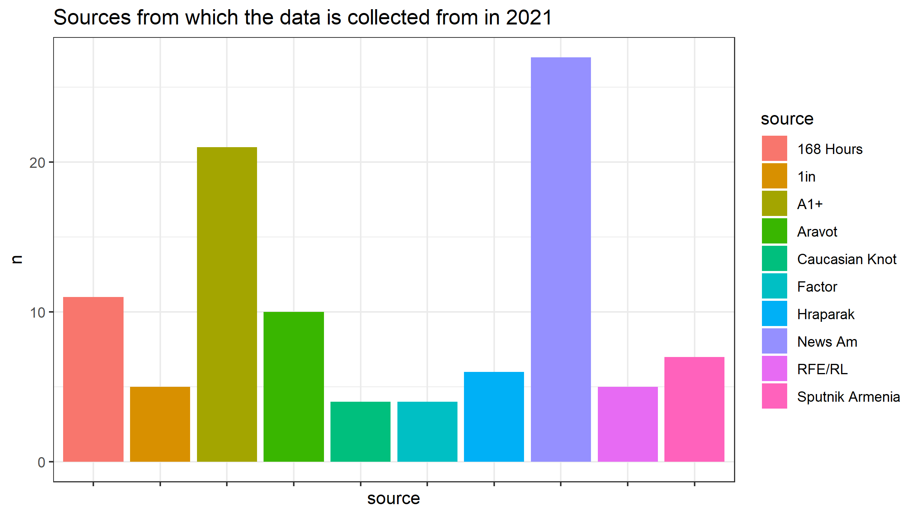
Sources from which the data is collected from in 2021

