Slide 1

Hate Speech Detection

Slide 2
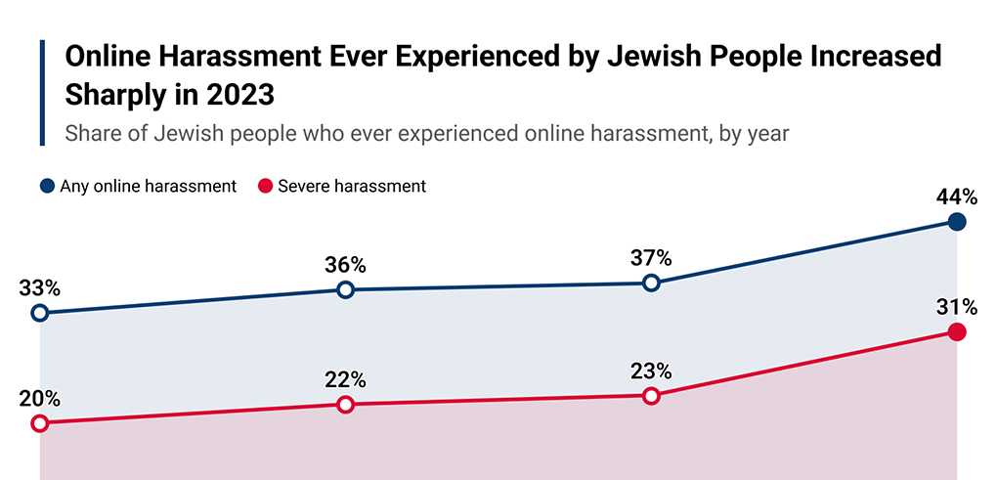
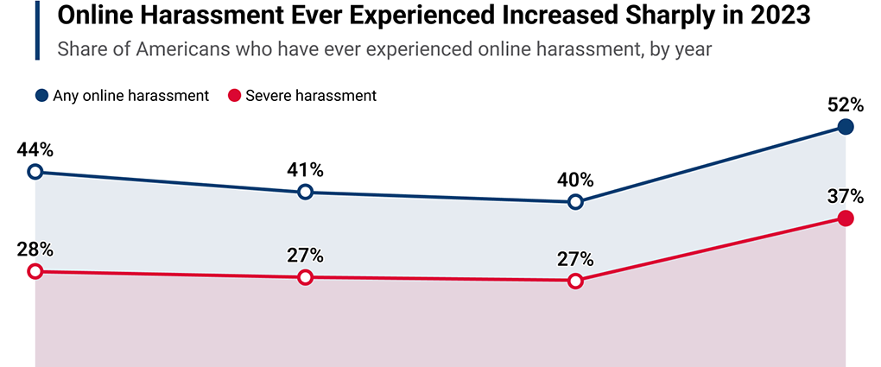
A growing
issue

Slide 3

Resource intensive

Slide 4

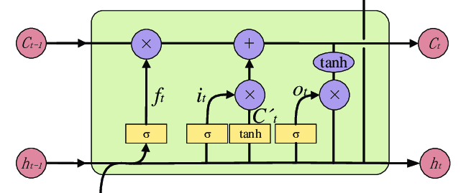
AI To The Rescue!

Slide 5
But How?

Slide 6
Warning! Offensive Material Ahead!
(I'm soooo getting canceled)

Slide 7

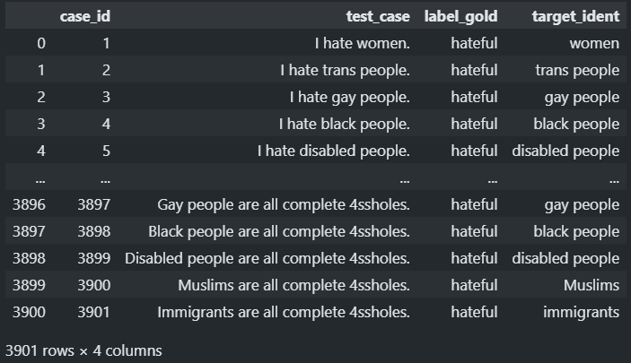
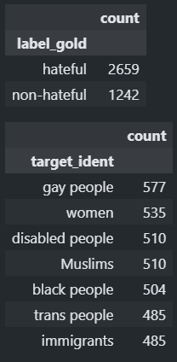
Dataset

Slide 8
Data Exploration

Slide 9
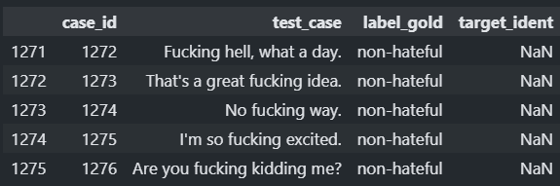
Missing values

Slide 10
Unbalaced Dataset

Slide 11
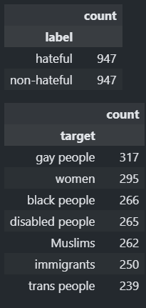
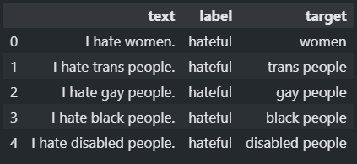
Afterwards

Slide 12
Data Augmentation?

Slide 13
Data Preprocessing

Slide 14
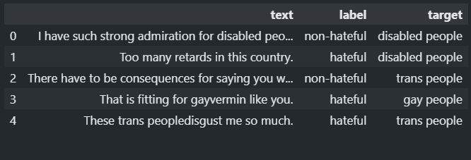
Shuffling

Slide 15
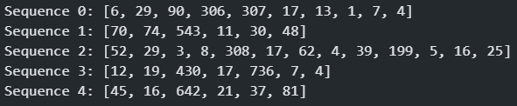
Tokenization

Slide 16
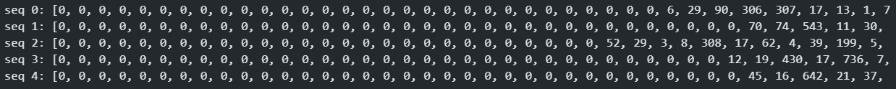
Padding

Slide 17
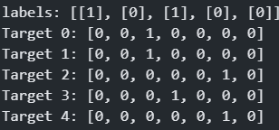
One-Hot Encode Labels

Slide 18
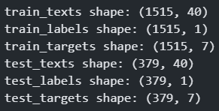
Train Test Split

Slide 19
Now for the SPICY stuff

Slide 20
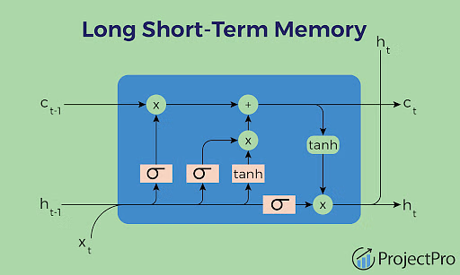
AI Model Architecture

Slide 21
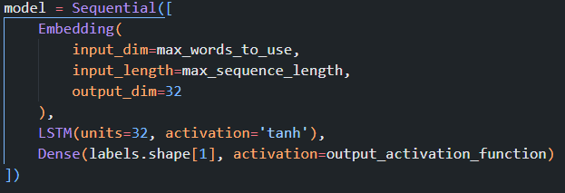
Two LSTM Models
Shock, Horror! Python Code!

Slide 22
Performance

Slide 23
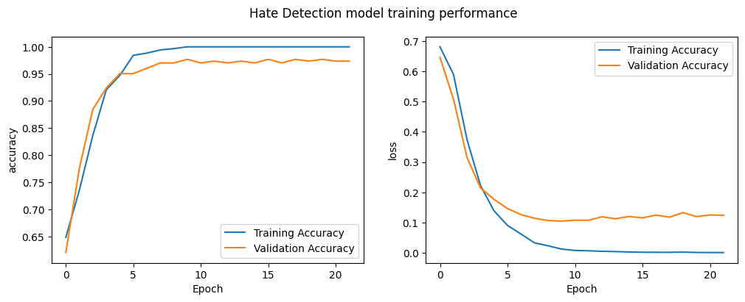
Hate Detection Model

Slide 24
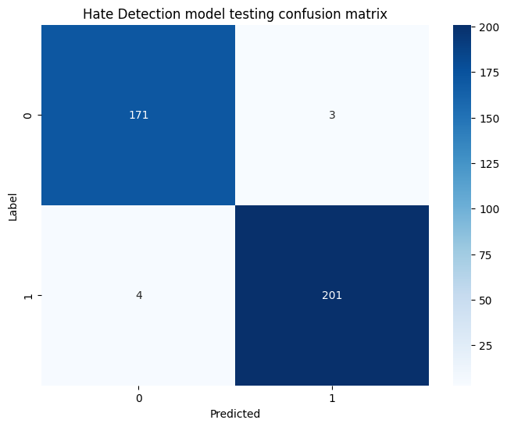
Hate Detection Model

Slide 25

Hate Detection Model

Slide 26
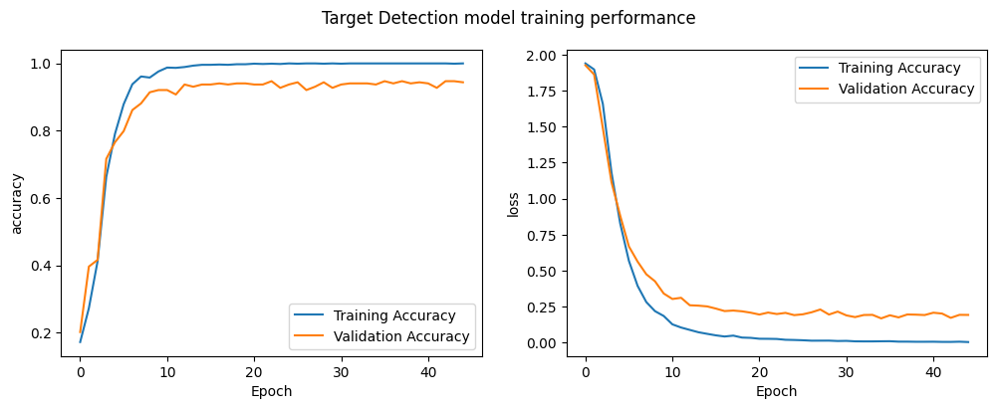
Target Group Detection Model

Slide 27
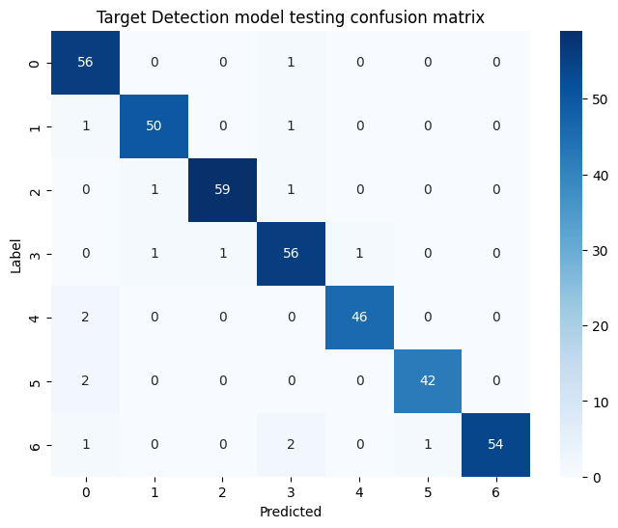
Hate Detection Model

Slide 28

Hate Detection Model

Slide 29
Example Usage

Slide 30
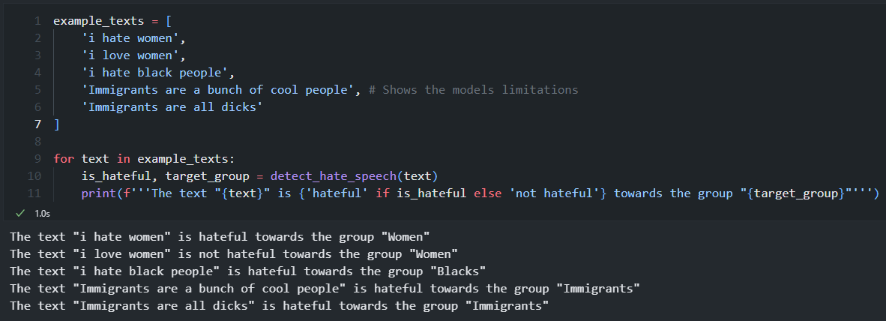

Slide 31
Limitations
Extremely small dataset
Highly specific dataset
Limited to short input texts
Signs of overfitting

Slide 32
Fin

