Slide 1

5G-Network
Basics

Slide 2
What is 5G?
5G - Fifth Generation (of mobile network technology)
Successor to 4G; launched in 2019.
Key Features:
Ultra-high speed: Up to 10 Gbps
Low latency: As low as 1 millisecond
Massive device connectivity: Supports up to 1 million devices/km²
Enhanced reliability and availability
Improved spectral efficiency

Slide 3
5G Architecture
A 5G network is broadly composed of three main segments:
User Equipment (UE): Devices like smartphones, sensors, or modems that connect to the 5G network.
Radio Access Network (RAN): The interface between the UE and the core network, handling radio communication and signal processing.
5G Core (5GC): The central part of the network that manages connectivity, mobility, and data routing across services.

Slide 4
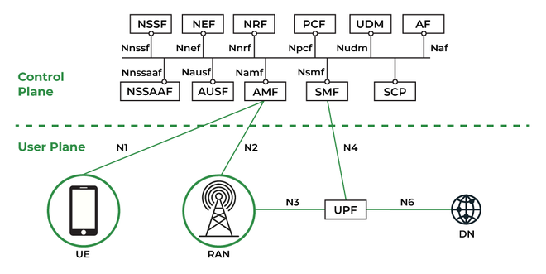
5G Architecture
Fig 1. Representation of Basic 5G Architechture

Slide 5
User Equipment (UE):
UE refers to any device that connects to the 5G network to access services and exchange data.
Examples: Smartphones, IoT sensors/devices, Tablets and laptops, Connected vehicles, Industrial machines
Key Functions:
Initiates and maintains connection with the gNB (5G RAN)
Performs authentication and mobility management
Supports dual connectivity (e.g., 5G + 4G)
Handles QoS (Quality of Service) negotiation with the network

Slide 6
RAN (Radio Access Network)
The RAN connects User Equipment (UE) to the 5G Core Network, enabling wireless communication over radio waves.
Key Components:
gNB (Next Generation NodeB):The base station that handles radio transmission and reception.
CU/DU (Centralized/Distributed Unit): Splits RAN processing for flexible deployment and lower latency.
Key Functions:
Radio signal processing and scheduling
Mobility management and handovers
Resource allocation and traffic control
Interface with 5GC via NG interface

Slide 7
5GC (5G Core Network):
The 5G Core (5GC) is the central part of the 5G network that manages connectivity, mobility, authentication, and data routing between UEs and external networks.
Key Characterisitics:
Based on a Service-Based Architecture (SBA)
Separation of Control and User Plane (CUPS)
Supports Network Slicing for flexible, service-specific virtual networks

Slide 8
5G Core Network Functions:
The 5G Core (5GC) follows a Service-Based Architecture (SBA), where each network function is modular and designed to perform a specific role. Let’s explore some of the key components.
1.AMF – Access and Mobility Management Function:
The AMF is responsible for managing user registration, authentication, and mobility.
It handles signaling between the UE and the core, manages handovers, and maintains the connection state.

Slide 9
5G Core Network Functions:
2. SMF – Session Management Function
The SMF manages session establishment, modification, and release.
It allocates IP addresses to UEs, enforces QoS policies, and selects the appropriate UPF for routing data.
3. UPF – User Plane Function
The UPF handles all user data traffic between the UE and external networks (e.g., internet).
It performs packet routing, forwarding, traffic usage reporting, and supports QoS and traffic steering.

Slide 10
5G Core Network Functions:
4. PCF – Policy Control Function
The PCF makes real-time decisions about network behavior based on policies.
It provides rules for QoS, data usage, and access control to the AMF and SMF, enabling personalized and optimized services.
5. UDM – Unified Data Management
UDM stores and manages user subscription information, profiles, and policies.
It interacts with AUSF for authentication and provides user data to other core functions when needed.

Slide 11
5G Core Network Functions:
6. AUSF – Authentication Server Function
AUSF is responsible for authenticating users and devices attempting to access the 5G network.
It works with the UDM and uses secure credentials to ensure legitimate access.
7. NRF – Network Repository Function
The NRF maintains a registry of all available 5G Core functions and their supported services.
It enables dynamic discovery and communication between network functions in the Service-Based Architecture.

Slide 12
5G Core Network Functions:
8. NSSF – Network Slice Selection Function
The NSSF determines which network slice a device or service should use, based on subscription and service requirements.
It ensures traffic is directed through the correct slice for performance, isolation, and SLA adherence.
Additional functions such as the NWDAF, NEF, CHF, etc... can be added based on the requirements of the network.

Slide 13
Thank You

