Slide 1
Capstone Project
Life Insurance Sales
Done by:
Kewal Kumar Singh

Slide 2
Business Problem We Are Trying to Solve
Constraints
Predict agent bonus accurately using available performance data.
Use predictions to drive agent engagement strategies and reward systems.
Limited data attributes (e.g., no direct premium value or exact policy details).
Data imbalance across regions and customer demographics.
Categorical variables requiring transformation for modeling.
Assumes past patterns will continue into future behavior.

Slide 3
Scope
Objectives
Develop a predictive model using historical agent and customer data.
Analyze key performance indicators affecting agent bonus.
Focus only on available dataset without external data sources.
Apply machine learning models (Linear, Tree-based, KNN, etc.) for comparison.
Build a model to predict agent bonuses effectively.
Identify top bonus-impacting features (e.g., Sum Assured, Monthly Income).
Provide actionable insights for training and reward programs.

Slide 4
EXPLORATORY DATA ANALYSIS
Univariate Analysis:
Most variables are positively skewed (e.g., AgentBonus, Age, CustTenure, MonthlyIncome).
Bimodal patterns seen in MonthlyIncome, LastMonthCalls.
AgentBonus concentrated between 2000–6000; SumAssured typically under 10L.
Bivariate & Correlation Analysis:
SumAssured has strongest positive correlation with AgentBonus.
Other influential variables: MonthlyIncome, CustTenure, Age, ExistingPolicyTenure.
Higher income/tenure/assured sum → higher agent bonus.

Slide 5
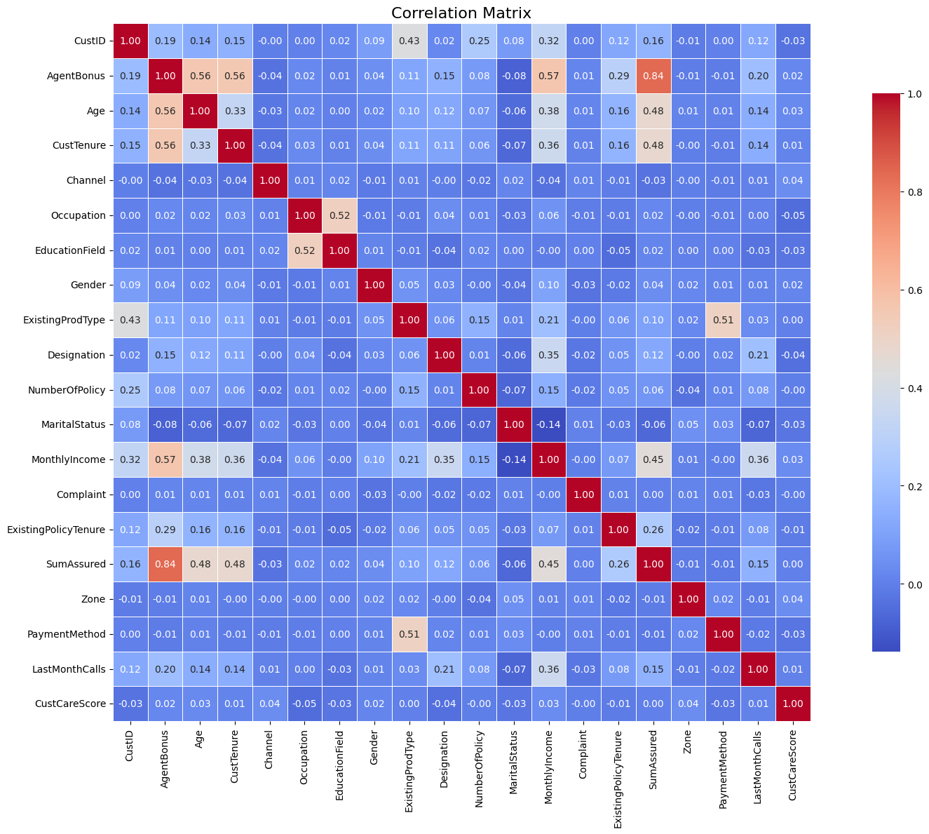

Slide 6
Missing Value Treatment:
Mean imputation for SumAssured, MonthlyIncome.
Median imputation for Age, CustTenure, PolicyTenure, etc.
Outlier Handling:
Applied IQR-based capping (5th and 95th percentile).
Reduced model distortion by removing extreme skew.
Data Imbalance Issues:
More people are minors (<18 yrs).
Zones underrepresented in East & South.
Acquisition channels dominated by Agents.
Payment modes mostly Yearly & Half-Yearly.

Slide 7
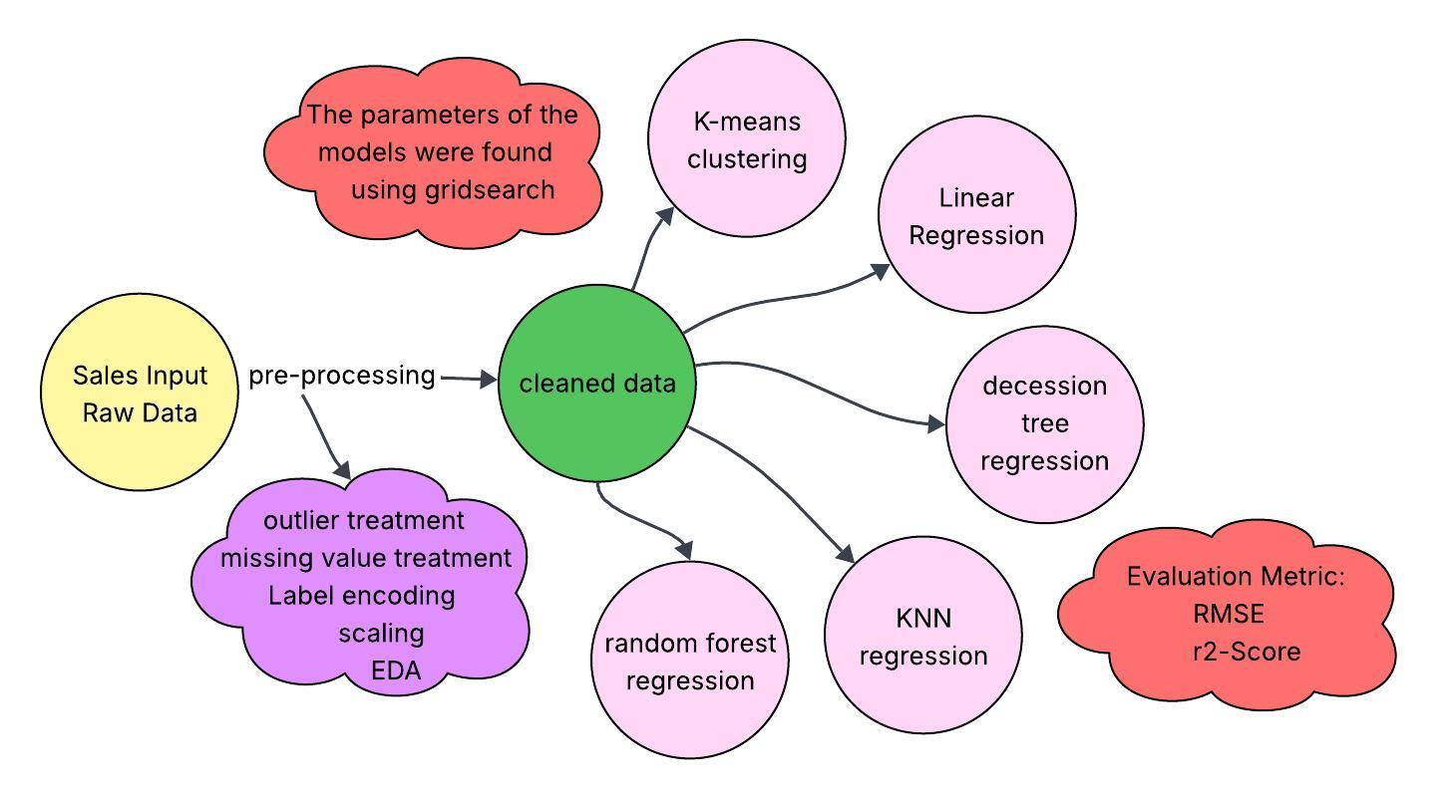
Modelling Approach Used

Slide 8
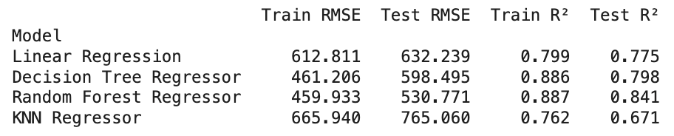
Result

Slide 9
Modelling Approach Used and Why
1. K-Means Clustering (Unsupervised):
Not a prediction model, but used to segment agents or customers.
Helps identify groups like high vs. low performers, or customer income clusters.
Supports targeted strategies and bonus planning.
2. Linear Regression:
Baseline model to understand linear relationships.
Helps interpret which features most influence Agent Bonus.
Quick to implement and explainable.

Slide 10
3. Decision Tree Regression:
Captures non-linear patterns and interactions between features.
Easy to visualize and explain to business stakeholders.
Useful for identifying important decision points like "Sum Assured".
4. KNN Regression:
Non-parametric model, good for local pattern recognition.
Useful when similar agents/customers yield similar outcomes.
Simple, yet effective for certain types of data clusters.
5. Random Forest Regression:
An ensemble of decision trees → more robust & accurate.
Reduces overfitting and handles high-dimensional data well.
Gives feature importance, aiding business insights.

Slide 11
Business Insights
Sum Assured is the Key Factor: Agents selling high-value policies earn significantly higher bonuses.
Target VP-Level Customers: Customers with VP designation buy more and higher-value policies.
Customer Tenure (8–20 Years): Majority of valuable clients fall in this range.
Monthly Income Matters: Higher income leads to higher policy values.
High vs Low Performing Agents: High performers deal with high-income, long-tenured clients and close higher sum assured policies.

Slide 12
Recommendations
For High-Performing Agents:
Launch incentive-based contests with specific Sum Assured targets.
Offer rewards such as high-end gadgets, exotic vacation packages, and bonus perks.
Maintain motivation through consistent recognition and performance-linked benefits.
For Low-Performing Agents:
Implement personalized upskilling and training programs.
Use feedback mechanisms to identify gaps in targeting and conversion.
Focus training on selling high-value policies and engaging optimal customer segments (e.g., high income, tenure 8–20 years).
Additional Data for Enhanced Insights:
Premium Amount Collected – directly aligns with agent bonus and financial impact.
Geographic Region – helps segment customers beyond general zones (East, West, etc.).
Agent ID – allows performance tracking and targeted intervention at the individual agent level.

