Slide 1
Socket Chat Room
Presented By Kewan Sulaiman

Slide 2
Outline
Introduction
Tools & Libraries
Features
System Design
Outputs
Conclusion

Slide 3
Introduction
Socket programming is a technique that allows communication between two computers over a network using sockets.
It enabling data transmission and connection establishment.
A socket chat room is a real-time communication program where users can exchange messages and interact with each other using socket programming.

Slide 4
Tools & Libraries
Programming Language : Python
IDE : Visual Studio Code
Libraries :
Socket : for creating socket
Thread: for threads
Sqlite3 : as a database for storing users
Hashlib : Encryption/Decryption user passwords
Tinker: as GUI library

Slide 5
Features
Sign in /Sign up for users want to join the chatroom
Database for storing users information
Messaging to chat room members(Broadcast messaging).
Private message to specific chat members.
Encryption/Decryption users password.
Graphic user interface for client app

Slide 6

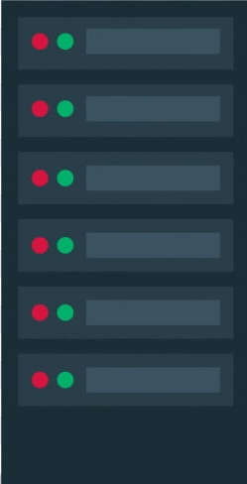

System Design
Server
Request/Response
Client-1
Request/Response
Create/Read
Request/Response
Client-2
Database
Client-N

Slide 7
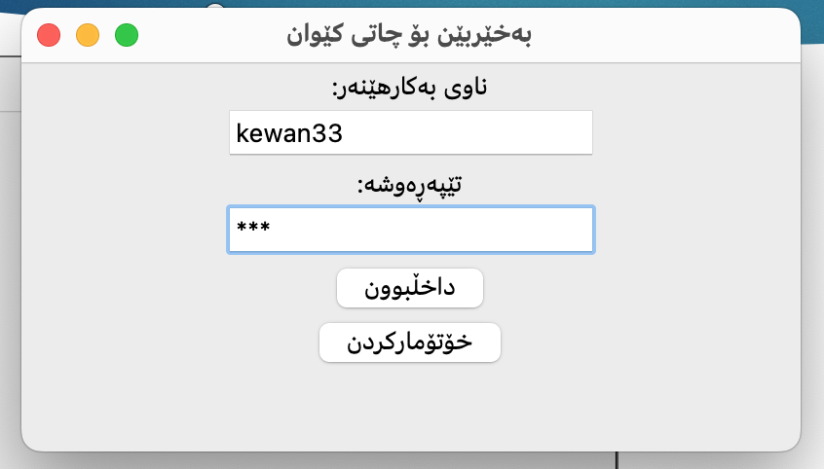
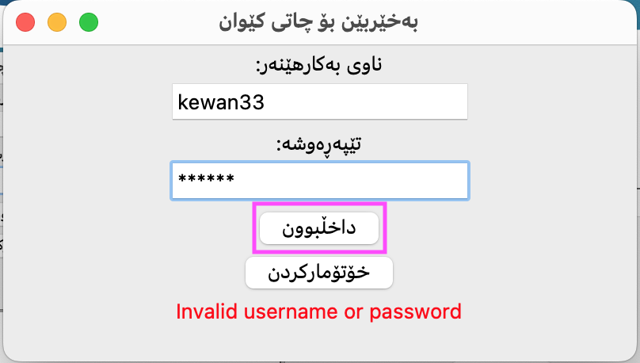
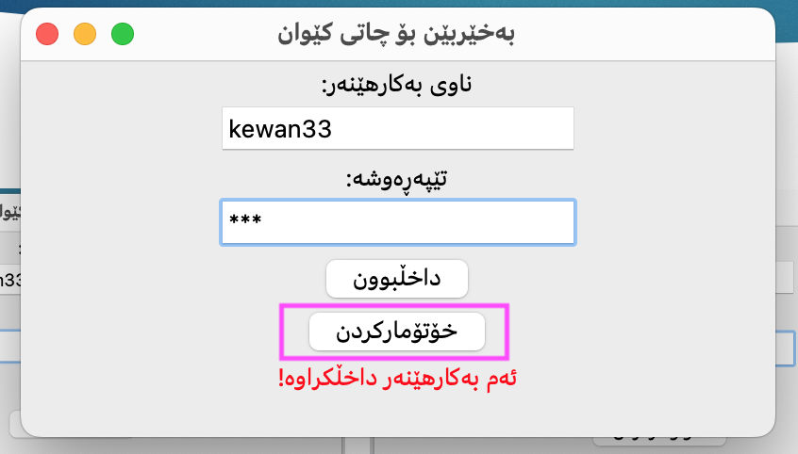
Outputs -Login Functionality

Slide 8
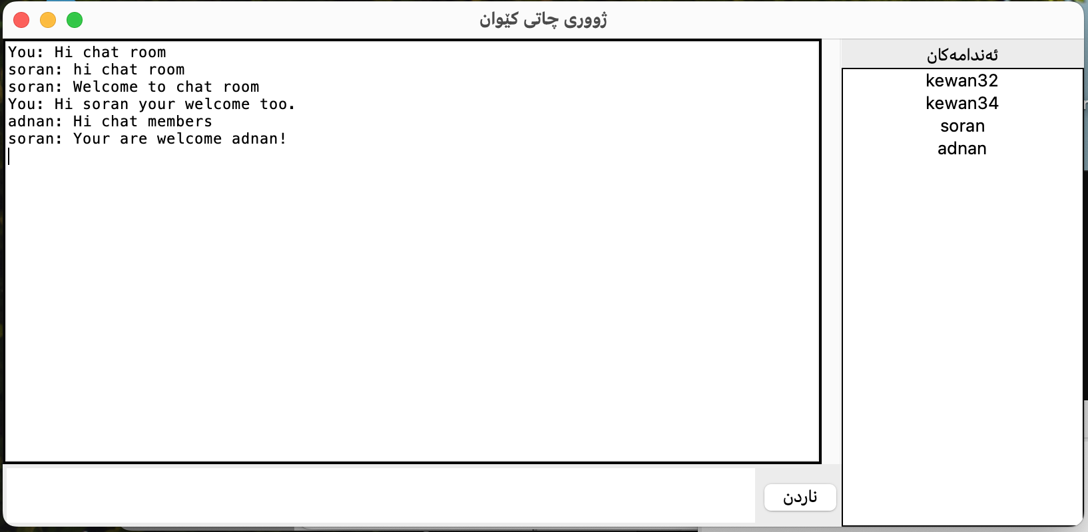
Outputs –Chat Room

Slide 9
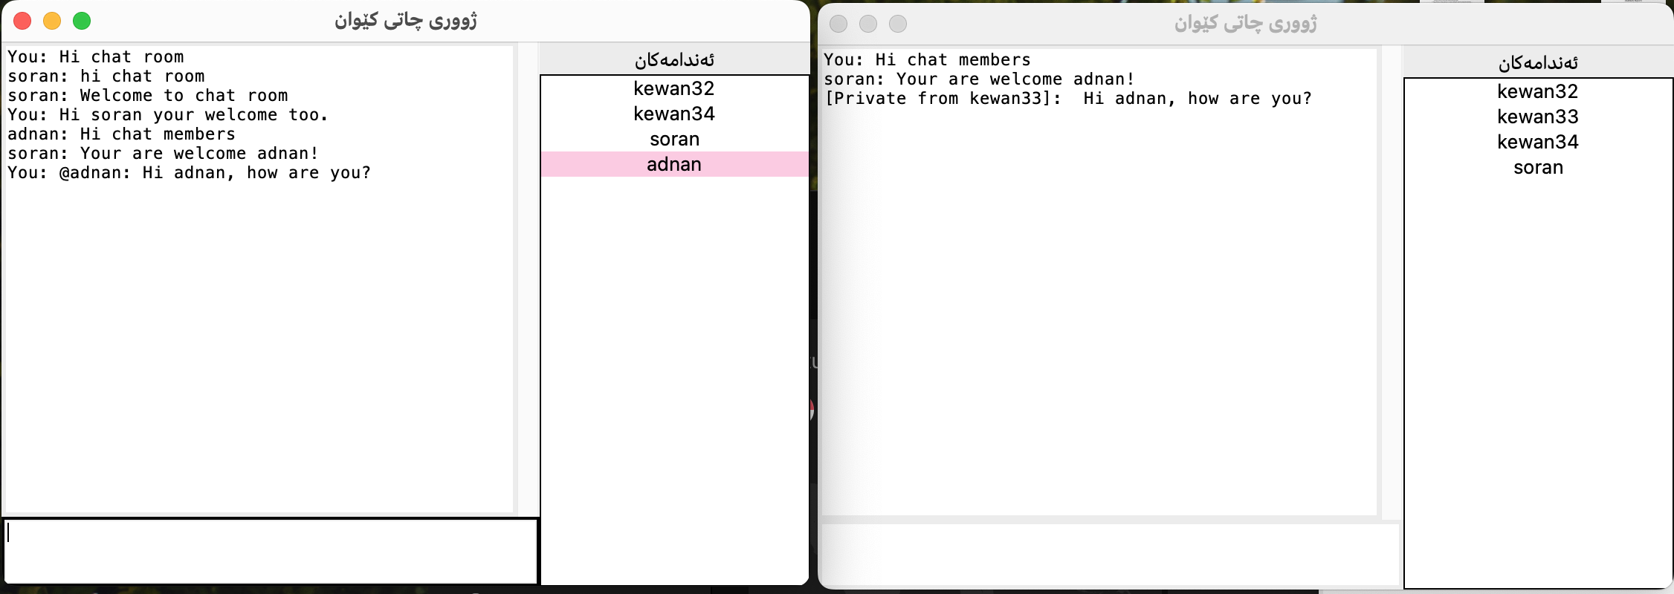
Outputs –Chat Room

Slide 10
Conclusion
Chat Room with socket programming
Public/Private Messaging
GUI for client apps.
Database for storing members information.
Encryption/Decryption member passwords

