Slide 1
Project 2: design of a cooling rib
Team: Wenjing Ke,
Christopher Reinartz

Slide 2
Outline
Overview of the steps
Analysis of steel part
Analysis of Steel-water interface
Analysis of water part

Slide 3
Overview of the steps
Set a initial temperature of the down side of steel T0
Solve the steel part
Get the heat flux φ of steel-water interface
Solve the water part
Combine the two sub-part

Slide 4
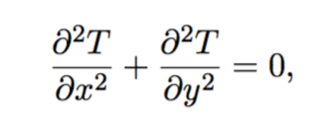
1. Analysis of steel part
Heat equation:
Boundary condition:

Slide 5
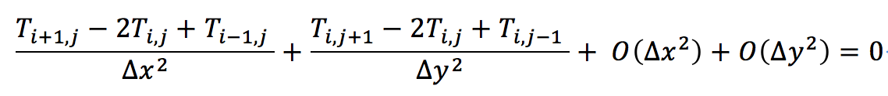
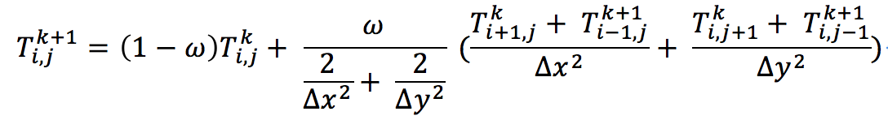
Discretization
Heat equation
by Succesive OverRelaxation (SOR) method,

Slide 6
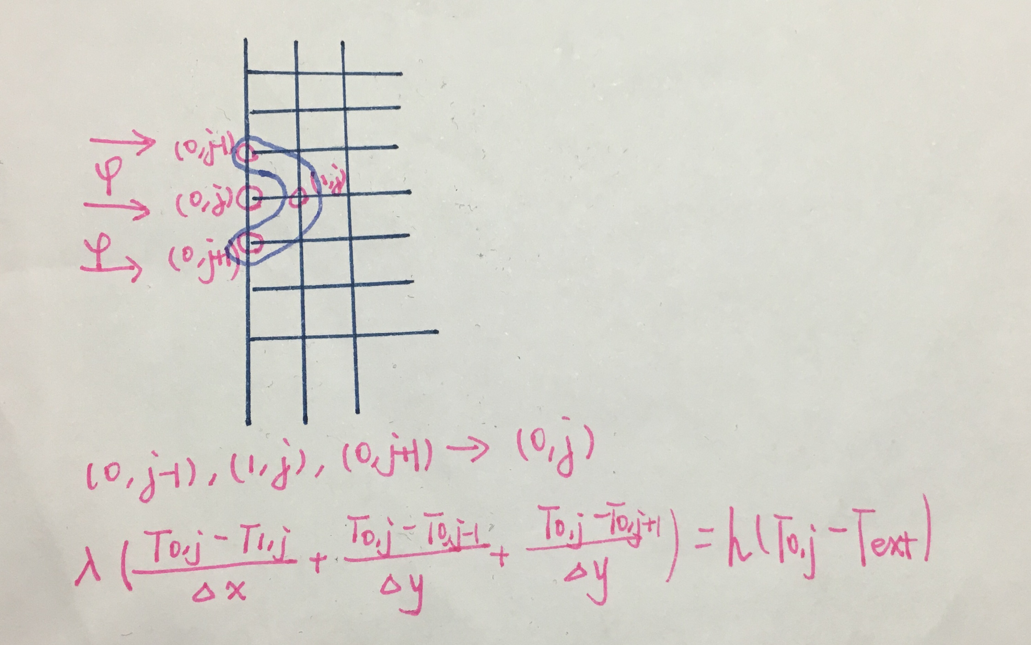
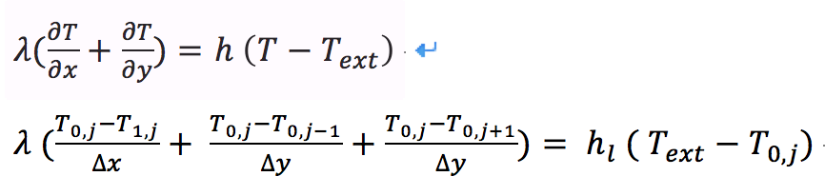

Discretization
left side(Neumann boundary condition)

Slide 7

Discretization
Right/top side
The same as the left side
Bottom side
Set an initial value T0:

Slide 8
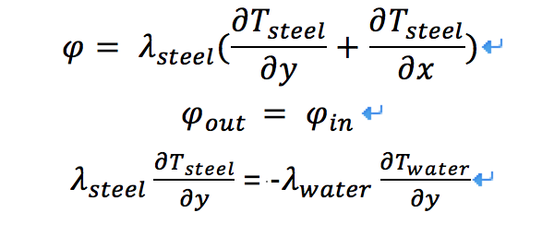
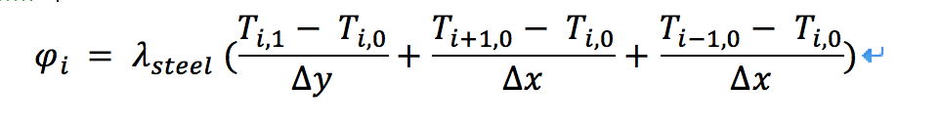
2. Steel-water interface
Heat flux φ of steel-water interface:
Discretization:

Slide 9
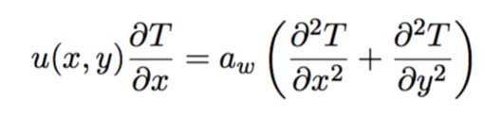
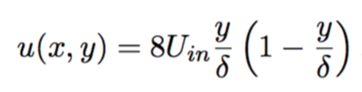
3. Water part
Heat equation:
with

Slide 10
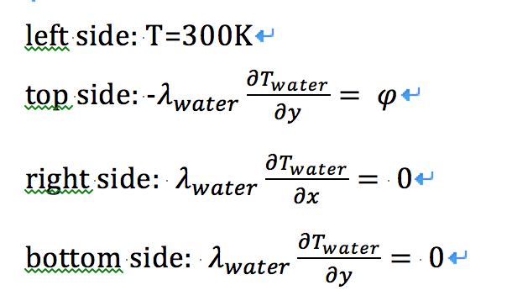
3. Water part
Boundary condition

Slide 11

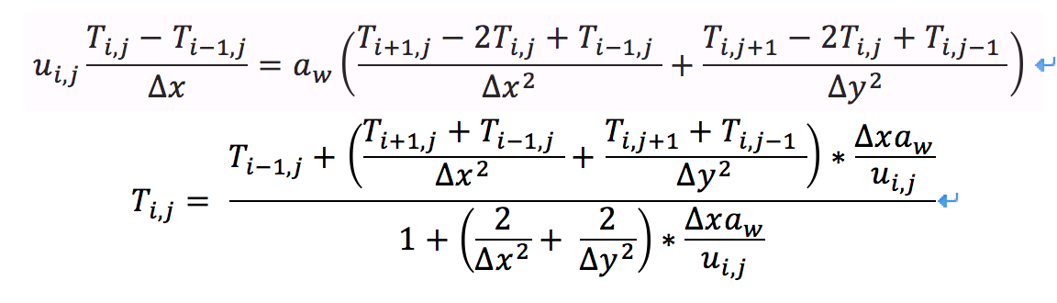
Discretization
Set the Uin, we can get the velocity :
Heat eq
Temp.

Slide 12
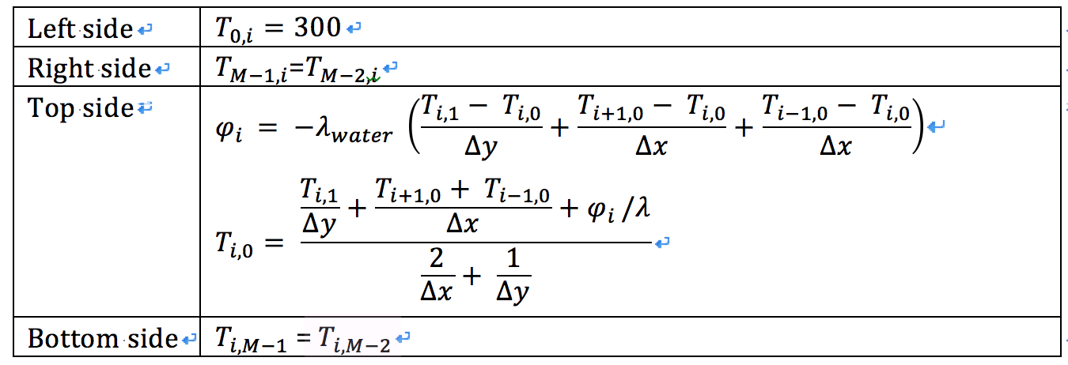
Discretization
Boundary condition

Slide 13
To be done:
Analysis of the whole system
Response of the questions
Conclusion in the last slide

