Slide 1
Project #1: The Belousov-Zhabotinskii reaction
Wenjing KE
Christopher Reinertz

Slide 2
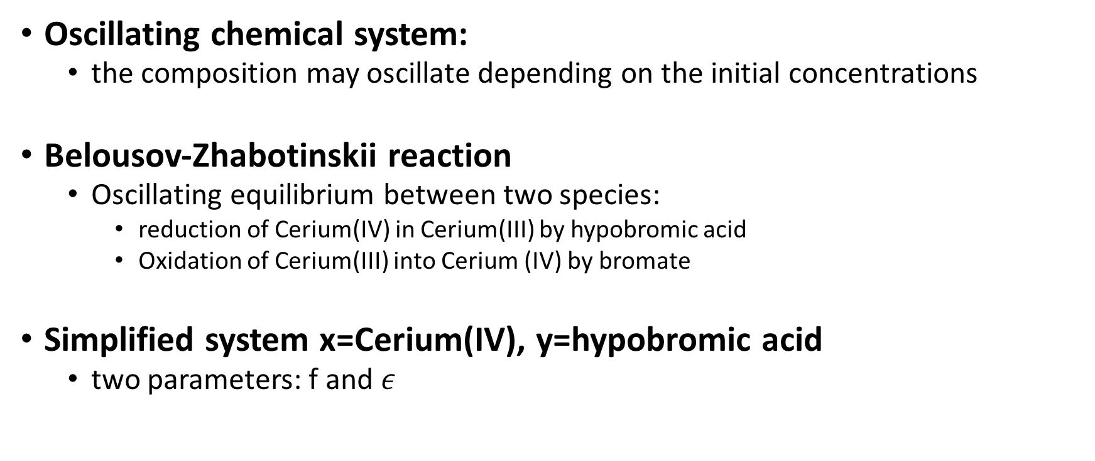
General problem
Oscillating chemical system:
the composition may oscillate depending on the initial concentrations
Belousov-Zhabotinskii reaction
Oscillating equilibrium between two species:
reduction of Cerium(IV) in Cerium(III) by hypobromic acid
Oxidation of Cerium(III) into Cerium (IV) by bromate
Simplified system x=Cerium(IV), y=hypobromic acid
two parameters: f and $ε$

Slide 3
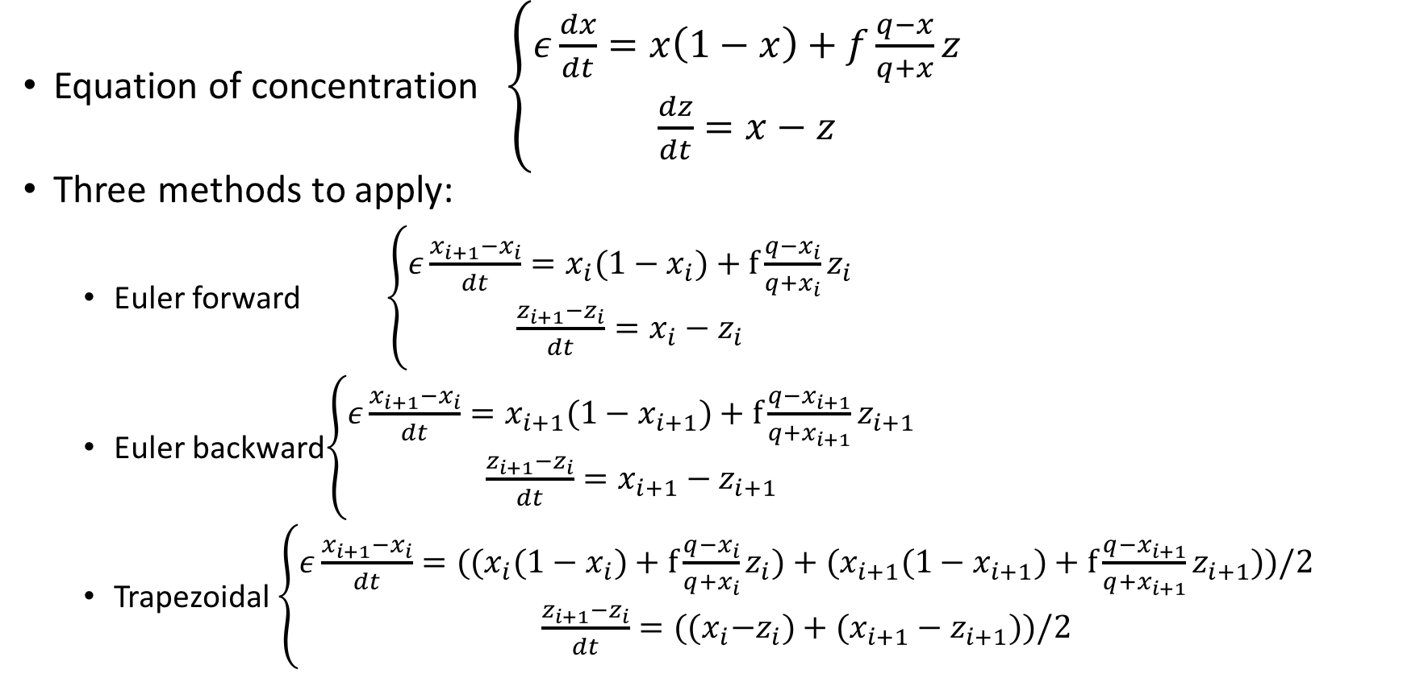
Analysis
Equation of concentration $\left\{\begin{aligned}ε\frac{dx}{dt}=x\left(1−x\right)+f\frac{q−x}{q+x}z \\ \frac{dz}{dt}=x−z\end{aligned}\right.$
Three methods to apply:
Euler forward $\left\{\begin{aligned}ε\frac{x_{i+1}{−x}_{i}}{dt}=x_{i}(1−x_{i})+f\frac{q−x_{i}}{q+x_{i}}z_{i} \\ \frac{z_{i+1}{−z}_{i}}{dt}=x_{i}−z_{i}\end{aligned}\right.$
Euler backward$\left\{\begin{aligned}ε\frac{x_{i+1}{−x}_{i}}{dt}=x_{i+1}(1−x_{i+1})+f\frac{q−x_{i+1}}{q+x_{i+1}}z_{i+1} \\ \frac{z_{i+1}{−z}_{i}}{dt}=x_{i+1}−z_{i+1}\end{aligned}\right.$
Trapezoidal $\left\{\begin{aligned}ε\frac{x_{i+1}{−x}_{i}}{dt}={((x}_{i}(1−x_{i})+f\frac{q−x_{i}}{q+x_{i}}z_{i})+(x_{i+1}(1−x_{i+1})+f\frac{q−x_{i+1}}{q+x_{i+1}}z_{i+1}))/2 \\ \frac{z_{i+1}{−z}_{i}}{dt}={((x}_{i}−z_{i})+(x_{i+1}−z_{i+1}))/2\end{aligned}\right.$
The equation is non-linear, we can not solve
directly, we use “fsolve” insteadly.

Slide 4
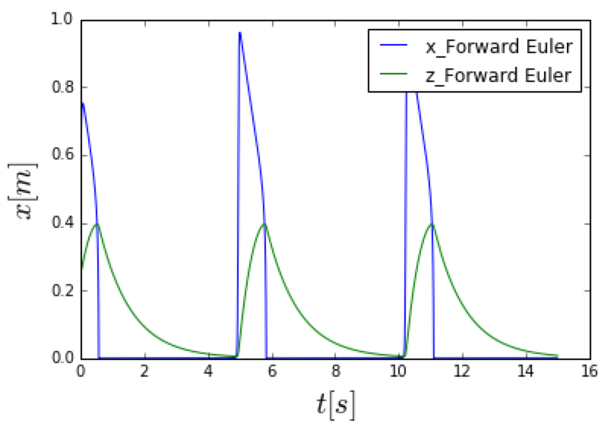
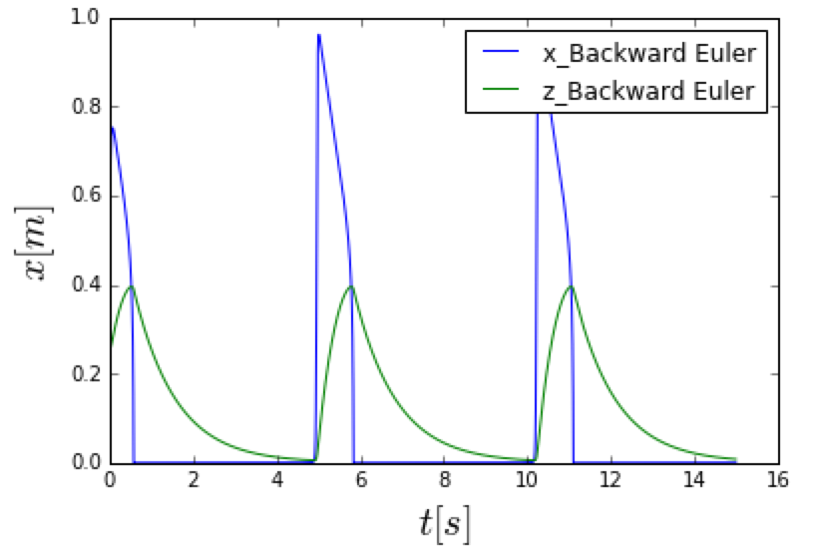
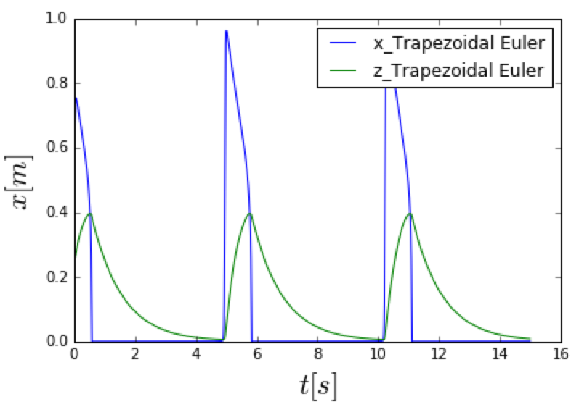
Result
The change of x and z are oscillating.
For z, z(max)=0.396, z(min)=0.06

