Slide 1
Project 2: Design of a cooling rib
Wenjing KE
Christopher Reinartz

Slide 2
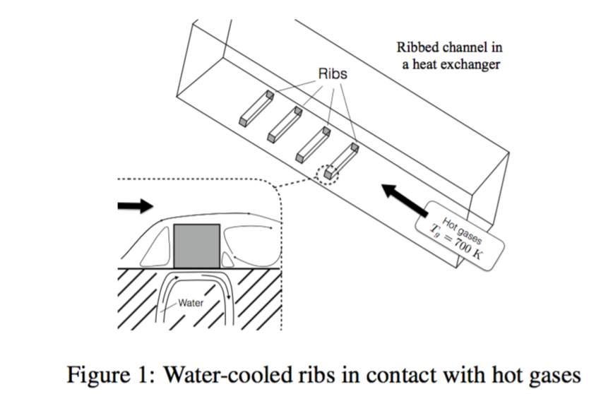
General
This is to solve a heat exchanger model in which the ribs are cooled down by water and heated by hot gases. We need to analyze the distribution of temperature in the rib and water.

Slide 3
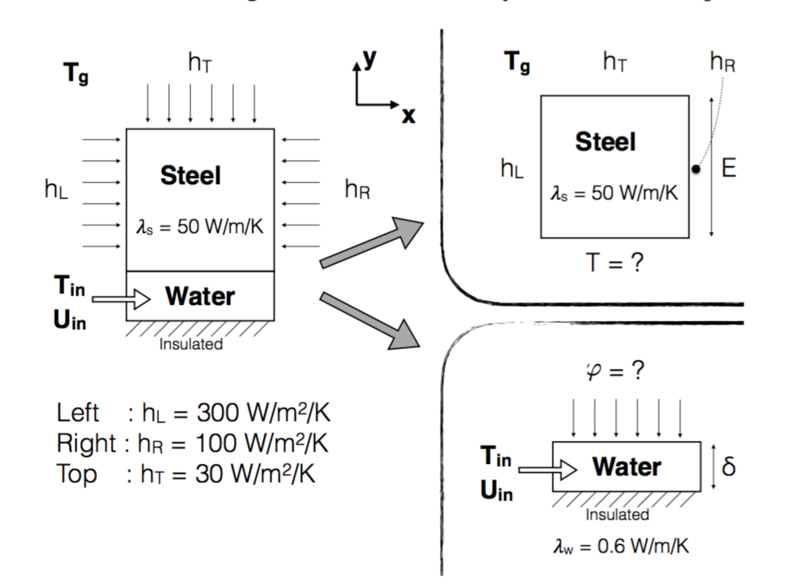
Modelization
Separate the system into two parts, solve the rib and water part separately.
For the steel part, suppose the temperature of steel bottom is constantly 300K, solve the distribution of temperature and calculate the heat flux transferred to the water part.
For the water part, get the heat flux from the upper side, suppose the heat flux of right side is zero, solve the distribution of temperature and calculate the temperature maximum.

Slide 4
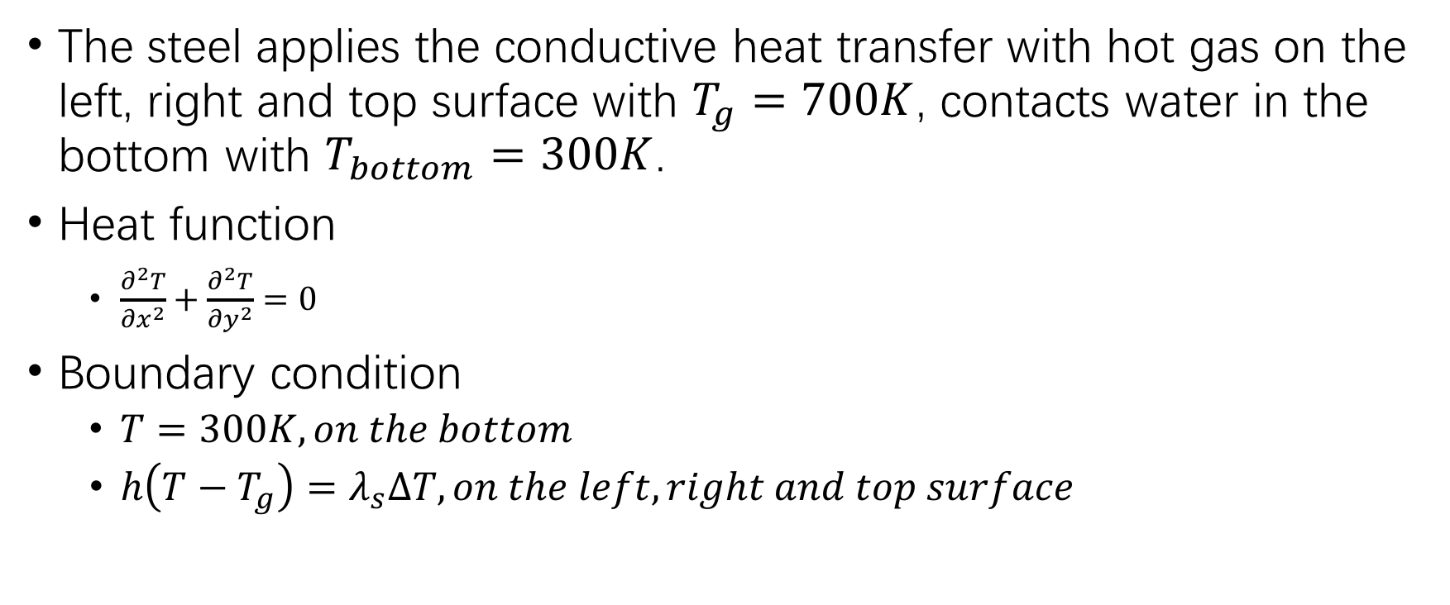
Steel part
The steel applies the conductive heat transfer with hot gas on the left, right and top surface with $T_{g}=700K$, contacts water in the bottom with $T_{bottom}=300K$.
Heat function
$\frac{∂^{2}T}{∂x^{2}}+\frac{∂^{2}T}{∂y^{2}}=0$
Boundary condition
$T=300K, on the bottom$
$h\left(T−T_{g}\right)=λ_{s}∆T, on the left, right and top surface$

Slide 5



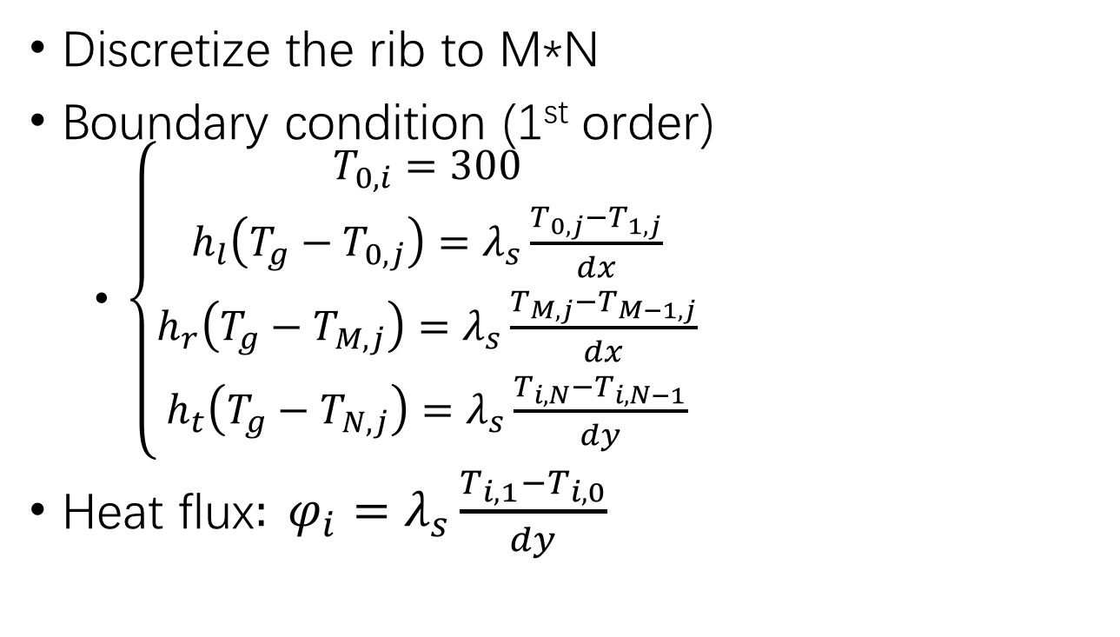


Steel part
Discretization
Discretize the rib to M*N
Boundary condition (1st order)
$\left\{\begin{aligned}T_{0,i}=300 \\ h_{l}\left(T_{g}−T_{0,j}\right)=λ_{s}\frac{T_{0,j}−T_{1,j}}{dx} \\ h_{r}\left(T_{g}−T_{M,j}\right)=λ_{s}\frac{T_{M,j}−T_{M−1,j}}{dx} \\ h_{t}\left(T_{g}−T_{N,j}\right)=λ_{s}\frac{T_{i, N}−T_{i,N−1}}{dy}\end{aligned}\right.$
Heat flux$: φ_{i}=λ_{s}\frac{T_{i,1}−T_{i,0}}{dy}$
$$h_{t}$$
y
$λ﷮s$=50 W/m/K
$$h_{l}$$
$$h_{r}$$
0
x
$$φ$$
Water part

Slide 6

Steel part
Heat function(SOR)
$\frac{T_{i+1,j}−2T_{i,j}+T_{i−1,j} }{{∆x}^{2}}+\frac{T_{i,j+1}−2T_{i,j}+T_{i,j−1} }{{∆y}^{2}}=0$
$T_{i,j}^{k+1}=\left(1−ω\right)T_{i,j}^{k}+ \frac{ω}{\frac{2}{{∆x}^{2}}+ \frac{2}{{∆y}^{2}}} (\frac{T_{i+1,j}^{k}+ T_{i−1,j}^{k+1}}{{∆x}^{2}}+ \frac{T_{i,j+1}^{k}+ T_{i,j−1}^{k+1}}{{∆y}^{2}})$
With $ω=2∗(\text{1−}\frac{π}{N}\text{+}\frac{π^{2}}{N^{2}})$

Slide 7
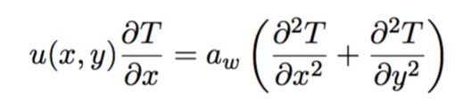
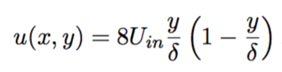
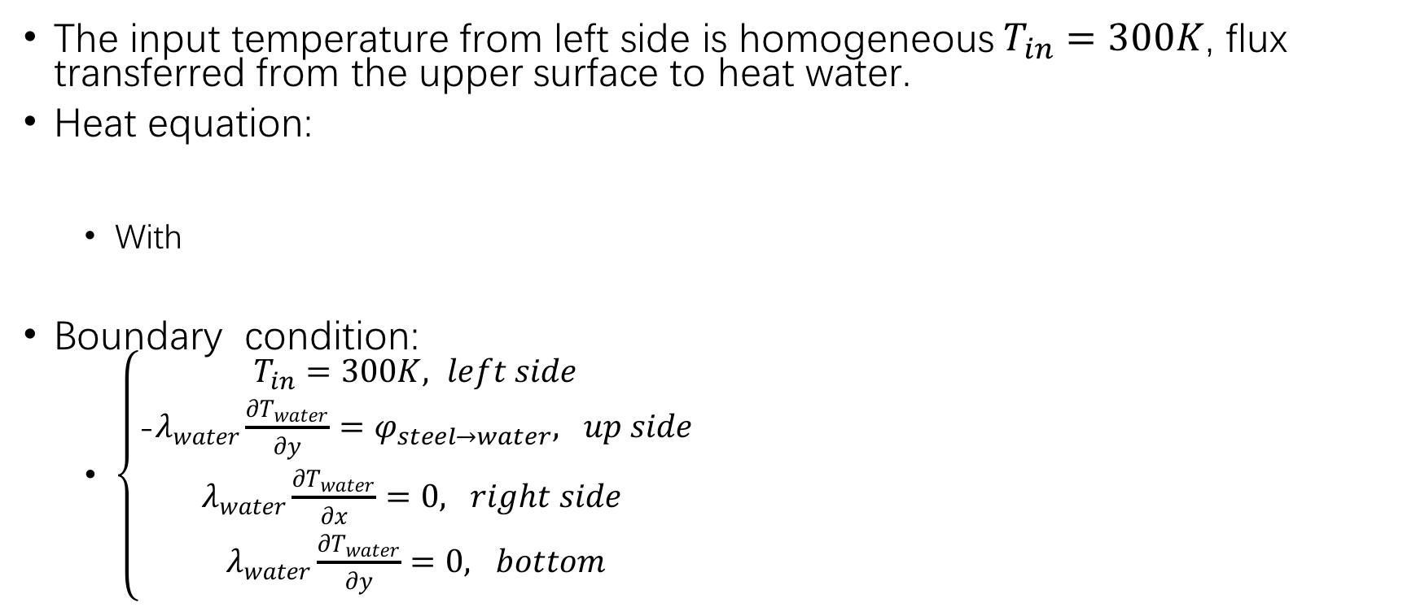
Water part
The input temperature from left side is homogeneous $T_{in}=300K$, flux transferred from the upper surface to heat water.
Heat equation:
With
Boundary condition:
$\left\{\begin{aligned}T_{in}=300K, left side \\ \text{−}λ_{water}\frac{∂T_{water}}{∂y}=φ_{steel→water}, up side \\ λ_{water}\frac{∂T_{water}}{∂x}=0, right side \\ λ_{water}\frac{∂T_{water}}{∂y}=0, bottom\end{aligned}\right.$

Slide 8


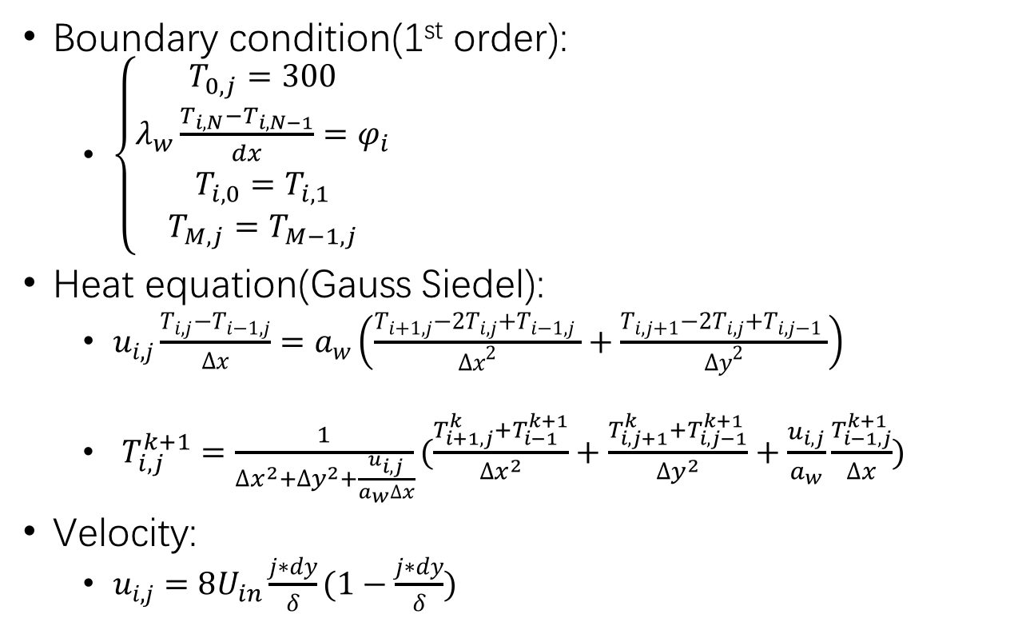
_{Water part}
Boundary condition(1st order):
$\left\{\begin{aligned}T_{0,j}=300 \\ λ_{w}\frac{T_{i,N}−T_{i,N−1}}{dx}=φ_{i} \\ T_{i,0}=T_{i,1} \\ T_{M,j}=T_{M−1,j}\end{aligned}\right.$
Heat equation(Gauss Siedel):
$u_{i,j}\frac{T_{i,j}−T_{i−1,j}}{∆x}=a_{w}\left(\frac{T_{i+1,j}−2T_{i,j}+T_{i−1,j} }{{∆x}^{2}}+\frac{T_{i,j+1}−2T_{i,j}+T_{i,j−1} }{{∆y}^{2}}\right)$
$T_{i,j}^{k+1}=\frac{1}{{∆x}^{2}+{∆y}^{2}+\frac{u_{i,j}}{a_{w}∆x}}(\frac{T_{i+1,j}^{k}+T_{i−1}^{k+1}}{{∆x}^{2}}+\frac{T_{i,j+1}^{k}+T_{i,j−1}^{k+1}}{{∆y}^{2}}+\frac{u_{i,j}}{a_{w}}\frac{T_{i−1,j}^{k+1}}{∆x})$
Velocity:
$u_{i,j}=8U_{in}\frac{j∗dy}{δ}(1−\frac{j∗dy}{δ})$
Discretization
$$φ$$
y
0
x
$$\left(i, j\right)∈\left[0,M\right]∗[0,N]$$

Slide 9
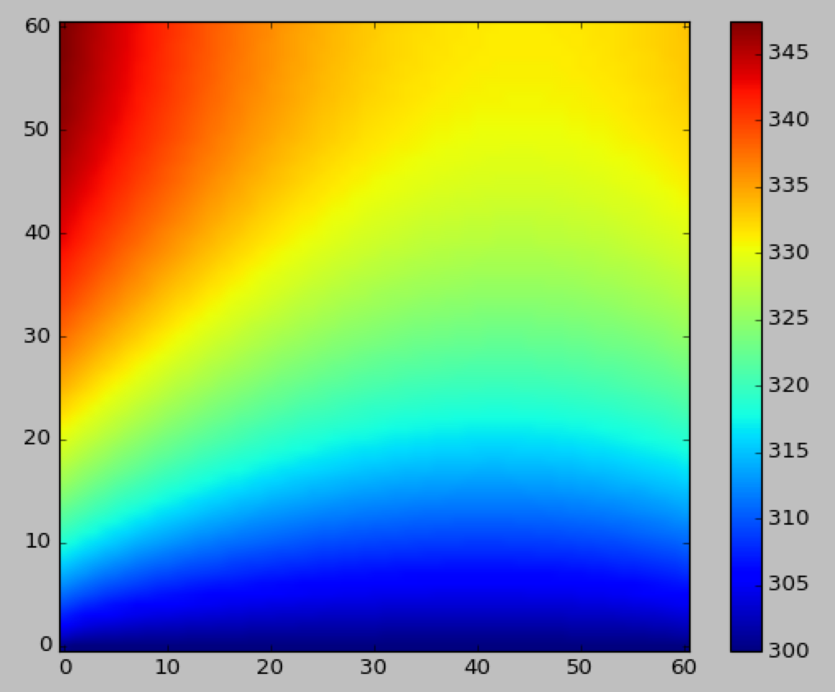
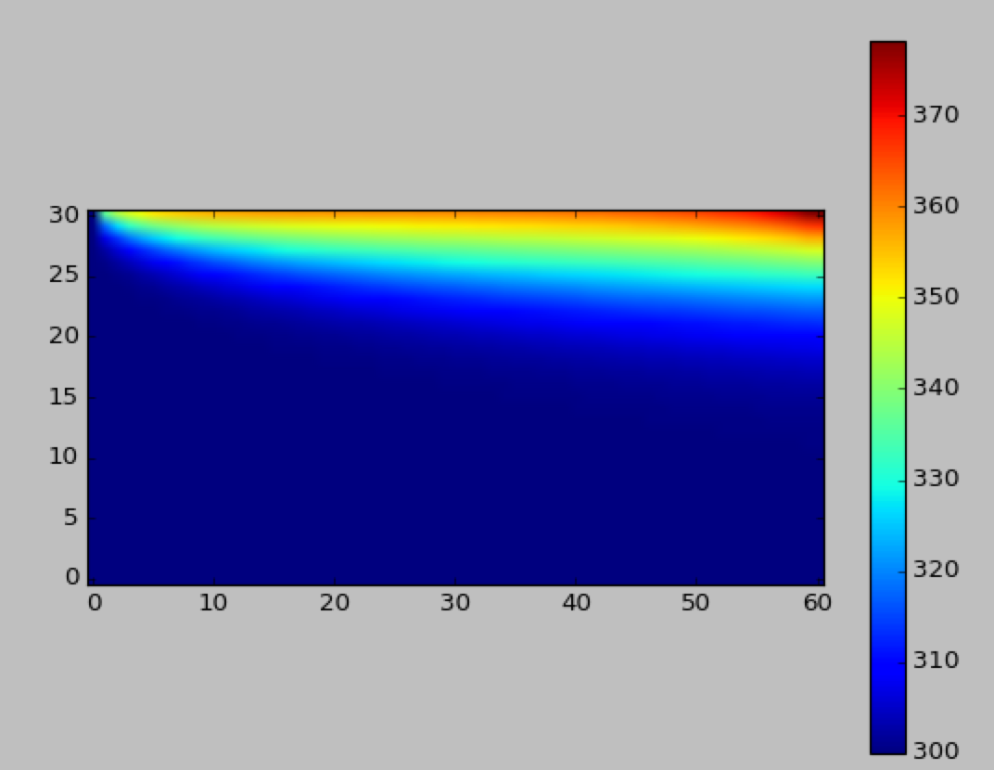

Result of implementation
Set Uin=0.5 m/s, temperature of the steel bottom $T_{b}=300K$, so we get the temperature champs as below:
Steel part
Water part

Slide 10
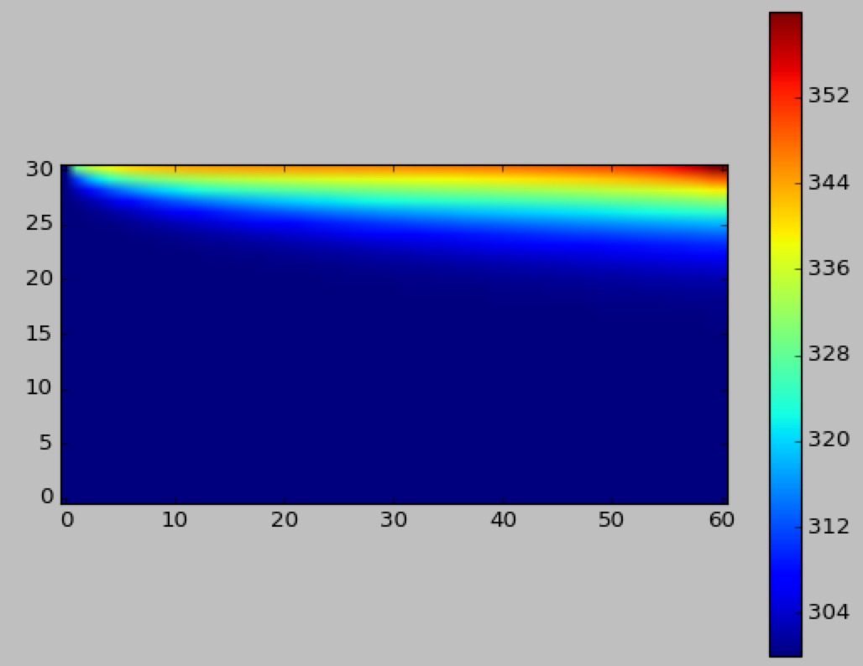
Specific questions
Determine the bulk velocity Uin to cool the rib and prevent boiling of the water inside the channel: As a safety measure, water temperature is not to exceed 360 K.
Increase Uin
Uin = 0.5, Tmax=378K
Uin=1.04 m/s, Tmax= 360.0K

Slide 11
Specific questions
Determine the bulk velocity Uin to cool the rib and prevent boiling of the water inside the channel: As a safety measure, water temperature is not to exceed 360 K.
Response: while Uin>1.04m/s, water temperature would not exceed 360K.

Slide 12
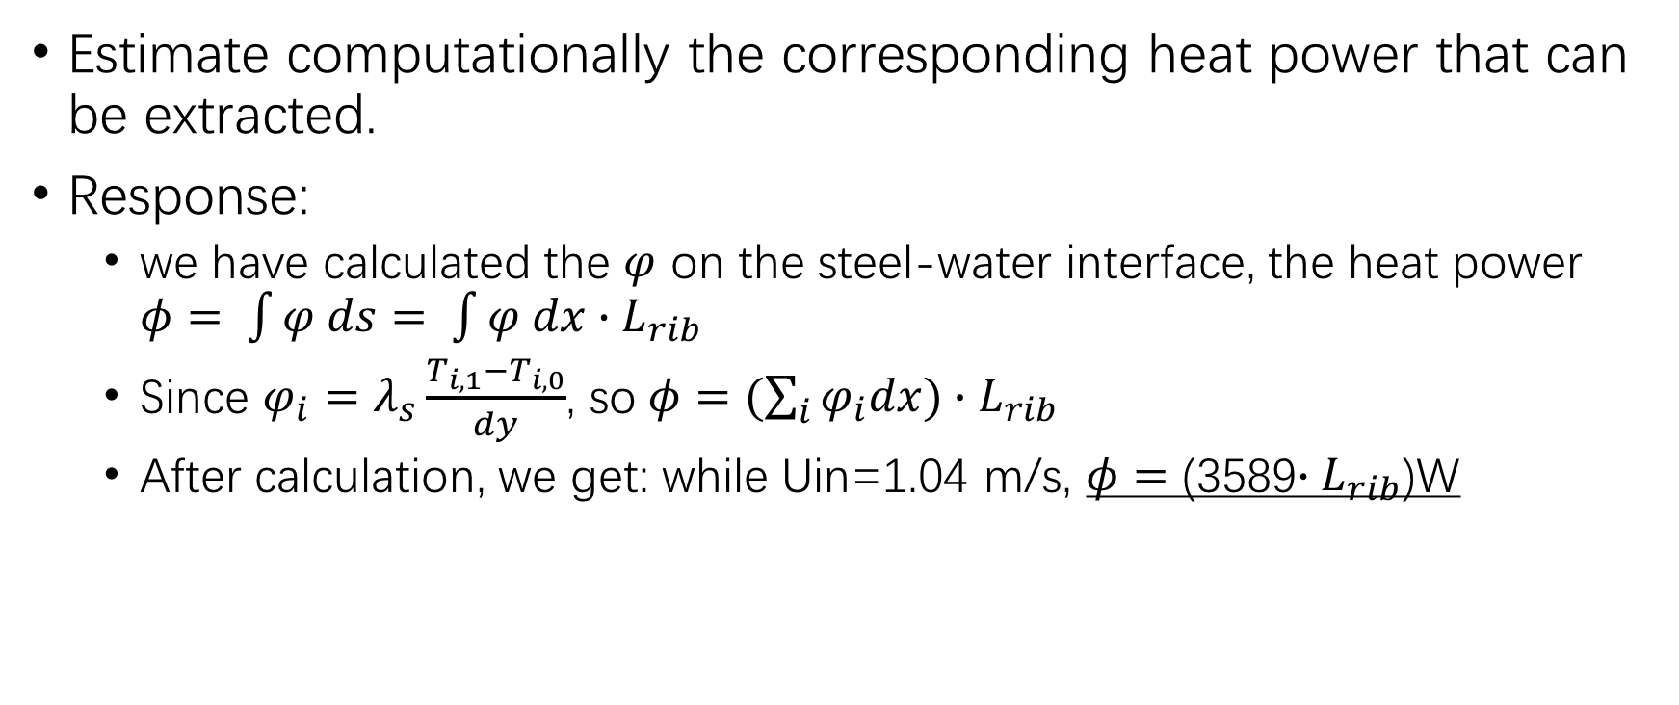
Specific questions
Estimate computationally the corresponding heat power that can be extracted.
Response:
we have calculated the $φ$ on the steel-water interface, the heat power $φ= \int{φ ds}= \int{φ dx∙L_{rib}}$
Since $φ_{i}=λ_{s}\frac{T_{i,1}−T_{i,0}}{dy}$, so$φ=(\sum_{i}{φ_{i}dx})∙L_{rib}$
After calculation, we get: while Uin=1.04 m/s, $φ=$ (3589$∙L_{rib}$)W

Slide 13
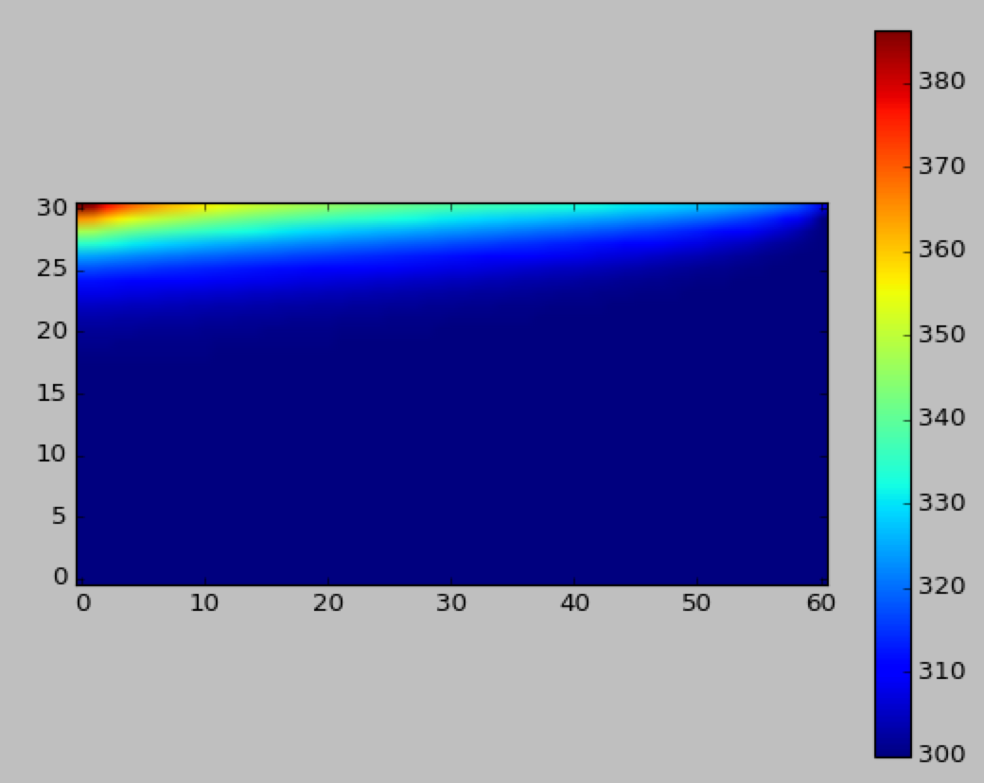
Specific questions
The case of flow reversal:
While Uin=1.04 m/s, normal we get the water Tmax=360K.
In the case of flow reversal, Tmax= 386K in the left side.
So, if it happens a wrong setting of the water pumping system, the water will boil more easily than the normal case.

Slide 14
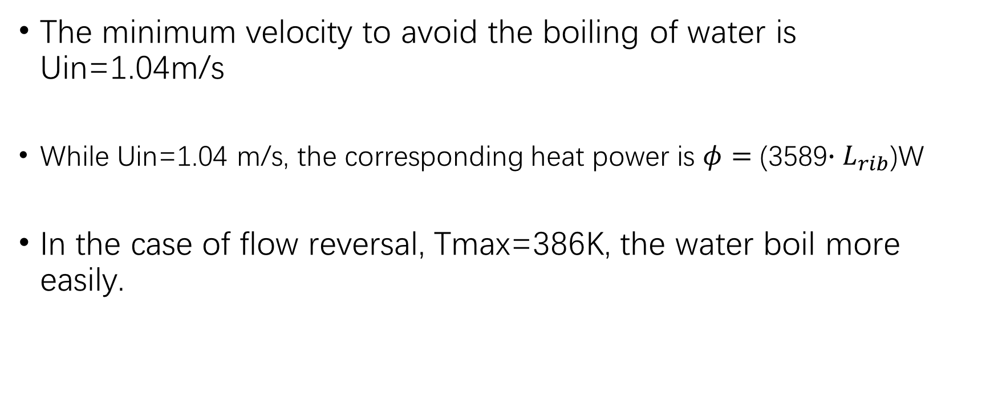
Resume
The minimum velocity to avoid the boiling of water is Uin=1.04m/s
While Uin=1.04 m/s, the corresponding heat power is $φ=$ (3589$∙L_{rib}$)W
In the case of flow reversal, Tmax=386K, the water boil more easily.

