Slide 1
Numerical Methods Project 4
Wenjing Ke and Christopher Reinartz

Slide 2
Table of contents
Problem description
Solution steps
Navier-Stokes equation – flow field
explicit diffusion
implicit diffusion
Temperature equation – temperature field
explicit diffusion
implicit diffusion
Results
Resume

Slide 3
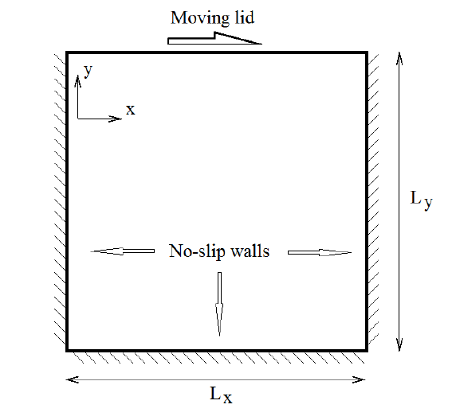
Problem description
Box filled with liquid with a moving lid
Liquid moves due to lid movement
Initial temperature is not homogeneus
Time dependent temperature and velocity fields

Slide 4
Velocity calculation
Velocity field development -> Navier-Stokes
solution of the complete equation problematic
equation splitting is used
Steps of equation splitting:
Calculate convective fluxes
Calculate diffusion influence
Update pressure field
Update velocity to satisfy continuity

Slide 5
Equation splitting
Splits the equation into multiple parts
convective part
diffusive part
pressure part
(+Poisson equation for pressure correction)
Generates first order splitting error
high error, even if high order discretization is used
Allows mixed implicit – explicit calculations
explicit convection and pressure
implicit diffusion (ADI)

Slide 6
Discretization
Convection
explicit -> forward Euler (CFL <= 1)
Diffusion
explicit -> forward Euler (F0 <= 0.5)
implicit -> ADI (no Fourier restriction)

Slide 7
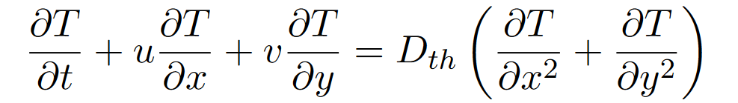
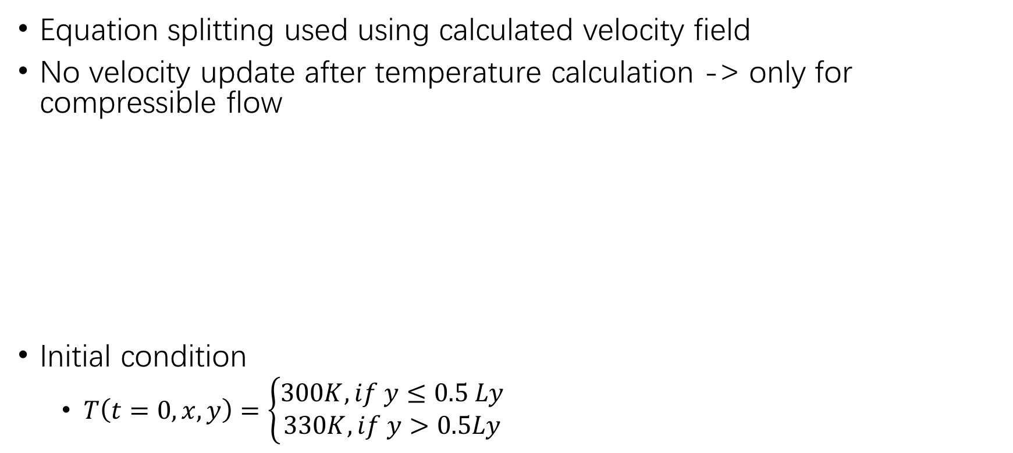
Temperature calculation
Equation splitting used using calculated velocity field
No velocity update after temperature calculation -> only for compressible flow
Initial condition
$T\left(t=0, x, y\right)=\left\{\begin{aligned}300K, if y≤0.5 Ly \\ 330K, if y>0.5Ly\end{aligned}\right.$
Convection
Diffusion

Slide 8
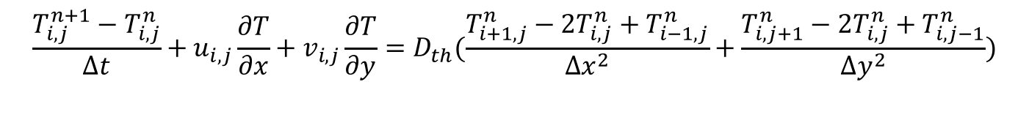
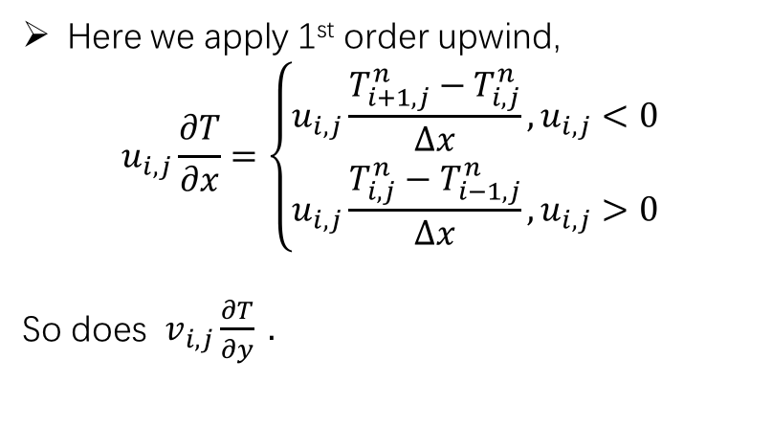
Discretization
Calculate temperature:
$$\frac{T_{i,j}^{n+1}−T_{i,j}^{n}}{Δt}+u_{i,j}\frac{∂T}{∂x}+v_{i,j}\frac{∂T}{∂y}=D_{th}(\frac{T_{i+1,j}^{n}−2T_{i,j}^{n}+T_{i−1,j}^{n}}{{∆x}^{2}}+\frac{T_{i,j+1}^{n}−2T_{i,j}^{n}+T_{i,j−1}^{n}}{{∆y}^{2}})$$
Here we apply 1st order upwind,
$$u_{i,j}\frac{∂T}{∂x}=\left\{\begin{aligned}u_{i,j}\frac{T_{i+1,j}^{n}−T_{i,j}^{n}}{Δx},u_{i,j}<0 \\ u_{i,j}\frac{T_{i,j}^{n}−T_{i−1,j}^{n}}{Δx},u_{i,j}>0\end{aligned}\right.$$
So does $v_{i,j}\frac{∂T}{∂y} .$

Slide 9
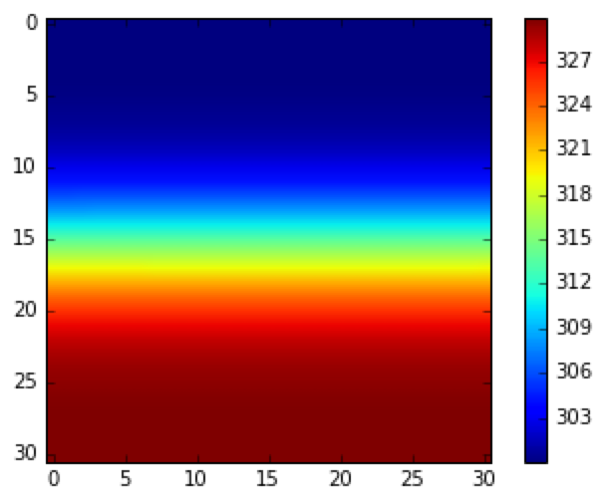
Question 1
When the upper lid velocity is zero, Re=0.
By observing the figure, we found that when velocity=0, the temperature diffuse to the upper and down side homogenously.
Timestep=300, tFin=40s

Slide 10
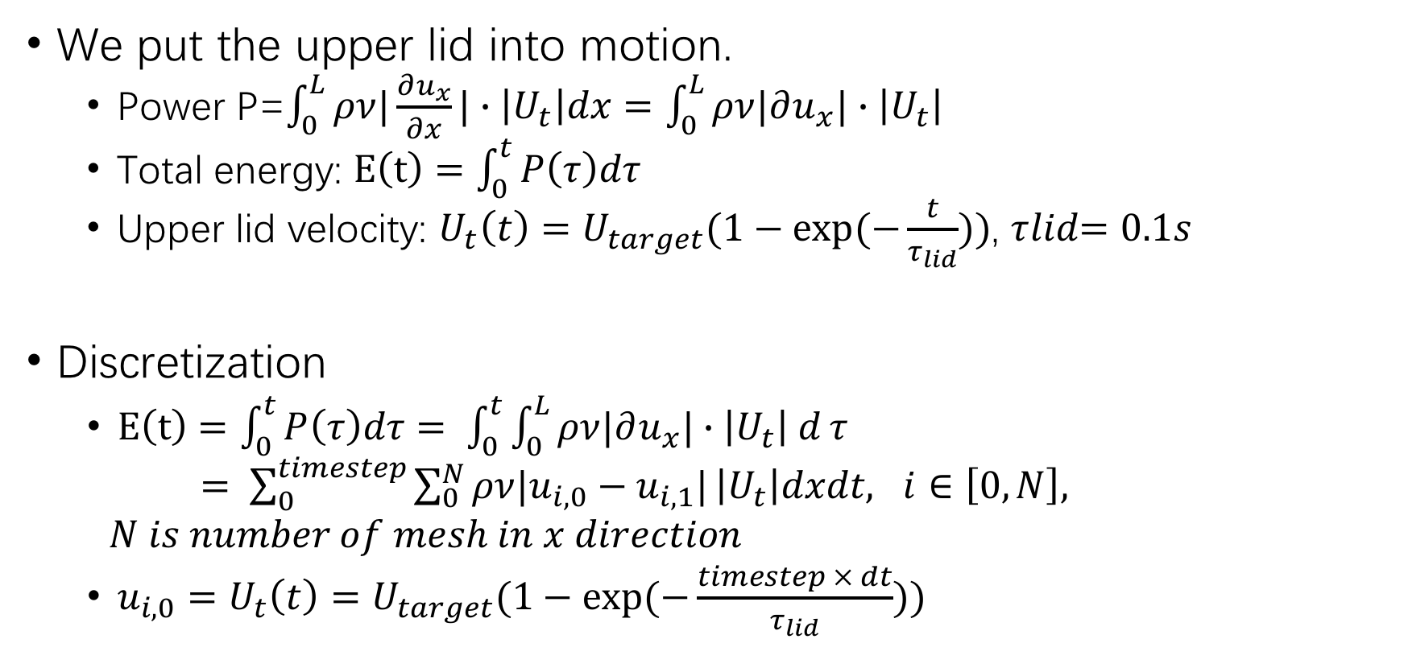
Question 2
We put the upper lid into motion.
Power P=$\int_{0}^{L}{ρν|\frac{∂u_{x}}{∂x}|}∙\left|U_{t}\right|dx=\int_{0}^{L}{ρν|∂u_{x}|}∙\left|U_{t}\right|$
Total energy: $E\left(t\right)=\int_{0}^{t}{P\left(τ\right)dτ}$
Upper lid velocity: $U_{t}\left(t\right)=U_{target}(1−exp⁡(−\frac{t}{τ_{lid}}))$, $τ﷮lid=0.1s$
Discretization
$E\left(t\right)=\int_{0}^{t}{P\left(τ\right)dτ= \int_{0}^{t}{\int_{0}^{L}{ρν|∂u_{x}|}∙\left|U_{t}\right| d}τ}$
$= \sum_{0}^{timestep}{\sum_{0}^{N}{ρν|u_{i,0}−u_{i,1}|}}\left|U_{t}\right|dxdt, i∈\left[0,N\right],$
$N is number of mesh in x direction$
${u_{i,0}=U}_{t}\left(t\right)=U_{target}(1−exp⁡(−\frac{timestep × dt}{τ_{lid}}))$
Boundary condition of u

Slide 11
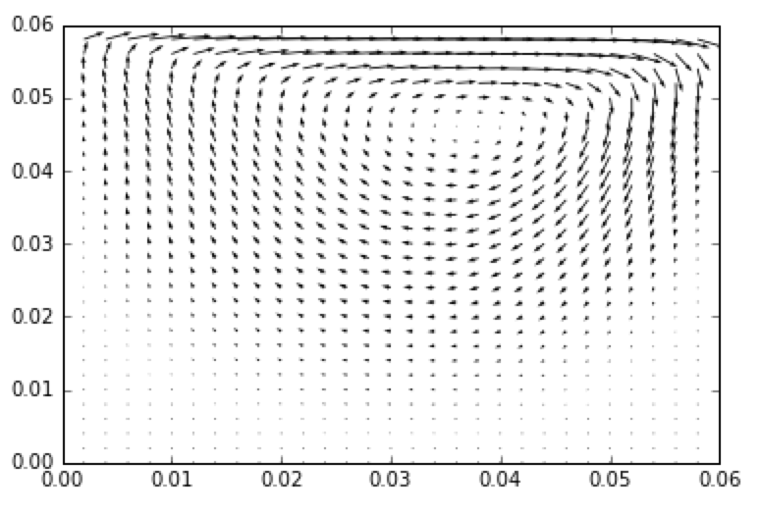
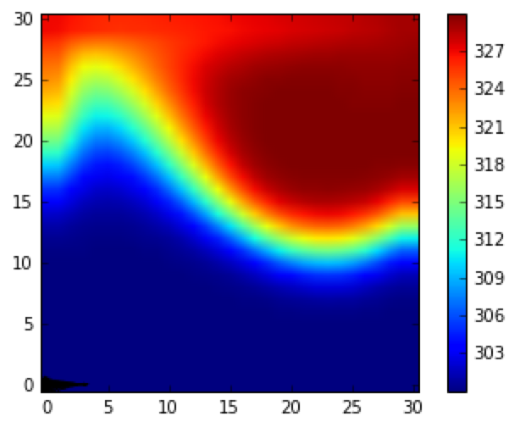
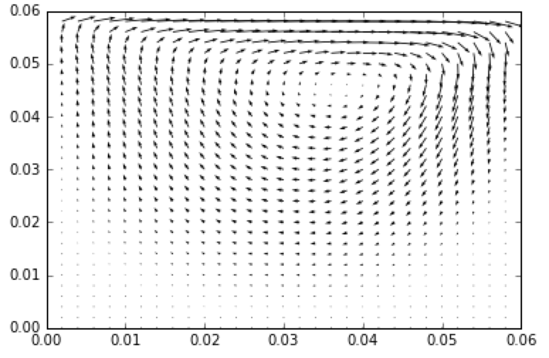
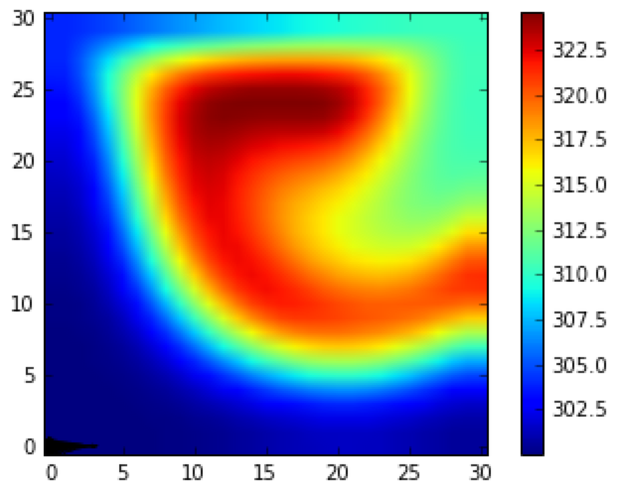
Question 2
Re=100, tFin=13s, E=3.8*10^-6 J
Re=100, tFin=40s, E=1.2*10^-5 J

Slide 12
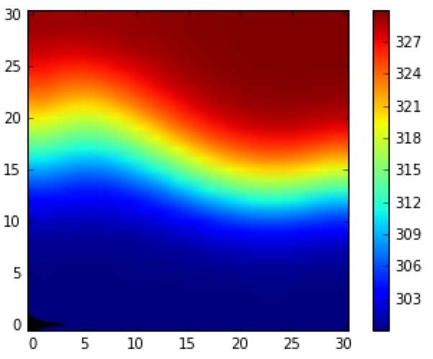
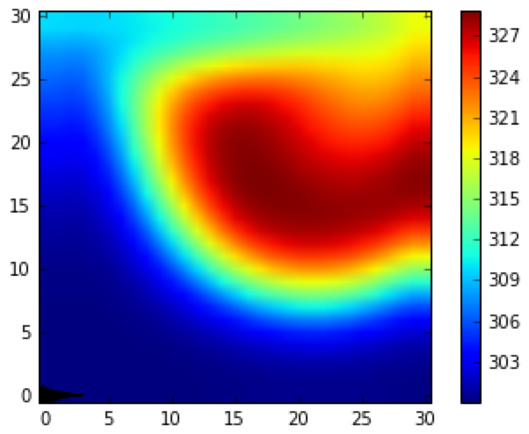
Question 2
Influence of Re
Case of tFin=40s
Re=10
Re=50
Re=100

Slide 13
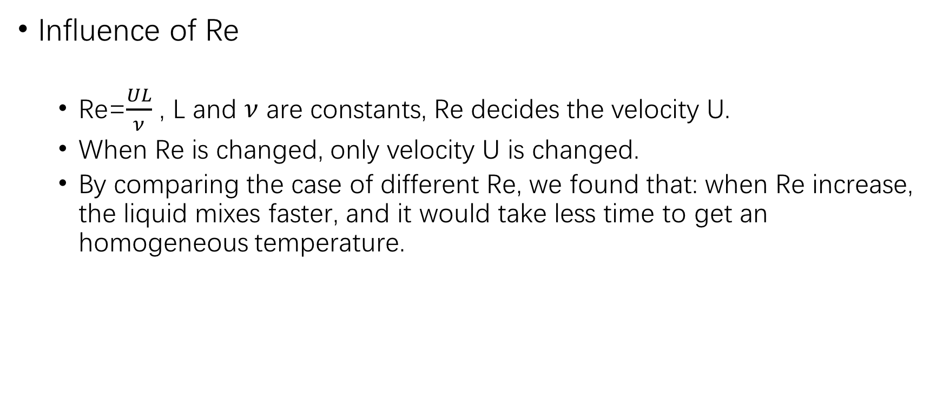
Question 2
Influence of Re
Re=$\frac{UL}{ν}$ , L and $ν$ are constants, Re decides the velocity U.
When Re is changed, only velocity U is changed.
By comparing the case of different Re, we found that: when Re increase, the liquid mixes faster, and it would take less time to get an homogeneous temperature.

Slide 14
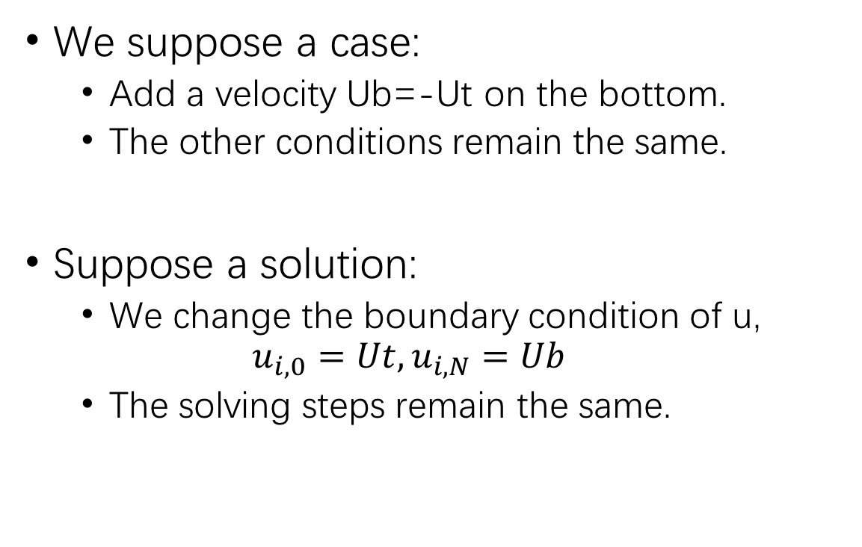
Question 3
Ut
We suppose a case:
Add a velocity Ub=-Ut on the bottom.
The other conditions remain the same.
Suppose a solution:
We change the boundary condition of u,
$$u_{i,0}=Ut,u_{i,N}=Ub$$
The solving steps remain the same.
Ub

Slide 15
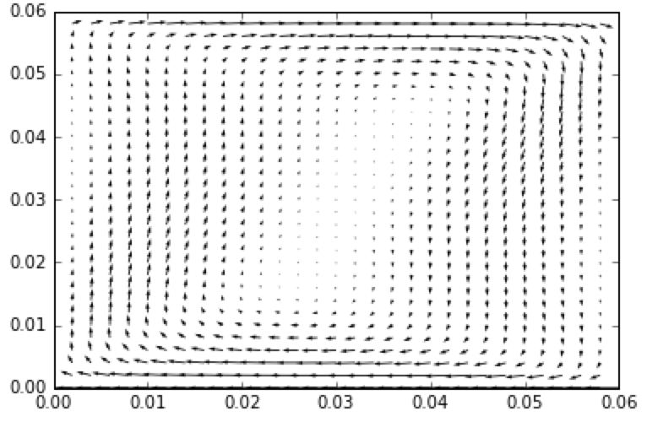
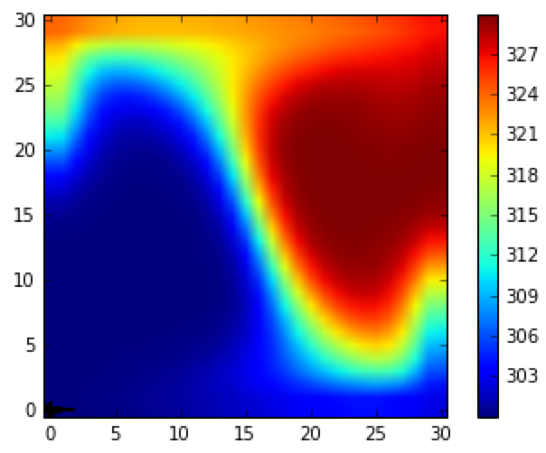
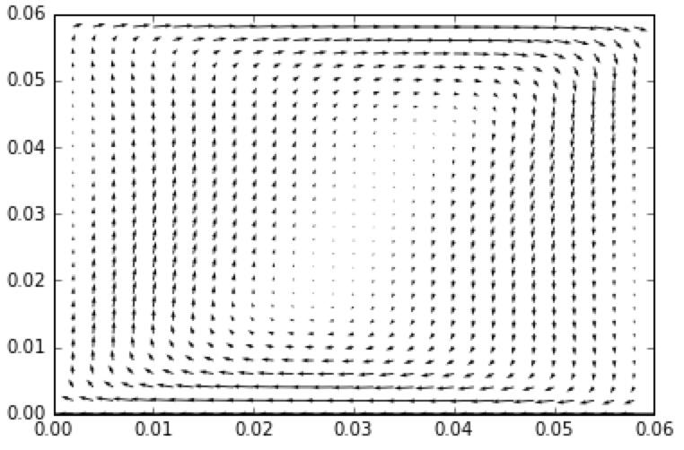
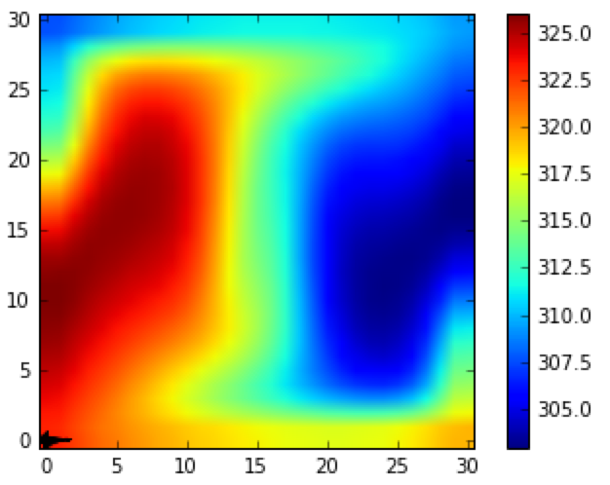
Question 3
Re=100, tFin=13s, E=8.8*10^-6 J
Re=100, tFin=40s, E=2.7*10^-5 J

Slide 16
Resume
Influence of Re
When we change Re, only velocity is changed. So the bigger Re is, the faster liquid mixes.
Influence of Ut
In question 1, Ut=0, the liquid mixes slowly and the temperature diffuse homogenously to the upper and down side
In question 2, we add a Ut on the upper side, the liquid in cavity gets a velocity, and the temperature mixes like a vortex.
In question 3, add a Ub=-Ut on the down side, the liquid mixes even faster.

