Slide 1
RedMule cube unit in GVSoC
Chi Zhang chizhang@iis.ee.ethz.ch

Slide 2
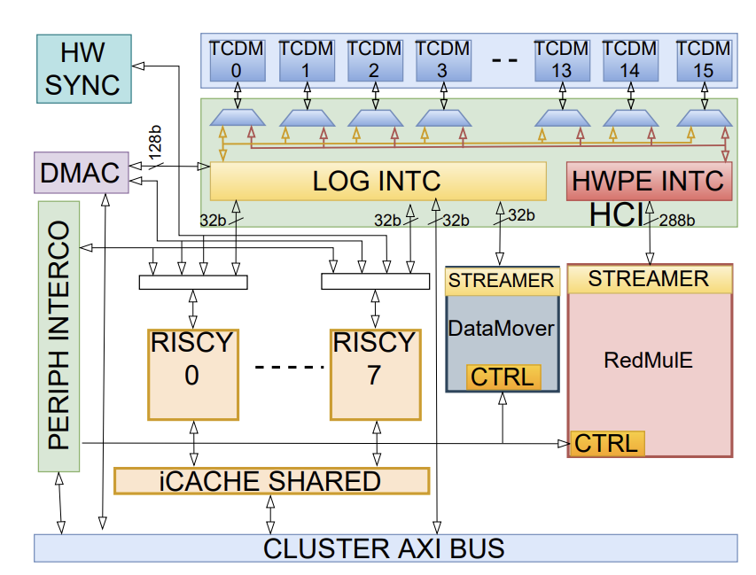
Current Progress
Redmule is Ready in GVSoC
A complete Redmule unit is modeled in GVSoC
Integrated to Pulp-Cluster in GVSoC
Redmule Hardware Abstraction Layer(HAL) is ready for SW develpment
Cross-Benchmark
Compare the runtime of Redmule model in GVSoC and RTL
The average runtime deviation is 6%
Debugging
GVSoC’s Redmule doesn’t function correctly when the Matrix dimension can not be divided exactly by Redmule’s dimension

Slide 3
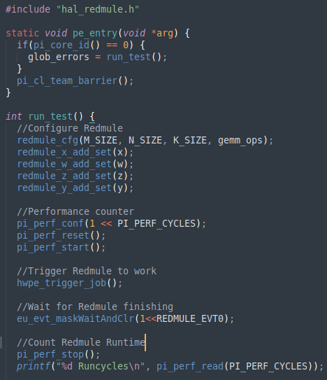
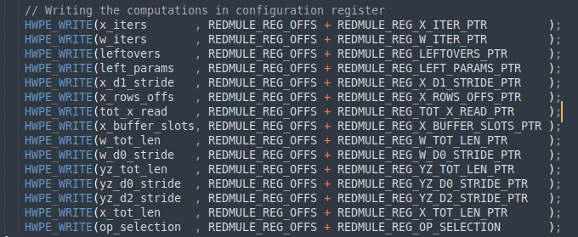
SW example to use Redmule
Redmule SW flow
Use one core to interact with Redmule
Configure Redmule
Trigger Redmule and wait for finishing
RedMule HAL
Calculate Metadata for Redmule
Write to Redmule configure register

Slide 4
Cross-Benchmark Redmule
Settings
Benchmark GVSoC model‘s accuracy
Redmule configure with 12x4 CE arrays
Varying input matrix dimension
Compare Redmule runtime cycles
Cross-Benchmark Results
The average runtime deviation is 6%
Both RTL & GVSoC models could reach relatively high compute utilization
At some input matrix dimensions, the runtime deviation goes upto 10%, I need to look in-depth what is happening there.

Slide 5
On going work -- Extend to a giant RedMule
Extend to a giant RedMule
Meet KiloPEs → Configure 48x16 CEs in RedMule
Extend the BW from TCDM to RedMule
We meet bugs
Both GVSoC and RTL model trgger bugs when extend CE arrays
Either the Redmule stall at a point forever or generate incorrect results
Plan for next
Hopefully we‘ll fix all bugs before next meeting, and cross-benchmark the extended Redmule‘s performance

