Slide 1
DRAM-Simulator Upgarde for GVSoC and Cleanup
Chi Zhang chizhang@iis.ee.ethz.ch

Slide 2
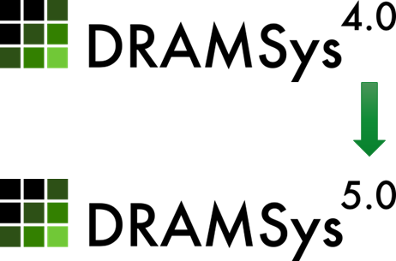
Upgrade to DRAMSys5.0 for DRAM co-simulation for GVSoC
Why we need to upgrade to DRAMSys5.0
DRAMSys5 add Support to Masked-Write
Without Masked-Write, we can not have DRAM access with misaligned address and misaligned(to 64Bytes) size
Both SoftHier Project and Pulp team need this feature urgently, So I put this task at the highest priority
Challenges From DRAMSys4.0 to DRAMSys5.0
DRAMSys5 has changed a lot in source code organization can only build standalone simulator
I need to
look into DRAMSys5 source code and understand their new interface
Insert a wrapper to build a dynamic library with C-type callback-based APIs
Update gvsoc-side dram-wrapper code for misaligned access support

Slide 3
Current Progress
DRAMSys5.0 is successfully integrated to GVSoC
Test with misaligned DRAM accesses on different DRAM models (HBM2, DDR4, DDR3, LPDDR4)
Add DRAMsys configure in GVSoC
Ctrl Schedule Policy, Ctrl & Phy delay, DRAM Addr Mapping
Cleanup and setup a git branch for SoftHier
https://github.com/gvsoc/gvsoc/tree/soft_hier
To build, run and test dramsys5-integrated GVSoC (~20min)
source dramsys_pushbutton.sh
To build, run PulpCluster + RedMule
cd pulp/pulp/redmule/run
make configure && make run

Slide 4
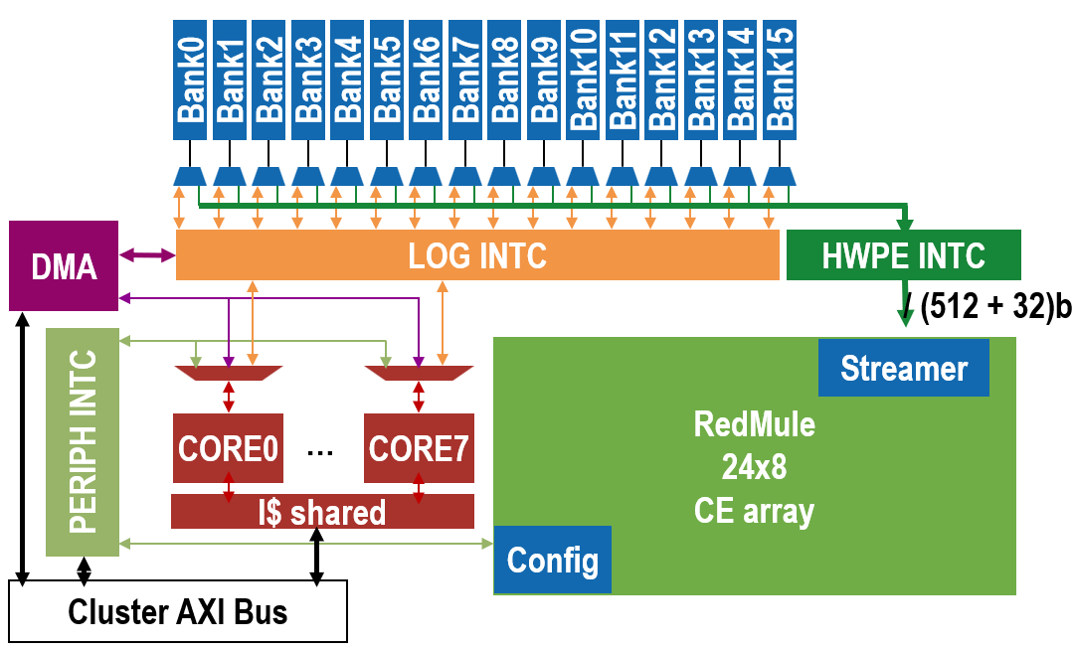
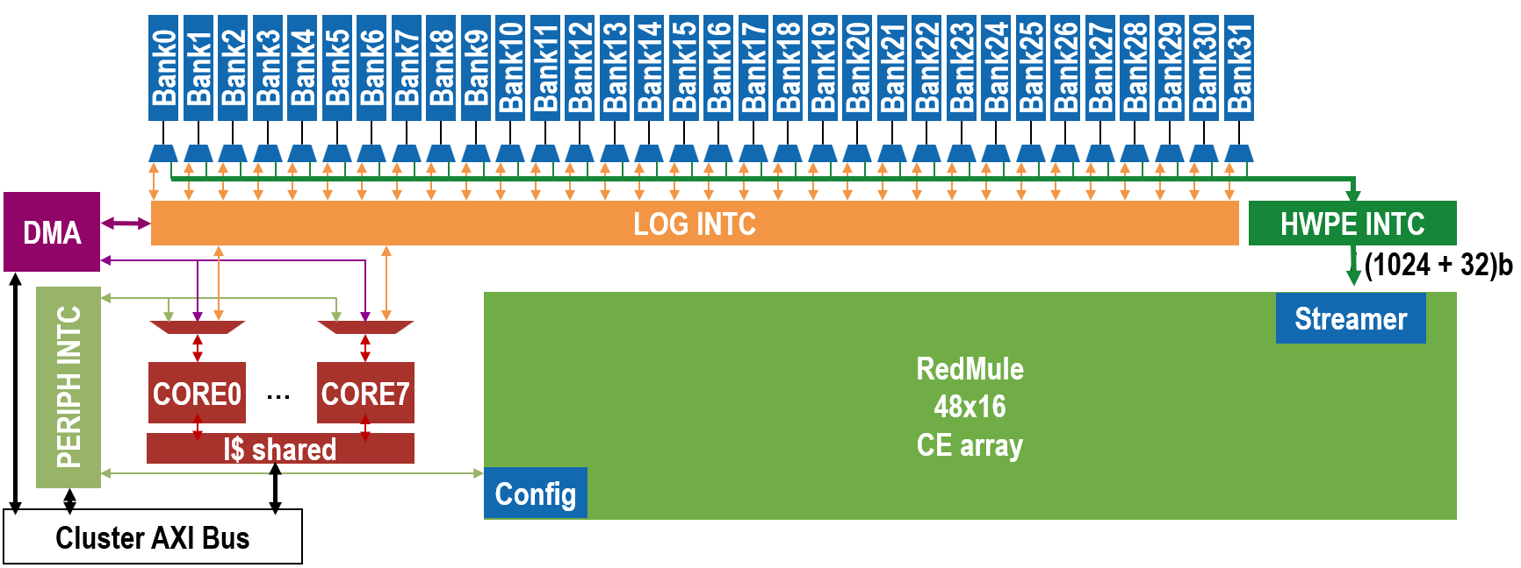
On-going work
Build Pulp-Cluster with extended RedMule (Cube Unit) in GVSoC
Increasing #TCDM-Banks
24x8 CE arrays -> 16Banks
48x16 CE arrays -> 32Banks
Holiday plan Feb10 – Feb20
192MACs/cycle
768MACs/cycle

Slide 5
DMA Additions In Snitch - GVSoC iDMA Model
Thomas Benz tbenz@iis.ee.ethz.ch

Slide 6
Status
Busy working towards a paper deadline.

Slide 7
Snitch runtime and tool updates
Luca Colagrande colluca@iis.ee.ethz.ch

Slide 8
Status
No major updates

