Slide 1
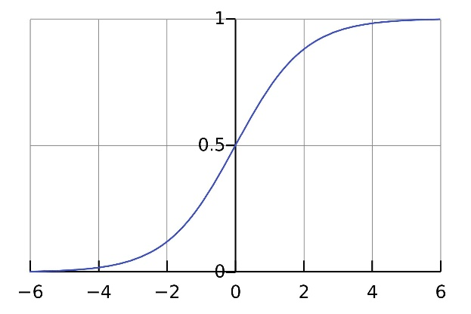
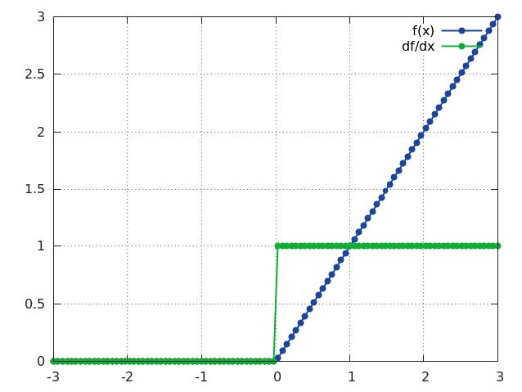

Slide 3
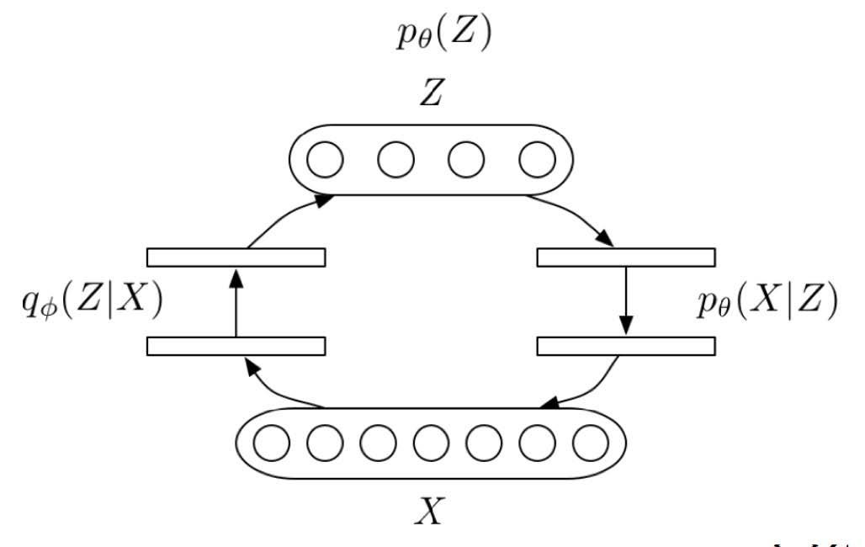
Inference
Path
(Encoding)
Generative
Path
(Decoding)

Slide 4
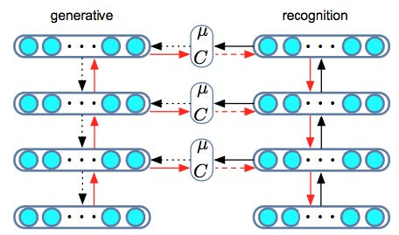
BP
Forward
Stochastic
BP
Sampling

Slide 5
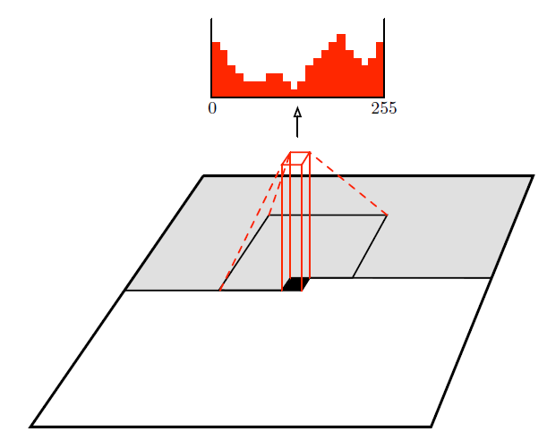
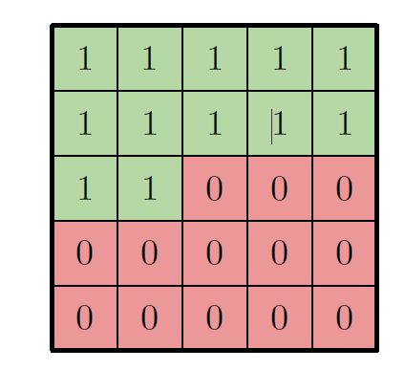

Slide 9




scaling function
mother wavelet
dilated
translated

Slide 11
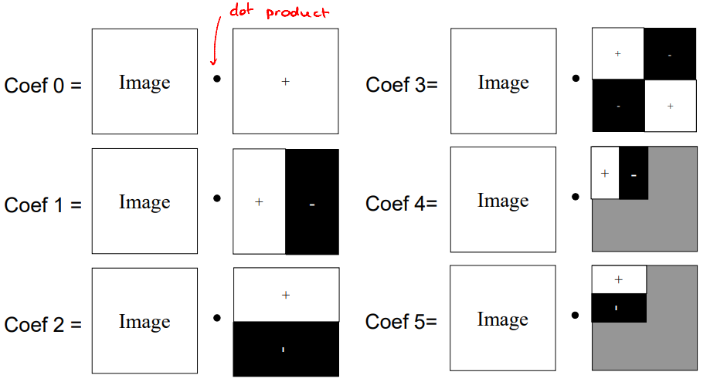
https://www.cs.toronto.edu/~mangas/teaching/320/slides/CSC320L11.pdf

Slide 12








Slide 14
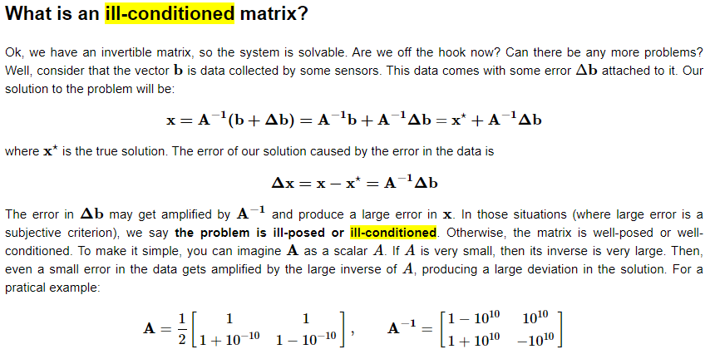

Slide 15
Overcomplete DCT
Overcomplete Haar
Learned Dictionary

Slide 16
