Slide 1

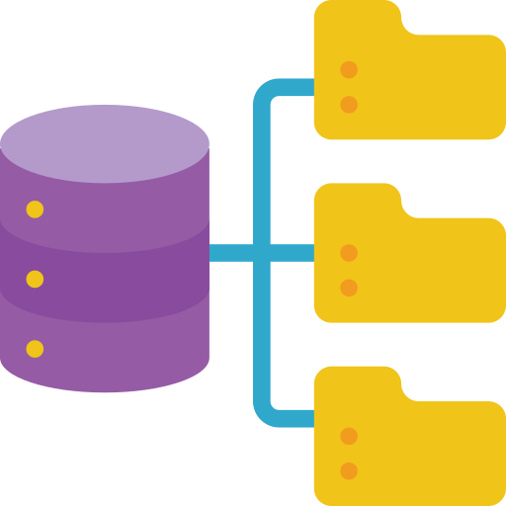




Multimodal GPT-4
Traditional NLP
Structed Data
Course Material
Student Query
Course-based GPT

