Slide 1

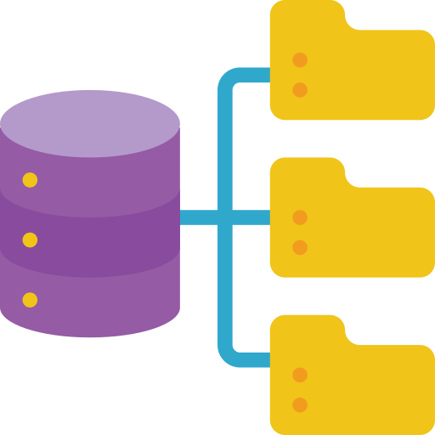




Multimodal GPT-4
Traditional NLP
Structed Data
Course Material
Student Query
Course-based GPT

Slide 2

Multimodal GPT-4
Course
Material
Traditional NLP
Structed Data
Student Query
Course-based GPT

Slide 3




Multimodal GPT-4
Data Preprocess
Course Material
Traditional NLP
JSON
File
AWS
S3 Bucket
AWS
MySQL
Database Setup
Student Query
Query
GPT
Interaction
Course GPT

