Slide 1


NIEM-UML-3 Specification Overview
Cory Casanave, Model Driven Solutions
September 2014 OMG Meeting
Austin, TX USA

Slide 2
Current Status
The “Initial Submission to the UML Profile for NIEM-3 (NIEM-UML-3)” was delivered to the Object Management Group (OMG) on August 16th, 2014. Final submission due: Feb 23rd, 2015.
GITHUB Site
Submission, machine readable files and design documents are on GITHIB site: https://github.com/NIEM/NIEM-UML/
Contributors and reviewers are welcome
Mail list: niem-uml@modeldriven.org
OMG Documents
Submission: gov/2014-08-02
Machine Readable Artifacts: on GITHUB
Fully OMG conformant machine readable files have not yet been produced. Magicdraw and Eclipse files are available on GITHUB

Slide 3
High level points
NIEM-UML-3 is a NIEM-3 update of the NIEM-UML specification (originally targeting NIEM 2.1)
Good news: While there are substantial changes to NIEM-3, the “Platform Independent Model” (PIM) profile and user models require minimal changes
Most NIEM-3 changes are encompassed in:
The automated “QVT” mappings from the PIM, through the PSM, to the NIEM artifacts
The “MPD Profile” which supplies the metadata for a NIEM MPD. NIEM-3 has additional metadata capabilities
Today we will focus on these changes

Slide 4
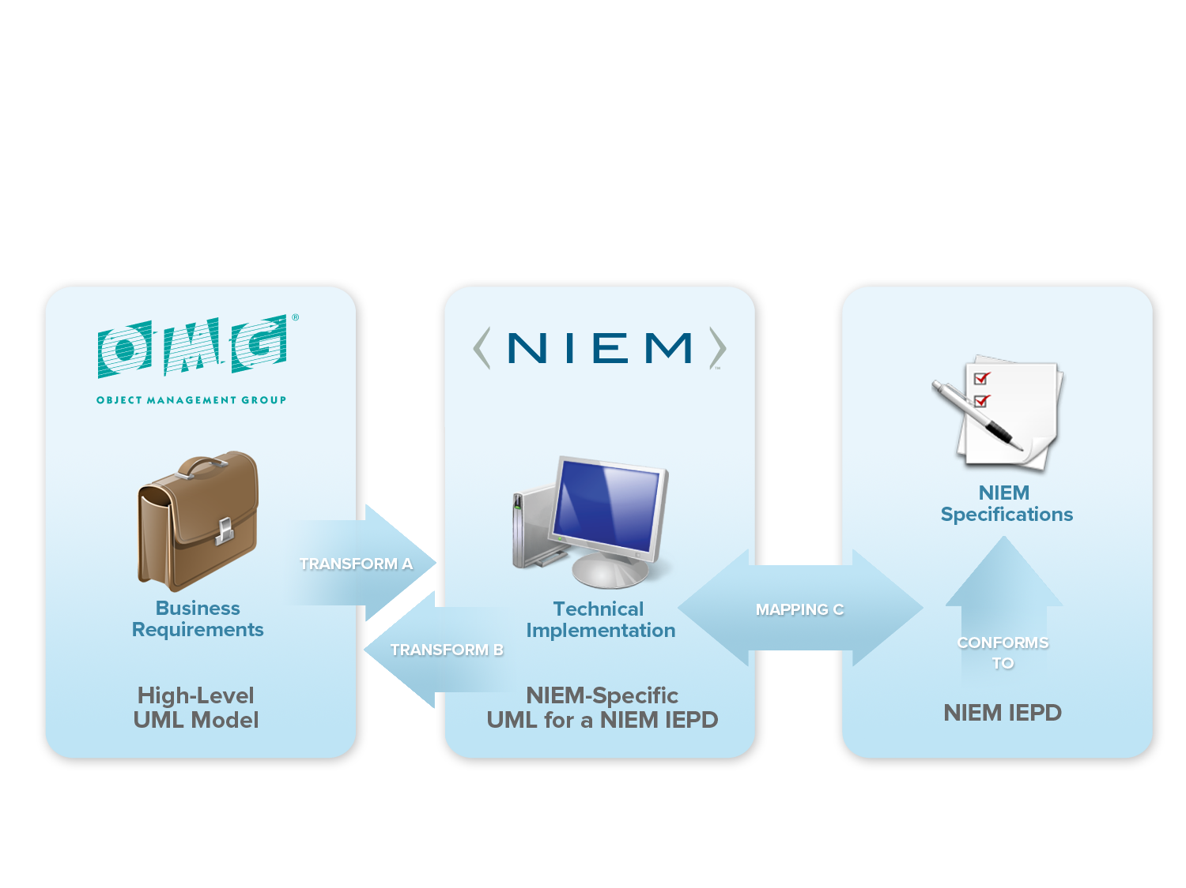
Collaborative Innovation

Slide 5
NIEM-UML Layered Architecture

Slide 6
Platform Independent Model (PIM) Changes

Slide 7

Unified Reference & Content
NIEM-2
UML “AggregationKind” (The symbol at the end of an association) corresponded with the “content” Vs. “Reference” distinction in NIEM-2
NIEM-3
No longer makes this distinction in the schema and uses “structures:ref” for reference – instances decide if and how to aggregate. UML aggregation may be used but has no meaning in NIEM-UML-3. Other possible interpretations can be considered.
By default, aggregation kind of “none” is used
Use of “Reference” suffix should be removed from models (may be automated by tools)
Has no impact on generated schema

Slide 8
NIEM-3 Augmentations
NIEM-2
Augmentations augment a class by use of an property in a subclass
NIEM-3
No subclass is required, augmentations augment a class by use of a substitution group head
NIEM-UML-3
<<augments>> is used to augment a type. This generates the member of the substitution group.

Slide 9
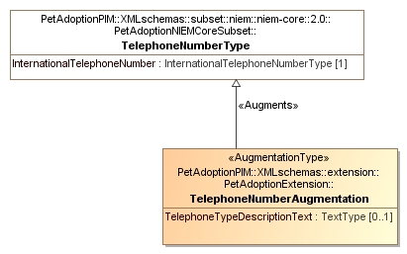
Augmentation Example
Restricted Augmentation of TelephoneNumber
<xsd:element name="TelephoneNumberAugmentation" nillable="false"
substitutionGroup="nc:TelephoneNumberAugmentationPoint " type="tns:TelephoneNumberAugmentationType">
.

Slide 10
Augmentation Details
Use of <<AugmentationType>> is optional when using <<augments>>
An <<AugmentationType>> with no <<Augments>> can augment any type
<<AugmentationApplication>> has been removed.
Like the reference models, all NIEM-UML generated object types and association types will generate an augmentation point to allow for future expansion.

Slide 11

Local Vocabularies
The local vocabulary is defined as a stereotype of enumeration where each enumeration literal is a vocabulary term. The enumeration literal’s UML name corresponds with the domain specific abbreviation, the specification corresponds with the expansion of the abbreviation and the UML comment corresponds to the NIEM description. The NIEM sourceURI may also be set by applying the “Source” stereotype to the enumeration literal.
The above defines the abbreviation “CPU” (Expansion and description not shown in notation)

Slide 12
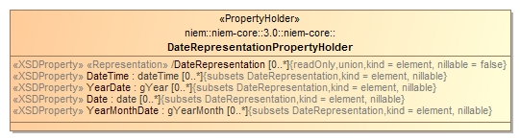
Representation
NIEM-3 representation is used as the typeless head of a substitution group. This impacts the naming convention.
A representation property has no type.
NIEM-UML-3 supplies a stereotype, the naming convention may also be used.
Representation

Slide 13
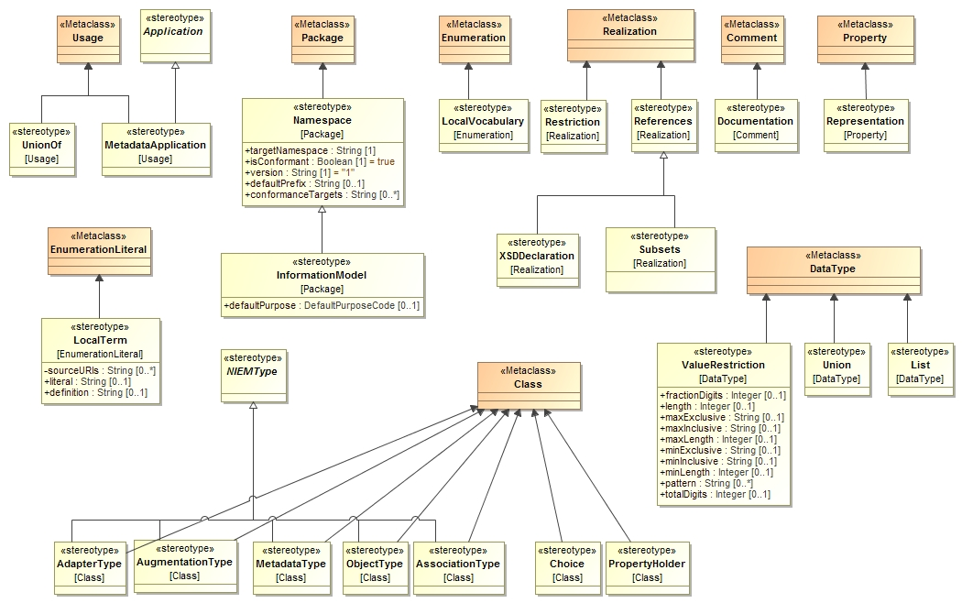
Common Profile

Slide 14
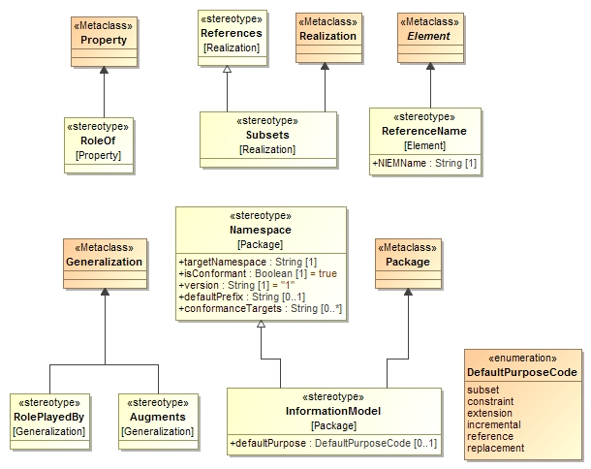
PIM Profile

Slide 15
Reference model changes
The NIEM reference models have undergone substantial changes.
NIEM-2 reference models may no longer be used
Tools may provide assistance in mapping NIEM-2 to NIEM-3 reference models, however this is not part of the NIEM-UML-3 specification
Not all mappings can be fully automated

Slide 16
MPD/IEPD Model Changes

Slide 17
MPD Changes Overview
Where possible, no change was made to the 2.1 MPD profile and changes in NIEM accommodated via mapping
Much of the new metadata is captured in “UML Instances”, not stereotype tags. This is due to the complexity of and linking between the metadata elements.
Gone are: POC Type, Nature code, purpose code, ModelPackageDescriptionFile, ModelPackageDescriptionRelationship
All moved to instance model

Slide 18
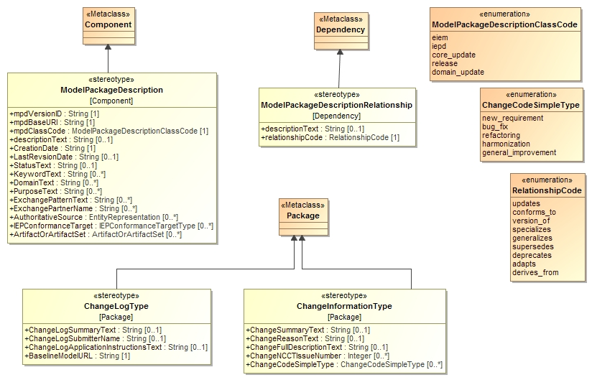
MPD Profile

Slide 19
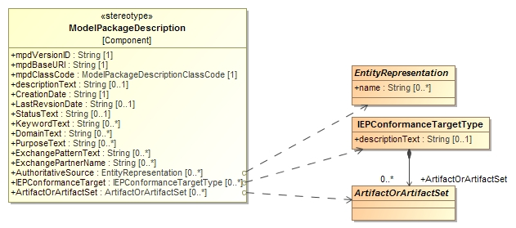
Profile points to class instances
Much of the MPD data is represented as UML instances (instances of classes). The profile elements reference these instances.

Slide 20
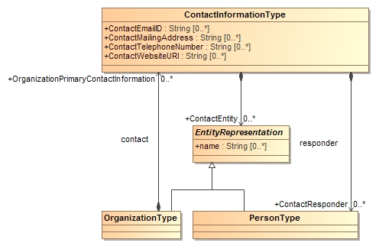
Contact Information Classes

Slide 21
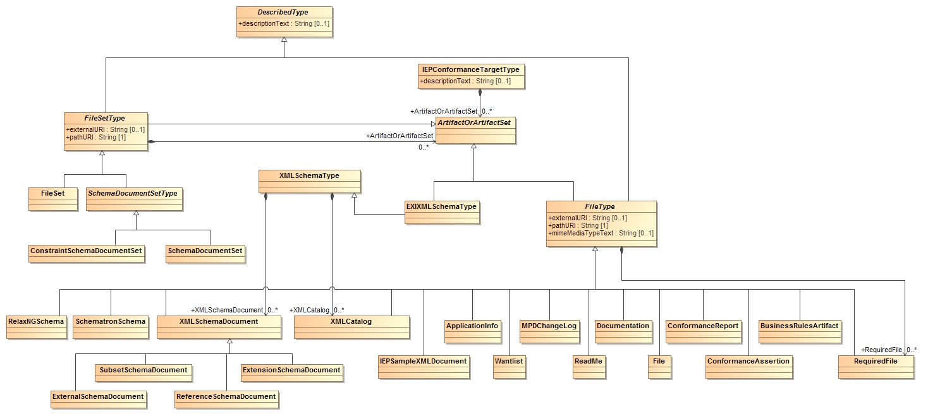
MPD Artifact Classes

Slide 22
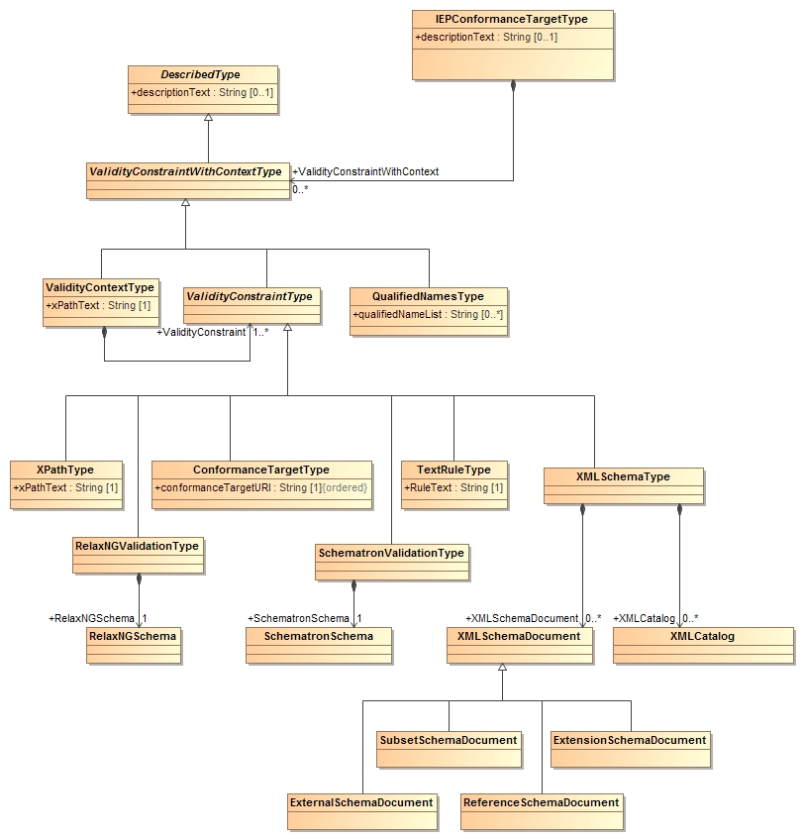
MPD Validity Constraint Classes

Slide 23
MPD Example
TODO: Find best example

Slide 24
Other Specification Changes
All references to NIEM rules updated to NIEM-3
Structured English portion of specification removed as redundant with QVT
Overall improvement in documentation
Still to do
Reference documentation generated from model
High level documentation of revised QVT
Finalize MPD section (not all changes reflected)

Slide 25
Potential Improvements & Simplifications
The following have been suggested, the submission team is looking for feedback on the highest priorities
See: design/NIEM-3 Simplification.doc
Comments and priorities are being sought within 1 month

Slide 26
Potential Simplification Summaries
General Information Models (OMG FTF Issue No: 18174)
Have A PIM model type that brings together subsets and extensions
Augmentation Vs. multiple inheritance
Make augmentation exactly like multiple inheritance (NIEM Issue)
Multiple subsets of the same type
Allow multiple subsets of the same thing
Substitution groups as property holders
Allow substitution groups “embedded” in class
Reducing the need for property holders
Require property holders only for the edge cases
Usability of reference models
Make them more “PIM LIKE”

Slide 27
Potential Simplification Summaries
Aggregation commitment
Have some interpretation for aggregation (Involve NTAC)
NIEM Association Types
Represent reference models using association classes
Treatment of union types and substitution groups
Allow unions of any class (e.g. entity)
Unnecessary Reified relationships (Association classes)
Look for a way to have options for association realization (NTAC Issue)
Removal of explicit PSM profile
Map directly from PIM to artifacts

Slide 28
Summary of issues
Issue | Impact Estimate
General Information Models (OMG FTF Issue No: 18174) | 5
Subset Vs. extension schema | 4
Augmentation Vs. multiple inheritance | 2
Multiple subsets of the same type | 3
Substitution groups as property holders | 2
Entities Vs data elements | 1
Reducing the need for property holders | 2
Usability of reference models | 4
Aggregation commitment | 2
NIEM Association Types | 3
Treatment of union types and substitution groups | 3
Unnecessary Reified relationships (Association classes) | Unknown
Removal of explicit PSM profile | 3

Slide 29
Questions and Comments

