Slide 1


NIEM-UML-3 Specification Overview
DRAFT
Cory Casanave, Model Driven Solutions
March 2015 OMG Meeting
Reston, VA USA

Slide 2
Current Status
The “Revised Submission to the UML Profile for NIEM-3 (NIEM-UML-3)” was delivered to the Object Management Group (OMG) on Feb 23rd, 2015.
GITHUB Site
Submission, machine readable files and design documents are on GITHIB site: https://github.com/NIEM/NIEM-UML/
Contributors and reviewers are welcome
Mail list: niem-uml@modeldriven.org
OMG Documents
Submission: gov/2015-02-01
Inventory: gov/2015-02-01
Submission files and other resources are on the github site.

Slide 3
High level points
NIEM-UML-3 is a NIEM-3 update of the NIEM-UML specification (originally targeting NIEM 2.1) based on NIEM-XML-3
Good news: While there are substantial changes to NIEM-XML-3, the UML “Platform Independent Model” (PIM) profile and user models require minimal changes
Most NIEM-XML-3 changes are encompassed in:
The automated “QVT” mappings from the PIM, through the PSM, to the NIEM artifacts
The “MPD Profile” which supplies the metadata for a NIEM MPD. NIEM-3 has additional metadata capabilities
Today we will focus on these changes

Slide 4
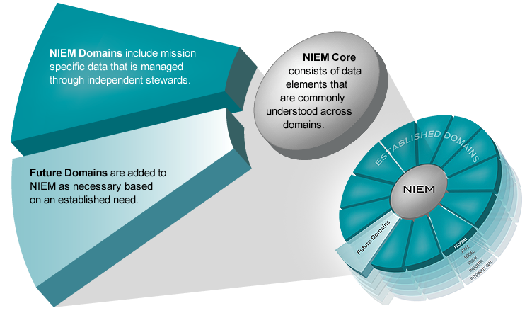
Major vs. Minor Release
NIEM 3.0 is a major release of the NIEM data model—containing updates to the NIEM Core as well as changes to several Domains.
A minor release involves limited changes to Domains

Slide 5
How has NIEM evolved over the years?
MAJOR
NIEM 1.0
MAJOR
NIEM 2.0
MINOR
NIEM 2.1
MAJOR
NIEM 3.0
1.0 Core
2.0 Core
2.0 Core
3.0 Core
1.0 Domains
2.0 Domains
2.1 Domains
3.0 Domains
2006
2007
2009
2013
Reference Schemas

Slide 6
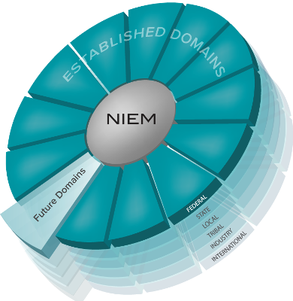
NIEM 3.0 Inputs
Domain Content Updates & Additions
Architectural Improvements
Content Harmonization
Resolved NIEM Configuration Control Tool (NCCT) Issues
Content Related NCCT Issues

Slide 7
NIEM 3.0 Normative Specifications
NIEM 3.0 was successfully launched on November 6, 2013. Various specifications serve as the “backbone” of the NIEM 3.0 technical architecture.
NIEM Naming and Design Rules V3.0
http://reference.niem.gov/niem/specification/naming-and-design-rules/3.0/
NIEM Model Pacakge Description Specification V3.0
http://reference.niem.gov/niem/specification/model-package-description/3.0/
NIEM Conformance Specification V3.0
http://reference.niem.gov/niem/specification/conformance/3.0/
NIEM Conformant Target Attribute Specification V3.0
http://reference.niem.gov/niem/specification/conformance-targets-attribute/3.0/

Slide 8
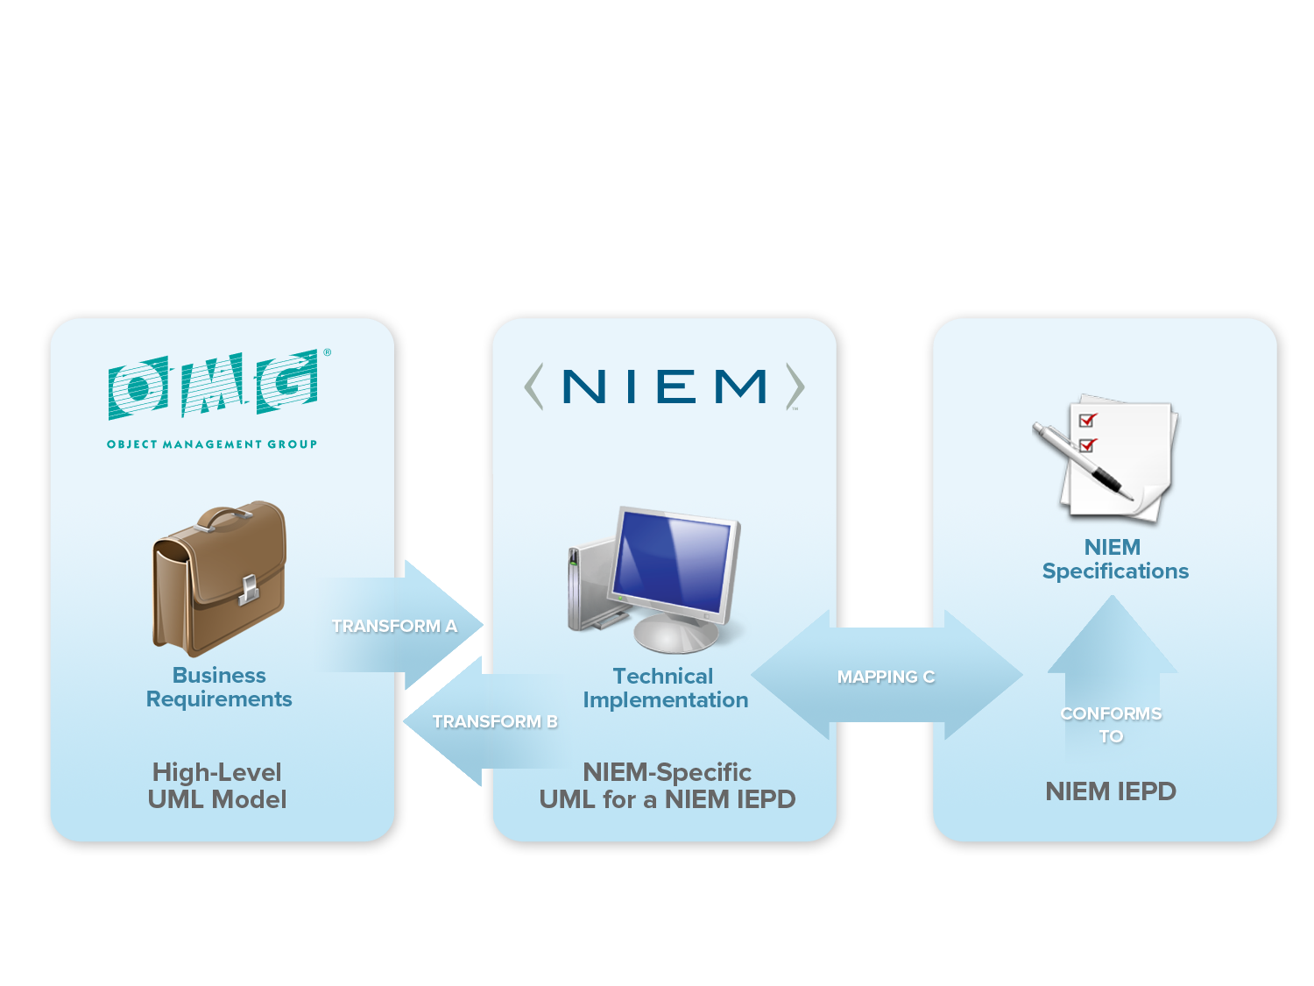
Collaborative Innovation

Slide 9
NIEM-UML Layered Architecture

Slide 10
Platform Independent Model (PIM) Changes

Slide 11

Unified Reference & Content
NIEM-UML-2
UML “AggregationKind” (The symbol at the end of an association) corresponded with the “content” Vs. “Reference” distinction in NIEM-2
NIEM-UML-3
No longer makes this distinction in the schema and uses “structures:ref” for reference – instances decide if and how to aggregate. UML aggregation may be used but has no meaning in NIEM-UML-3. Other possible interpretations can be considered.
By default, aggregation kind of “none” is used
Use of “Reference” suffix should be removed from models (may be automated by tools)
Has no impact on generated schema

Slide 12

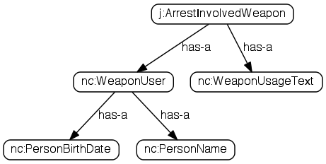
Unified content & reference elements In NIEM-XML
<j:ArrestInvolvedWeapon>
<nc:WeaponUser>
<nc:PersonBirthDate>
<nc:Date>1968-05-14</nc:Date>
</nc:PersonBirthDate>
<nc:PersonName>
<nc:PersonFullName>Mark Moe</nc:PersonFullName>
</nc:PersonName>
</nc:WeaponUser>
<nc:WeaponUsageText>Fired</nc:WeaponUsageText>
</j:ArrestInvolvedWeapon>
CONTENT
<j:ArrestInvolvedWeapon>
<nc:WeaponUser structures:ref="Person1"/>
<nc:WeaponUsageText>Fired</nc:WeaponUsageText>
</j:ArrestInvolvedWeapon>
<nc:Person structures:id="Person1">
<nc:PersonBirthDate>
<nc:Date>1968-05-14</nc:Date>
<nc:PersonName>
<nc:PersonFullName>Mark Moe</nc:PersonFullName>
</nc:PersonName>
</nc:PersonBirthDate>
</nc:Person>
REFERENCE

Slide 13
NIEM-3 Augmentations
NIEM-2
Augmentations augment a class by use of an property in a subclass
NIEM-3
No subclass is required, augmentations augment a class by use of a substitution group head
NIEM-UML-3
<<augments>> is used to augment a type. This generates the member of the substitution group.

Slide 14
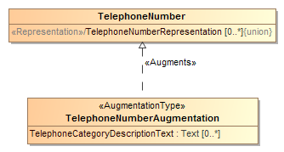
Augmentation Example
Restricted Augmentation of TelephoneNumber
<xsd:element name="TelephoneNumberAugmentation" nillable="false"
substitutionGroup="nc:TelephoneNumberAugmentationPoint " type="tns:TelephoneNumberAugmentationType">
.

Slide 15
Augmentation Details
Use of <<AugmentationType>> is optional when using <<augments>>
An <<AugmentationType>> with no <<Augments>> can augment any type
<<AugmentationApplication>> has been removed.
You do not need to subclass the augmentation to use it – it will implicitly augment the base type and any subtypes
Like the reference models, all NIEM-UML generated object types and association types will generate an augmentation point to allow for future expansion.

Slide 16
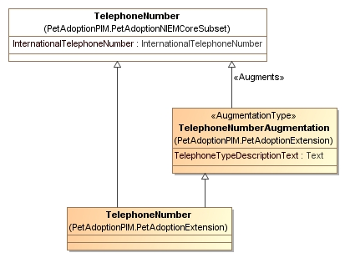
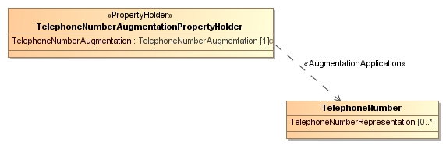
Removed from NIEM-3
Changed to realization
Only needed if there are other extensions
X
X
X

Slide 17
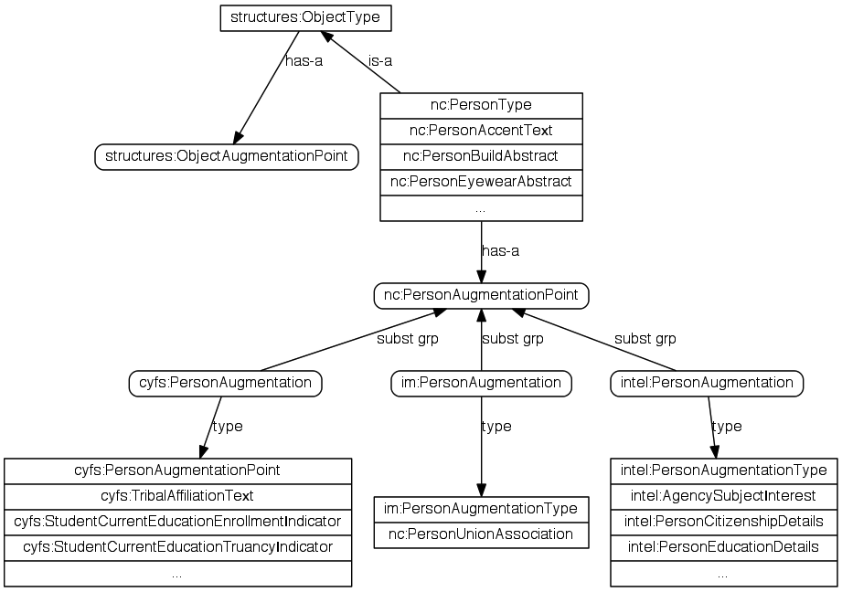
NIEM-XML 3.0 Updated Augmentations
Augmentations are extensions without subclasses
Each object or association type contains an augmentation point element
Augmentation elements are substitutable for the augmentation point

Slide 18

Local Vocabularies
Local vocabularies identify non-dictionary terminology: jargon, acronyms, slang
In NIEM-UML local vocabulary is defined as a stereotype of enumeration where each enumeration literal is a vocabulary term. The enumeration literal’s UML name corresponds with the domain specific abbreviation, the specification corresponds with the expansion of the abbreviation and the UML comment corresponds to the NIEM description. The NIEM sourceURI may also be set by applying the “Source” stereotype to the enumeration literal.
The above defines the abbreviation “CPU” (Expansion and description not shown in notation)

Slide 19
NIEM-XML 3.0 Local vocabulary
Annotations in the schema identify non-dictionary terminology: jargon, acronyms, slang
Removes NDR 1.3 Table 9-1: Abbreviations
Used in Immigration namespace
<term:LocalTerm term="SEVIS"
literal="Student and Exchange Visitor Information
System"/>
<term:LocalTerm term="ICE"
literal="Immigration and Customs Enforcement"/>
<term:LocalTerm term="USCIS"
literal="United States Citizenship and Immigration
Services"/>
ICEEmployeeType
ICEOfficerType
SEVISPersonDependentAssociationType
ICEEmployee
ICEEmployeeAssistantUSAttorneyIndicator
ICEEmployeeAttorneyIndicator
ICEEmployeeAugmentationPoint
ICEEmployeeBadgeIdentification
ICEEmployeeK9Indicator
ICEEmployeePINIdentification
ICEEmployeePayGradeNumeric
ICEEmployeeTitleText

Slide 20
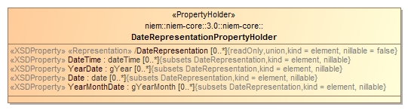
Representation
NIEM-3 representation is used as the typeless head of a substitution group. This impacts the naming convention.
A representation property has no type.
NIEM-UML-3 supplies a stereotype, the naming convention may also be used.
Representation

Slide 21
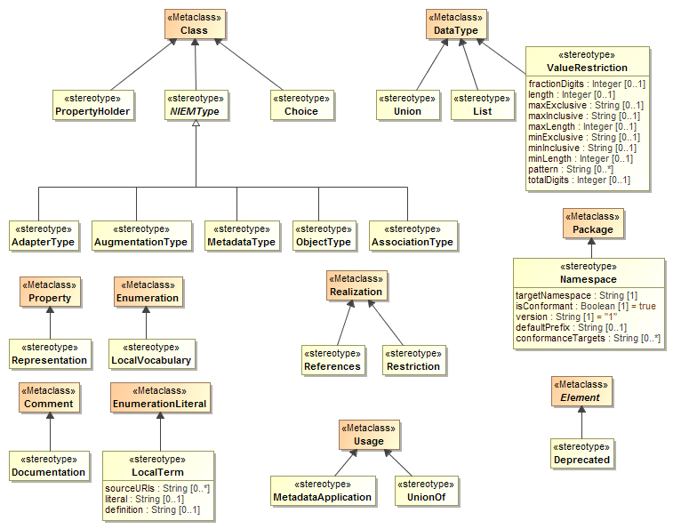
NIEM-UML-3 Common Profile

Slide 22
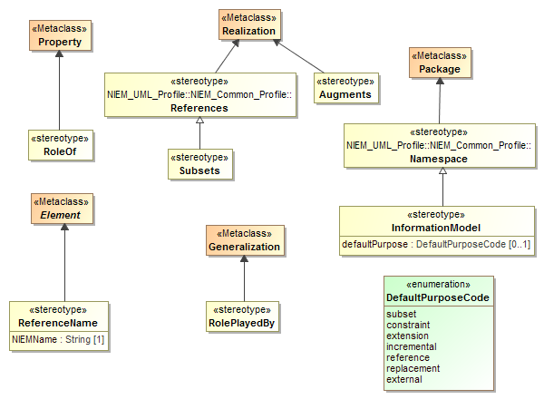
NIEM-UML-3 PIM Profile

Slide 23
Reference model changes
The NIEM reference models have undergone substantial changes.
NIEM-2 reference models may no longer be used
Tools may provide assistance in mapping NIEM-2 to NIEM-3 subset models, however this is not part of the NIEM-UML-3 specification
Not all mappings can be fully automated

Slide 24
NIEM 3.0 Content Updates (changes from 2.1)
Domains
New Domain: Biometrics
Updates: Justice, CBRN, Immigration, Screening, Biometrics, International Trade, Maritime
Family Services (FS) changed its name to Children, Youth, & Family Services (CYFS)
Resolved issues in NIEM Configuration Control Tool (NCCT)
100+ NCCT issues backlogged after NIEM 2.0 and 2.1
~100 issues resolved since the NIEM 3.0 Kickoff in August
Significant object updates: LocationType (refactored), DocumentType, ContactInformation (types and associations), FacilityType, ItemType, BiometricType, Measures and MeasureType.
New code lists: HL7 (religion), GENC, Census-USCounty, occs-facility, DoL-soc (occupations), XCard (v-card XML representation)
Code list updates: FIPS (sunset lists), mmucc, nga-vdatum, ansi-d20
Harmonization: Justice & Biometrics, Immigration & Screening, CBRN & International Trade, Screening & Biometrics, Core & Biometrics

Slide 25
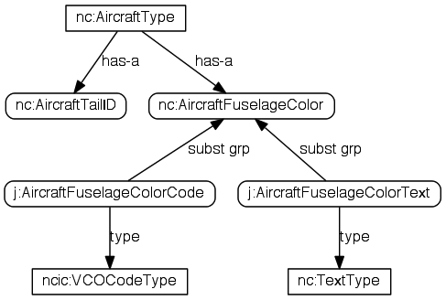
NIEM 3.0 Technical Updates: abstract elements for codes
Code + Text with the same basic meaning
Release defines an abstract, typeless element for each
Code + Text are substituted for the base element

Slide 26
MPD/IEPD Model Changes

Slide 27
MPD Changes Overview
NIEM-3 MPSs and therefor the MPD Profile are substantially different.
Much of the new metadata is captured in “UML Instance specifications”, not stereotype tags. This is due to the complexity of and linking between the metadata elements.
MPD elements are instances of UML Artifacts
Gone are: POC Type, Nature code, purpose code, ModelPackageDescriptionFile, ModelPackageDescriptionRelationship
All moved to instance model

Slide 28
MPD Profile

Slide 29
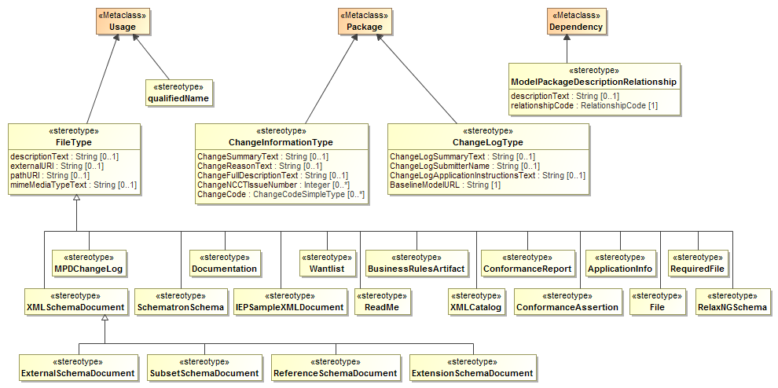
MPD Profile (Cont)

Slide 30
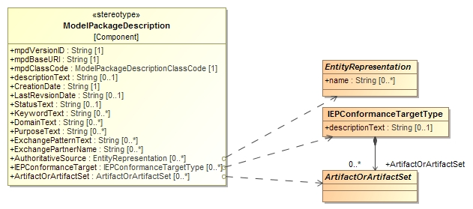
Profile points to class instances
Much of the MPD data is represented as UML instances (instances of classes). The profile elements reference these instances.

Slide 31
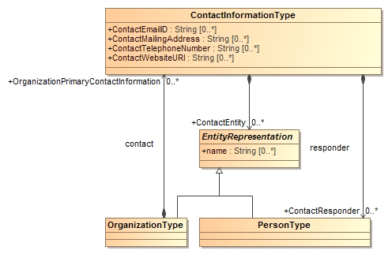
Contact Information Classes

Slide 32
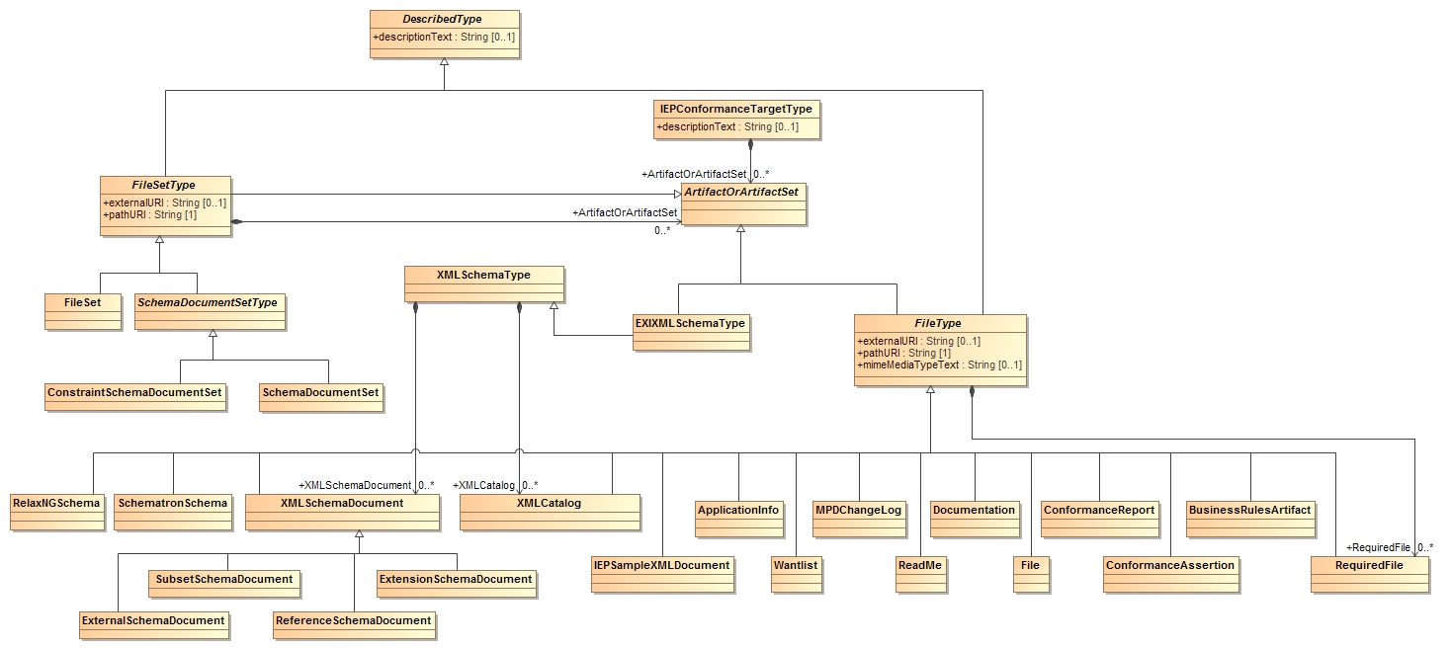
MPD Artifact Classes

Slide 33
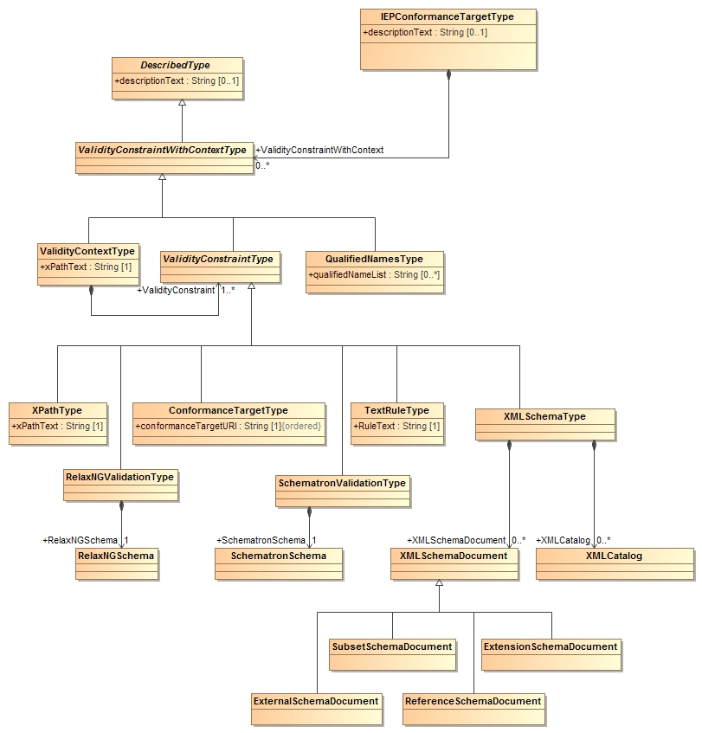
MPD Validity Constraint Classes

Slide 34
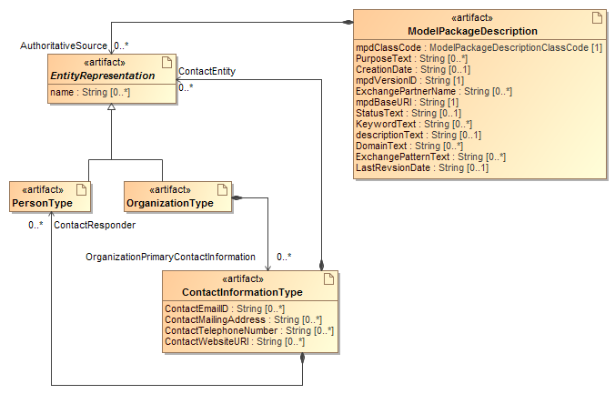
MPD Artifacts

Slide 35
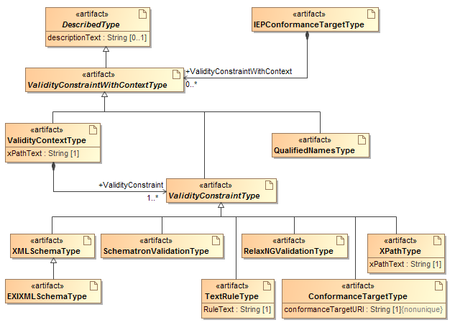
MPD Artifacts (Cont)

Slide 36
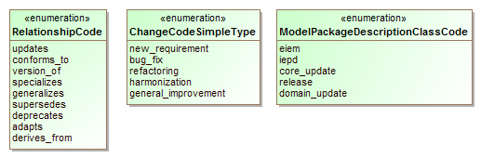
MPD Enumerations

Slide 37
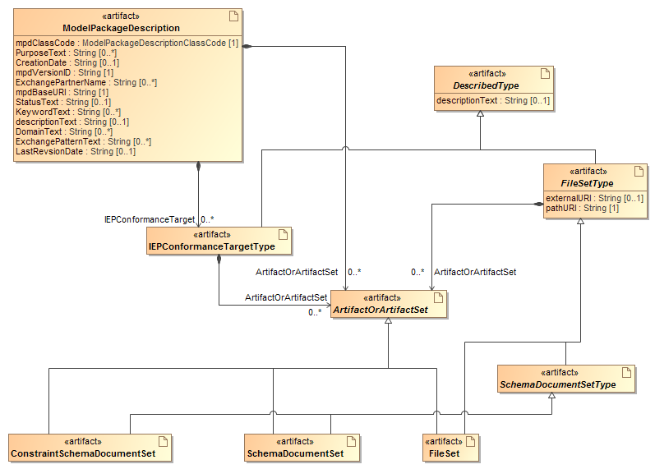
MPD Artifacts (Cont)

Slide 38
Other Specification Changes
All references to NIEM rules updated to NIEM-3
Structured English portion of specification removed as redundant with QVT
Overall improvement in documentation
Still to do
Reference documentation generated from model
High level documentation of revised QVT
Finalize MPD section (not all changes reflected)
Examples with complete metadata

Slide 39
Automated changes
Changes in NIEM-3 that are taken care of by the NIEM-UML tooling

Slide 40
NIEM 3.0 Technical Updates: Simplified structures
NIEM 2.0 | NIEM 3.0
structures:linkMetadata attribute | Replaced with structures:relationshipMetadata attribute
structures:sequenceID | Removed
structures:Augmentation element | Removed
structures:Metadata element | Removed
structures:ComplexObjectType | Replaced with structures:ObjectType and structures:AssociationType
structures Object and Association resources (for appinfo:Base) | Removed; extend from base types
structures:ReferenceType | Removed

Slide 41
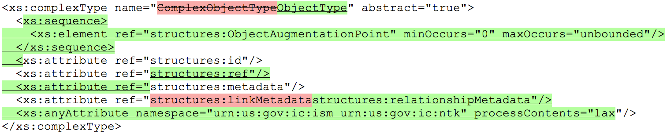
NIEM 3.0 Technical Updates: structures base types
Split ComplexObjectType into ObjectType, AssociationType
Added augmentation point element
Added structures:ref attribute
Renamed linkMetadata to relationshipMetadata
Added attribute wildcard for IC ISM, NTK namespaces

Slide 42
NIEM-XML 3.0 Simplified annotations
NIEM 2.0 | NIEM 3.0
appinfo:ConformantIndicator | Schema: use attribute ct:conformanceTargets. Imports: use attribute appinfo:externalImportIndicator
appinfo:Base | Use the base types structures:ObjectType, structures:AssociationType.
appinfo:ReferenceTarget | Use the element's type attribute.
appinfo:AppliesTo | Augmentations: use the augmentation element's substitutionGroup attribute. Metadata: use attributes appinfo:appliesToTypes, appinfo:appliesToElements.
appinfo:ExternalAdapterTypeIndicator | Use attribute appinfo:externalAdapterTypeIndicator

Slide 43
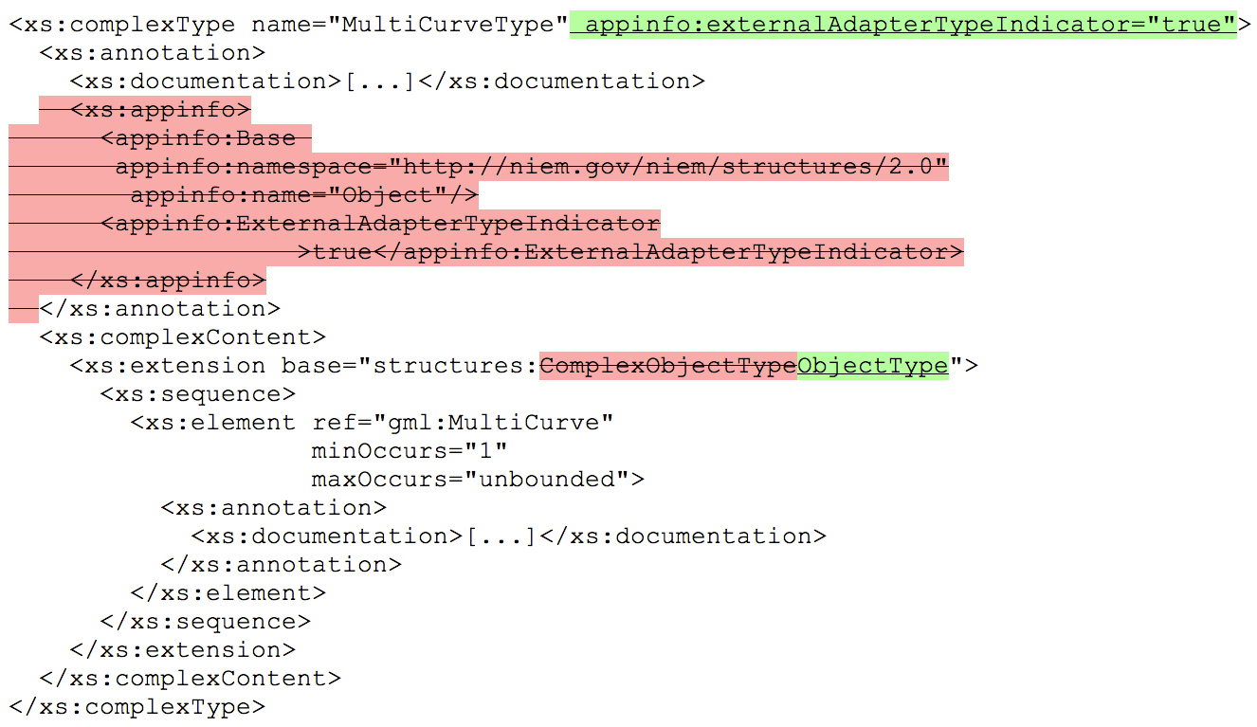
Simplified annotations

Slide 44
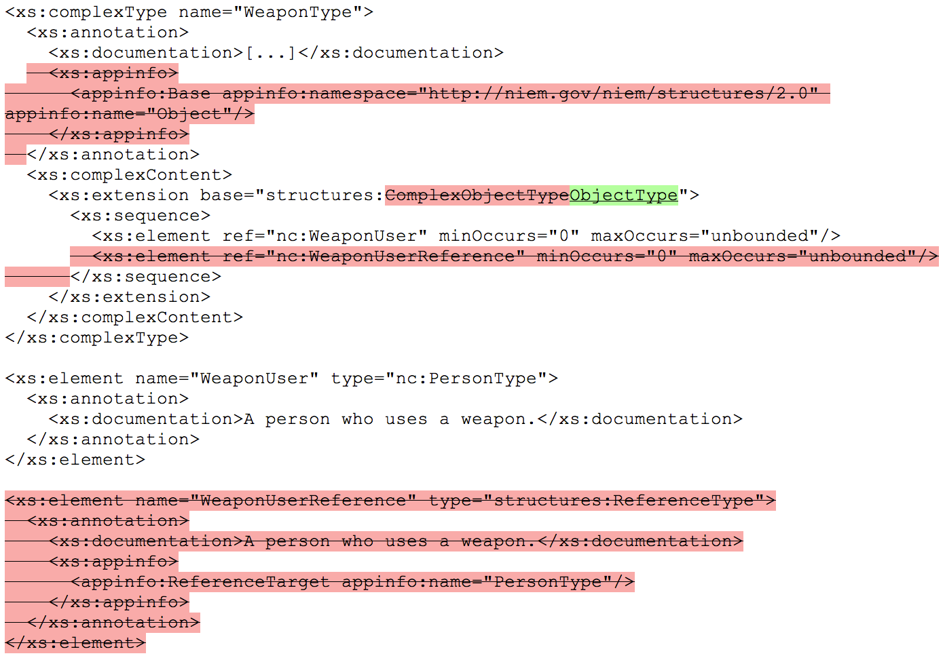
NIEM 3.0 Technical Updates: simplified schemas

Slide 45
Questions and Comments

