Slide 1
Microsoft Movie Studio
One…Two… Three… Action!!
New Business Opportunity
Notes:
To change the image on this slide, select the picture and delete it. Then click the Pictures icon in the placeholder to insert your own image.

Slide 2
Problem Statement.
Microsoft sees all the big companies creating original video content and they want to get in on the fun. They have decided to create a new movie studio, but they don’t know anything about creating movies.
As a potentially new entrant to the market, what type of films are doing the best in the box office?

Slide 3
Objectives
Explore what types of films are currently doing the best at the box office.
Translate those findings into actionable insights that the head of Microsoft's new movie studio can use to help decide what type of films to create.

Slide 4
Number of Movies Released between the years 2010 and 2019

Slide 5
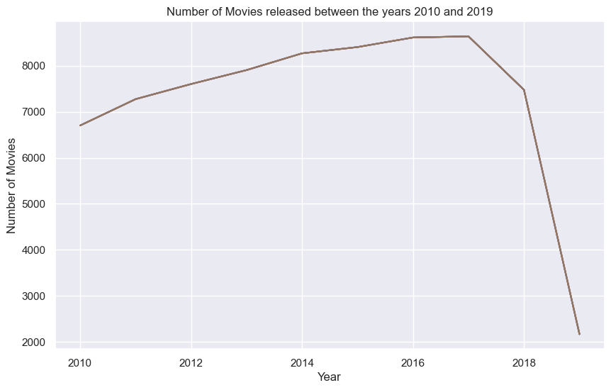
Number of Movies Released between the years 2010 and 2019

Slide 6
Average viewer weighted rating of movies released between year 2010 and 2019.

Slide 7
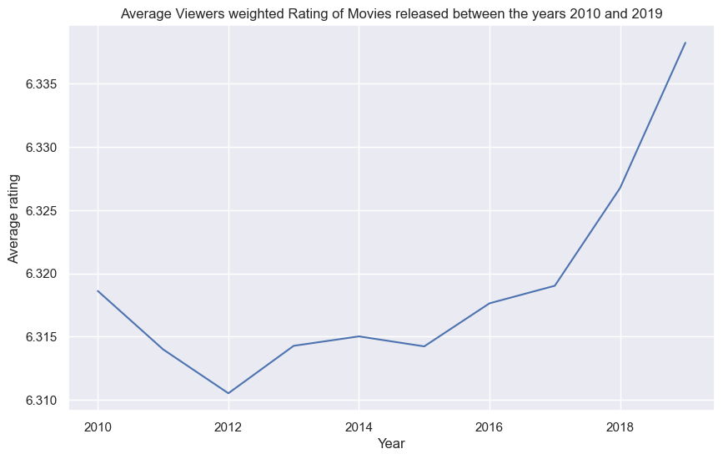
Average viewer weighted rating of movies released between year 2010 and 2019.

Slide 8
Average viewer weighted rating of movies released between year 2010 and 2019.

Slide 9
Top 10 Movie Genres

Slide 10
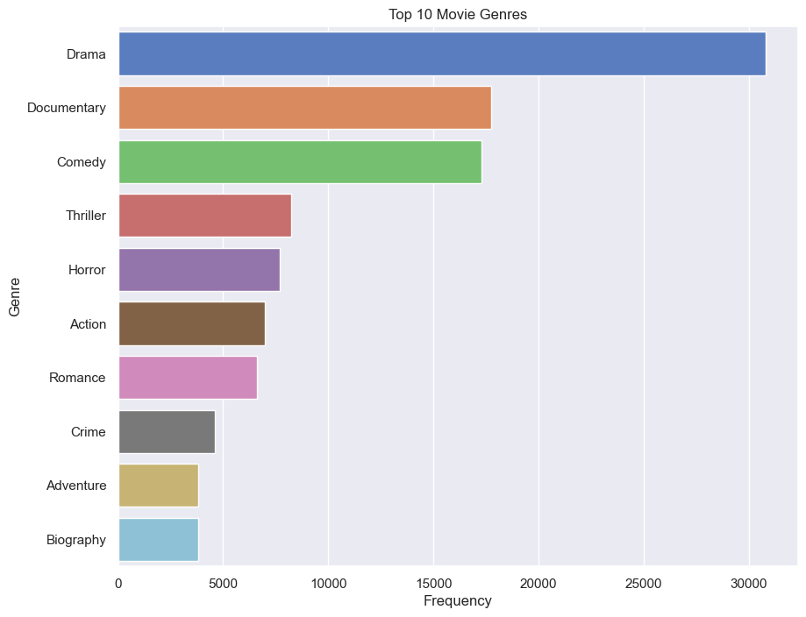
Top 10 Movie Genres

Slide 11
Findings and Recommendations.
1. Most popular genre of movies included Drama, Documentaries, comedy, Thriller and horror movies
2. Most profitable movies genres based on foreign gross income we action and drama
3. Diseases and pandemics can affect the revenues a movie can make upon launch
Based on the above observations, The following are our recommendations:
To build on the popularity on Microsoft's movie studio, Microsoft should initially produce Drama and Documentaries as the then to be popular
Action and Drama themed movies have the greatest potential of making profit for the soon to be established Microsoft Studio
The average length of a movie is 94 minutes

Slide 12
Thank You!

