Slide 1

Pump it Up:
Data Mining the Water Table
Focus on Tanzania
PHASE 3 PROJECT PRESENTATION BY KIMANI J. IRUNGU.

Slide 2
PROBLEM STATEMENT.
The goal of this analysis and model determine which water pumps are faulty and hence enable access to clean water across Tanzania reliably.
OBJECTIVE
The purpose of this analysis is to use classification modeling techniques to accurately predict which water pumps are faulty and allow for stakeholders to repair/replace such and ensure a consistent supply of clean water across Tanzania.

Slide 3
DATA UNDERSTANDING.
The dataset used in this modelling is derived from The dataset used in this modelling is derived from https://www.drivendata.org/competitions/7/pump-it-up-data-mining-the-water-table/page/25/.
The data contain information on water pumps recorded across the country of Tanzania. The Target variable is the status group of a pump given various characteristics of the pump including but not limited to Geographic location, Water quantity, GPS height location and Construction year among other features.
SUCCESS CRITERIA
The objective is to obtain a prediction model that can correctly predict the condition of a water pump by 80% accuracy.

Slide 4
METHODOLOGY
Interpret the results of our model and give insignts
Get a snapshot of the characteristics of our dataset
Get a snapshot of the characteristics of our dataset
Data Loading Merging
Data Understanding
Data Cleaning & Features engineering
Data Visualization
Data Modeling
Observations & conclusions
Merge the labels, test and train sets into a data frame for analysis
Conduct modelling analysis on the data. Regression and Classification models
Create new features from already existing features

Slide 5
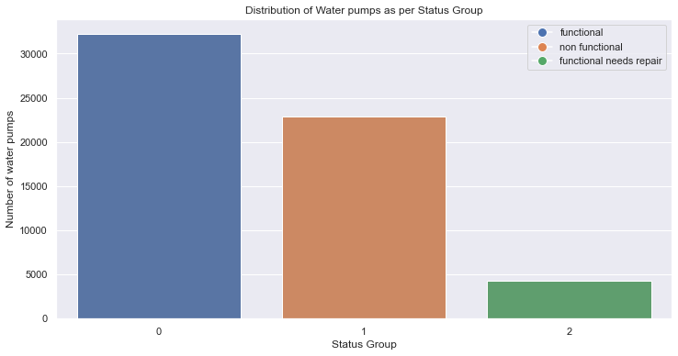
DATA UNDERSTANDING
Total Number of Pumps recorded 59,400
Functional Pumps = 54.3%
Non- functional = 38.4%
Functional need repair = 7.3%

Slide 6
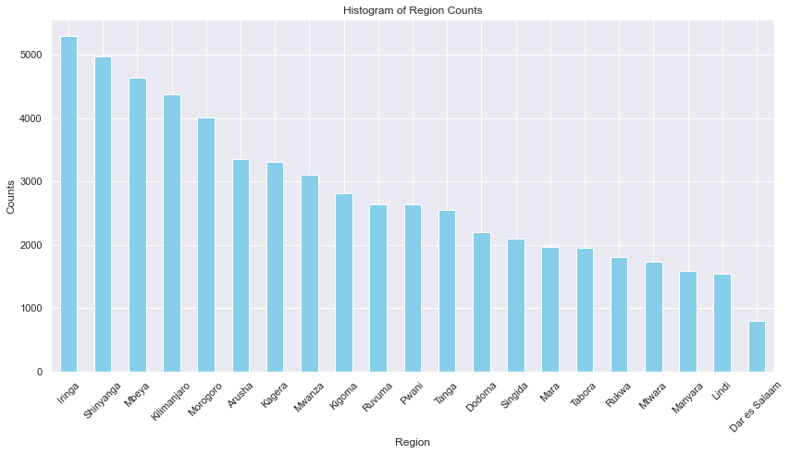
DATA UNDERSTANDING
Distribution of Water Pimps per Region

Slide 7
DATA MODELING.
Multiple linear Regression
OLS Regression Results
==============================================================================
Dep. Variable: status_group R-squared: 0.205
Model: OLS Adj. R-squared: 0.204
Method: Least Squares F-statistic: 139.2
Date: Wed, 22 May 2024 Prob (F-statistic): 0.00
Time: 21:44:33 Log-Likelihood: -49837.
No. Observations: 59400 AIC: 9.990e+04
Df Residuals: 59289 BIC: 1.009e+05
Df Model: 110
Covariance Type: nonrobust
The Feature variables only explain 20% in the variability of our target variable
Further analysis is required to enable us increase the predictive power of our model, using classification models

Slide 8
CLASSIFICATION MODELING RESULTS
A brief history of the accuracy of each model.
Logistic Regression Model
AdaBoost
Accuracy : 0.74
Accuracy : 0.75
Gradient Boosting Model
K-Nearest Neighbors
Accuracy : 0.80
Accuracy : 0.72
Decision Tree Model
Random Forest Model
Accuracy : 0.75
Accuracy : 0.78

Slide 9
CONCLUSION
Overall, The best perfoming classsication model is the Gradient Boosting Model with an accurancy of 80%.
Further, the random forest model performed well with an accuracy of 78%

Slide 10
The End

