Slide 1
Semantic Web Overview
DS / SE 603 Data Modeling

Slide 2
Learning Objectives
Understand the need for semantics on the web
Explain what semantic linking is
Talk about the major technologies involved in Semantic Web

Slide 3
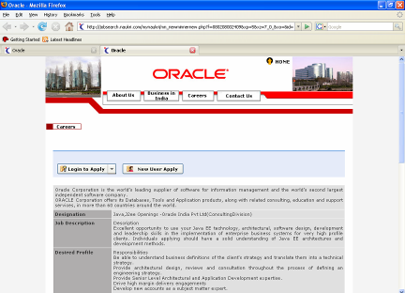
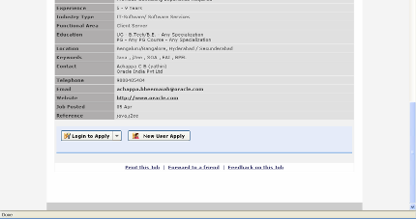
Today’s Web Site
Complex
Business
Processes
Multiple
Data Sources
The Semantic Boundary
Notes:
Websites have evolved in several stages:
Static HTML pages that were hand-coded simply to display some static information about something or someone
Dynamic pages were made possible with some interesting capabilities drawn from javascripts and animations
Web sites became the user interface for enterprise applications that involved multiple databases and complex business processes

Slide 4
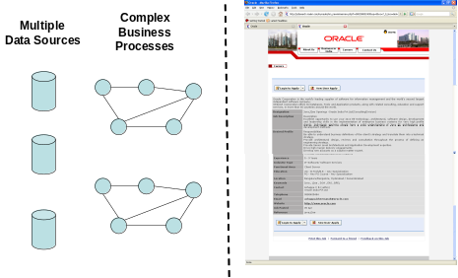
Today’s Web
Notes:
The only relationship between amongst the many web sites today is that one web site contains hyperlinks to other web sites. These relationships (i.e., whether to add a hyperlink between two web sites) are dictated manually by the web site owners.
Even navigation of the hyperlinks in a web site (i.e., whether one clicks on a link or not) is decided manually by the user. Why is it so hard (or so easy some times) to convince a user to click on a particular link?

Slide 5
A Closer Look
<TABLE WIDTH="100%" BORDER="0" ALIGN="center" CELLPADDING="4" CELLSPACING="1" CLASS="jobsTable">
<TR VALIGN="top">
<TD WIDTH="20%" CLASS="jdHead">Designation</TD>
<TD VALIGN="top" CLASS="detailJob"> Java,J2ee Openings -Oracle India Pvt Ltd(ConsultingDivision) </TD>
</TR>
<TR VALIGN="top">
<TD CLASS="jdHead">Job Description</TD>
<TD VALIGN="top" CLASS="detailJob"> Description<br />
Excellent opportunity to use your Java EE technology, architectural, software design, development and leadership skills in the implementation of enterprise business systems for very high profile clients. Individuals applying should have a solid understanding of Java EE architectures and development methods.
</TR>
<TR VALIGN="top">
<TD CLASS="jdHead">Desired Profile </TD>
<TD VALIGN="top" CLASS="detailJob"> Responsibilities<br />
Be able to understand business definitions of the client's strategy and translate them into a technical strategy.<br />

Slide 6
What is the problem?
The semantics of a web page are buried inside the HTML syntax
  <TD WIDTH="20%" CLASS="jdHead">Designation</TD>
  <TD CLASS="jdHead">Job Description</TD>
  <TD CLASS="jdHead">Desired Profile </TD>
This problem impacts both producers and consumers of information
The goal is to represent information in such a way that the semantics are understood by the machine
So what?
How?
So what?

Slide 7
Example: Smart Classifieds
Challenge #1: How do you bring sellers and prospective buyers together
AUTOMATICALLY?
I want to sell
I want to buy
Seller name
Product
Price
Buyer name
Product
Max. Price
Quantity
Newspaper #1
Newspaper #1
Seller name
Product
Price
How?
Buyer name
Product
Max. Price
Quantity
Newspaper #1
Newspaper #1

Slide 8
Example: Smart Classifieds
Challenge #2: How do you bring together buyers and sellers across the system boundaries?
I want to sell
I want to buy
Seller name
Product
Price
Buyer name
Product
Max. Price
Quantity
Newspaper #1
Newspaper #1
Seller name
Product
Price
How?
Buyer name
Product
Max. Price
Quantity
Newspaper #1
How?
Seller name
Product
Price
Newspaper #3
Newspaper #2

Slide 9
What is the problem?
The semantics of a web page are buried inside the HTML syntax
  <TD WIDTH="20%" CLASS="jdHead">Seller name</TD>
  <TD CLASS="jdHead">Product</TD>
  <TD CLASS="jdHead">Price </TD>
How does one web site know what information is present in the other website?
This is the semantic linking problem

Slide 10
Possible Solutions - 1
Option 1: Collaboration between sites
Exchange of data files
SOAP-based web services
Issues
  Business terms of the partnership?
  All challenges associated with B2B integration
  How many collaborations? (Combinatorial explosion)

Slide 11
Possible Solutions - 2
Option 2: Screen Scraping
Directly access the HTML output by sending HTTP requests
Parse and extract semantic information by parsing the HTML
Issues
  What if the site changes the HTML?
  How many HTML formats will be parsed (combinatorial explosion)

Slide 12
Some Smarter Solutions
HTML Meta Tags
RSS

Slide 13
HTML Meta Tag
They are content stored within the <head> tag of HTML
Comprised of standard name/value pairs for “description”, “keywords”, “last-modified”, etc.
Additional custom tags can be added to share more semantics about the site
Issues for our problem: All issues (except format-dependency) associated with screen scraping are applicable

Slide 14
RSS

Slide 15
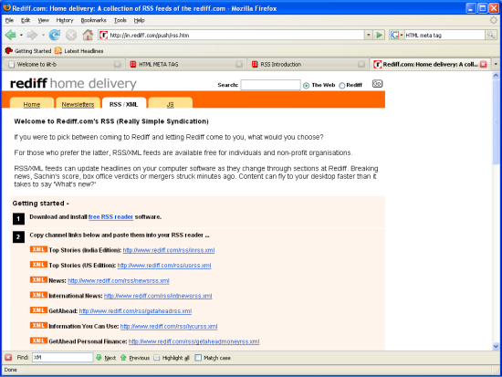
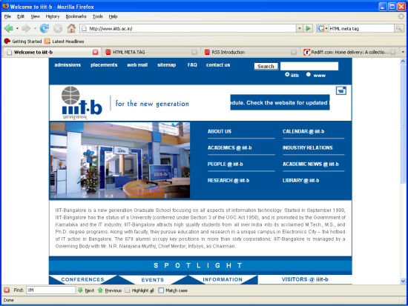
RSS – Really Simple Syndication
RSS Feed
RSS Reader
RSS Feed
RSS Feed

Slide 16
RSS Feed Structure
<?xml version="1.0" encoding="ISO-8859-1" ?>
<rss version="2.0">
<channel>
<title>All items for sale</title>
<link>http://www.portal-1.com</link>
<description>Free classifieds</description>
<item>
<title>Stereo for sale</title>
<link>http://www.portal-1.com/classifieds/item1293</link>
<description>Mini stereo system for sale</description>
</item>
<item>
<title>iPod for sale</title>
<link>http://www.portal-1.com/classifieds/item1898</link>
<description>iPod with 2GB memory for sale </description>
</item>
</channel>
</rss>
Two main elements:
Channel*
Item*

Slide 17
Exercise
Think of creative ways of solving our problem with RSS

Slide 18
Possible Solution using RSS
Encode every classified ad pertaining to sale into a “channel”
Encode meta-data about the product (product name, price, etc.) as name/value pairs in “item”
  Use Item→Title for name
  Use Item→Description for the value

Slide 19
Issues
Channel explosion
  One channel for each ad
Semantics are still buried (but at least we know where to look for)
  We still need to rely on generic text fields such as “Title” and “Description” for extracting product name, price, etc.
How do you ensure there is cross-site homogeneity in the way the information is sent?

Slide 20
Semantic Web Technologies

Slide 21
So, what IS Semantic Web?
Extension of existing Web technology
Support for data sharing (as opposed to information sharing supported by html documents)
Every web site turns into a database so that we can go beyond text-based search
So the vision is to turn the web into a huge database!

Slide 22
Technologies
A set of new technologies are being developed to help establish the Semantic Web
Key concepts:
  RDF (Resource Description Framework)
    RDF/XML, N3, Turtle etc.
  Web Ontologies
    OWL

Slide 23
URI
URI stands for Uniform Resource Identifier
Helps uniquely identify resources
  Website
  Products
  People
  Just about anything!

Slide 24
RDF
RDF stands for Resource Description Framework
It is essentially a new format for representing data
RDF statements are TRIPLETS
  Subject
  Predicate
  Object

Slide 25
Examples
John wants to sell Harry Potter
Harry Potter costs Rs. 400
JK Rowling wrote the book Harry Potter
RDF N-Triples
John | sell | Harry Potter
Harry Potter | price | 200
JK Rowling | authored | Harry Potter

Slide 26
RDF-view of a Relation
Seller_Classifieds
Classified_Key | Seller_Name | Seller_Product | Seller_Price
1001 | John | Harry Potter | 200
1002 | Jane | Harry Potter | 150
RDF N-Triples
<primaryKey> <column_name> "field value"
1001 | type | Seller_Classifieds
1001 | Seller_name | John
1001 | Seller_Product | Harry Potter
1001 | Seller_Price | 200
1002 | Seller_name | Jane
1002 | Seller_Product | Harry Potter
1002 | Seller_Price | 150

Slide 27
RDF-view of a Relation
Buyer_Classifieds
Classified_Key | Buyer_Name | Buyer_Product | Max_Price
5001 | Jim | Harry Potter | 225
5002 | Jill | Harry Potter | 100
RDF N-Triples
<primaryKey> <column_name> "field value"
5001 | type | Buyer_Classifieds
5001 | Buyer_name | Jim
5001 | Buyer_Product | Harry Potter
5001 | Max_Price | 225
5002 | Buyer_name | Jill
5002 | Buyer_Product | Harry Potter
5002 | Max_Price | 100

Slide 28
How does it help?
A web-site can send the same “query” to multiple RDF-enabled websites
  Find me all potential buyers of the book Harry Potter
  Find me all sellers who can sell the book Harry Potter within my price range
This allows websites to be semantically linked together
This is “active linking” as opposed “passive linking” using static hyperlinks

Slide 29
An issue
How can we ensure that the RDF data is comparable across the web?
  “Harry Potter” versus “harry potter”?
  “Max_Price” versus “Maximum price”?
URIs to the rescue
  “Harry Potter” →http://www.myclassifieds.com/book/harryPotter
  “Maximum Price” → http://www.myclassfieds.com/price/max_price

Slide 30
RDF and URI’s
The Subject and Predicate of the RDF statement should be URIs
The Object can be a URI or a normal value
5001 | Buyer_Product | Harry Potter
http://www.myclassifieds.com/buyer_classifieds/5001
http://www.myclassifieds.com/buyer/attribute/buyer_product
http://www.myclassifieds.com/book/harryPotter

Slide 31
RDF Examples
Reference: http://www.w3.org/TR/rdf-primer

Slide 32
A simple example
Someone named John Smith created a particular Web page
http://www.example.org/index.html has a creator whose value is John Smith
the RDF terms for the various parts of the statement are:
  the subject is the URL http://www.example.org/index.html
  the predicate is the word "creator"
  the object is the phrase "John Smith"

Slide 33
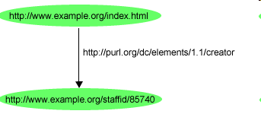
RDF graph example
SUBJECT
PREDICATE
OBJECT

Slide 34
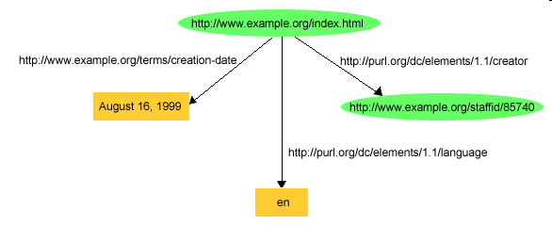
RDF graph example
http://www.example.org/index.html has a creation-date whose value is August 16, 1999
http://www.example.org/index.html has a language whose value is English

Slide 35
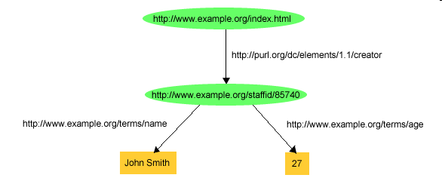
RDF graph example
The following RDF graph shows some additional statements giving John's name and age
Note: Predicates are URI too!

Slide 36
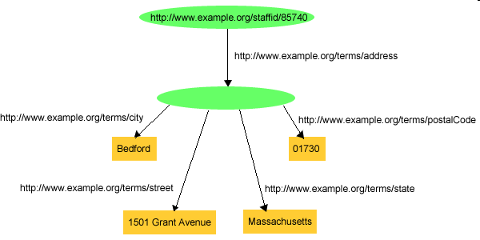
Using blank nodes for aggregation
Suppose John's address needed to be recorded as a structure consisting of separate street, city, state, and postal code values?

Slide 37
RDF Serialization
RDF graph is an abstract data structure
We have to serialize it in order to make it machine readable
Several RDF serialization options available
  RDF/XML
  Turtle

Slide 38
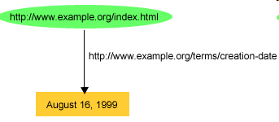
RDF/XML Example
1. <?xml version="1.0"?>
2. <rdf:RDF xmlns:rdf="http://www.w3.org/1999/02/22-rdf-syntax-ns#"
3. xmlns:exterms="http://www.example.org/terms/">
4. <rdf:Description rdf:about="http://www.example.org/index.html">
5. <exterms:creation-date>August 16, 1999</exterms:creation-date>
6. </rdf:Description>
7. </rdf:RDF>

Slide 39
Multiple statements about same resource
1. <?xml version="1.0"?>
2. <rdf:RDF xmlns:rdf="http://www.w3.org/1999/02/22-rdf-syntax-ns#"
3. xmlns:dc="http://purl.org/dc/elements/1.1/"
4. xmlns:exterms="http://www.example.org/terms/">
5. <rdf:Description rdf:about="http://www.example.org/index.html">
6. <exterms:creation-date>August 16, 1999</exterms:creation-date>
7. <dc:language>en</dc:language>
8. <dc:creator rdf:resource="http://www.example.org/staffid/85740"/>
9. </rdf:Description>
10. </rdf:RDF>

Slide 40
RDF Containers
RDF Containers can be used for describing groups of things
RDF Container Vocabulary
  rdf:Bag
  rdf:Seq
  rdf:Alt

Slide 41
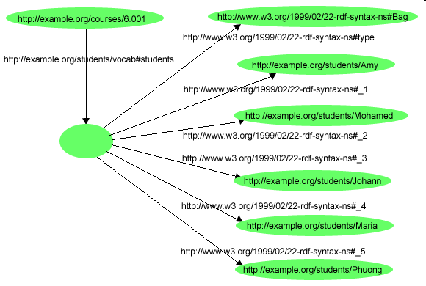
RDF Bag Container Example

Slide 42
RDF Bag Container Example
<?xml version="1.0"?>
<rdf:RDF xmlns:rdf="http://www.w3.org/1999/02/22-rdf-syntax-ns#"
xmlns:s="http://example.org/students/vocab#">
<rdf:Description rdf:about="http://example.org/courses/6.001">
<s:students>
<rdf:Bag>
<rdf:li rdf:resource="http://example.org/students/Amy"/>
<rdf:li rdf:resource="http://example.org/students/Mohamed"/>
<rdf:li rdf:resource="http://example.org/students/Johann"/>
<rdf:li rdf:resource="http://example.org/students/Maria"/>
<rdf:li rdf:resource="http://example.org/students/Phuong"/>
</rdf:Bag>
</s:students>
</rdf:Description>
</rdf:RDF>

Slide 43
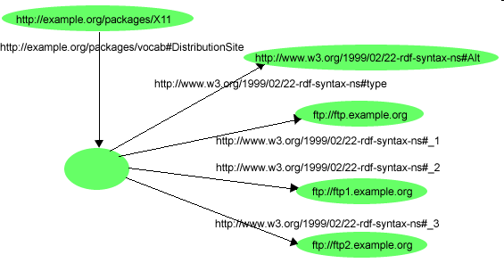
RDF Alt Container Example

Slide 44
RDF Alt Container Example
<?xml version="1.0"?>
<rdf:RDF xmlns:rdf="http://www.w3.org/1999/02/22-rdf-syntax-ns#"
xmlns:s="http://example.org/packages/vocab#">
<rdf:Description rdf:about="http://example.org/packages/X11">
<s:DistributionSite>
<rdf:Alt>
<rdf:li rdf:resource="ftp://ftp.example.org"/>
<rdf:li rdf:resource="ftp://ftp1.example.org"/>
<rdf:li rdf:resource="ftp://ftp2.example.org"/>
</rdf:Alt>
</s:DistributionSite>
</rdf:Description>
</rdf:RDF>

Slide 45
RDF Collections
A limitation of the containers is that there is no way to close them, i.e., to say "these are all the members of the container".
Containers does not say that other members do not exist. Also, while one graph may describe some of the members, there is no way to exclude the possibility that there is another graph somewhere that describes additional members.
RDF provides support for describing groups containing only the specified members, in the form of RDF collections.
An RDF collection is a group of things represented as a list structure in the RDF graph.

Slide 46
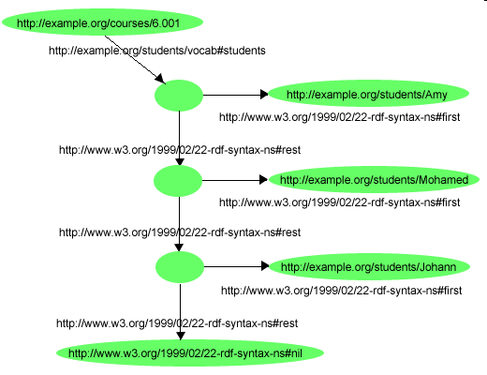
RDF Collections Example

Slide 47
RDF Collection Example
<?xml version="1.0"?>
<rdf:RDF xmlns:rdf="http://www.w3.org/1999/02/22-rdf-syntax-ns#"
xmlns:s="http://example.org/students/vocab#">
<rdf:Description rdf:about="http://example.org/courses/6.001">
<s:students rdf:parseType="Collection">
<rdf:Description rdf:about="http://example.org/students/Amy"/>
<rdf:Description rdf:about="http://example.org/students/Mohamed"/>
<rdf:Description rdf:about="http://example.org/students/Johann"/>
</s:students>
</rdf:Description>
</rdf:RDF>

Slide 48
A pending issue!
How do we ensure everyone uses the same URI when referring to a specific data element (e.g., “Harry Potter”)?
Schemas and Ontologies to the rescue!

Slide 49
Ontologies
“An ontology is a specification of a conceptualization”*
Ontologies specify the terms, vocabularies and relationships in a particular domain
Once specified, they can be realized in a variety of forms such as XML Schemas
* http://www-ksl.stanford.edu/kst/what-is-an-ontology.html

Slide 50
RDFS – RDF Schema

Slide 51
Need for a schema
RDF provides a way to express simple statements about resources, using named properties and values
However, RDF user communities also need the ability to define the vocabularies (terms) they intend to use in those statements

Slide 52
What is RDFS
RDFS provides the facilities needed to describe classes and properties,
Can indicate which classes and properties are expected to be used together
  for example, to say that the property ex3:jobTitle will be used in describing a ex3:Person).
In other words, RDF Schema provides a type system for RDF.

Slide 53
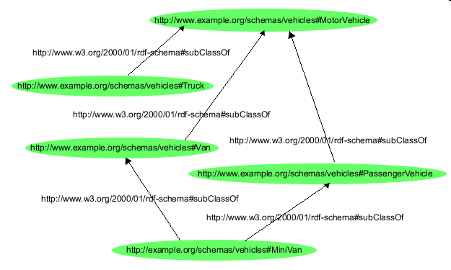
Example RDFS Class Hierarchy

Slide 54
Vehicle Hierarchy in RDF/XML
<?xml version="1.0"?>
<!DOCTYPE rdf:RDF [<!ENTITY xsd "http://www.w3.org/2001/XMLSchema#">]>
<rdf:RDF
xmlns:rdf="http://www.w3.org/1999/02/22-rdf-syntax-ns#"
xmlns:rdfs="http://www.w3.org/2000/01/rdf-schema#"
xml:base="http://example.org/schemas/vehicles">
<rdf:Description rdf:ID="MotorVehicle">
<rdf:type rdf:resource="http://www.w3.org/2000/01/rdf-schema#Class"/>
</rdf:Description>
<rdf:Description rdf:ID="PassengerVehicle">
<rdf:type rdf:resource="http://www.w3.org/2000/01/rdf-schema#Class"/>
<rdfs:subClassOf rdf:resource="#MotorVehicle"/>
</rdf:Description>
<rdf:Description rdf:ID="Truck">
<rdf:type rdf:resource="http://www.w3.org/2000/01/rdf-schema#Class"/>
<rdfs:subClassOf rdf:resource="#MotorVehicle"/>
</rdf:Description>
<rdf:Description rdf:ID="Van">
<rdf:type rdf:resource="http://www.w3.org/2000/01/rdf-schema#Class"/>
<rdfs:subClassOf rdf:resource="#MotorVehicle"/>
</rdf:Description>
<rdf:Description rdf:ID="MiniVan">
<rdf:type rdf:resource="http://www.w3.org/2000/01/rdf-schema#Class"/>
<rdfs:subClassOf rdf:resource="#Van"/>
<rdfs:subClassOf rdf:resource="#PassengerVehicle"/>
</rdf:Description>
</rdf:RDF>

Slide 55
RDFS Properties
We need to be able to describe specific properties that characterize those classes of things
In RDF Schema, properties are described using:
  rdf:Property
  rdfs:domain, rdfs:range, and rdfs:subPropertyOf.

Slide 56
RDFS Property Example
<rdf:Property rdf:ID="registeredTo">
<rdfs:domain rdf:resource="#MotorVehicle"/>
<rdfs:range rdf:resource="#Person"/>
</rdf:Property>
<rdf:Property rdf:ID="rearSeatLegRoom">
<rdfs:domain rdf:resource="#PassengerVehicle"/>
<rdfs:range rdf:resource="&xsd;integer"/>
</rdf:Property>
<rdfs:Class rdf:ID="Person"/>
<rdfs:Datatype rdf:about="&xsd;integer"/>

Slide 57
A sample instance
<rdf:RDF>
<ex:PassengerVehicle rdf:ID="johnSmithsCar">
<ex:registeredTo rdf:resource="http://www.example.org/staffid/85740"/>
<ex:rearSeatLegRoom
rdf:datatype="&xsd;integer">127</ex:rearSeatLegRoom>
<ex:primaryDriver rdf:resource="http://www.example.org/staffid/85740"/>
</ex:PassengerVehicle>
</rdf:RDF>

Slide 58
RDF Vocabularies

Slide 59
Dublin Core Metadata Initiative
The Dublin Core is a set of "elements" (properties) for describing documents (and hence, for recording metadata).
The element set was originally developed at the March 1995 Metadata Workshop in Dublin, Ohio.

Slide 60
Dublin Core Properties
Title: A name given to the resource.
Creator: An entity primarily responsible for making the content of the resource.
Subject: The topic of the content of the resource.
Description: An account of the content of the resource.
Publisher: An entity responsible for making the resource available
Contributor: An entity responsible for making contributions to the content of the resource.
Date: A date associated with an event in the life cycle of the resource.
Type: The nature or genre of the content of the resource.
Format: The physical or digital manifestation of the resource.
Identifier: An unambiguous reference to the resource within a given context.
Source: A reference to a resource from which the present resource is derived.
Language: A language of the intellectual content of the resource.
Relation: A reference to a related resource.
Coverage: The extent or scope of the content of the resource.
Rights: Information about rights held in and over the resource.

Slide 61
A Web Page Described using Dublin Core Properties
<rdf:RDF
xmlns:rdf="http://www.w3.org/1999/02/22-rdf-syntax-ns#"
xmlns:dc="http://purl.org/dc/elements/1.1/">
<rdf:Description rdf:about="http://www.dlib.org">
<dc:title>D-Lib Program - Research in Digital Libraries</dc:title>
<dc:description>The D-Lib program supports the community of people
with research interests in digital libraries and electronic
publishing.</dc:description>
<dc:publisher>Corporation For National Research Initiatives</dc:publisher>
<dc:date>1995-01-07</dc:date>
<dc:subject>
<rdf:Bag>
<rdf:li>Research; statistical methods</rdf:li>
<rdf:li>Education, research, related topics</rdf:li>
<rdf:li>Library use Studies</rdf:li>
</rdf:Bag>
</dc:subject>
<dc:type>World Wide Web Home Page</dc:type>
<dc:format>text/html</dc:format>
<dc:language>en</dc:language>
</rdf:Description>
</rdf:RDF>

Slide 62
PRISM
PRISM: Publishing Requirements for Industry Standard Metadata [PRISM] is a metadata specification developed in the publishing industry.
Magazine publishers and their vendors formed the PRISM Working Group to identify the industry's needs for metadata and define a specification to meet them.

Slide 63
PRISM Description of a Photograph
<?xml version="1.0" encoding="UTF-8"?>
<rdf:RDF xmlns:rdf="http://www.w3.org/1999/02/22-rdf-syntax-ns#"
xmlns:dc="http://purl.org/dc/elements/1.1/"
xml:lang="en-US">
<rdf:Description rdf:about="http://travel.example.com/2000/08/Corfu.jpg">
<dc:title>Walking on the Beach in Corfu</dc:title>
<dc:description>Photograph taken at 6:00 am on Corfu with two models
</dc:description>
<dc:creator>John Peterson</dc:creator>
<dc:contributor>Sally Smith, lighting</dc:contributor>
<dc:format>image/jpeg</dc:format>
</rdf:Description>
</rdf:RDF>

Slide 64
Other RDF Vocabularies
Gene Ontology Consortium
  provides controlled vocabularies to describe specific aspects of gene products
Describing Device Capabilities and User Preferences
  encode content delivery context - the device's capabilities, the user's preferences, the network characteristics, etc. - in such a way that a server can use the context to customize content for the device and user

Slide 65
Review of Learning Objectives
Understand the need for semantics on the web
  We saw an example of how to bring buyers and sellers together without tight coupling between the sites
Explain what semantic linking is
  We saw how HTML meta tags and RSS can help add some level of semantic linking
Talk about the major technologies involved
  We talked about RDF structure, the role of URIs, the need for ontologies

