Slide 1
Semantic Web Frameworks
DS / SE 603 Data Modeling
Reference: Chapter 5 Semantic Web Programming by Hebeler et al.

Slide 2
Outline
Key elements of semantic web frameworks
Storing RDF
Retrieving RDF
Reasoning / Inferencing

Slide 3
Semantic Web Framework
STORAGE
INFERENCE
ACCESS

Slide 4
Storing RDF

Slide 5
RDF Stores
RDF stores persist the serialized RDF statements in an RDF graph
RDF stores can leverage existing model such as relational databases
RDF stores can use native storage facilities

Slide 6
Relational RDF store
Table: TRIPLES
ID | SubjectID | PredicateID | ObjectID | IsExplicit
Table: RESOURCES
ID | Namespace | Localname
Serves as master list of all possible resources
These can be used in any of the ids as foreign key in TRIPLES
Based on MySQL-based RDF triple store included in Sesame framework

Slide 7
Graph model-based stores
Any graph store can be used efficient storage/retrieval of RDF graphs
Similar to persistence of object graphs
Traditional graph representation techniques can be used too
  Edge lists, Adjacency lists

Slide 8
Accessing RDF

Slide 9
Accessing RDF stores
Browsing interface
API-based interface
SPARQL

Slide 10
RDF browsers
Can see RDF information on the browser
Information is displayed in linked form to help navigate from resource to resource

Slide 11
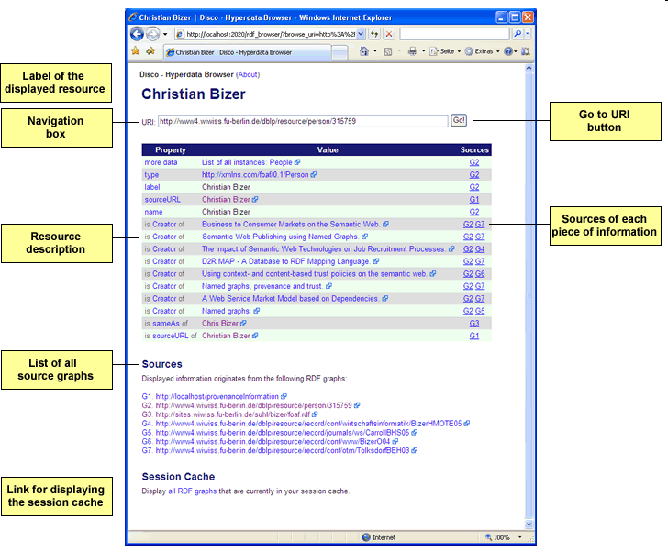
Disco - Hyperdata Browser

Slide 12
SPARQL
Tutorial
www.cambridgesemantics.com/2008/09/sparql-by-example/

Slide 13
Inferencing

Slide 14
Terminology
The terms “fact” and “knowledgebase” borrowed from the field of AI
Fact
  Refers to something that is known
  This is synonymous with the term “statement” used in semantic web
Knowledge base
  Collection of facts
  This is synonymous to RDF store in semantic web

Slide 15
Types of Facts
Explicit facts
  Those that are directly asserted in the knowledge base (repository)
Implicit facts
  Those that are derived from explicit facts
  Also referred to as “entailments”

Slide 16
What is Inferencing
Statements
Truths
Rules
Inferencing Engine
Entailments

Slide 17
Rules
Rule structure
  IF <antecedent>
  THEN <consequent>
Rule constructs
  Conjunctive rules
  Disjunctive rules
  Negations
  Etc.

Slide 18
Rule Example - 1
[IF]
?class1 ?fds:subClassOf ?class2
AND
?instance rdf:type ?class2
[THEN]
?instance ?rdf:type ?class2

Slide 19
Rule Example - 2
[IF]
?class2 ?fds:subClassOf ?class1
AND
?class3 ?fds:subClassOf ?class2
[THEN]
?class3 ?fds:subClassOf ?class1

Slide 20
Rule-based Inferencing
Forward Chaining
Backward Chaining

Slide 21
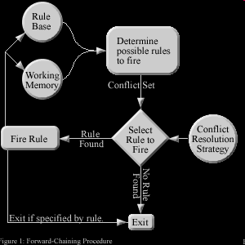
Forward Chaining
All entailments are asserted directly to the knowledge base
When new facts are added to the repository, the entailments are immediately added too
Notes:
http://ai-depot.com/Tutorial/RuleBased-Methods.html

Slide 22
Example Forward Chaining
ADDING A FACT
IF ?x dog
THEN ?x canine
IF ?x canine
THEN ?x animal
IF ?x animal
THEN ?x hasLife
Pluto dog
ENTAILMENTS
Pluto canine
Pluto animal
Pluto hasLife
Pluto hasLife – TRUE or FALSE?

Slide 23
Implications of Forward Chaining
The knowledge base contains both explicit as well implicit facts
Query processor need not distinguish between explicit and implicit facts… it sees all of it as just facts
No inferencing needed at the time of query processing
Knowledge base size can keep growing
Checking of facts is fast but adding/removal of facts can be slow
So what?
Why?

Slide 24
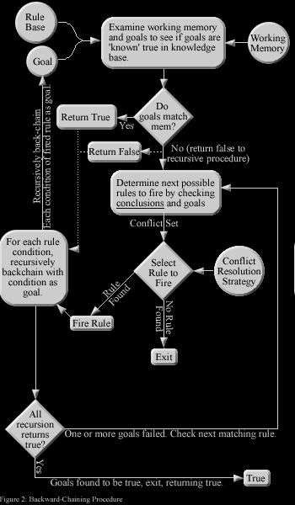
Backward Chaining
Goal-based reasoning
Only minimum number of rules get fired depending upon the goal
Notes:
http://ai-depot.com/Tutorial/RuleBased-Methods.html

Slide 25
Example Backward Chaining
FACT
Pluto dog
IF ?x dog
THEN ?x canine
IF ?x canine
THEN ?x animal
IF ?x animal
THEN ?x hasLife
Pluto hasLife – TRUE or FALSE?
RECURSIVE QUESTIONS
Pluto animal (T or F?)
Pluto canine (T or F?)
Pluto dog (T or F?)

Slide 26
Implications of Backward Chaining
The knowledge base contains only explicit facts
Query processor will be able to respond to only queries based on explicit facts
Inferencing is needed at the time of query processing to check implicit facts
Knowledge base size is minimal
Checking of facts can be slow
So what?
Why?

Slide 27
Framework Summary
Semantic Web Framework has three main components
  RDF stores
  RDF access mechanisms (API, SPARQL)
  Inferencing

Slide 28
JENA Programming API
References
https://jena.apache.org/index.html

Slide 29
About Jena
A free and open source Java framework for building Semantic Web and Linked Data applications.

Slide 30
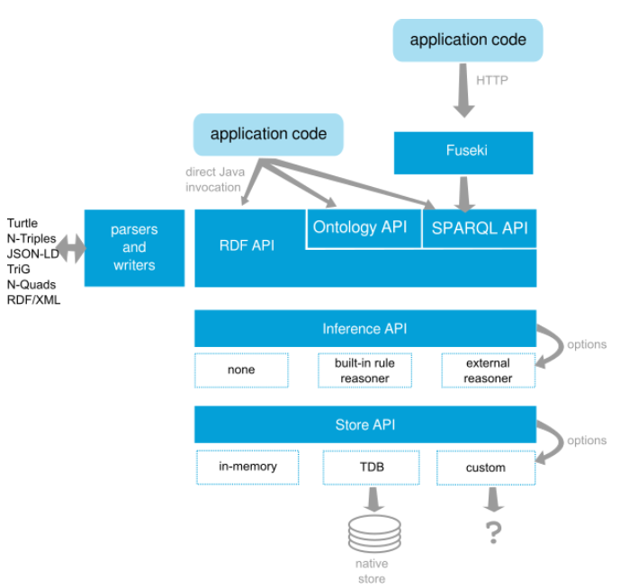
Jena Architecture

Slide 31
LDOW Initiative
References
http://www4.wiwiss.fu-berlin.de/bizer/pub/linkeddatatutorial/
tomheath.com/slides/2009-02-austin-linkeddata-tutorial.pdf

Slide 32
What is LDOW
Linked Data on the Web
Term coined by Tim-Berners Lee
The term refers to a style of publishing and interlinking structured data on the Web.
Key tenets
  use the RDF data model to publish structured data on the Web
  use RDF links to interlink data from different data sources

Slide 33
Purpose of LDOW
Leads to the creation of a data commons on the Web,
Allows people and organizations to post and consume data about anything.

Slide 34
Use existing vocabularies to link
Friend-of-a-Friend (FOAF), vocabulary for describing people.
Dublin Core (DC) defines general metadata attributes. See also their new domains and ranges draft.
Semantically-Interlinked Online Communities (SIOC), vocabulary for representing online communities.
Description of a Project (DOAP), vocabulary for describing projects.
Simple Knowledge Organization System (SKOS), vocabulary for representing taxonomies and loosely structured knowledge.
Music Ontology provides terms for describing artists, albums and tracks.
Review Vocabulary, vocabulary for representing reviews.
Creative Commons (CC), vocabulary for describing license terms.
Other list of well-known vocabularies

Slide 35
Why to link across sources
Linking enable Linked Data browsers and crawlers to navigate between data sources and to discover additional data.

Slide 36
Linking approaches
Use owl:sameAs
  X owlSameAs Y where X belongs to one source and Y belongs to another source
  Here this link serves as an entry point for navigation to different data sources
Use domain-specific link predicates
  foaf:knows, foaf:basedNear

Slide 37
Setting up RDF links
Manual linking
  Refer to the “Linking Open Data Dataset” list to understand about data sources
  Manually search in these for the URI references you want to link to
  You can use Linked Data browsers like Tabulator or Disco to explore the dataset and find the right URIs
  You can use SPARQL end points if available
  Approach does not scale well for large number of resources (e.g., interlinking 70,000 places in DBpedia to their corresponding entries in Geonames)

Slide 38
Setting up RDF links
Automatic linking
  Automatic linking is difficult and comes under the general problem of “record linkage” research
  Good, easy-to-use tools to auto-generate RDF links not available
  Use dataset-specific record linkage algorithms for auto-generation

Slide 39
Semantic Web Summary

Slide 40
Review of Learning Objectives
Understand the need for semantics on the web
  We saw an example of how to bring buyers and sellers together without tight coupling between the sites
Explain what semantic linking is
  We saw how HTML meta tags and RSS can help add some level of semantic linking
Talk about the major technologies involved
  We talked about RDF structure, the role of URIs, the need for ontologies and finally about OWL

Slide 41
Other References
Semantic Web tutorial - Primer by Tim Berners-Lee
Semantic Web Tutorial – By Ivan Herman, W3C
Semantic Web Tutorial – W3Schools Tutorial
W3Schools RSS Introduction
And many other resources available upon search

