Slide 1

Secure Design and Development
Dance Studio Management Website
Ou Zheliang
14090055

Slide 2

01
Methodology and Gantt Chart
02
Requirements Analysis
03
System Design
CONTENT
04
Formal Methods
05
System Development
06
Demonstration

Slide 3
01
Methodology and Gantt Chart
01
Waterfall model and Gantt chart

Slide 4
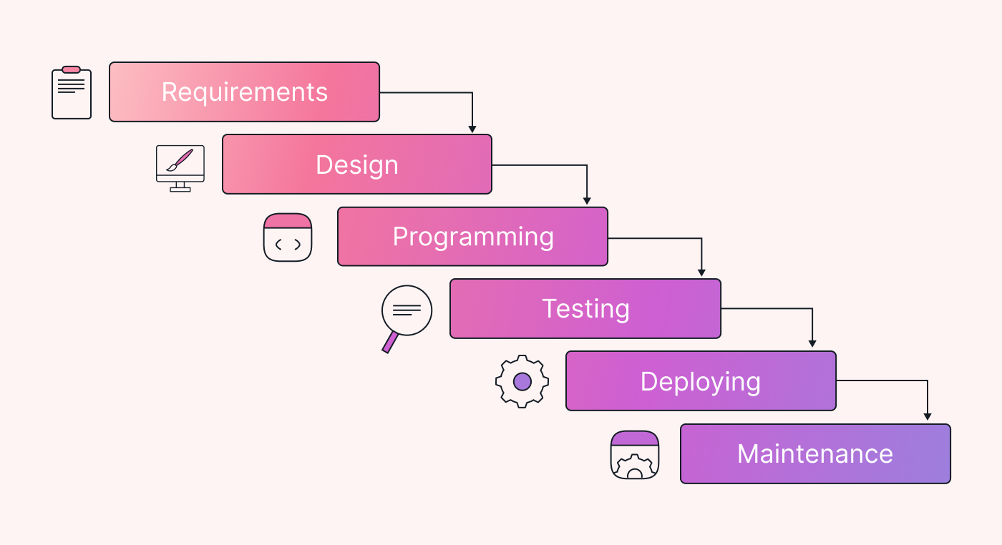
Methodology
Waterfall model

Slide 5
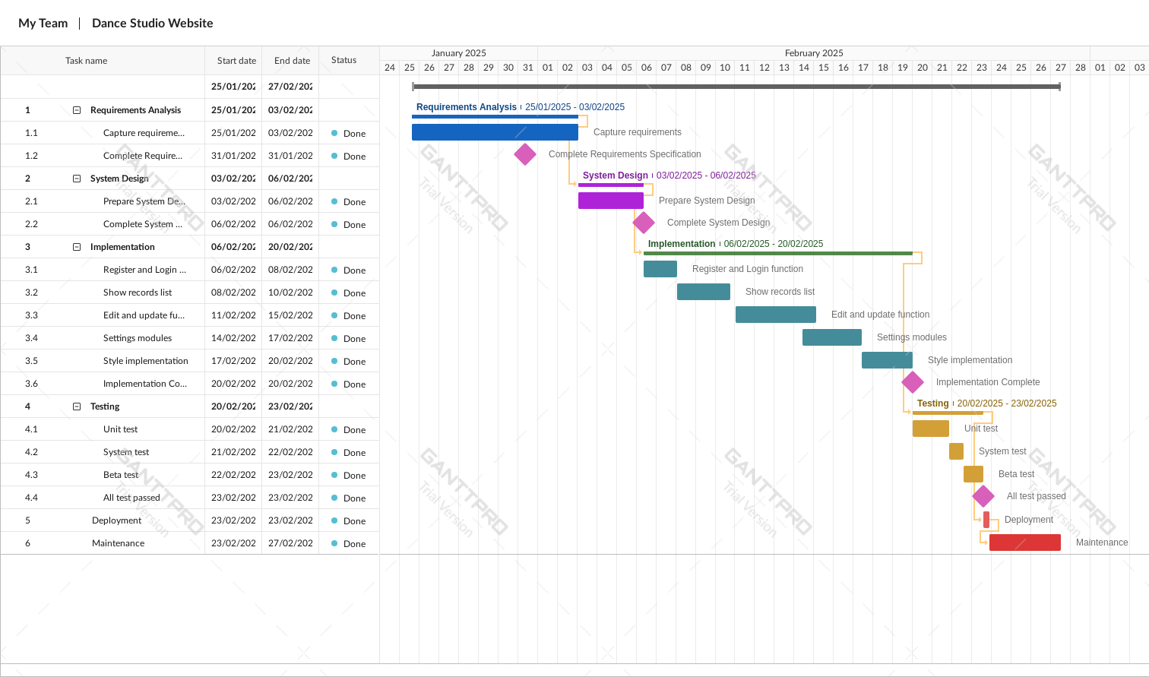
Gantt Chart

Slide 6
02
Requirements Analysis
02
Dance studio management website requirements

Slide 7
Requirements
A Performance and dance group has hired you to develop a web-based application/software that enables the directors and coaches to keep records of the training and performance data using personal accounts, enter and store the statistics and personal information of the artists, update attendance and injury records and also perform other club activities. The group includes children and adults from the age of 7 up to 70.

Slide 8
03
System Design
03
Development Objectives, use case diagram and domain class diagram

Slide 9
Development Objectives
Only the directors and coaches would be able to access the system.
The directors and coaches would be the admin of the system.
The directors would be allowed to do an admin creation for artist module and performance module.
The coaches would be allowed to do an admin creation for training module.
Artists would not access to the system.
Performance and training have no dependencies.

Slide 10
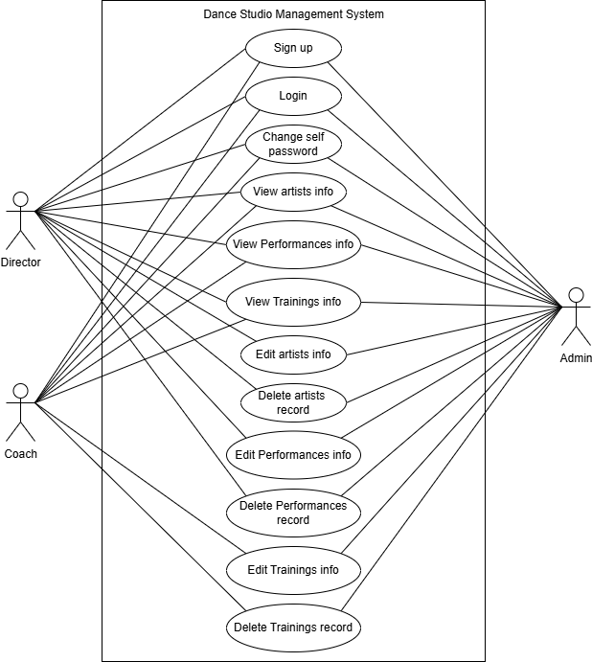
Use Case Diagram

Slide 11
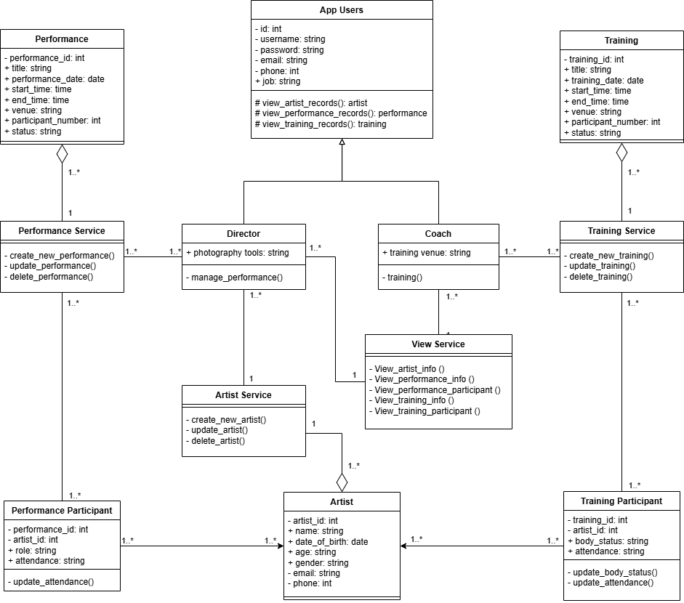
Domain Class Diagram

Slide 12
Security Principles
Security Principles | Description
Least privilege | Director and coaches can view all data. Director can only create and edit artist and performance data. Coaches can only create and edit training data. Artist can’t access any data.
Input validation | All input will be validated on the server side.
Human-machine verification | The system uses RECAPTCHA to verify whether the user is a human or a machine.
Password encryption | Django framework use PBKDF2 algorithm and SHA256 hash function with random salt to encrypt the user password.
XSS protection | Django framework use “autoescape” to perform simple HTML escaping.
CSRF Protection | Django framework provide CSRF token to protect CSRF attack.
SQL injection protection | Django framework provide Object-Relational Mapping to protect SQL injection.

Slide 13
04
Formal Methods
04
Finite automata and Petri nets

Slide 14
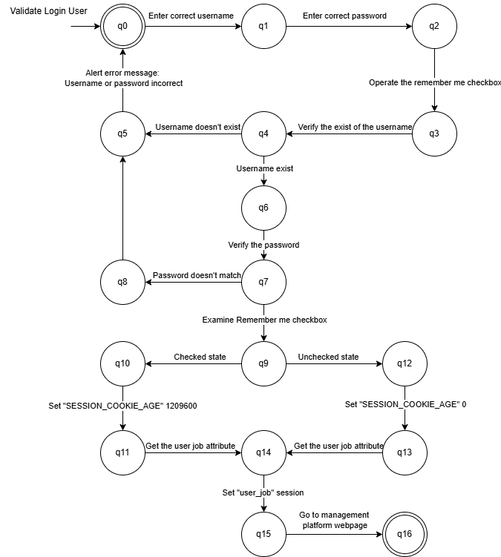
Finite Automata
Login Process

Slide 15
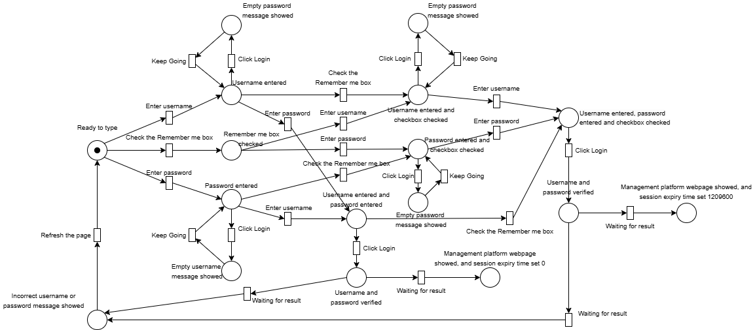
Patri Nets
Login Process

Slide 16
05
System Development
05
Visual Studio Code, Python and, XAMPP

Slide 17



Development Tools

Slide 18
06
Demo
06
Shows the basic functions and key secure implementations

Slide 19
Conclusion
In conclusion, the development of the secure web-based system for the performance and dance group has successfully addressed the core requirements of managing sensitive data. The system achieves a robust defense against common threats such as XSS, CSRF, and unauthorized data access.

Slide 20
Thank you

