Slide 1


Comp 4200: project
Library management system
By Zhiming Huang, Keyang Gao, Thomas Cui, Ebuka Nwakoby

Slide 2
System functionalities
Readers:
can create new account by register using username and password
Can login after register into system
Can check all the books in the system
Can update their profile
Can check borrowed books
Can borrow books

Slide 3
System functionalities(conti)
Administrator:
Can login with administrator account
Can check borrowed book information
Can check all books information
Can check all return books information
Can add new readers
Can delete readers
Can search books
Can search readers
Can add/delete books

Slide 4
Database design
book table:
id | varchar | Primary key | Book id
bookid | varchar |  | ISBN
name | char |  | name
author | char
publisher | char
comment | varchar
img | varchar |  | image

Slide 5
Database design(Cont)
reader table:
id | char | Primary key | User id
user | char |  | username
name | char |  | Real name
password | varchar
sex | char
phone | varchar

Slide 6
Database design(Cont)
Borrowed book table:
Bid | varchar | Primary key | Borrow id
Bname | char |  | User name
Bookid | char |  | isbn
bookname | char
bookauthor | char
nowtime | varchar |  | Borrow time

Slide 7
Database design(Cont)
Returned book table:
id | varchar | Primary key | Return id
Bname | char |  | User name
Bookid | char |  | ISBN
bookname | char
bookauthor | char
nowtime | varchar

Slide 8
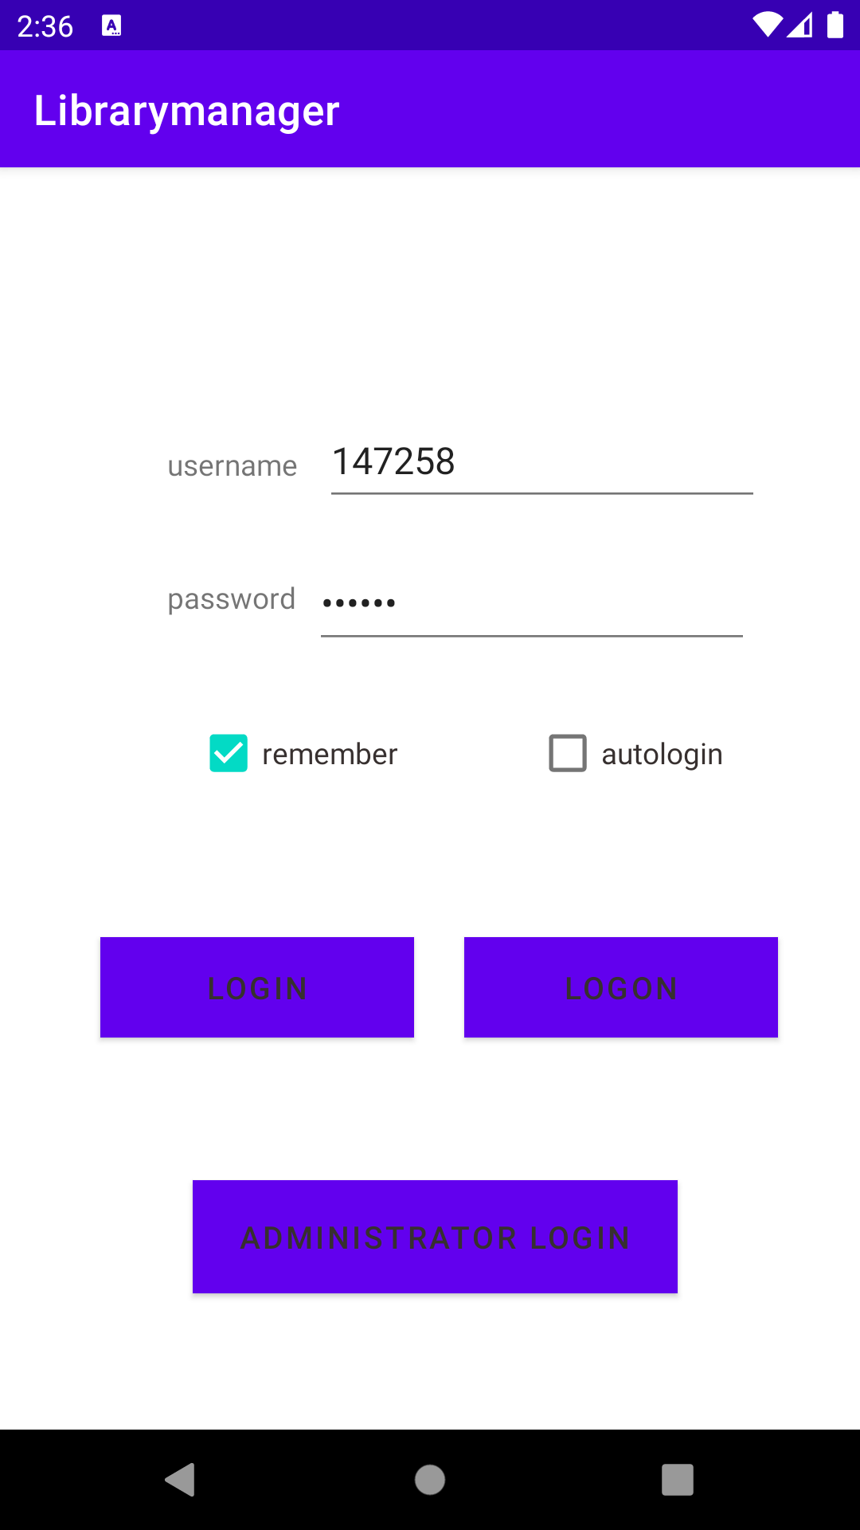
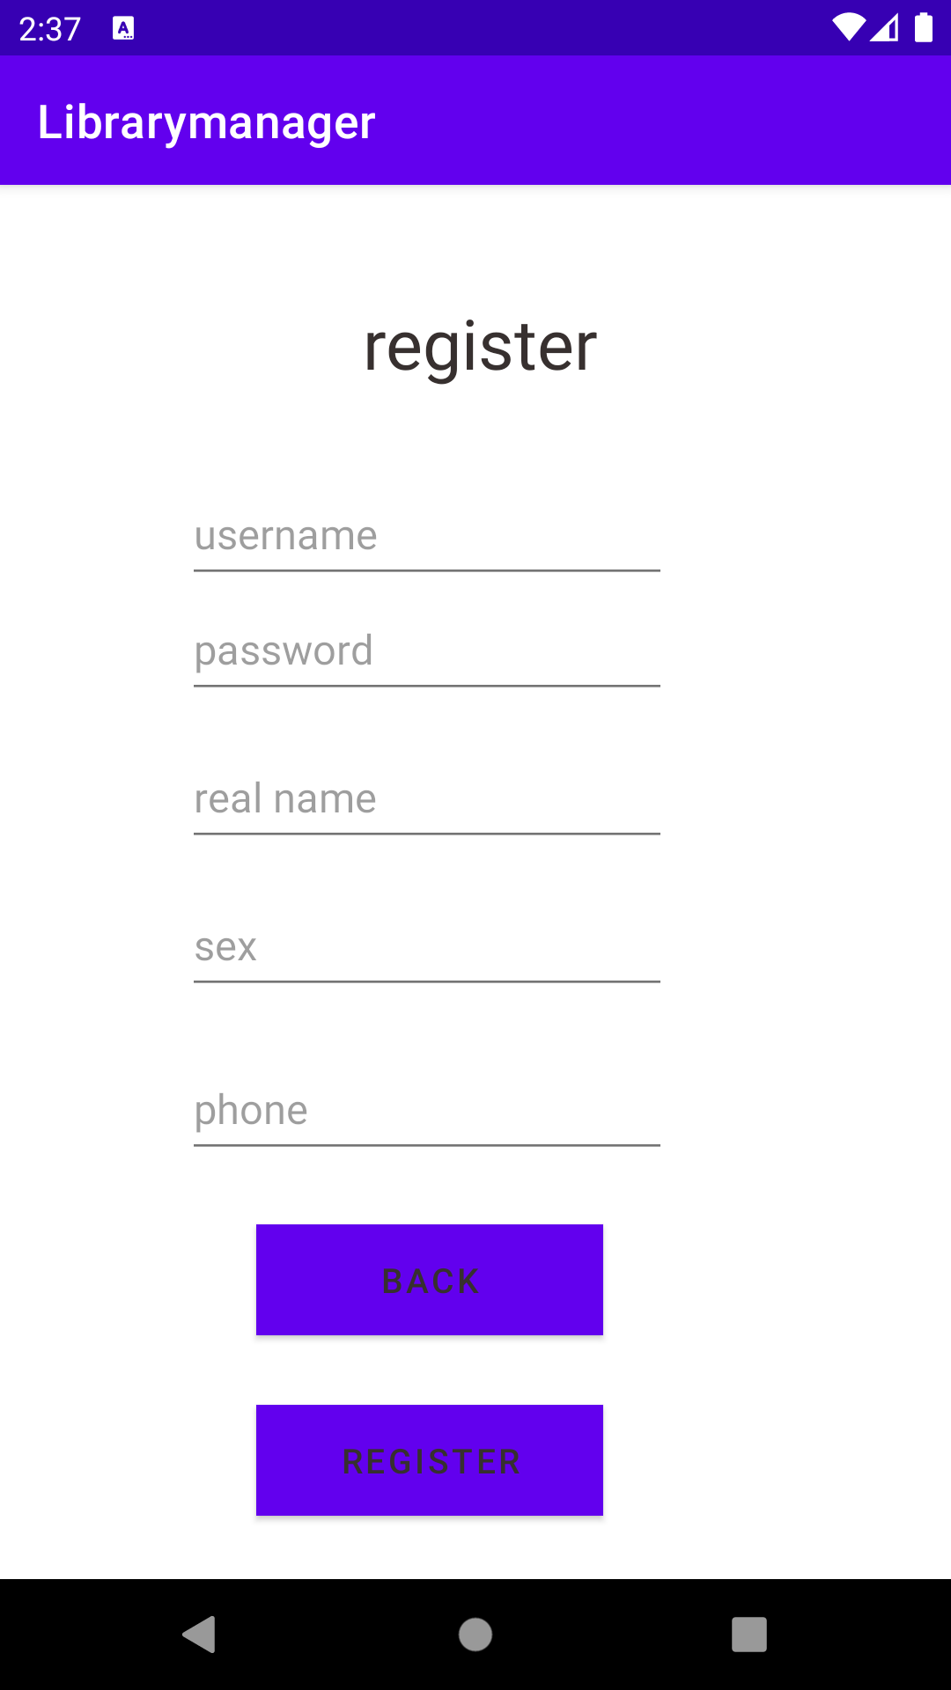
User login
Notes:
Can register with 6 digits username and password, personal information
The click register, it will insert the data to database(reader table)
After create new account, reader can log in with their 6 digits username and password, they have the option to remember their username and password so next time the information will refill
They can also login as an administrator with username 888888 and password 123456

Slide 9
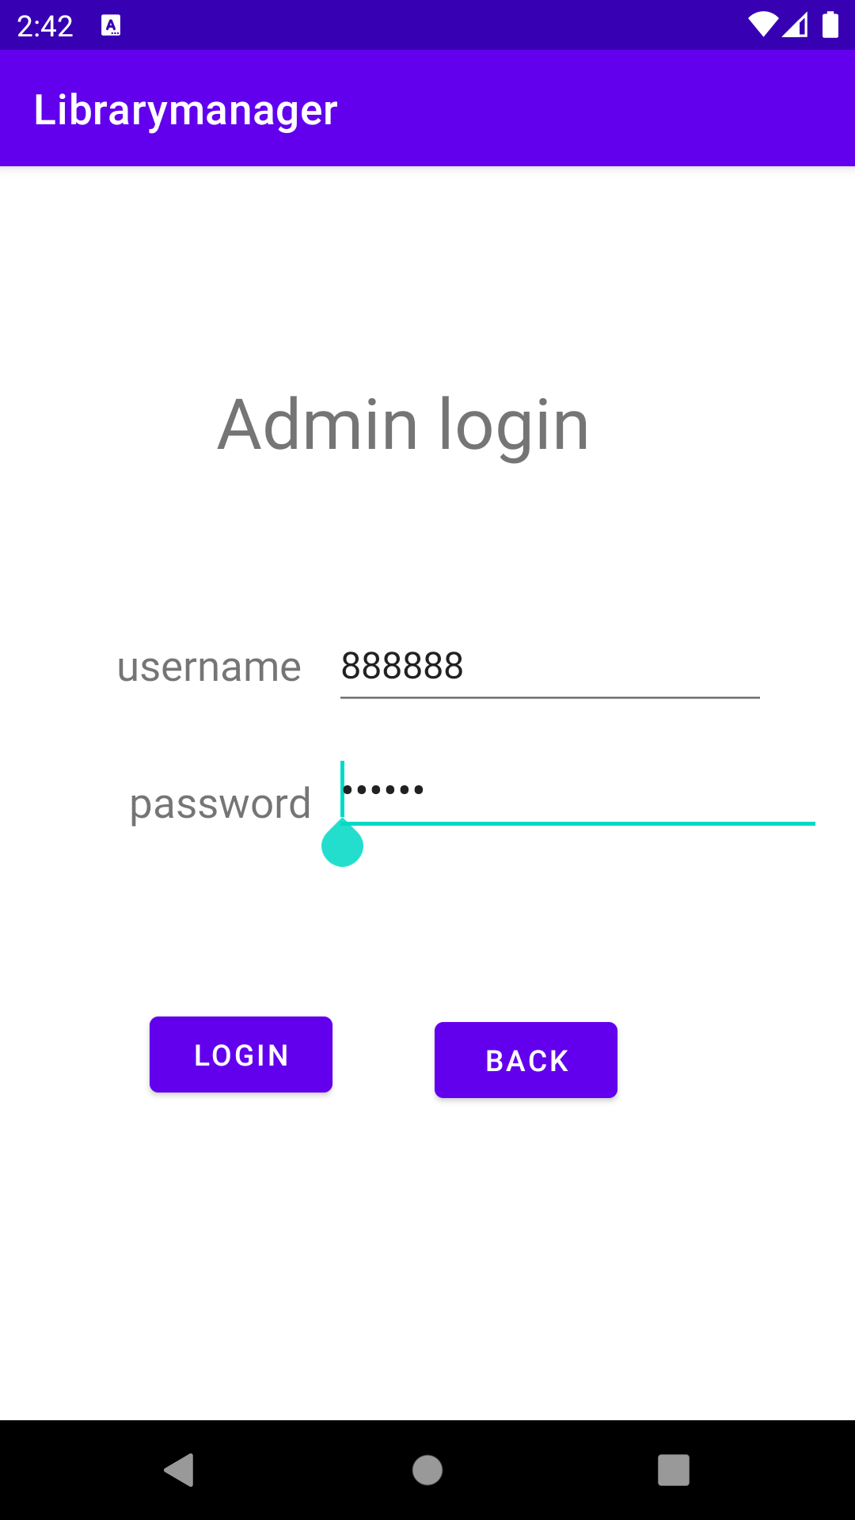
Admin login
Notes:
can also login as an administrator with username 888888 and password 123456

Slide 10
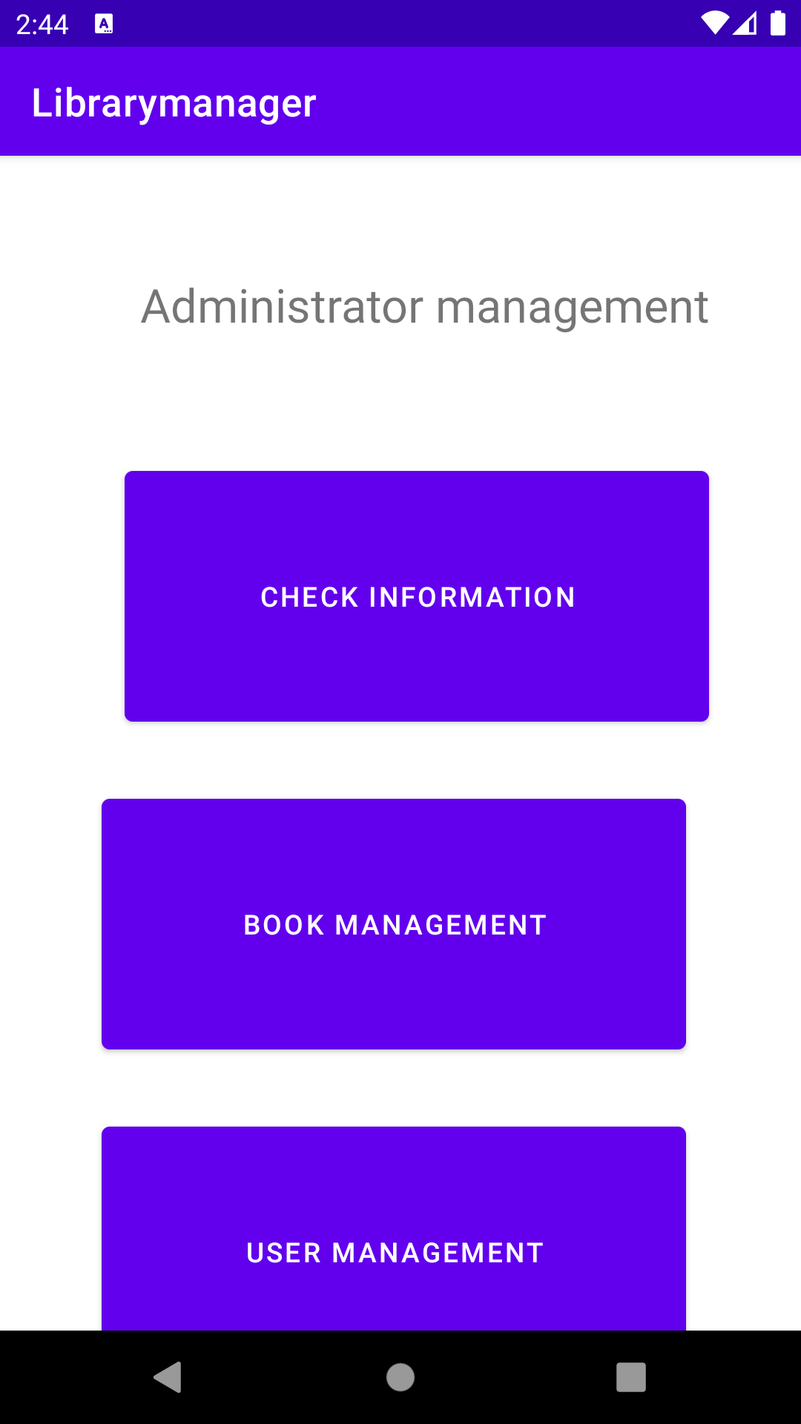
Admin functions
Notes:
Administrator can check book information, can do books management and user management

Slide 11
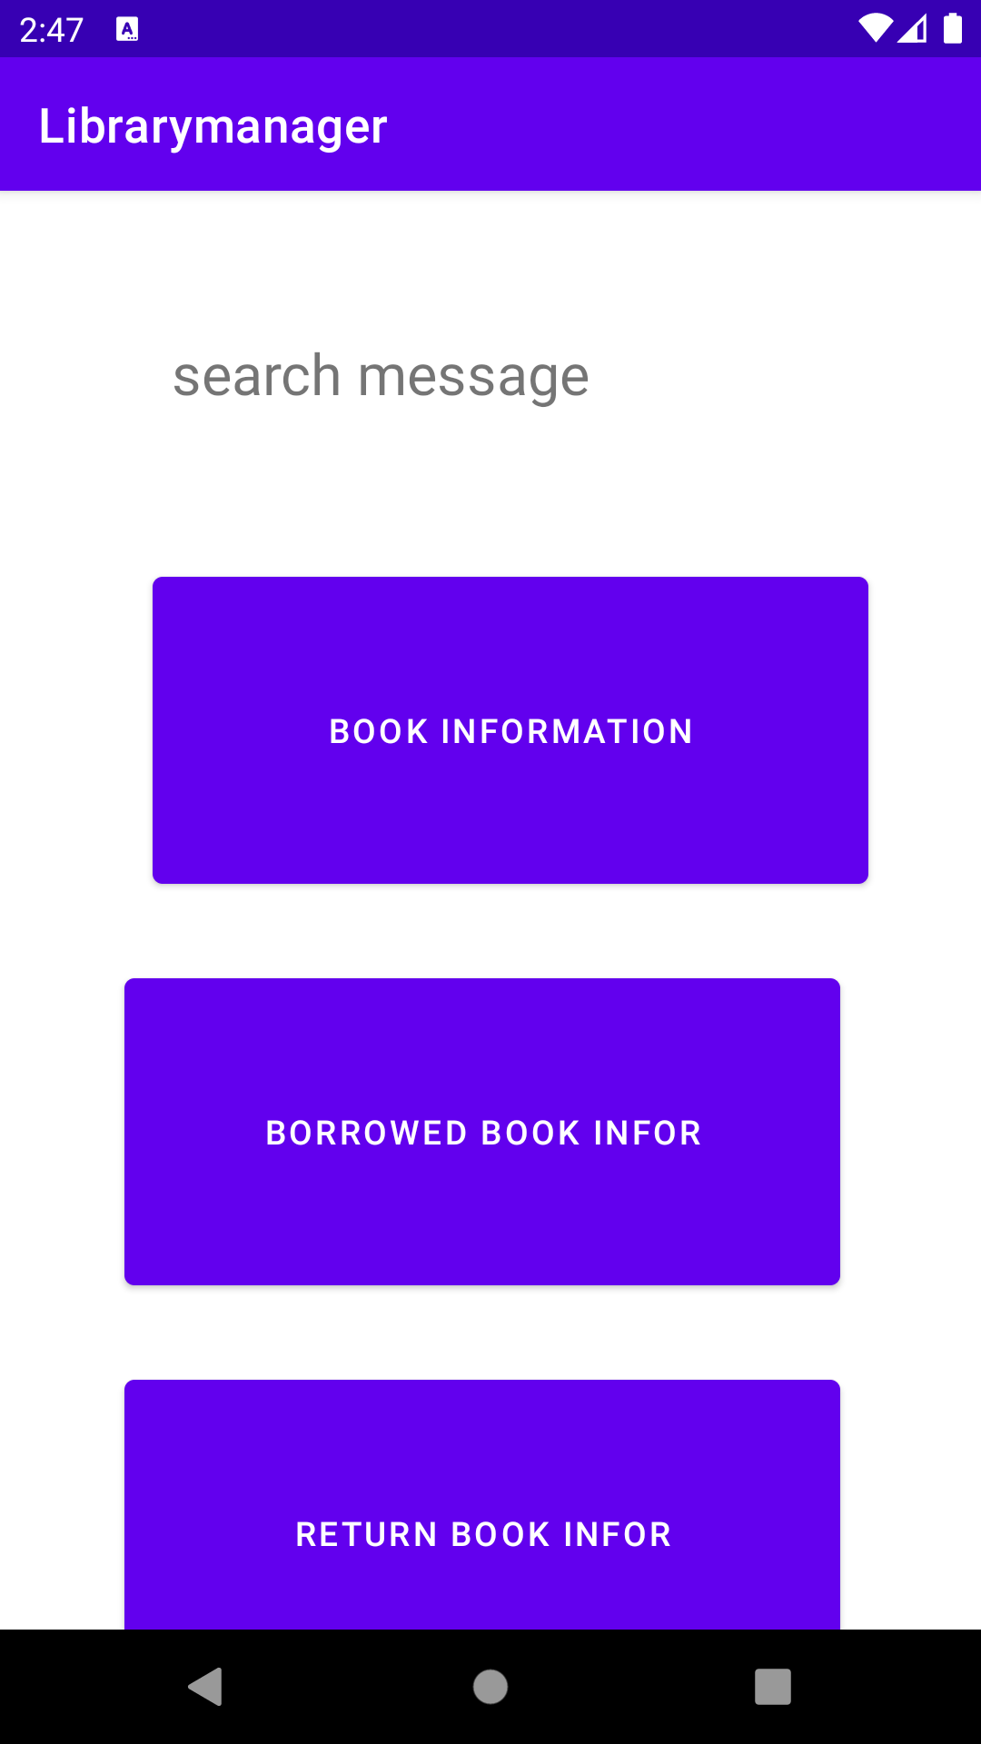
Check information
Notes:
Administrator can check all books information,
Can check borrowed books information
Can check returned books information

Slide 12
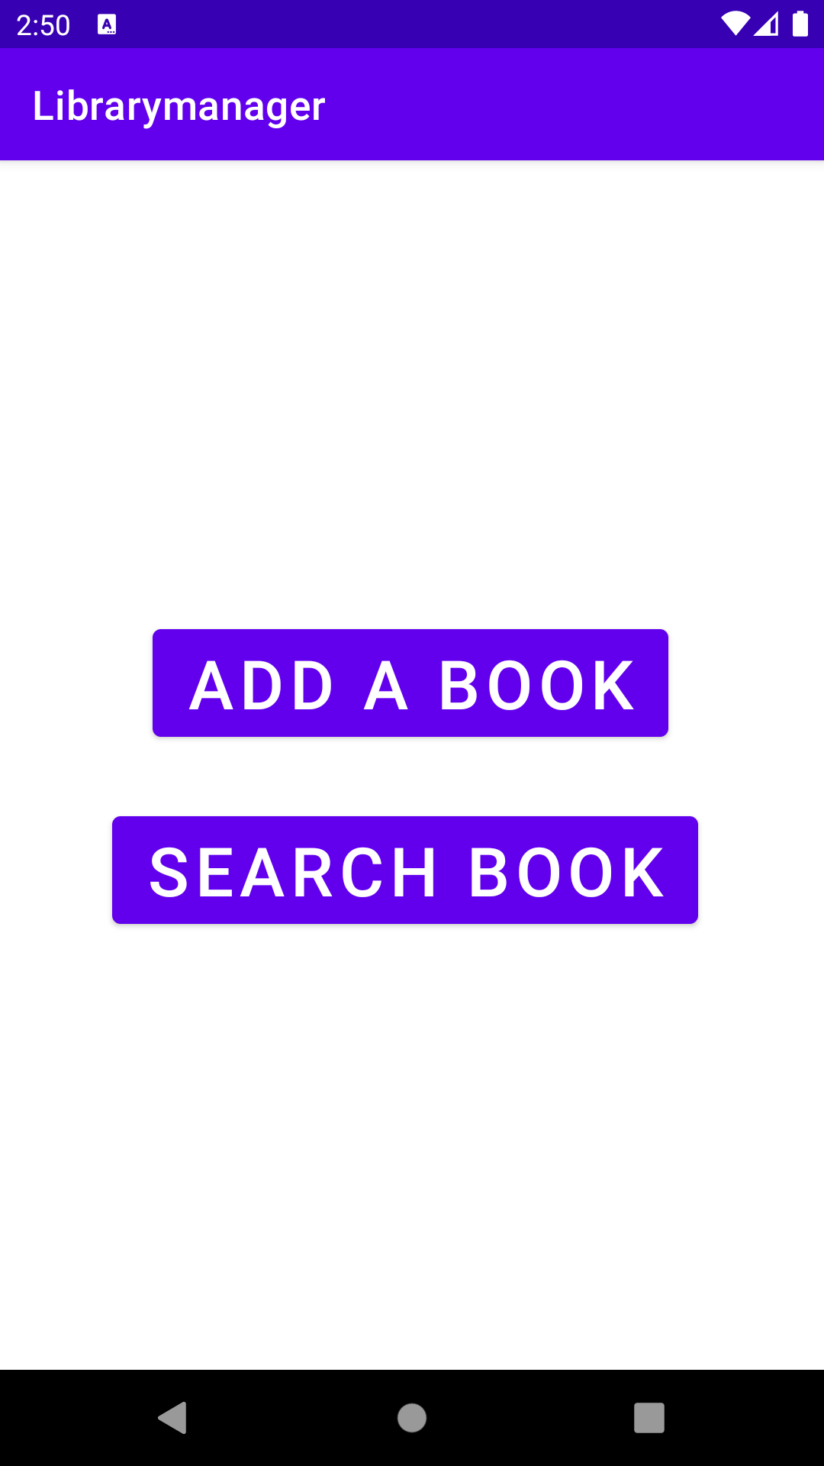
Book management
android:id="@+id/nav_view"
android:layout_width="match_parent"
android:layout_height="match_parent"
android:layout_gravity="start"
app:headerLayout="@layout/nav_head"
app:menu="@menu/nav_meun">
Notes:
Administrator can add books
Can search books

Slide 13
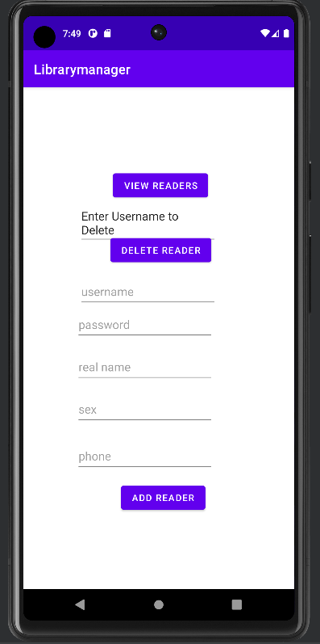
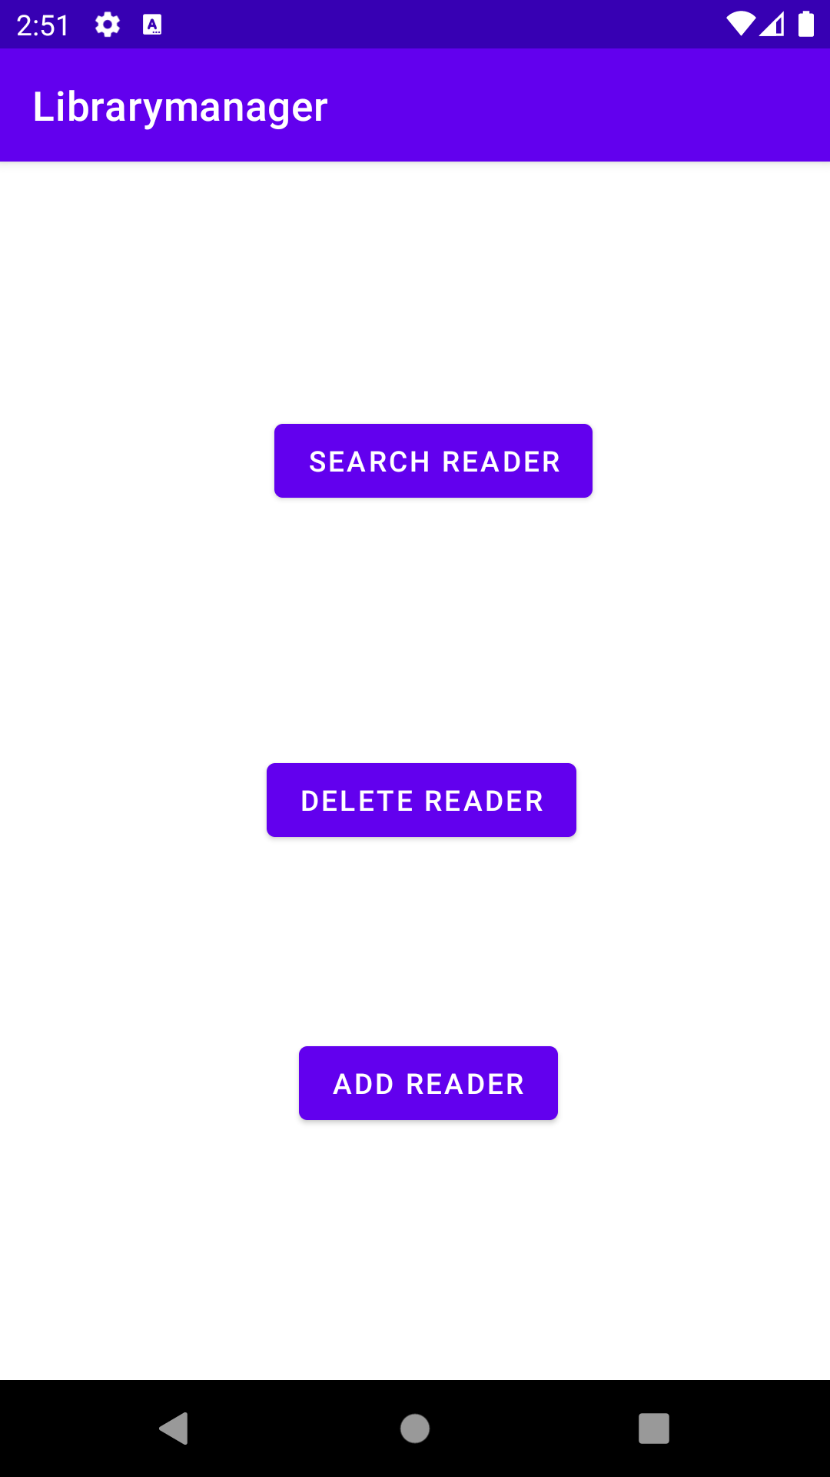
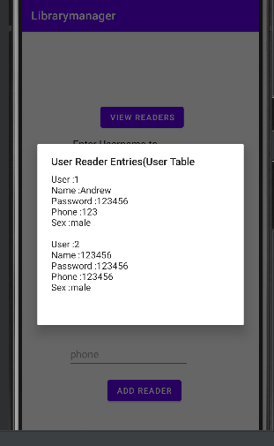
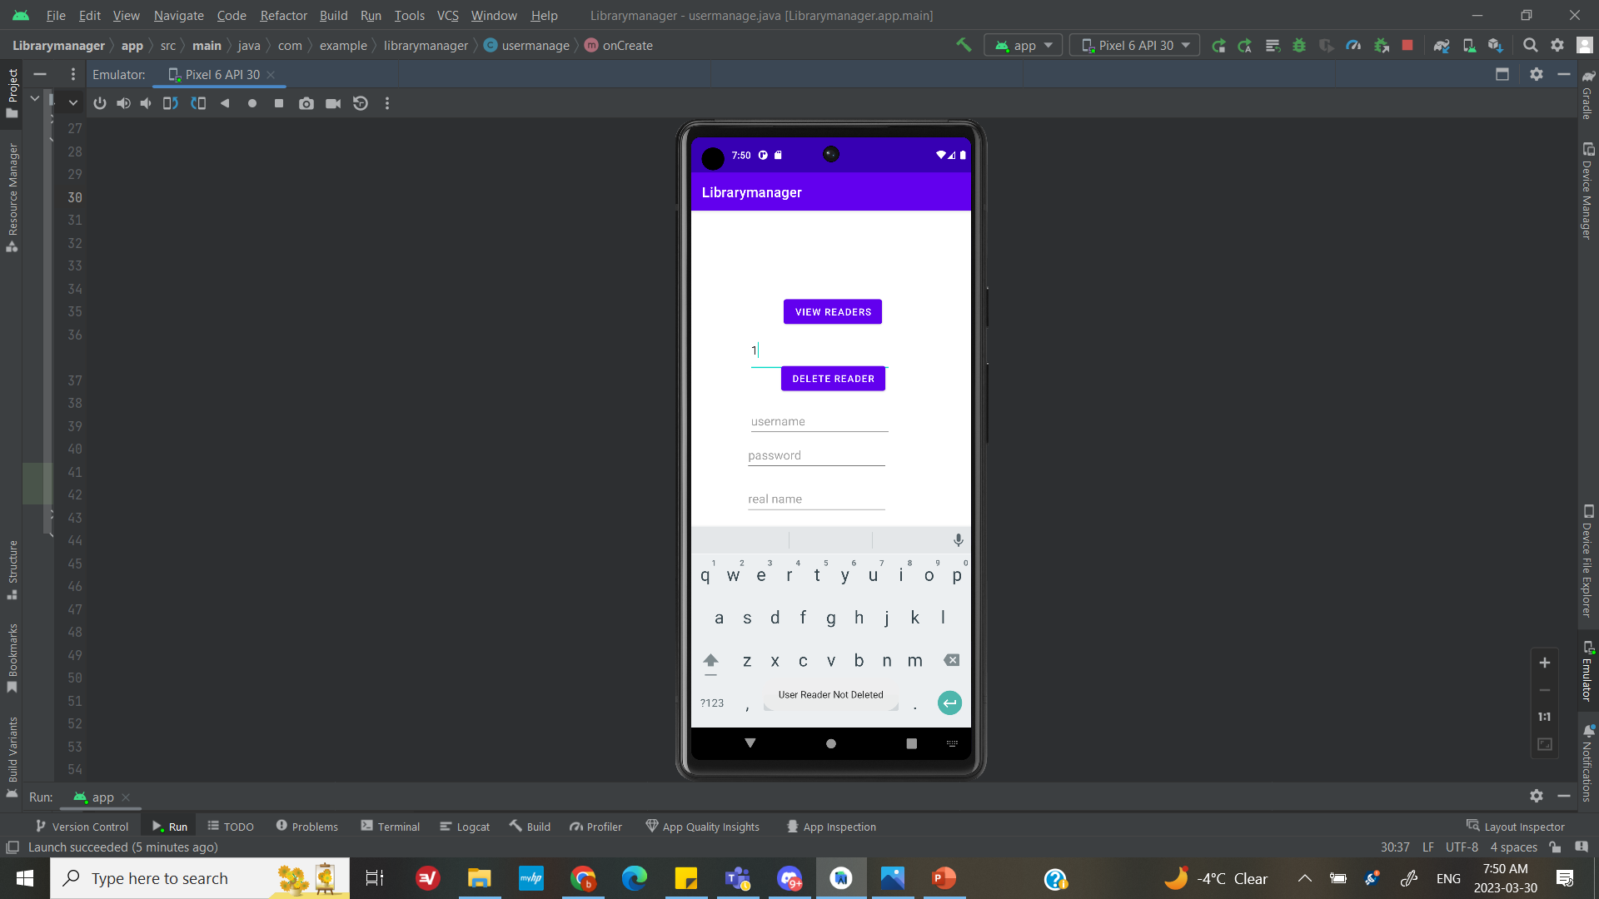
reader management
android:id="@+id/nav_view"
andrd:layout_width="match_parent"
android:layout_height="match_parent"
android:layout_gravity="start"
app:headerLayout="@layout/nav_head"
app:menu="@menu/nav_meun">
Notes:
Administrator can search readers and delete reader, add new reader

Slide 14
Thank you for listening!
android:id="@+id/nav_view"
android:layout_width="match_parent"
android:layout_height="match_parent"
android:layout_gravity="start"
app:headerLayout="@layout/nav_head"
app:menu="@menu/nav_meun">
Notes:
Administrator can add books
Can search books

