Slide 1

ACME Network Project
GROUP 6
External Security & Web Servers (Keyao Huang)
DNS & IDS (Zhiyuan Lin)
Wireless Security & File Exchange (Enze Wang)
CA & OpenSSL (Ziyang Song)
Presentation Date: March 15, 2023

Slide 2
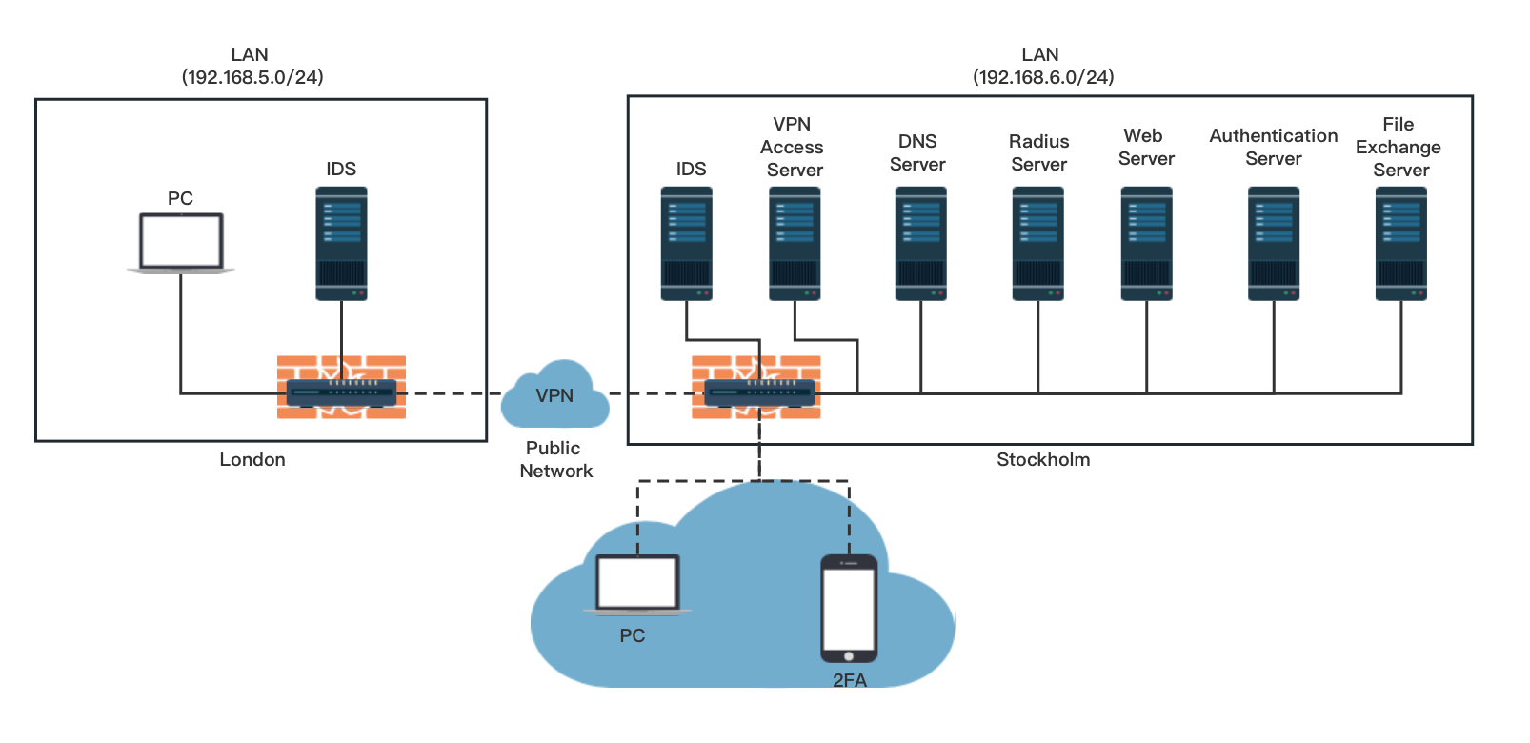
Network Topology

Slide 3
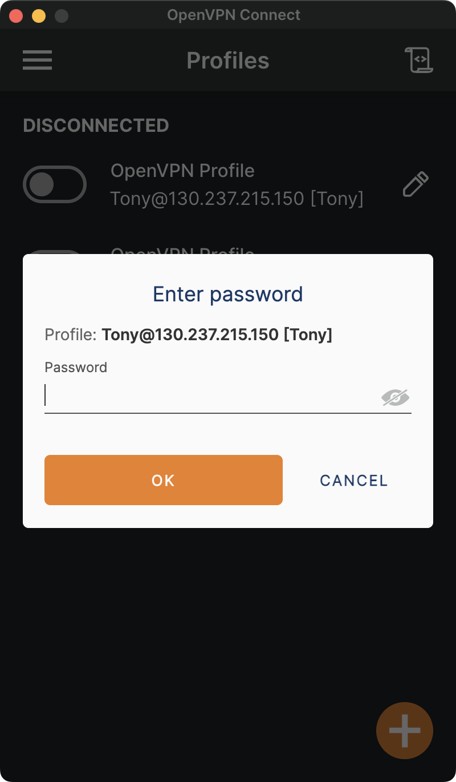
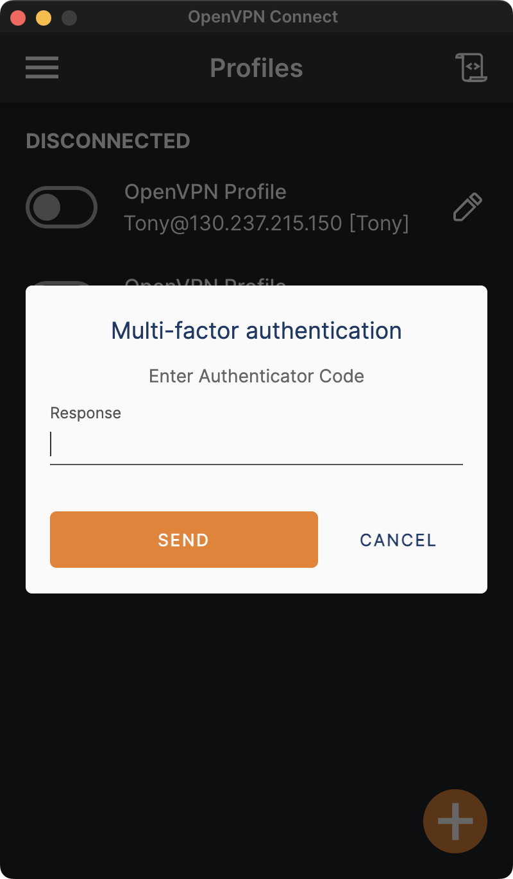
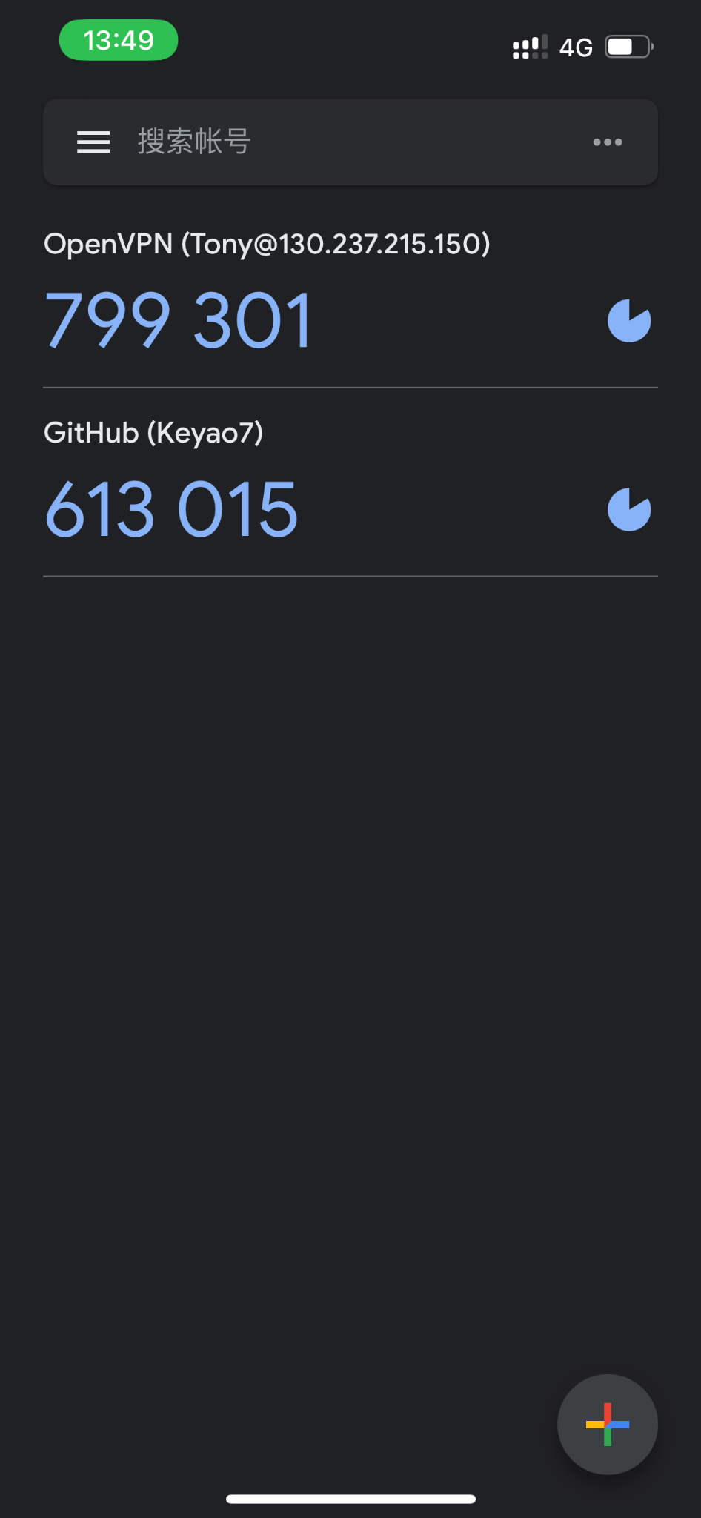
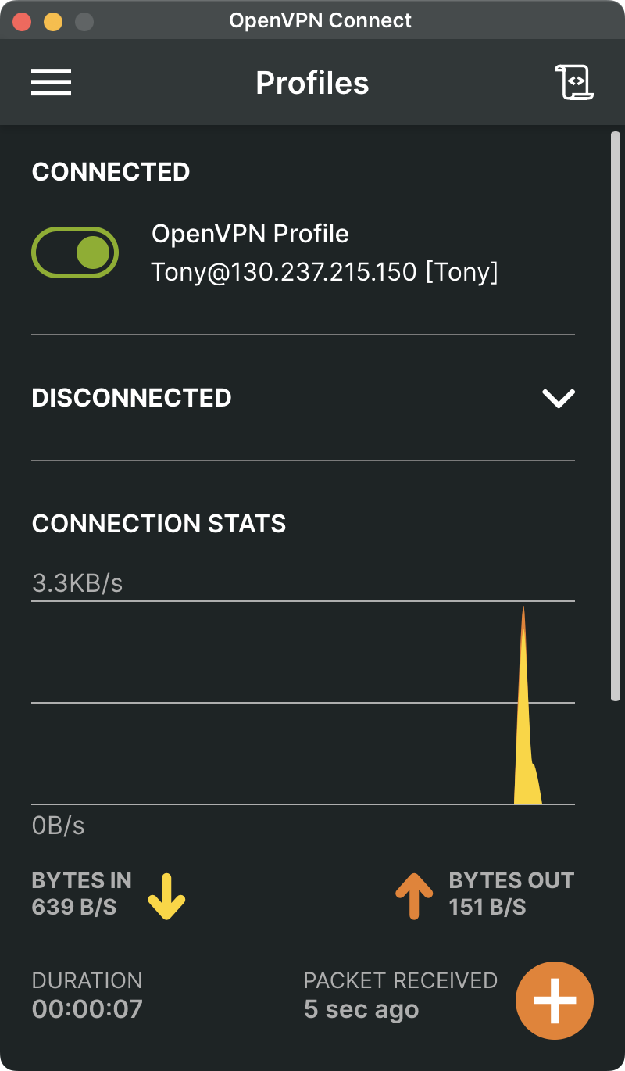
External Security - VPN & 2FA
1. Router VPN
Stockholm Router -> OpenVPN Server
Only Accept One Client (London Router)
2. VPN Access Server
Install OpenVPN-as in VM
Accept External Client
3. VPN 2FA
One Time 6 Digit Pin-Codes
With Google Authenticator

Slide 4
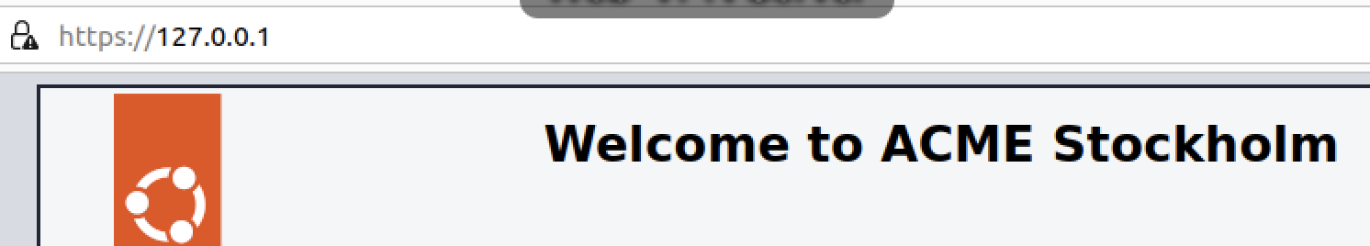
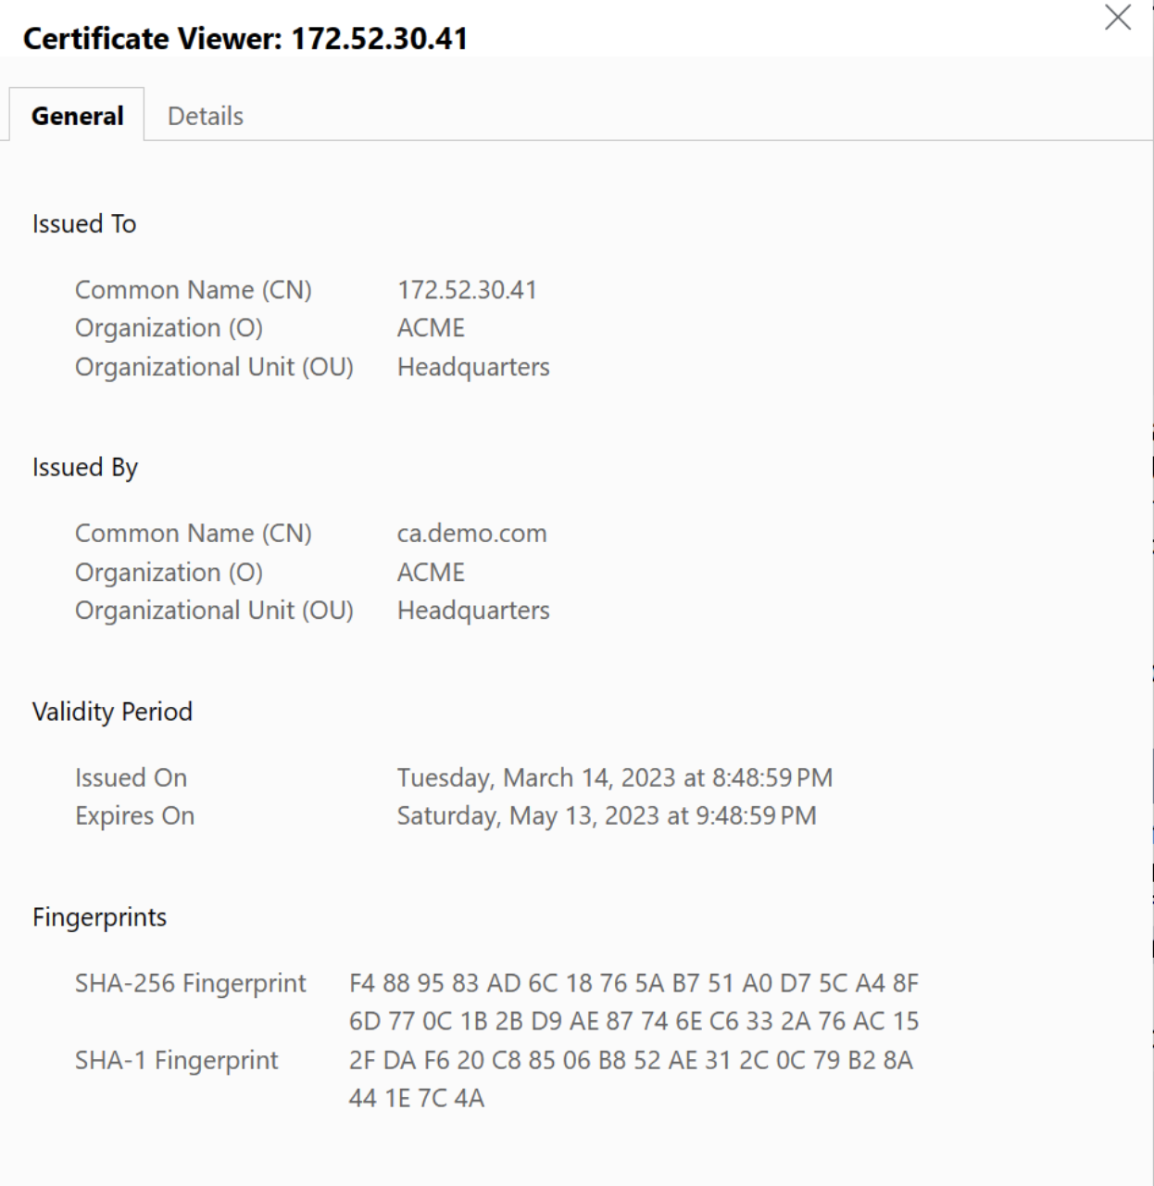
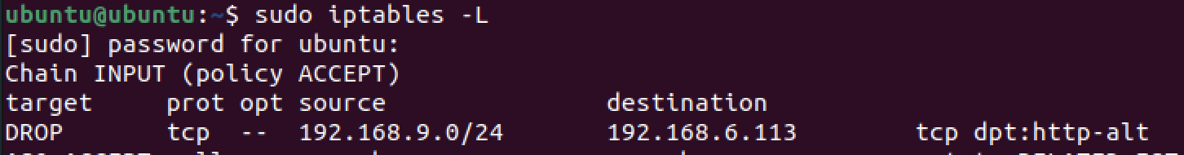
Web Servers
1. Normal Web Server
Can be access by In-company users and external users
Using HTTPS
2. Critical Web Server
Not allow external users to access
Using iptables to block external users

Slide 5
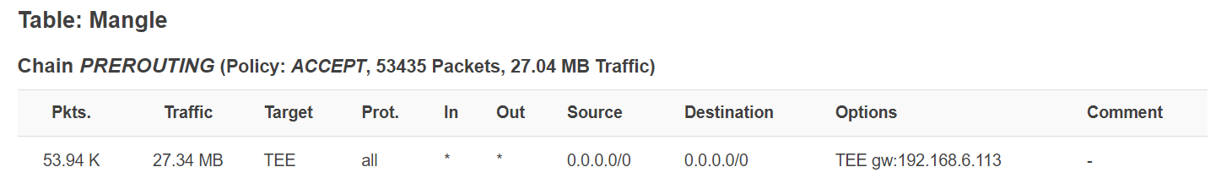
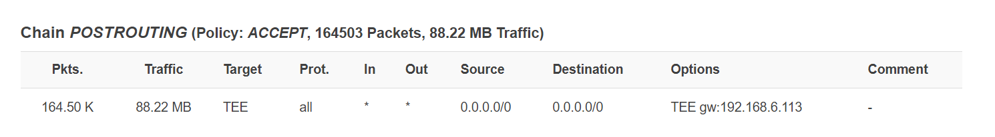
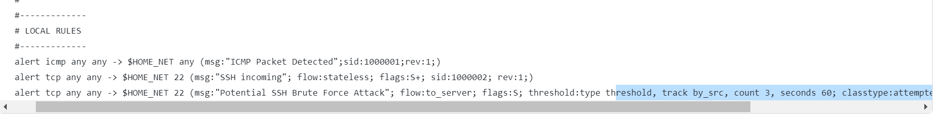
Internal Security—IDS
Snort as an NIDS, with mirrored traffic from router to get more coverage
Configure the local rules file or download the rules from SNORT website.
Set up snort.conf file, test and run

Slide 6
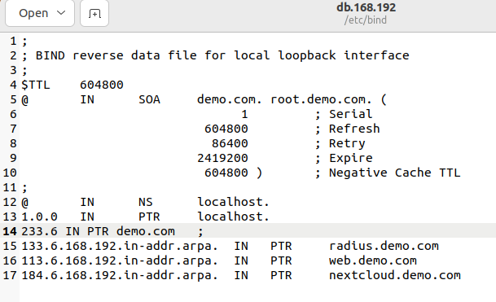
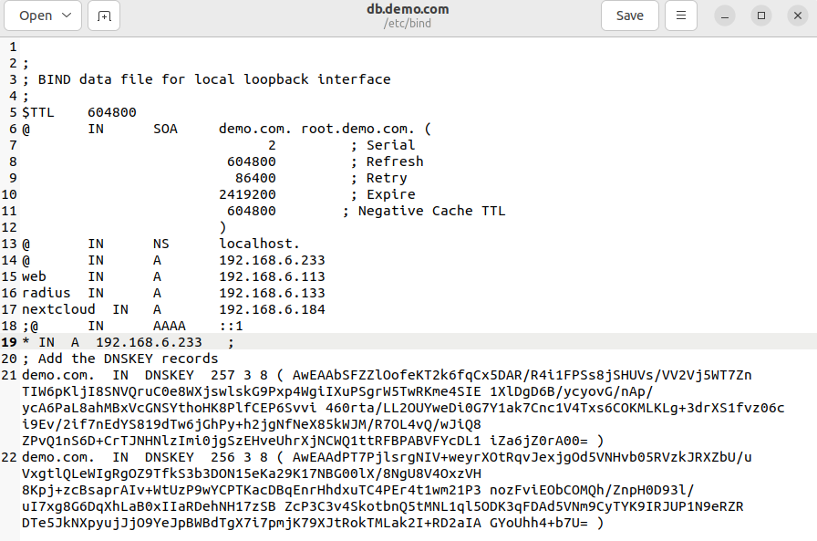
DNS
BIND9 is used for deploying the DNS service for STOCKHOLM network
Configure db.demo.com and db.168.192 and named.conf.local files

Slide 7
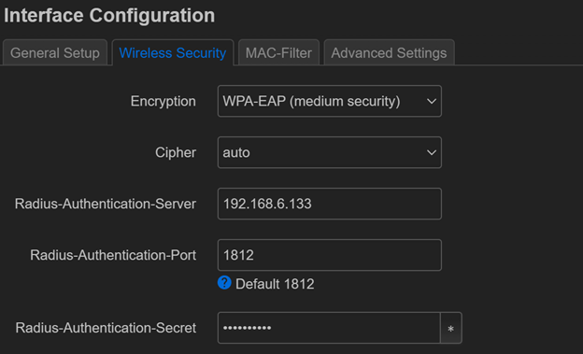
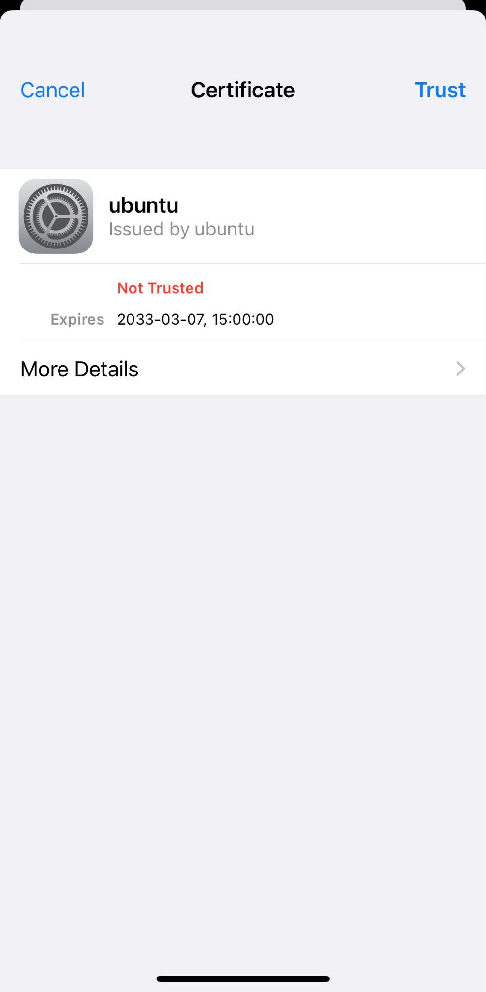
Wireless Security: Radius Server
Main configuration for freeradius :
1) at /freeradius/3.0/clients.conf set two routers as the NAS
2) edit /freeradius/3.0/users file which includes employees’ user/password information
3) under /freeradius/3.0/certs/client.cnf, modify the cnf file and run “make” generate user certificates
Set WPA-EAP as the encryption
for router and server on OpenWRT :

Slide 8
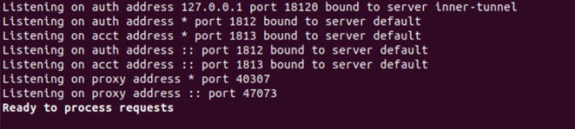
Wireless Security: Radius Server
Start the debug mode : “freeradius -X”, and “ready to process request” is shown in the terminal.
Now, employees can access the wireless internet through radius authentication:
A user connects to the Network Access Server (router) and initiates a login.
The NAS (router) communicates with the RADIUS server using a shared secret mechanism that the port 1812 is for authentication.
The NAS sends a RADIUS message (an Access-Request) to the server.

Slide 9
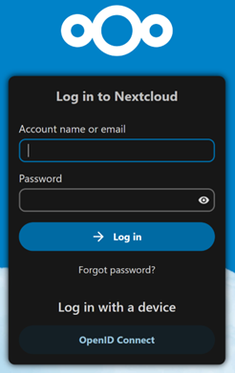
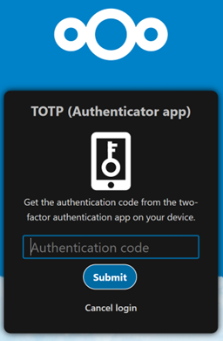
File Exchange server: Nextcloud
We run nextcloud server with docker container. So, we run the server using Docker Desktop.
Sever is running, you should be able to login Nextcloud at 192.168.6.184:9006 with 2FA. After successfully logging in, users should be able to chat and shire files. For example, one way to share files is transferring ownership.

Slide 10

Document Structure
*.key Private Key
*.pem Certificate or Certificate chain file
*.csr Certificate signing request (CSR)
*.cnf Configuration File
*.crl Certificate revocation list (CRL)
*.vrfy Certificate Verification
All files use PEM format.
Hierarchy:
1. Root CA
(External, with full chain)
2. Intermediate CA
(Internal, maintaining local CRL)
3. Server or User
(With mutual TLS verification)

Slide 11
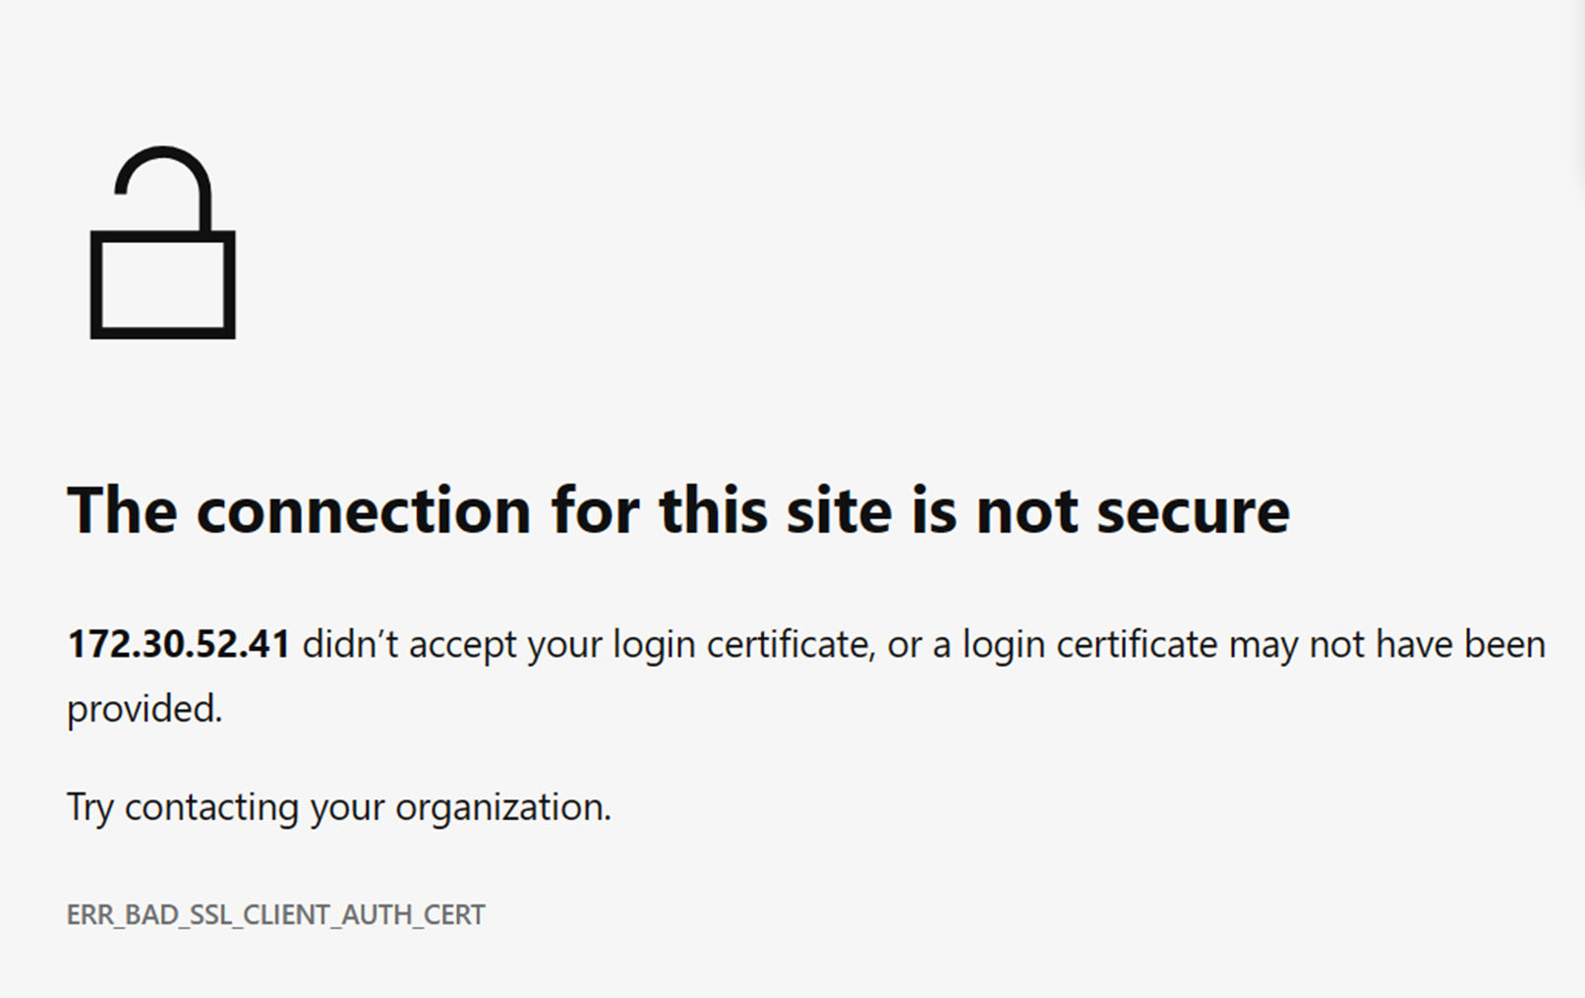
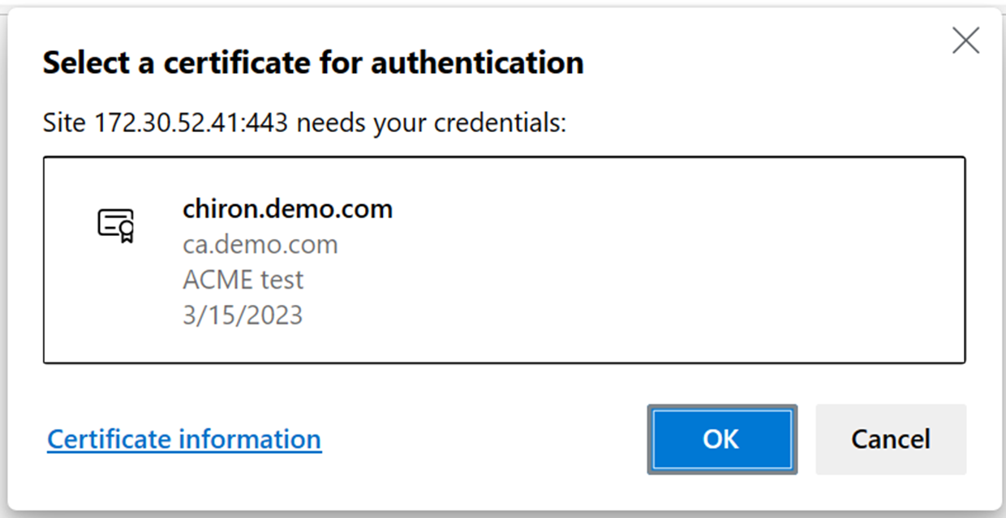
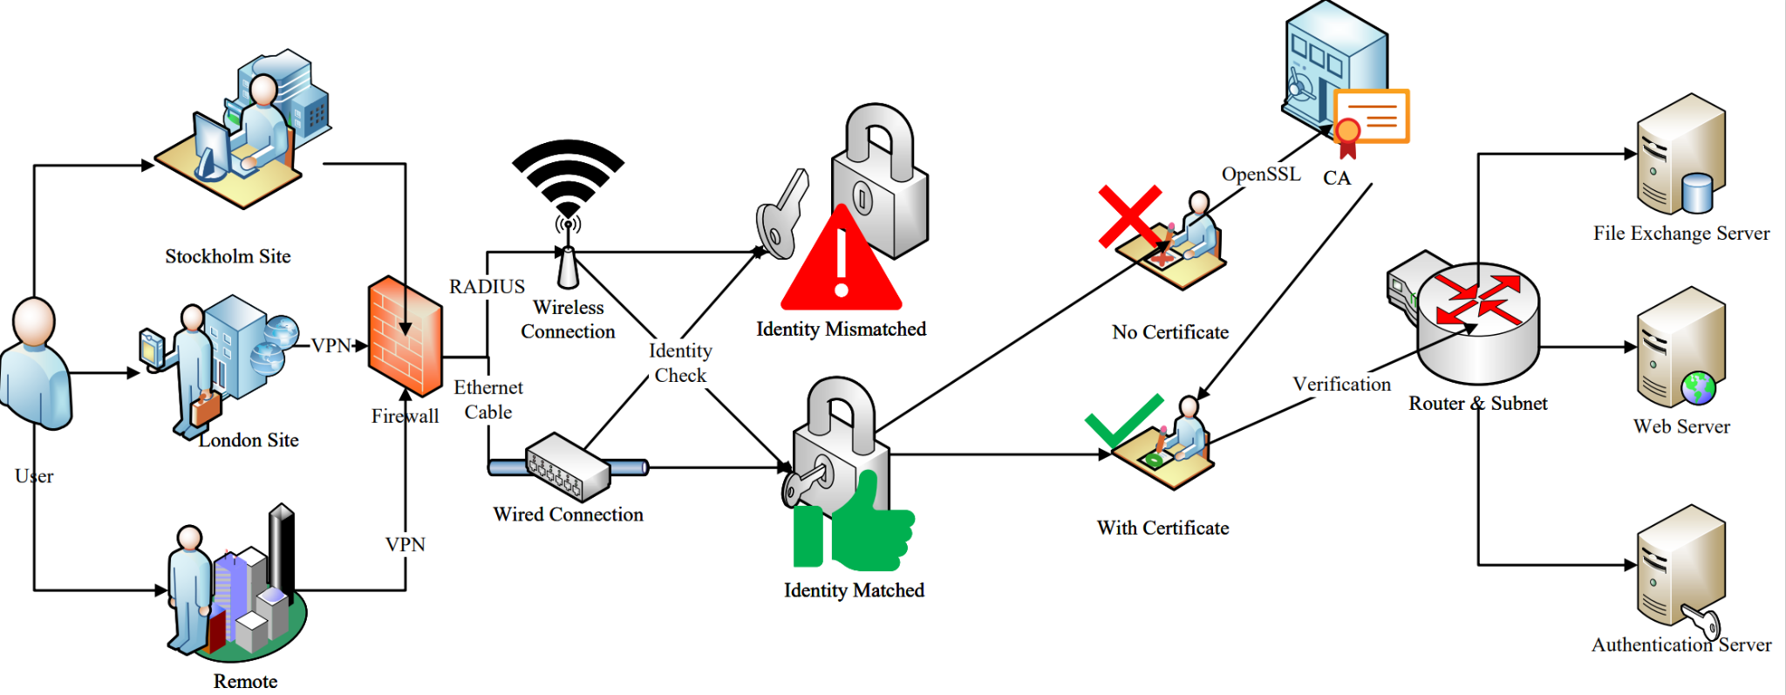
Web Server certificate and authentication
General Structure of Trust
(Imaginary)

