Slide 1
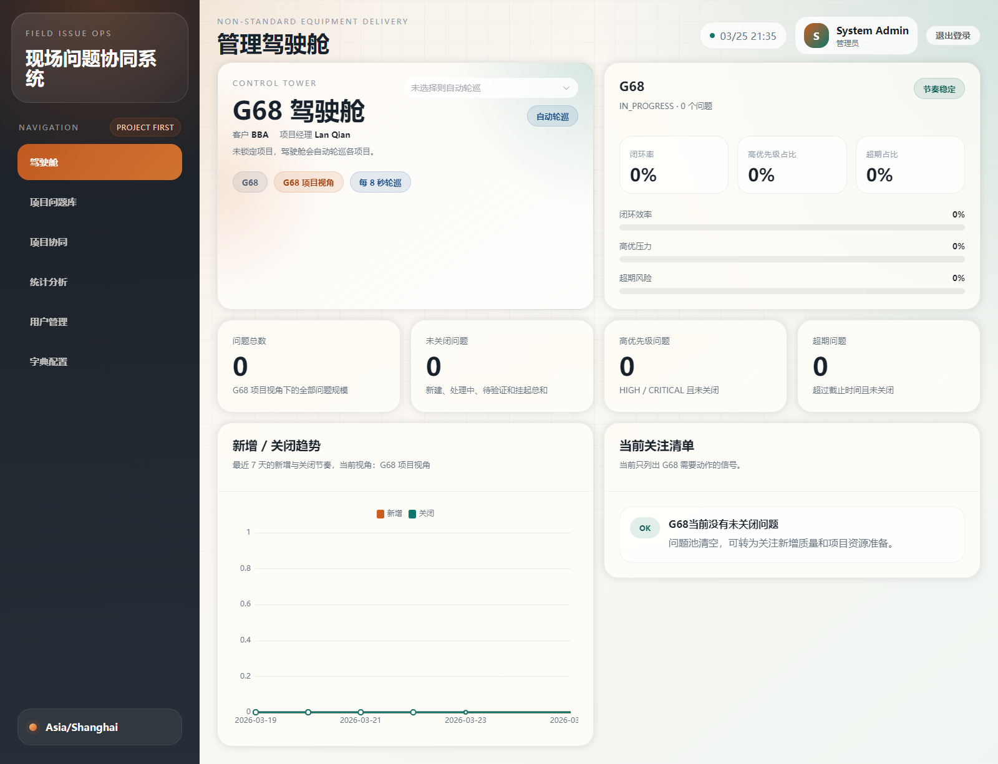
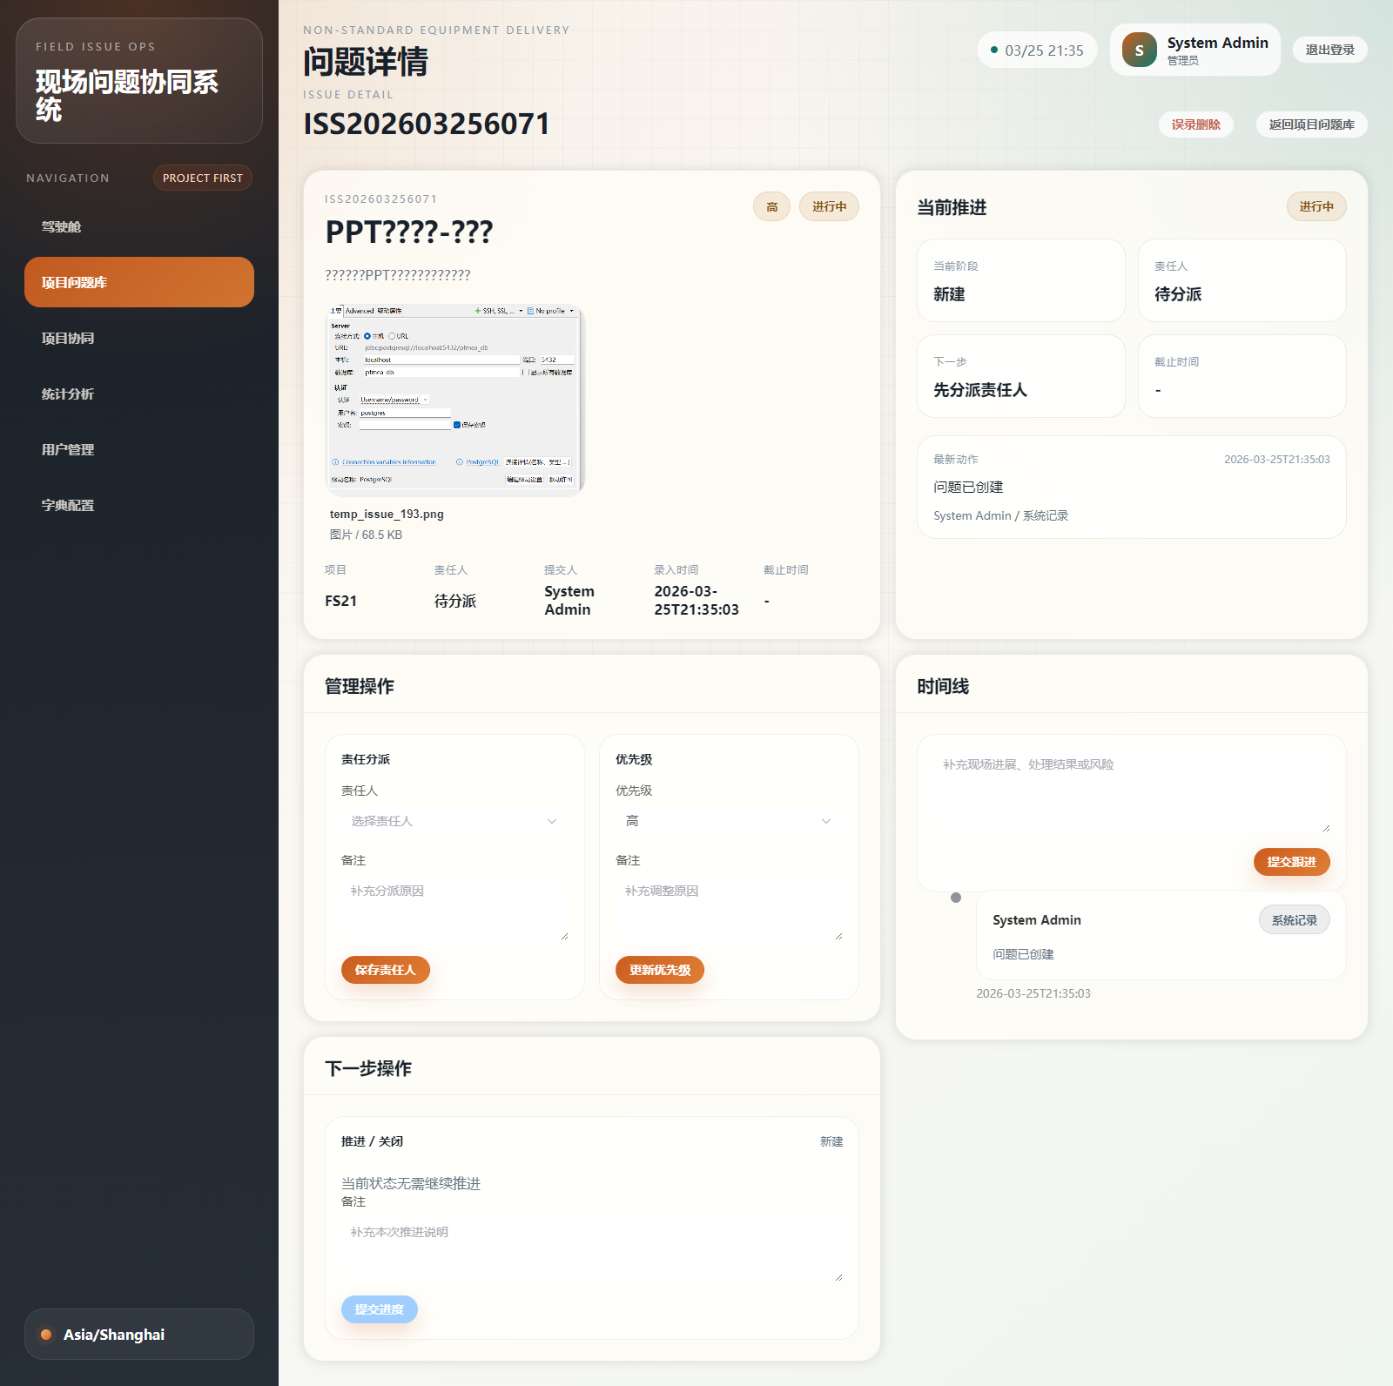
PROJECT ISSUE HUB
INTRANET DEPLOYMENT
Intranet-Only
Deployment Overview
All core services remain inside the corporate network.
Users access via Web on intranet.
• No public exposure of backend, databases, or storage.
• Single intranet domain for Web access.
• Operations stay within internal security policies.
For leadership & IT
All services stay in the intranet.
Access via Web only.
Private Network Only
2026-04

Slide 2
Why This Matters
01
Pain points from Excel-based OPL and the targeted improvements.
Current Pain Points
What We Change
• Issues recorded as plain text, without full workshop context.
• Repeated questions about impact, owner, and next step.
• Status flow and ownership are not transparent.
• Cross-project issues are混 in one list.
• Statistics are manual, slow, and inconsistent.
• Single intranet web system for all projects.
• Clear owner, status, next action, and closure evidence.
• Project-level dashboards and reporting.
• Unified issue library with standard lifecycle.

Slide 3
Approach
02
Web-first intranet deployment for project issue collaboration.
1. Capture
2. Assign
3. Track
4. Close
Field / PM enters issue with photos, video, and details.
Owner and department are cleared, with due dates.
Status flow with evidence and timeline.
Verification and closure evidence retained.
Key idea: One intranet system, unified rules, clear ownership, and full traceability.

Slide 4
Intranet Architecture
03
All services remain inside the corporate network.
Intranet Only
Web Admin
Backend
MySQL
Redis
MinIO
Vue3
Intranet domain
Spring Boot
Unified rules
Business DB
Cache / Session
Attachments
Access via intranet domain only. No public endpoints required in this version.

Slide 5
Security & Operations
04
Simple controls aligned with internal security policy.
Access Control
RBAC
Only intranet DNS resolution and firewall ACLs allow access.
Role-based permission model for pages and actions.
Audit Trail
Backups
Status flow, assignment, priority changes, closures all logged.
MySQL + MinIO backups on schedule.

Slide 6
Deployment Steps
05
Minimal steps for IT to deliver an intranet-only system.
Step 1: Deploy Core
Step 2: Set Intranet DNS
• MySQL / Redis / MinIO / Backend / Web in intranet.
• Verify Web login and key flows.
• Bind `pih-web.intra.company.com` to Web server.
• Restrict access to intranet only.
Step 3: Data & Users
Step 4: Go Live
• Import projects and OPL data.
• Create users, roles, and project teams.
• Run a pilot project first, then expand to more teams.

Slide 7
Current System
06
Real screenshots to show the system is operational.
Web Dashboard
Issue Detail

Slide 8
Recommendation
07
Best fit for internal deployment and adoption.
Keep all services inside the intranet. Provide Web-only access for internal teams.
Benefits
Next Steps
• No public exposure of core services.
• Faster internal approvals.
• Lower operational risk.
• Fits internal security policies.
• Confirm intranet servers and DNS plan.
• Pilot with one live project.
• Finalize training and SOP.
• Review backup and monitoring cadence.

